Slide 1
Reduced Order Modeling for Reduced Computation Time of Fluids
Jacob Miller

Slide 2
Outline
Problem
1D Heat Equation
Problem-Solution Techniques
Reduced Order Model (ROM) Pipeline
Results
Where’s the Novelty?
Technical Stuff
POD
Galerkin Projection
Autoencoders
Discussion of Next Steps/Research Plan

Slide 3
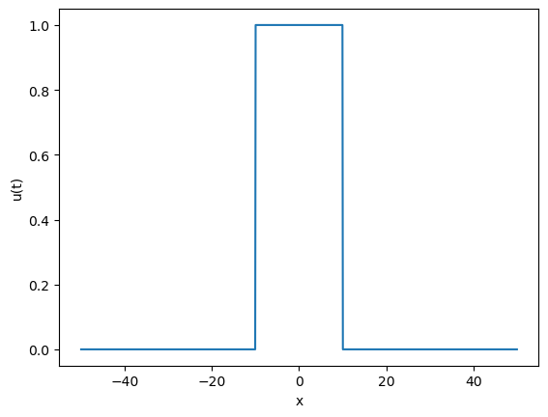
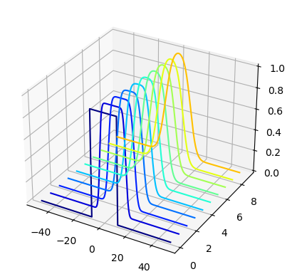

Problem – 1D Heat Equation
$$\frac{∂u}{∂t}= α^{2}\frac{∂^{2}u}{∂x^{2}}$$
Simple, well studies PDE
Alpha is thermal diffusivity
Initial conditions and solution dynamics given in top and bottom figure, respectively
Solved for t=0 to t=10 seconds

Slide 4
Problem – Solution Techniques
Finite difference method
Spatially and temporally discretizing the 1D heat equation
Spectral methods
Use Fourier transforms to turn PDE into an ODE and solve in spectral domain
Reduced Order Models
Construct a lower dimensional model that approximates the exact solution

Slide 5
Problem – Classic ROM Pipeline
Data Generation
POD
Perform POD to get optimal, orthogonal modes
Galerkin Projection
Project modes onto governing equation to produce ROM
High fidelity simulation or benchtop experimentation
Validate ROM
Test ROM against “training” data and new, unseen data

Slide 6
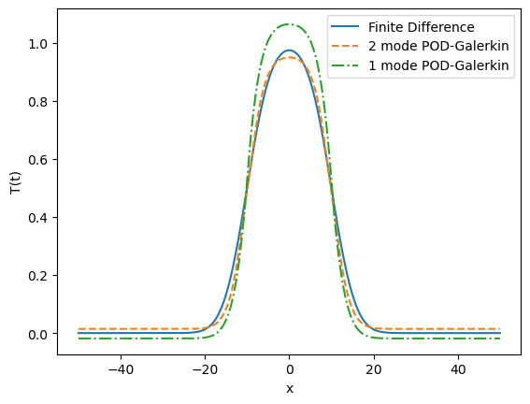
Results – Validation
Comparison of ROM against FDM on the “training” dataset
 | Computational Time
Finite Difference | 23.9 seconds
1 Mode POD-Galerkin | 16.3 seconds
2 Mode POD-Galerkin | 14.8 seconds
Approximately 32% to 38% faster than FDM even including training time
For time = 10 seconds

Slide 7
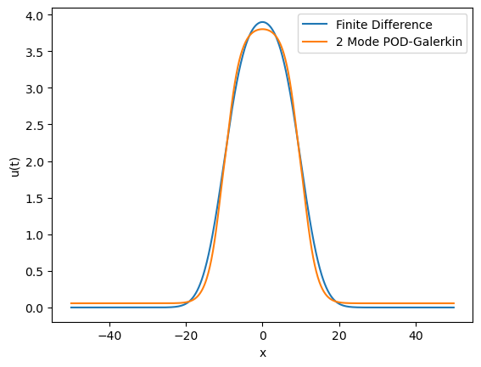
Results – Comparison on Unseen ICs
New initial conditions:
u(t) = 0, -50<x<=-10
u(t) = 4, -10<x<10
u(t) = 4, 10<= x < 50
 | Computational Time
Finite Difference | 22.3 seconds
2 Mode POD-Galerkin | 1.2 seconds
Finite difference method must go through entire simulation process again, but the already trained ROM can be used immediately with new ICs.
Result: ~95% reduction in cost
For time = 10 seconds

Slide 8
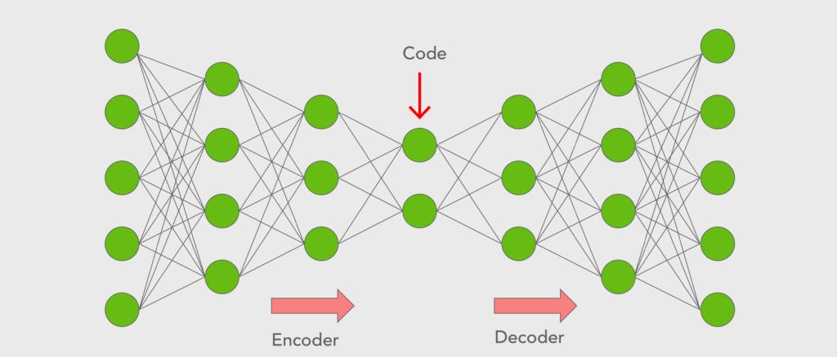
Where’s the Novelty?
POD-Galerkin ROMs have been established and studied for decades
What areas can we explore to add to the literature?
Comparison of POD modes and autoencoder modes
Comparison of ML ROMs and POD-Galerkin ROMs
Focus on relevance to coronary artery stenoses
Bottom line: really investigate how ML-based ROMs compare to standard methods while focusing on geometries relevant to coronary artery disease

Slide 9
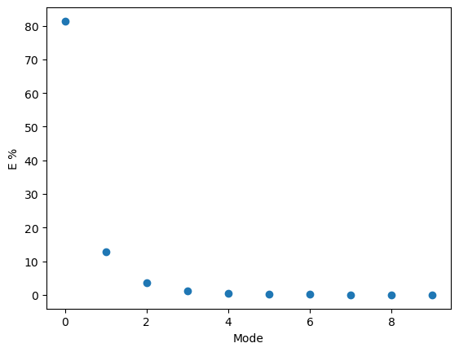
Proper Orthogonal Decomposition (POD)
Both PCA and POD are derivative of Singular Value Decomposition (SVD)
Produces optimal, orthogonal basis functions based on computational or experimental data
Layman’s Terms:
Produces “modes” that best describe the solution or flow field without having any overlap in the features they are describing (think: multicollinearity)
Just 2 modes describe ~ 93% of the solution

Slide 10

Galerkin Projection
Under Construction

Slide 11
Autoencoders
Under Construction

Slide 12
Discussion of Next Steps/Research Plan
Ideal End Goal:
An interdisciplinary and interinstitutional team has accomplished this to some extent using classic ROMs
Practical Research Directions:
Comparison of POD and autoencoder modes for 2D Burger’s equation through a stenosed tube. Possibly tie in with recirculation zones.
Comparison of classic POD-Galerkin ROMs and ML-based ROMs for 2D Burger’s equation with a focus on implications to coronary artery disease
Comparison of classic parameterized POD-Galerkin ROMs and ML-based ROMs for 2D Burger’s equation with a focus on implications to coronary artery disease
Parametric 3D Navier Stokes based ROM for coronary artery disease for use in clinical setting
Probably too lofty for us

