Slide 1
Atoms Info
GPU Memory
Groups Info
Batch Info
Init N-Buffers
Visibility
(cross-sections, frustrum & occlusion culling)
Sphere Batching
Rendering
(dynamic tessellation & sphere sprite rendering)
Workflow

Slide 2
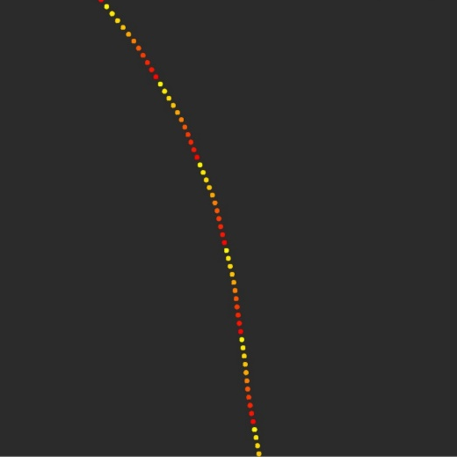
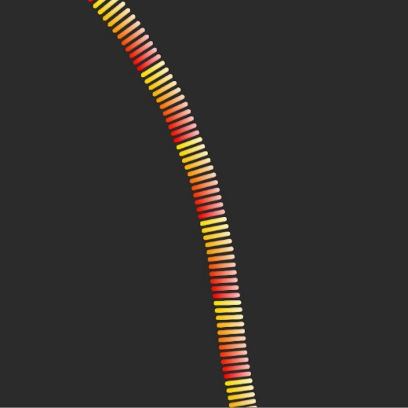
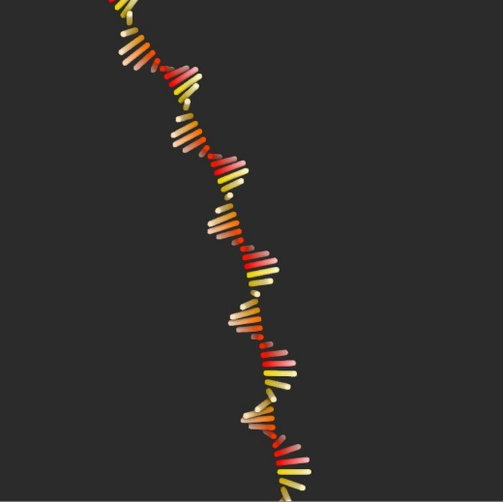
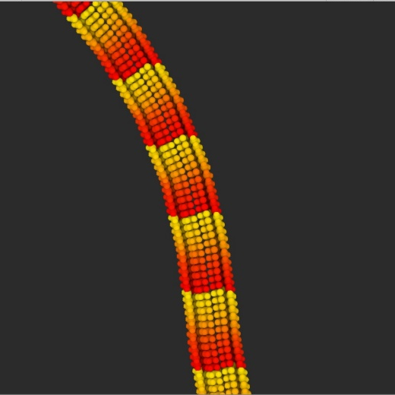
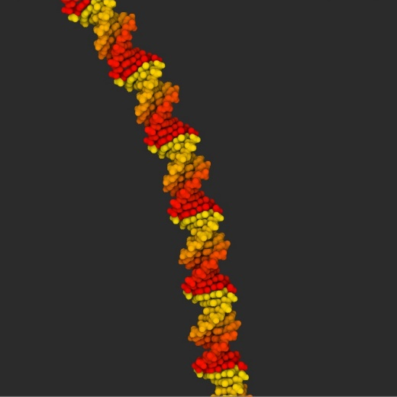

Slide 3
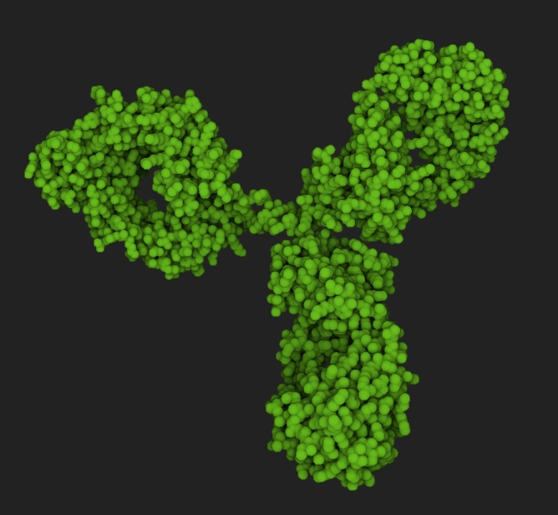
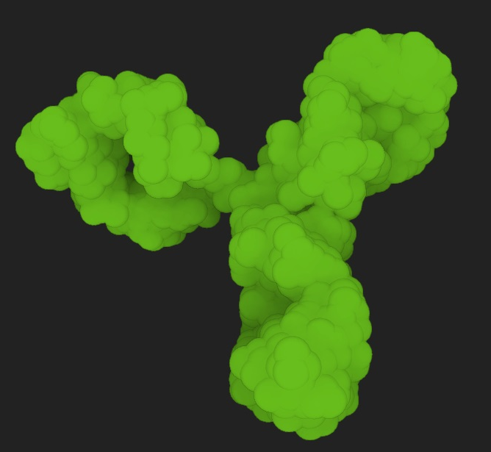
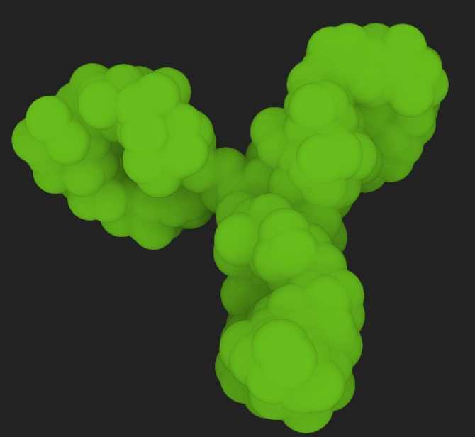
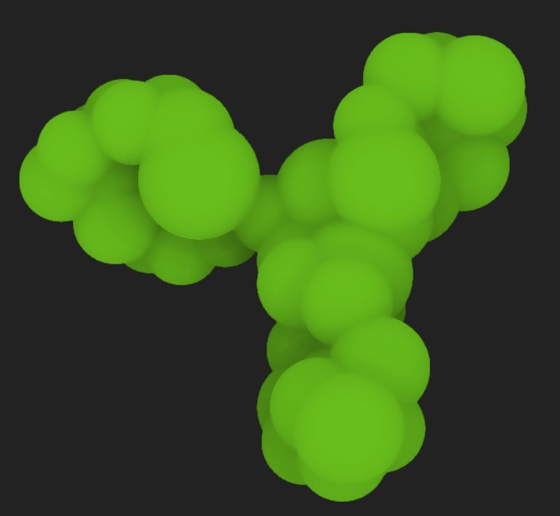

Slide 5
Depth buffer
Item buffer
Color buffer
Draw visible molecules
at frame t-1
Generate
N-Buffers
Compute visibility for remaining molecules
Draw remaining visible molecules
Read visibility from item buffer
Fetch colors from item buffer
Generate & issue render commands
Frustrum & occlusion culling
Generate & issue render commands
N-buffers
Cull Flags

