Slide 1
Atoms Info
GPU Memory
Groups Info
Batch Info
Init N-Buffers
Visibility
(cross-sections, frustrum & occlusion culling)
Sphere Batching
Rendering
(dynamic tessellation & sphere sprite rendering)
Workflow

Slide 2
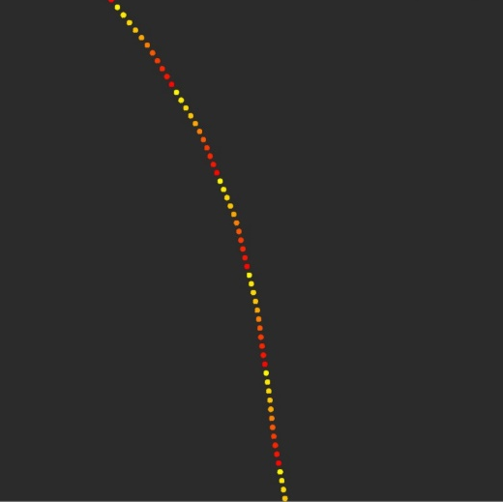
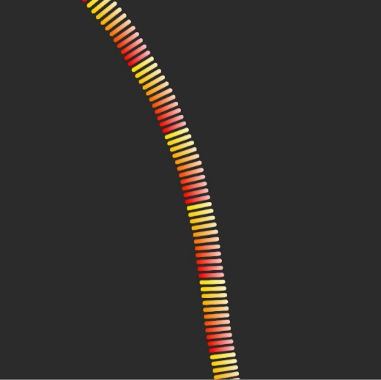
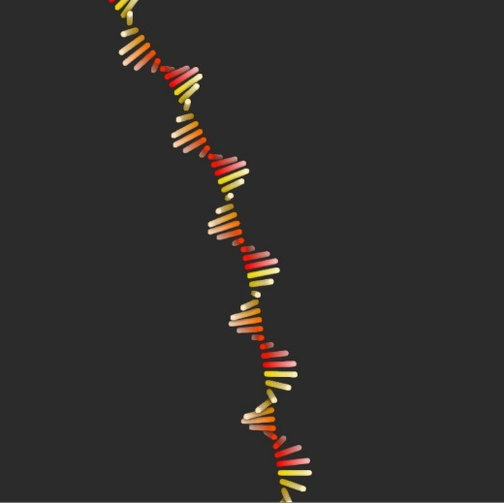
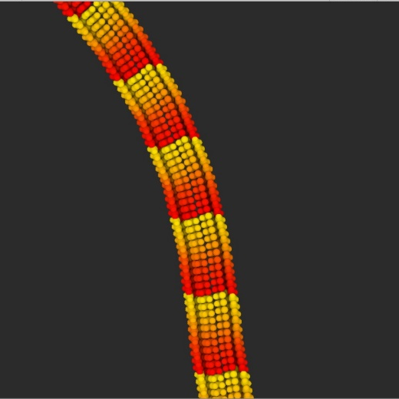
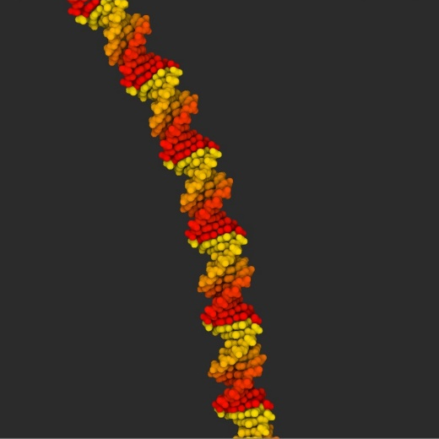

Slide 3
