Slide 1
Connect Four
Connecting blocks with blockchain

Slide 2
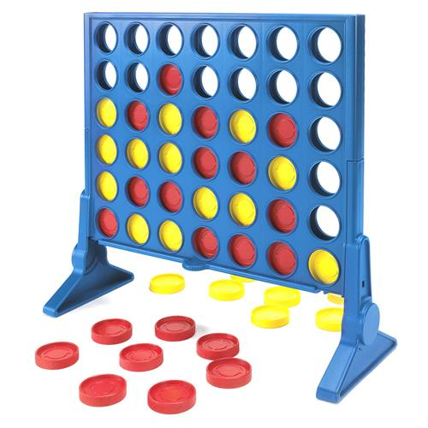
The Concept
Let’s create a simple turn-based game for 2 players.
Connect Four
Front-End necessary
Let them play for ether and we take a cut.
Incentives
Restrictions
Connect four is a solved game!

Slide 3
The Rules in General
Connect Four Rules (Jakob’s Rules for the website)
2 Players, Connect four blocks (create a blockchain lol) to win, your stone falls down to lowest position per column
Picture: Explain how you can win: 8 directions from your last played stone

Slide 4
Problems
Picture of new setup
What if more than two players want to play?
Simplicity: the game is time locked
What if a player bets 1’000 ether and blocks the contract?
Simplicity: the bets are restricted to 10 ether
What if a player is bound to lose and simply doesn’t continue his turn?
Incentive to give up: small payout for loser
What if someone plays who knows that the game is solved?
New Rules!

Slide 5
The Smart Contract
function checkVictoryCondition(uint8 _col, uint8 _row) private {
//Code for one direction (horizontal)
cp = p;
i = _col;
vp--;
while(cp == p && i >= 0) {
vp++;
if (i > 0) {
i--;
cp = grid[i][_row];
} else {
break;
}
}
Two players join the contract/game
They bet the same amount of ether
With each turn they make a small transaction
The contract checks
If a turn is legal
If a player has won
If the game has ended in a tie
The winner gets 90% of both bets, we take 10%

Slide 6
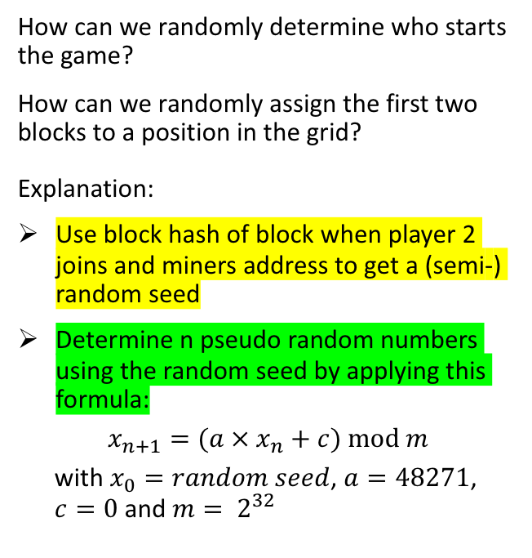
Random Number Generator
player2JoinBlockNumber = block.number; // when player 2 joins
player2JoinBlockHash = blockhash(player2JoinBlockNumber);
startCoinbase = block.coinbase;
// Miner’s address of block when game starts
[...]
currentRandomNumber = uint( player2JoinBlockHash ^ bytes32(uint256(startCoinbase) << 96) );
[...]
function rand() private returns(uint256) {
// use randomSeed as X_0
// X_(n+1) = a*X_n + c mod m
// a = 48271, c = 0, m = 2**32 (=4294967295)
currentRandomNumber = (48271 * currentRandomNumber) % 4294967295;
return currentRandomNumber;
}
How can we randomly determine who starts the game?
How can we randomly assign the first two blocks to a position in the grid?
Explanation:
Use block hash of block when player 2 joins and miners address to get a (semi-) random seed
Determine n pseudo random numbers using the random seed by applying this formula:
$$x_{n+1}=(a × x_{n}+c) mod m$$
with $x_{0}=random seed$, $a=48271$,
$c=0$ and $m= 2^{32}$

Slide 7
Security Problems
Code
Problem 1: (Semi-)random seed
Set maximum bet low enough so that incentives are not distorted
Problem 2:

Slide 8
Let’s play!
Link

