Slide 1
Connect Four
Connecting blocks with blockchain

Slide 2
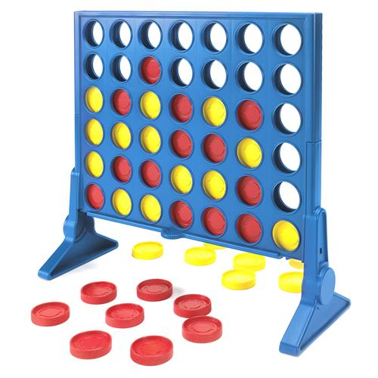
The Concept
Let’s create a simple turn-based game for 2 players.
Connect Four
Front-End necessary
Let them play for ether and we take a cut.
Incentives
Restrictions
Connect four is a solved game!

Slide 3
The Rules in General
Connect Four Rules (Jakob’s Rules for the website)
2 Players, Connect four blocks (create a blockchain lol) to win, your stone falls down to lowest position per column
Picture: Explain how you can win: 8 directions from your last played stone

Slide 4
The Smart Contract
function checkVictoryCondition(uint8 _col, uint8 _row) private {
Code for one direction and mention that we do this for 8!
Two players join the contract/game
They bet the same amount of ether
With each turn they make a small transaction
The contract checks
If a turn is legal
If a player has won
If the game has ended in a tie
The winner gets 90% of both bets, we take 10%

Slide 5
Problems
Picture of new setup
What if more than two players want to play?
Simplicity: the game is time locked
What if a player bets 1’000 ether and blocks the contract?
Simplicity: the bets are restricted to 10 ether
What if a player is bound to lose and simply doesn’t continue his turn?
Incentive to give up: small payout for loser
What if someone plays who knows that the game is solved?
New Rules!

Slide 6
Random Number Generator
Code
How can we randomly assign the first two blocks to a position in the grid?
Explanation:

Slide 7
Security Problems
Code
Explain why certain functions may be subject to attack and how we could solve this

Slide 8
Let’s play!
Link

