Slide 1
FINAL PROJECT | INDUSTRY-SIMULATED AI PRODUCT WORKFLOW
Will this order arrive late?
Predicting late deliveries at checkout with a CrewAI Flow: a Data Analyst crew hands off to a Data Scientist crew
Matanel
Olist Brazilian e-commerce data | CrewAI + Gemini, scikit-learn, Streamlit, Flask, GitHub
Code: github.com/matnael332/olist-crewai-flow
Live dashboard: olist-late-delivery-1.streamlit.app
Notes:
One sentence: we built an AI product workflow that turns raw marketplace data into insights and a deployable late-delivery risk model, with two AI agent teams and automatic quality gates between them.

Slide 2
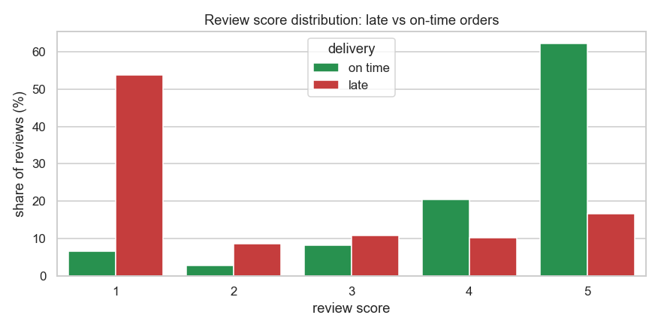
THE BUSINESS PROBLEM
Late deliveries destroy customer satisfaction
62.4%
of LATE orders get a 1-2 star review
9.2%
of ON-TIME orders get a 1-2 star review
6.8%
of 96,203 delivered orders arrived late
Goal: flag risky orders at checkout so operations can act before the customer is let down.
Olist late-delivery AI workflow | 2
Notes:
Lead with the 62% vs 9% contrast; this is why predicting lateness at checkout matters.

Slide 3
DATASET
Real marketplace data, cleaned and versioned
Source: Olist Brazilian E-Commerce, 9 tables (orders, items, payments, reviews, customers, products, sellers, geolocation, categories), pinned commit + sha256 manifest
Scale: 99,441 orders, 2016-09 to 2018-10
Real quality issues: non-delivered orders, missing delivery dates, out-of-sequence timestamps, products without category, duplicate reviews, invalid payments
Result: clean_data.csv with 96,203 delivered orders, one row per order, 38 documented columns
rule | rows removed
R1 keep delivered | 2,963
R2 require delivery date | 8
R3 purchase window | 267
rows kept | 96,203
Olist late-delivery AI workflow | 3
Notes:
Nine linked tables from Olist's own GitHub at a pinned commit; every file is sha256-checked.

Slide 4
ARCHITECTURE
Two AI crews, three quality gates, one product
9 raw tables
pinned + hashed
Crew 1
Data Analyst
6 agents
gate
contract
Crew 2 phase 1
features
gate
features
Crew 2 phase 2
models + card
fail_gracefully (any failed gate)
status file, exit 1, nothing promoted
artifacts/ promoted
8 spec files + reports
gate artifacts
Crew 1 (6 agents): data engineer, documentation writer, analytics lead, insights writer, data steward, contract author.
Crew 2 (5 agents): feature engineer and reviewer, ML engineer, model reviewer, model card author.
Ops copilot
chat for the agent operator
Dashboard
business + data science
API
/predict, /predict/batch, /risk-list
Olist late-delivery AI workflow | 4
Notes:
Run-then-narrate: tested Python computes every artifact, agents inspect and explain; the Flow decides pass or fail. A failed gate stops the run and nothing is promoted. On top, three channels read the published artifacts through one risk policy.

Slide 5
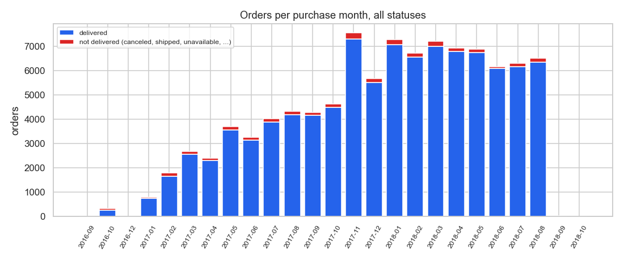
CREW 1 INSIGHTS
What happened: fast growth and a Black Friday spike
800 to 7,544
orders per month, Jan 2017 to Nov 2017
1,176
orders on 2017-11-24 (next busiest day: 499)
All 99,441 orders by purchase month, every status: 97.0% were delivered. November 2017, the Black Friday month, is the tallest bar.
10 vs 24 days
median actual vs promised delivery time
Olist late-delivery AI workflow | 5
Notes:
All-orders layer for volume; delivered layer for lateness. Every number comes from eda_summary.json.

Slide 6
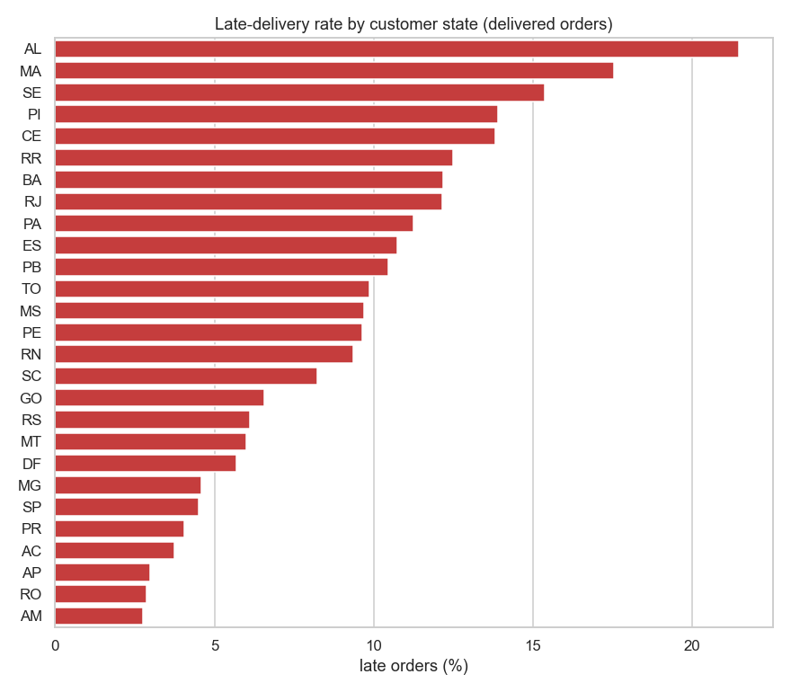
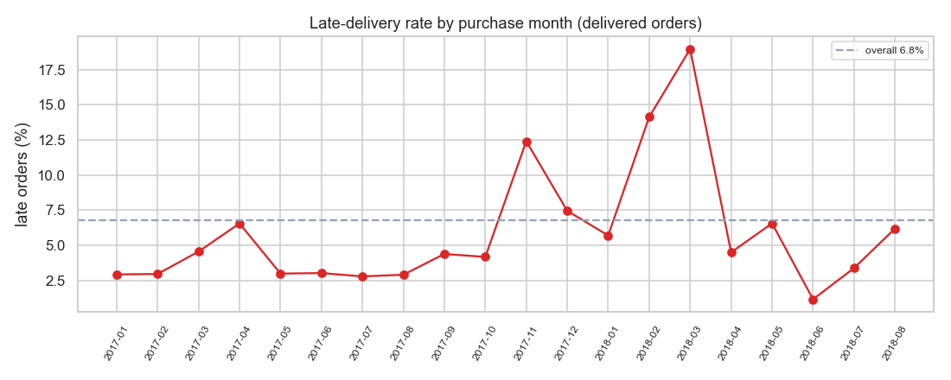
CREW 1 INSIGHTS
Lateness depends on region and drifts over time
Worst: AL 21.5%, MA 17.5%, PI 13.9%
Best: MG 4.6%, SP 4.5%, PR 4.1%
Implication: evaluate on later months, never a random split
Olist late-delivery AI workflow | 6
Notes:
Northeast states are three to five times worse than the South and Southeast; the late rate swings from about 1% to 19% between months.

Slide 7
DATA CONTRACT
The dataset contract is the handoff
Schema: 38 columns with types, nullability, bounds and allowed values (27 states, 4 payment types, categories)
Constraints: 11 binding rules, e.g. is_late == (delivery_days > promised_days), one row per order
Target: is_late means delivered after the promised date, counted in calendar days, among delivered orders (6.8% late)
Required features: 14; forbidden post-purchase columns: 7 (no leakage)
Gate 1: the contract matches the cleaned data (21 checks)
Gate 2: every required feature exists before modeling (13 checks)
HANDOFF analyst->scientist
contract_version=1.0
contract_sha256=c330762f13cd
rows=96203
required=14 forbidden=7
The log line every run prints when the handoff passes; the same hash is stored in the feature spec, model metadata and model card.
Olist late-delivery AI workflow | 7
Notes:
The analysts publish a versioned contract; the scientists must follow it; the Flow verifies it twice.

Slide 8
CREW 2 DESIGN
Checkout-time features, time-aware evaluation
Features: 25 checkout-time features: basket, package, payment, geography (states, distance), promise and timing, category
Candidates: prior baseline, logistic regression, histogram gradient boosting (sklearn pipelines, seed 42)
Selection: time-series cross-validation on the train window, PR-AUC (imbalanced target)
Threshold: tuned on out-of-fold predictions only
Leakage guard: 7 post-purchase columns are forbidden; the features gate fails the run if one appears
split | purchase dates | orders | late rate
train | 2017-01-01 to 2018-04-30 | 70,851 | 7.6%
test | 2018-05-01 to 2018-07-31 | 19,001 | 3.8%
censored buffer | 2018-08-01 to 2018-08-31 | 6,351 | 6.2%
August 2018 is held out as a censored buffer: the snapshot ends in mid-October 2018, so very late August orders may not have arrived yet.
Olist late-delivery AI workflow | 8
Notes:
Only information known when the customer pays; trained on earlier months, tested on later ones.

Slide 9
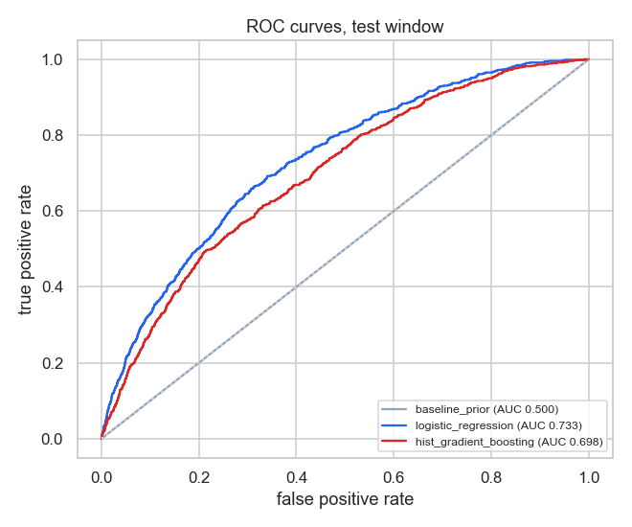
RESULTS
The simpler model wins: 3x better than chance at the top
model | CV PR-AUC | test ROC-AUC | test PR-AUC | precision, top 10%
baseline prior | 0.090 | 0.500 | 0.038 | 4.3%
hist gradient boosting | 0.167 | 0.698 | 0.084 | 10.0%
logistic regression | 0.180 | 0.733 | 0.102 | 12.1%
12.1%
0.733
late among the riskiest 10% (3.2x the 3.8% base rate)
test ROC-AUC (baseline 0.500)
Strongest signals: promised_days, customer_state, same_state, distance_km.
Olist late-delivery AI workflow | 9
Notes:
Logistic regression beat gradient boosting in cross-validation and on the test window.

Slide 10
RELIABILITY
Engineered like a product: gates, failure, reproducibility
Gates: contract (21 checks), required features (13), artifacts (9); every check is logged
Graceful failure: 7 injectable faults; a failed gate writes run_status.json, exits 1 and promotes nothing
Reproducible: two fresh runs with different hash seeds give byte-identical data; the LLM run differs only in prose
Observable: pipeline.log records stages, gates, the handoff, crews, tools and every LLM call
Team workflow: one pull request per milestone, protected main, CI on every PR
$ olist_flow.run --no-llm --inject-fault missing_feature
FAULT INJECTED missing_feature
GATE gate_required_features required_features_present FAIL
GATE gate_required_features RESULT FAIL (11/13 checks)
RUN demo-fault FAILED at gate_required_features
run demo-fault: failed (exit 1), nothing promoted
$ olist_flow.run verify-repro
clean_data.csv byte-identical identical
features.csv byte-identical identical
metrics.json byte-identical identical
predictions_test.csv byte-identical identical
figures/*.png same machine 11/11 identical
ALL DETERMINISTIC ARTIFACTS IDENTICAL
Olist late-delivery AI workflow | 10
Notes:
Show the fault-injection demo and the reproducibility table in the video.

Slide 11
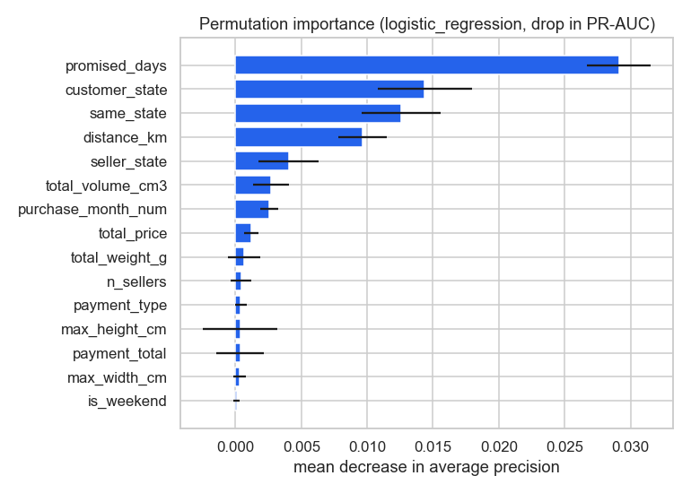
MODEL CARD
Responsible use: model card and ethics
Purpose: prioritize risky orders for proactive action, never deny service or penalize customers or sellers
Limitations: delivered orders only; right-censoring; the late rate drifts, so the threshold must be re-tuned; 2017-2018 data
Regional bias: North and Northeast customers face more delays; interventions must improve their service
Privacy: pseudonymous ids; zip prefix plus timestamps are quasi-identifiers, so dashboards show aggregates only
License: Olist data for non-commercial use (CC BY-NC-SA 4.0 listing); review text is never used
The score leans on the promise length and on geography, so regional fairness is part of monitoring.
Olist late-delivery AI workflow | 11
Notes:
Read the ethical considerations section aloud; it is part of the deliverable.

Slide 12
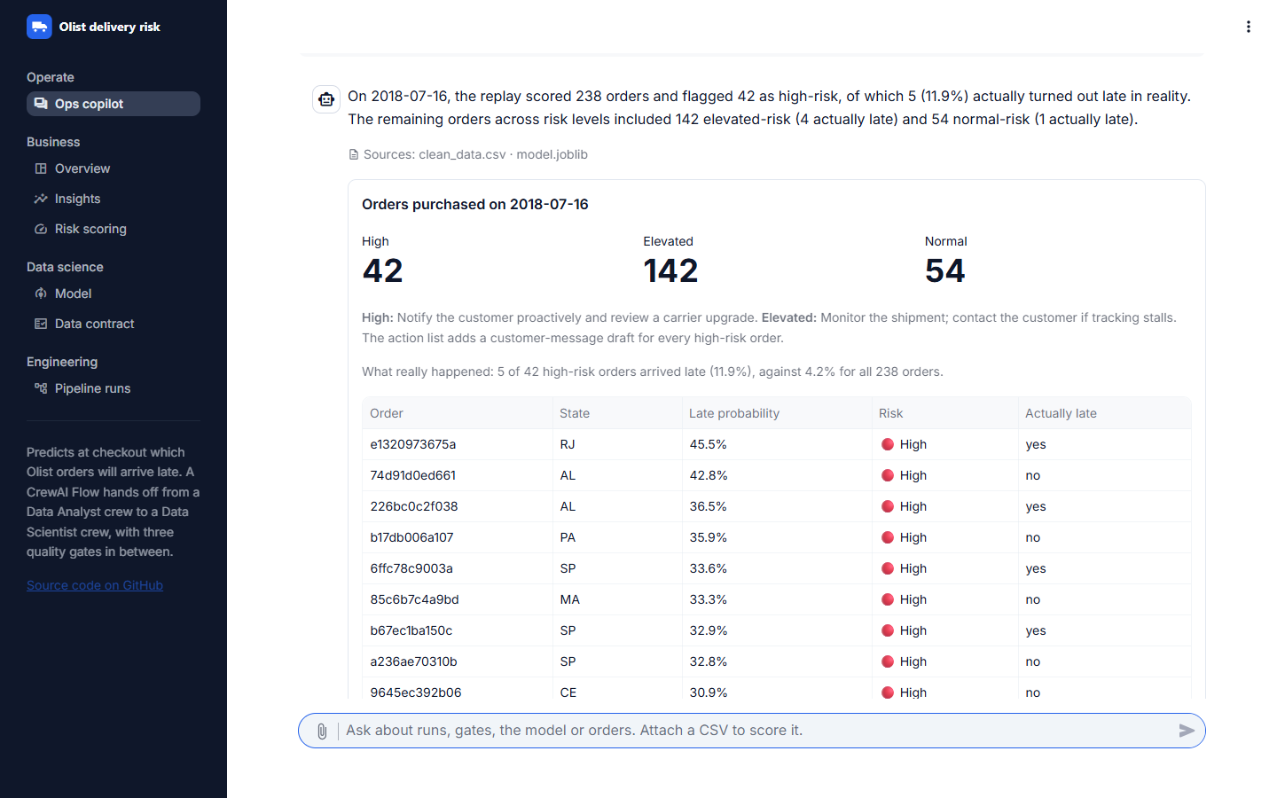
THE PRODUCT AND NEXT STEPS
From engine to product, and what comes next
Ops copilot: a chat for the team that operates the agents: runs, gates, model and data; scores a CSV, a replayed day or one order. Read-only, every number sourced
Dashboard and API: the same artifacts and one risk policy for people and systems
Run it: uv run kickoff (Gemini) or the --no-llm deterministic mode
Next: a Telegram bot and an 8:00 digest on the same copilot core
Next: send the customer messages and track handled orders
Next: seller-history features and a delivery-days regression
Live: olist-late-delivery-1.streamlit.app
Ops copilot replaying 2018-07-16, with what really happened
Olist late-delivery AI workflow | 12
Notes:
Run final-llm-6 produced the committed artifacts (llm mode). Demo: replay 2018-07-16 in the copilot, download the action list, then ask a free question.

