Slide 1



POM 610-631: Supply Chain Management I Polaris Case Presentation
PRESENTED BY: Dong, Yuhan; Ndong, Mathieu and Shelly, Henry

Slide 2
Global Supply Chain Network US Assembly vs Overseas Assembly

Slide 3
Reasons to only assembly in the US
American Manufacturing
Both customers and employees are proud that the product is manufactured in the United States
Supply Chain Visibility
Order communication, production and transportation (fuel price volatility)
Product Returns
Quality (State of the Art Injection Molding Plant at Roseau)

Slide 4

Reasons to only assembly in the US
Higher Hidden Cost
Managing Exchange Rate Risks
Invoice Errors
Tariffs and Taxes
5% production tariffs for China Plant
Freight Costs
Transportation modes and quantity

Slide 5
NPV Calculations US vs Mexico vs China

Slide 6


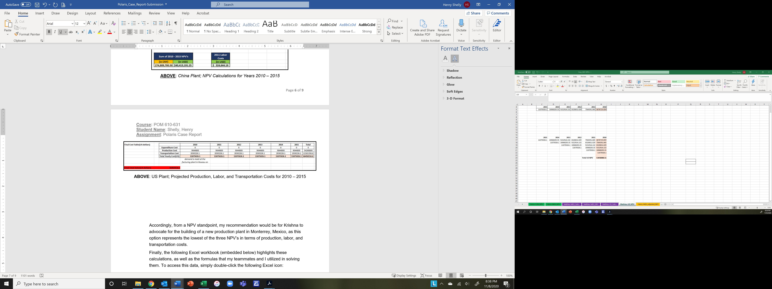
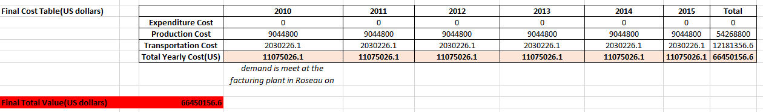
NPV Calculation: U.S. Plant
ABOVE: US Plant; NPV Calculations ($53,058,088.51) for Years 2010 – 2015
ABOVE: US Plant; Projected Production, Labor, and Transportation Costs for 2010 – 2015

Slide 7

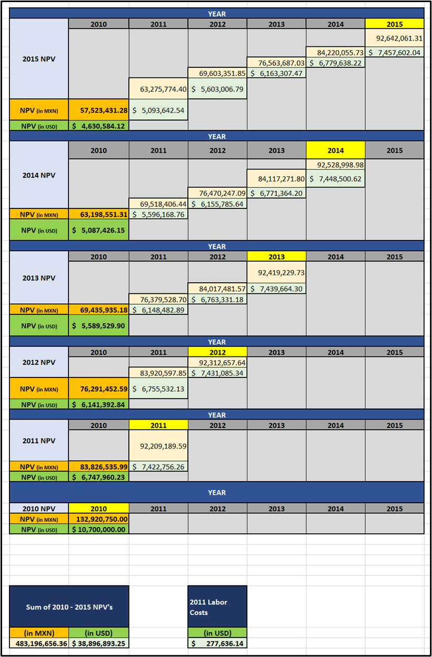

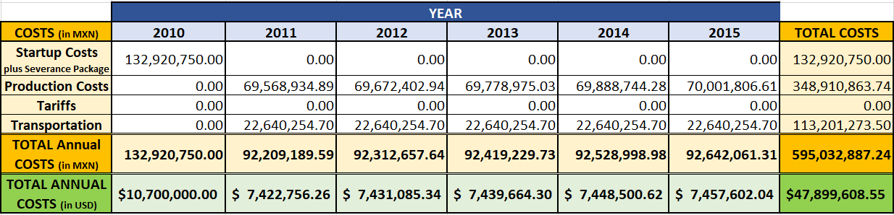
NPV Calculation: Mexico Plant
ABOVE: Mexico Plant; Projected Production, Labor, and Transportation Costs for 2010 – 2015
ABOVE: Mexico Plant; NPV Calculations ($38,896,893.25) for Years 2010 – 2015

Slide 8
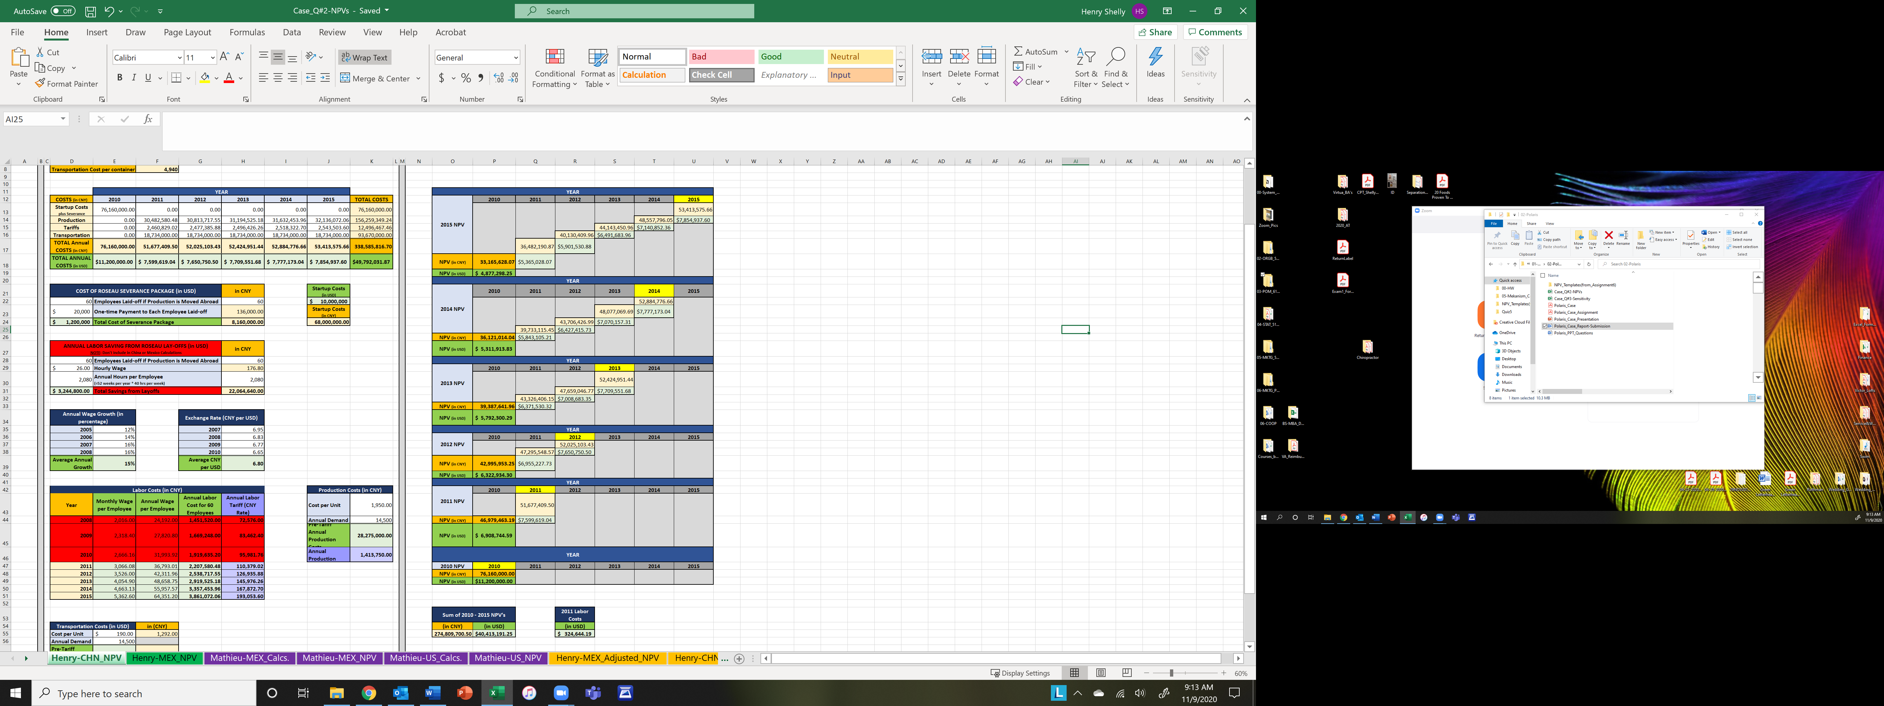

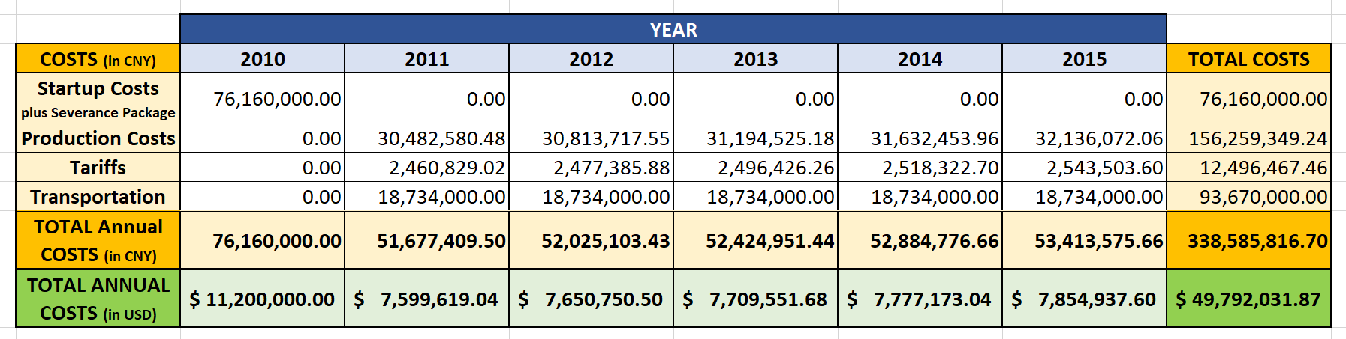
NPV Calculation: China Plant
ABOVE: China Plant; Projected Production, Labor, and Transportation Costs for 2010 – 2015
ABOVE: China Plant; NPV Calculations ($40,413,191.25) for Years 2010 – 2015

Slide 9
Sensivity Analysis Mexico vs China

Slide 10
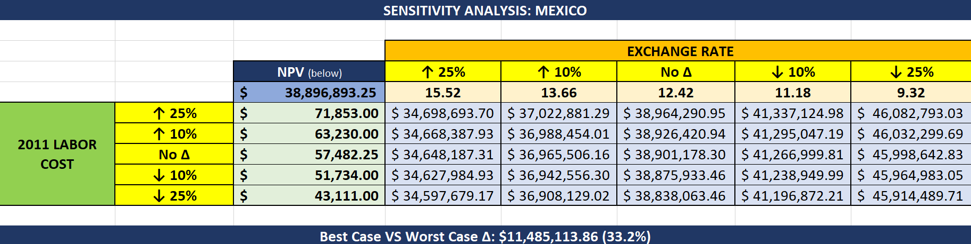
Sensitivity Analysis: Mexico Plant

Slide 11
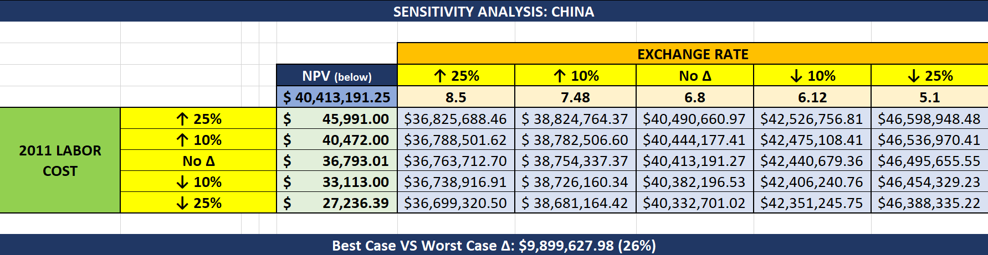
Sensitivity Analysis: China Plant
ABOVE: Mexico Plant; Projected Production, Labor, and Transportation Costs for 2010 – 2015

Slide 12
Manufacturing Location Decision (Beside cost)

Slide 13
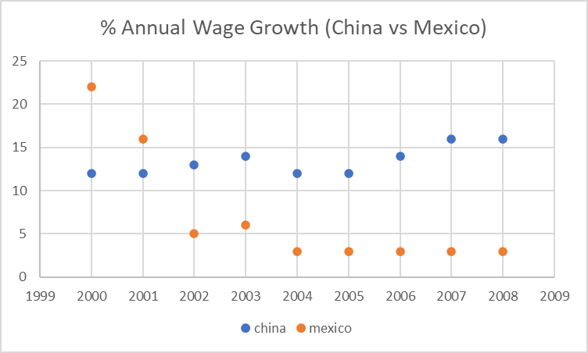
Responsiveness of the Supply Chain
Procurement Risk
Exchange rate risk
Significant part of the business dependent of a single external source
Systems Risk
Information System Failure
Disruptions
Covid 19 example

Slide 14
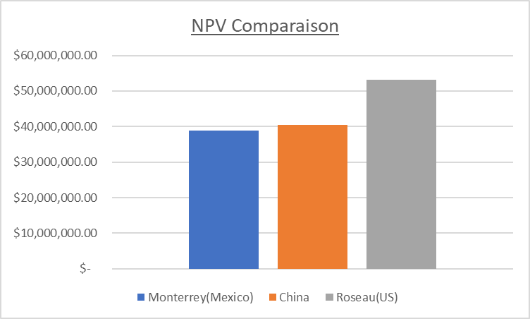
Flexibility of the Supply Chain
Receivable Risk
Customer quantity (change in demand)
Capacity Risk
Cost of Capacity
Capacity Flexibility
Forecast Risk
Incorrect forecast(production delays)

Slide 15


