Slide 1

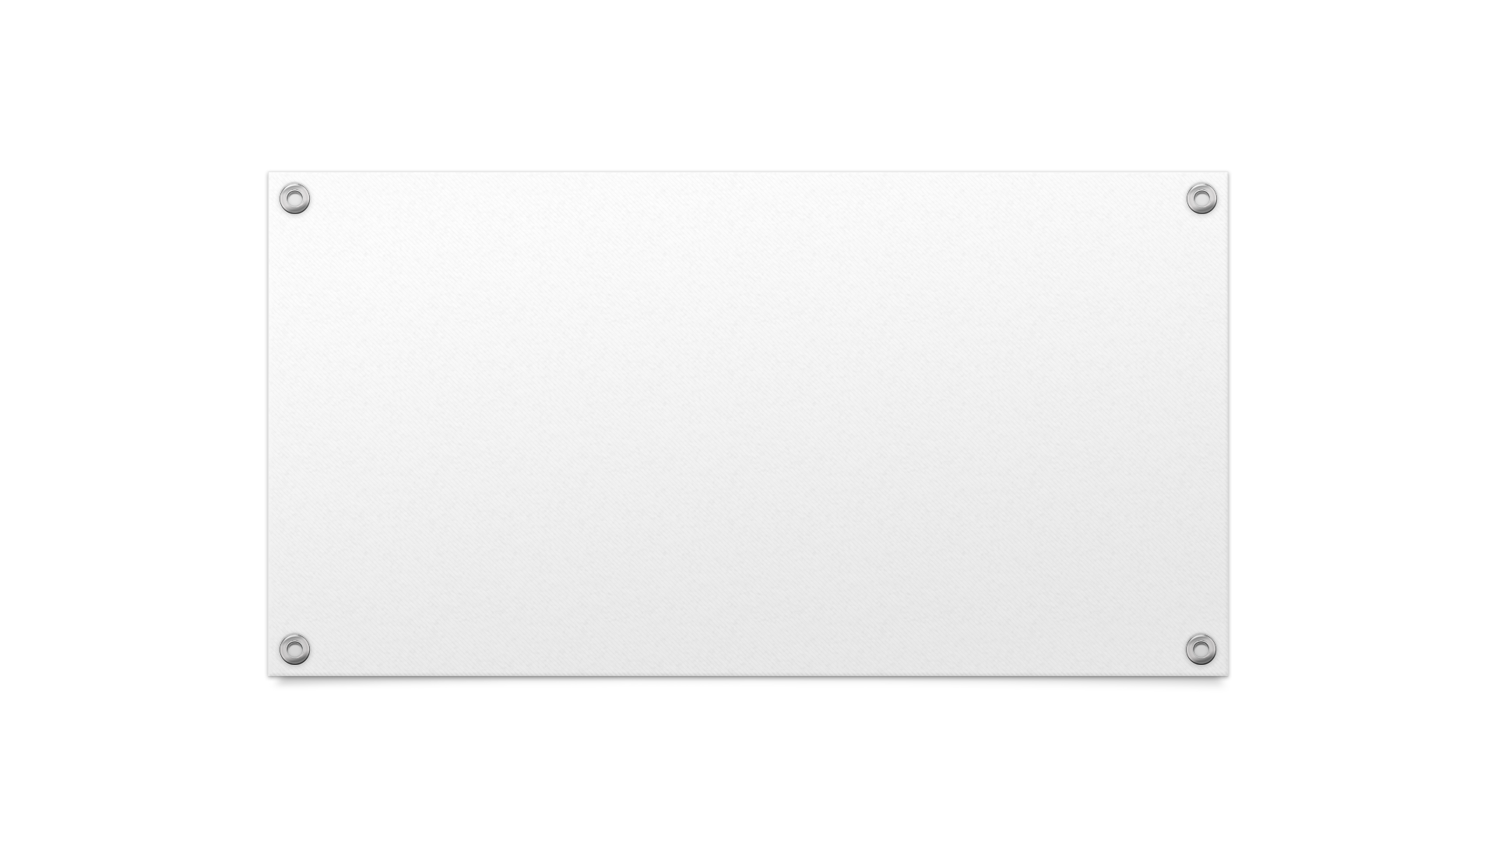

POM 610-631: Supply Chain Management I Walmart Business Case Presentation
PRESENTED BY: Dong, Yuhan; Ndong, Mathieu; Shelly, Henry

Slide 2
Analysis of Walmart’s Six Supply Chain Drivers

Slide 3
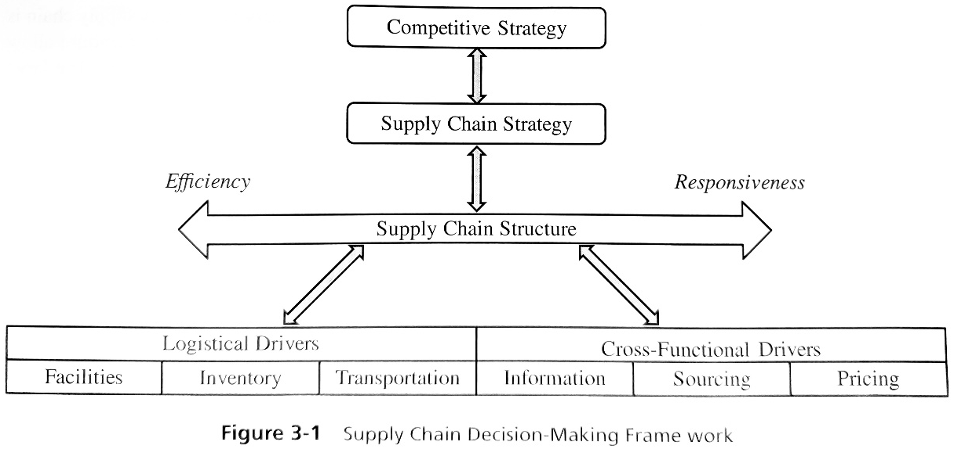
The Relationship Between Supply Chain Operations and the Six Supply Chain Drivers
Chopra, S. (2019). Supply Chain Management: Strategy, Planning, and Operation. (7th ed.) Pearson Education.

Slide 4
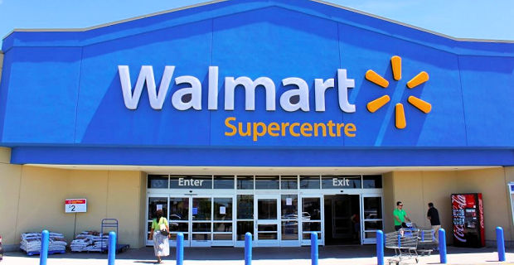
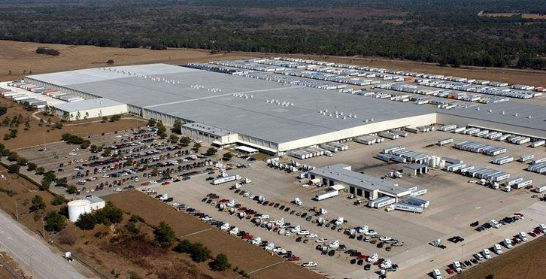
Facilities (Logistical Driver)
Capability
Supercenters function primarily as retail stores that house approximately 120,000 different products available for consumer purchase
Distribution Centers (DCs) receive and house approximately 77% of merchandise that ultimately ends up in supercenters
Location
United States: supercenters are strategically located within 10 miles of 90% of the population
Using the “hub-and-spoke” design, DCs are strategically placed within an average of 130 miles from supercenters
Capacity
Use of DCs, as well as plans for consolidation centers, allow supercenters to achieve lower capacity and inventory levels while still maintaining the responsive the supply chain strategy requires

Slide 5

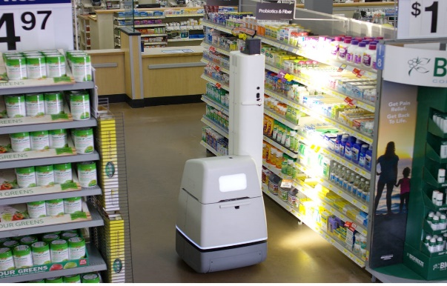
Inventory (Logistical Driver)
Cycle Inventory
Maintained low costs by purchasing merchandise in large batches, as a means of capitalizing on the economies of scale of its suppliers
Safe Inventory
Avoided need for excess capacity through use of information systems and inventory data
Seasonal Inventory
Again, avoided need for excess capacity through use of information systems and inventory data
Level of Product Availability
Use of strategically placed DCs supported lower levels at retail supercenters

Slide 6
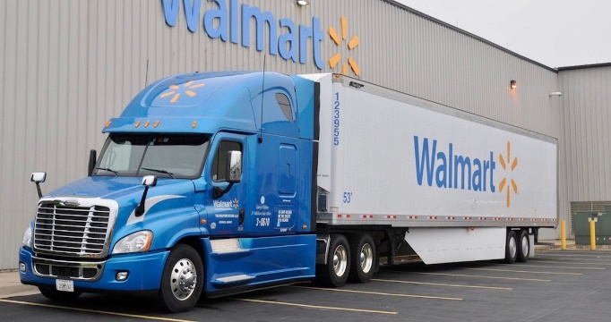
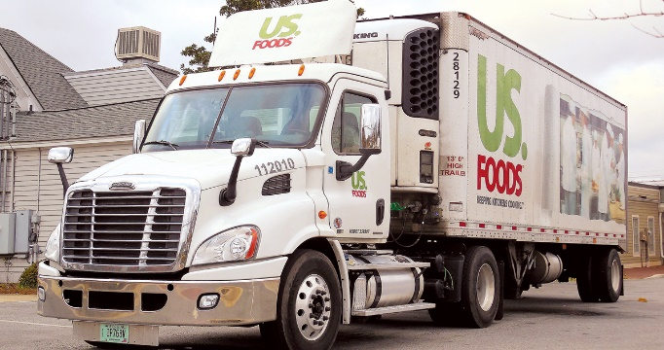
Transportation (Logistical Driver)
Design of Transportation Network
Mix of “direct to demand point” shipping and “consolidation point” shipping
“Hub-and-spoke” distribution channel design promotes efficiency and responsiveness
Choice of Transportation Mode
Walmart owned and operated truck fleet
Distribution sourced through common carriers

Slide 7
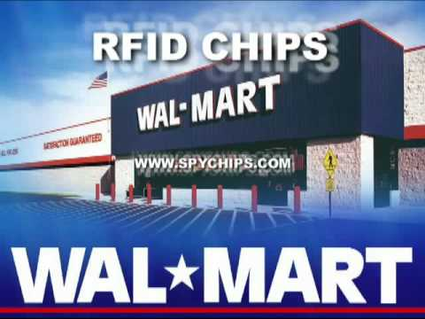
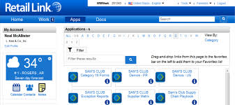
Information (Cross-Functional Driver)
Demand Planning
Access to Retail Link allowed Walmart’s suppliers to accurately estimate future demand forecasts based upon historical sales data
Coordination and Information Sharing
The profitability of Walmart’s total supply chain was maximized via the practice of information sharing
Sales and Operations Planning (S&OP)
Walmart structure supply chain strategy to meet future demand forecasts through use of historical sales data

Slide 8

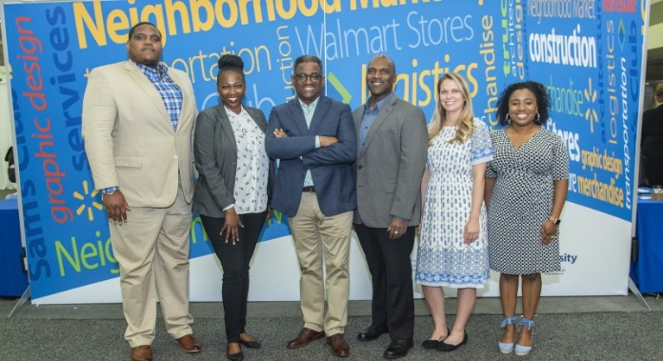
Sourcing (Cross-Functional Driver)
Combination of both “In-House” and “Outsourcing”
In-House – (e.g.) distribution via Walmart’s privately owned and operated truck fleet
Outsourced – (e.g.) delivery of perishable grocery merchandise via common carriers
Supplier Selection
Walmart estimated to have approximately 60,000 suppliers globally
Leverage advantage → Walmart
Procurement
Walmart’s buyers worked with an array of suppliers
Buyers met quarterly to (e.g.) network, gather & exchange field intelligence, review new products, etc.

Slide 9
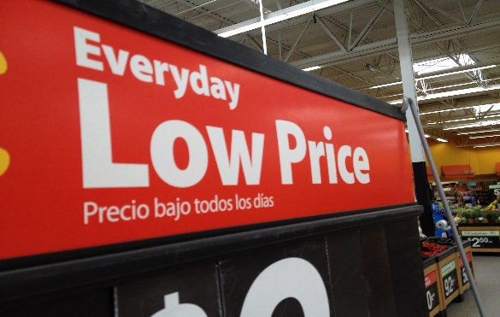
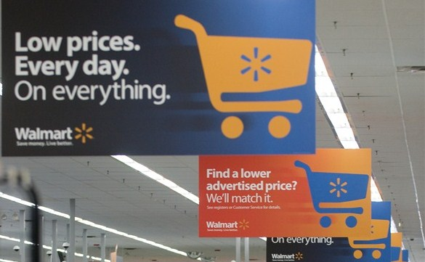
Pricing (Cross-Functional Driver)
Pricing and Economies of Scale
Walmart promoted economies of scale for its suppliers, as well exploiting economies of scale for itself
Every Day Low Pricing (EDLP), rather than High-Low Pricing
EDLP helped Walmart to keep its costs low while promoting a more stable demand for products
Menu Pricing, rather than Fixed Price
Pricing contingent upon supplier’s adherence to on-time delivery requirements
Price negotiations with suppliers

Slide 10
Analysis of Walmart’s Financial Performance Walmart VS. Amazon VS. Target Study

Slide 11
Supply Chain Metrics: INVT and ART
Walmart turns its inventory ten times faster than Target on average
Walmart ART values are good relative to competitors
Both ART and INVT values have decreased from 2018 to 2019 for Walmart

Slide 12
Supply Chain Metrics: APT and C2C
Walmart and Amazon have almost the same value of -5 in 2018. It means that they collected their money from the sales of their products more than 5 weeks before they had to pay their respective suppliers
Walmart finance its own operations for 6.4 weeks in 2019 with its suppliers’ money compare to 9.45 weeks for Amazon.

Slide 13
Operating Margin and Net Margin
Net Margin Table
Operating Margin Table
Year | Walmart | Amazon | Target
2015 | 0.03 | -0.003 | 0.03
2016 | 0.03 | 0.005 | 0.05
2017 | 0.028 | 0.02 | 0.04
2018 | 0.02 | 0.02 | 0.04
2019 | 0.01 | 0.04 | 0.038
Year | Walmart | Amazon | Target
2015 | 0.06 | 0.02 | 0.06
2016 | 0.05 | 0.039 | 0.07
2017 | 0.05 | 0.03 | 0.07
2018 | 0.04 | 0.07 | 0.06
2019 | 0.04 | 0.06 | 0.05
Net margin shows how good a company is at converting revenue into profits
Steady decrease from 2015 to 2019
The Operating margin for Amazon is increasing over this period indicates a company whose profitability is improving.
Steady decrease from 2015 to 2019

Slide 14
Gross Profit Return, Asset Turnover & ROE
Gross profit Return on Inventory
Asset Turnover
ROE
Year | Walmart | Amazon | Target
2015 | 2.67 | 3.16 | 2.43
2016 | 2.72 | 3.45 | 2.53
2017 | 2.89 | 4.16 | 2.57
2018 | 2.89 | 4.1 | 2.49
2019 | 2.91 | 5.45 | 2.32
Year | Walmart | Amazon | Target
2015 | 2.38 | 1.63 | 1.75
2016 | 2.41 | 1.63 | 1.83
2017 | 2.44 | 1.63 | 1.88
2018 | 2.45 | 1.35 | 1.86
2019 | 2.35 | 1.43 | 1.82
Year | Walmart | Amazon | Target
2015 | 0.19 | -0.02 | 0.17
2016 | 0.19 | 0.04 | 0.25
2017 | 0.17 | 0.12 | 0.24
2018 | 0.12 | 0.11 | 0.25
2019 | 0.09 | 0.23 | 0.26
High asset Turnover
Steady increase in Gross Profit Return on Inventory
Decrease in ROE
Walmart is less efficient in generating profit

Slide 15
Analysis of Walmart’s Supply Chain Distribution Structures and Challenges Moving Forward

Slide 16
Distribution Options
1. Manufacturer storage, direct shipping
2. Manufacturer storage, direct shipping, in-transit merge
3. Distributor/retailer storage, carrier delivery
4. Distributor/retailer storage, last-mile delivery
5. Manufacturer/distributor storage, customer pickup
6. Retail storage with customer pickup

Slide 17
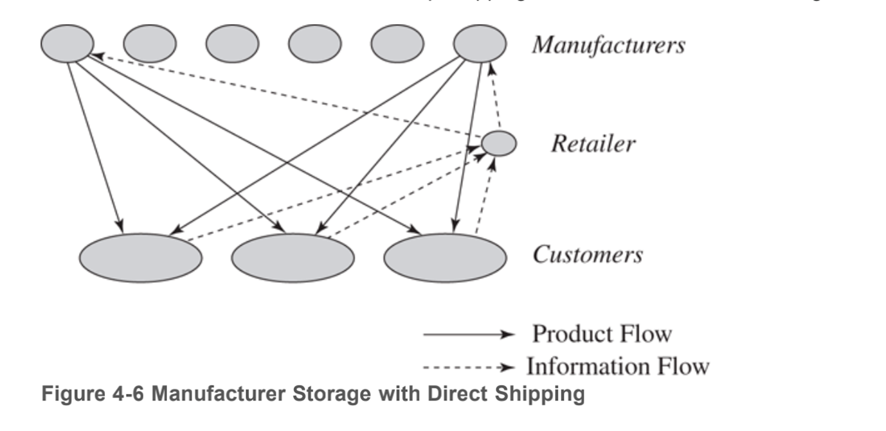
Manufacturer Storage with Direct Shipping
Chopra, S. (2019). Supply Chain Management: Strategy, Planning, and Operation. (7th ed.) Pearson Education.

Slide 18
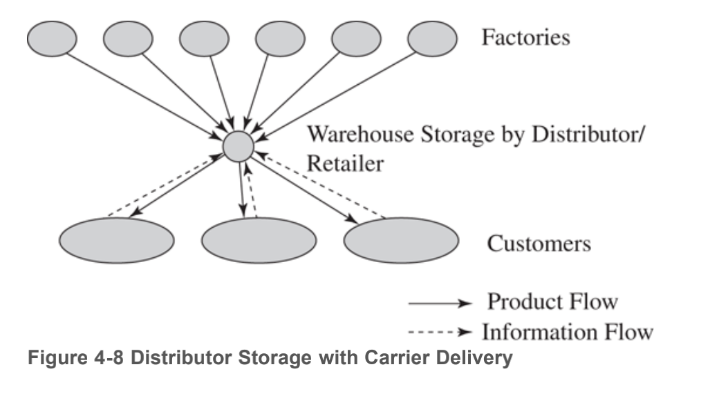
Distributor Storage with Carrier Delivery
Chopra, S. (2019). Supply Chain Management: Strategy, Planning, and Operation. (7th ed.) Pearson Education.

Slide 19
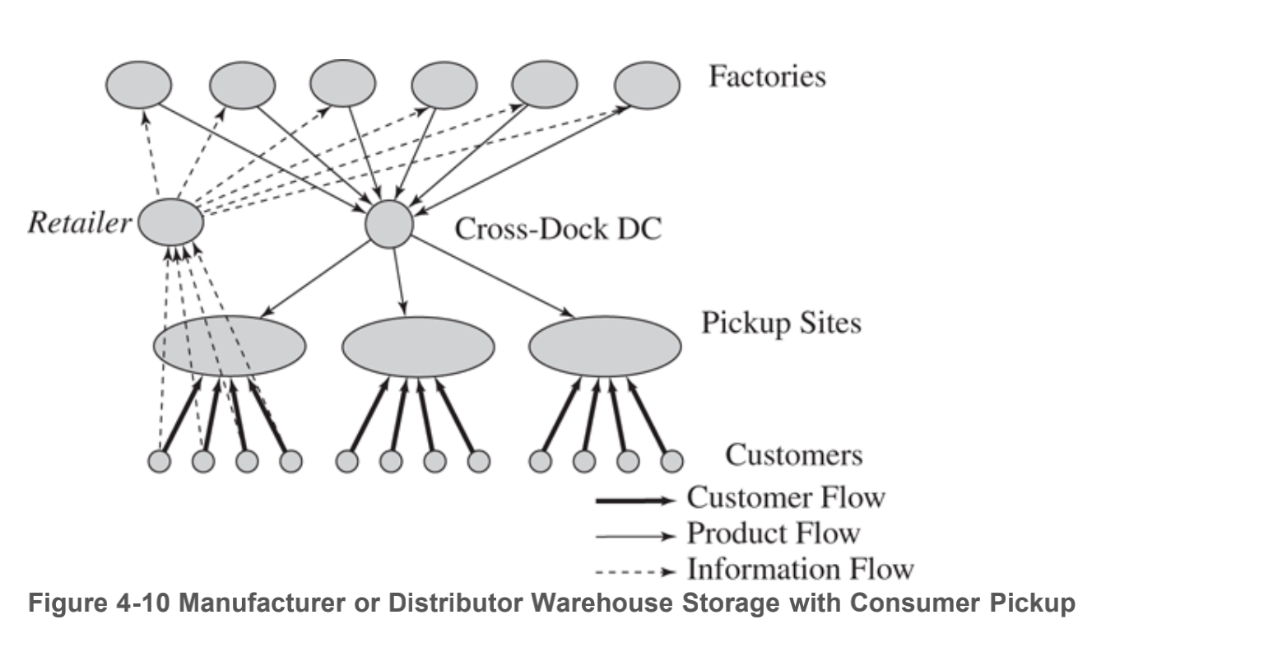
Manufacturer or Distributor Storage with Customer Pickup
Chopra, S. (2019). Supply Chain Management: Strategy, Planning, and Operation. (7th ed.) Pearson Education.

Slide 20
Challenges Moving Forward
What changes needed to make to Walmart’s ever-expanding supply chain to support its strategic objectives.
What supply chain capabilities would they need as its business model continued to evolve.

Slide 21
Strategies Moving Forward
Reshaped its supply chain strategy to tackle the “last miles”
Focus on opportunities to reduce operational and supply chain costs, which translated into lower retail prices.
Insisted on saturating the area within a day’s driving distance of DC in order to gain economies of scale.
Actively developed new apps for customers and store associates to convenient customer’s shopping experience and inventory management in stores.

Slide 22


