Slide 1
SEG800 · DIGITAL SIGNAL PROCESSING
Comb Filters
Delay as a Spectral Tool
Theory · Implementation · MATLAB Evidence
x[n] + x[n−D] → repeated peaks and notches
Group #____ · Member 1 · Member 2 · Member 3

Slide 2
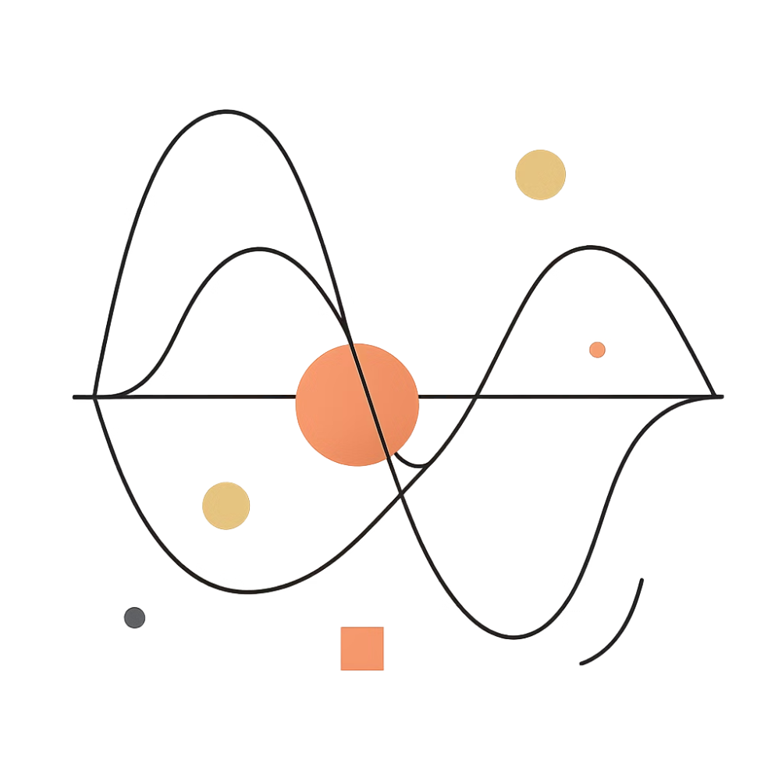

SEG800 · COMB FILTERS
A Delayed Copy Creates the Filter's "Teeth"
A comb filter combines a signal with a delayed version of itself. The phase relationship between the original and delayed copy determines whether each frequency is reinforced or cancelled.
In Phase → Reinforcement
Out of Phase → Cancellation
Peaks in the frequency response
Notches (deep nulls) in the response

Slide 3
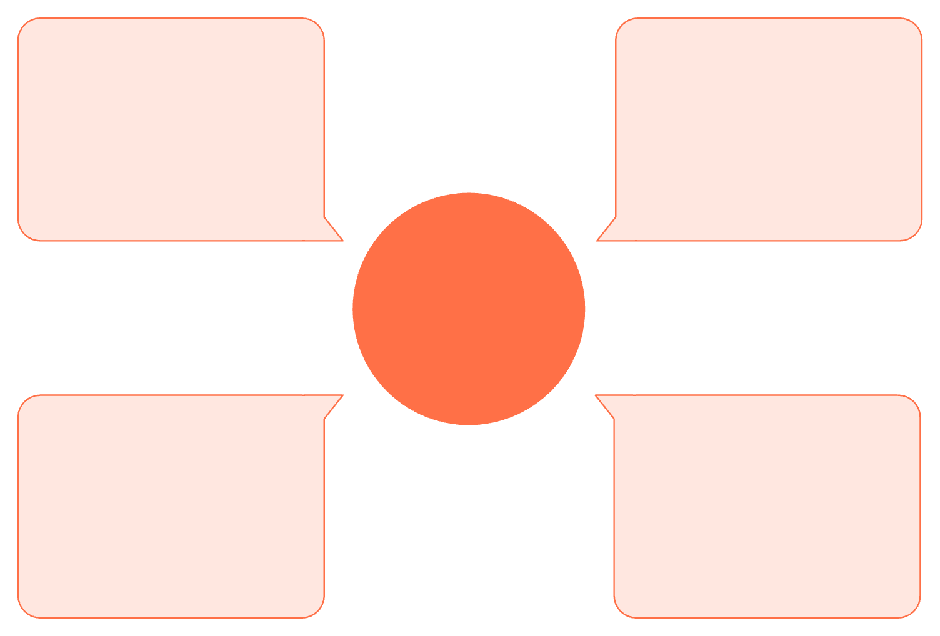
SEG800 · COMB FILTERS
Feedforward Creates Regularly Spaced Peaks and Notches
Summation
Input signal
Direct + delayed → y[n]
x[n] enters the filter
Feedforward Comb Filter
Delayed path
Direct path
Delay D then scale by a
Immediate passthrough to sum
The direct and delayed paths sum at the output, producing periodic peaks and notches.
y[n] = x[n] + a · x[n−D]
Two Signal Paths
FIR Structure
Direct path x[n] and delayed path with gain a and delay D samples
Finite impulse response — inherently stable, no feedback loop

Slide 4

SEG800 · COMB FILTERS
Feedback Sharpens the Repeated Resonances
Summation Node
Delay & Scale
Sum x[n] and a·y[n−D]
Delay by D and scale by a
Input Signal
Output
x[n] enters the filter
Produce y[n] result
The delayed output feeds back to the input, reinforcing resonant peaks with each pass.
y[n] = x[n] + a · y[n−D]
Recursive Path
IIR · Stability Condition
The delayed output is returned to the input. Each pass reinforces the next, creating narrower and stronger resonant peaks.
Infinite impulse response. Requires |a| < 1 to remain stable.

Slide 5


SEG800 · COMB FILTERS
Delay Sets the Spacing Between Every Tooth
200 Hz
8000
Tooth Spacing Δf
Sample Rate (Hz)
Fₛ ÷ D = 8000 ÷ 40
Fₛ = 8000 Hz
40
Delay (samples)
D = 40 samples
Key insight: A longer delay packs the teeth closer together. Spacing is constant across the entire frequency response: \Delta f = F_s / D.

Slide 6






MATLAB TEST SETUP
The MATLAB Test Isolates the Effect of the Delay
A simple two-tone signal makes attenuation and resonance easy to observe and verify.
Input Signal
Sample Rate
Delay
300 Hz + 400 Hz two-tone test signal
8000 Hz sampling frequency
40 samples → 5 ms delay
Feedforward Gain
Feedback Gain
a = 1.0 for FIR comb filter
a = 0.7 for IIR comb filter
Expected tooth spacing: Δf = 200 Hz

Slide 7
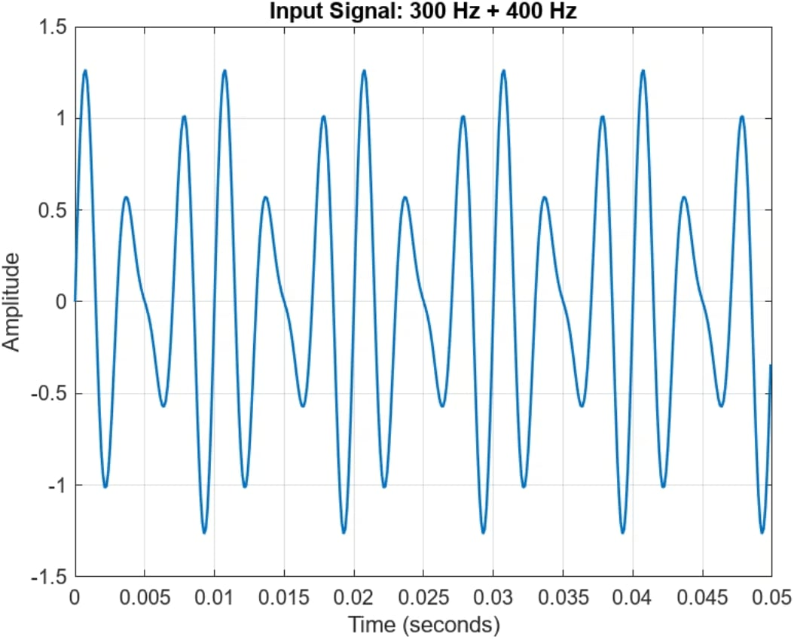
MATLAB RESULTS · INPUT
The Input Contains Only Two Known Frequencies
The clean two-tone input provides a controlled baseline. Any spectral changes in the output are caused entirely by the comb filter — no other frequency content is present to obscure the result.
300 Hz
400 Hz
Larger amplitude component
Smaller amplitude component

Slide 8
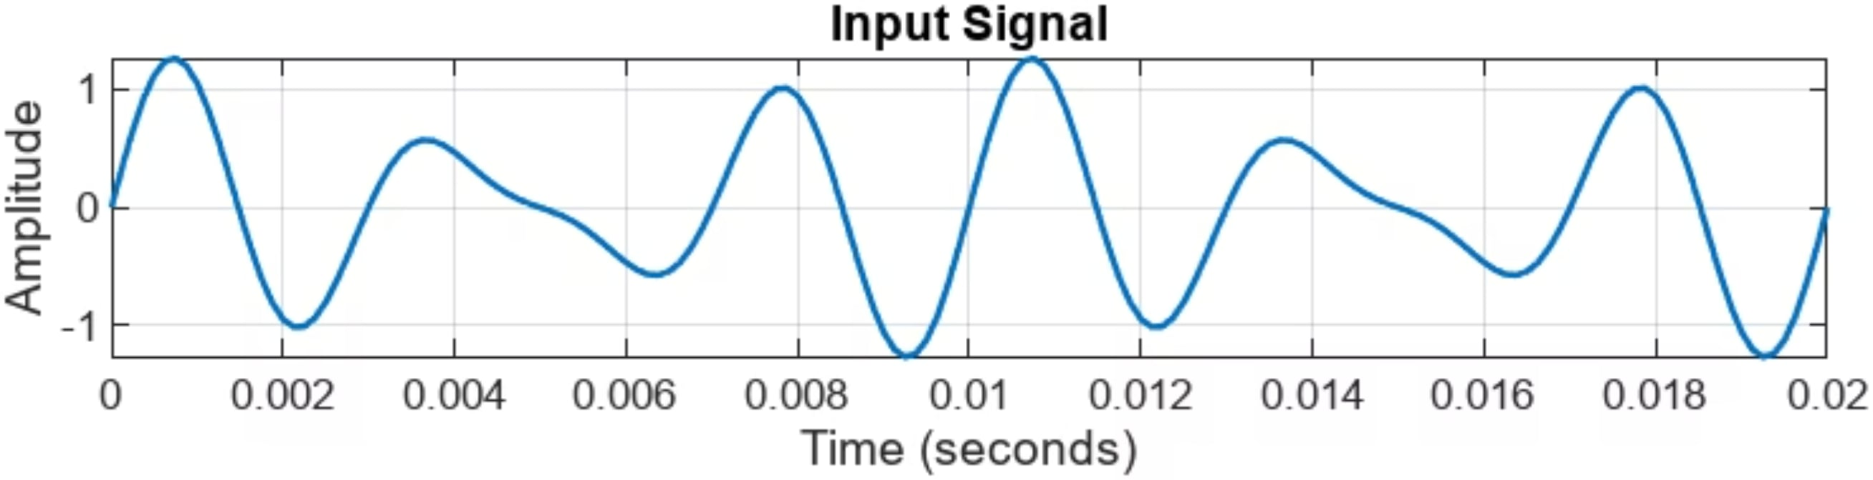
MATLAB RESULTS · TIME DOMAIN
A 5 ms Delay Is Visible Within the Short Time Window
Delay Calculation
Interpretation
40 samples ÷ 8000 samples/s = 5 ms
Each delayed copy shifts the waveform by one quarter of the 20 ms view window — clearly visible in the time-domain plot.

Slide 9

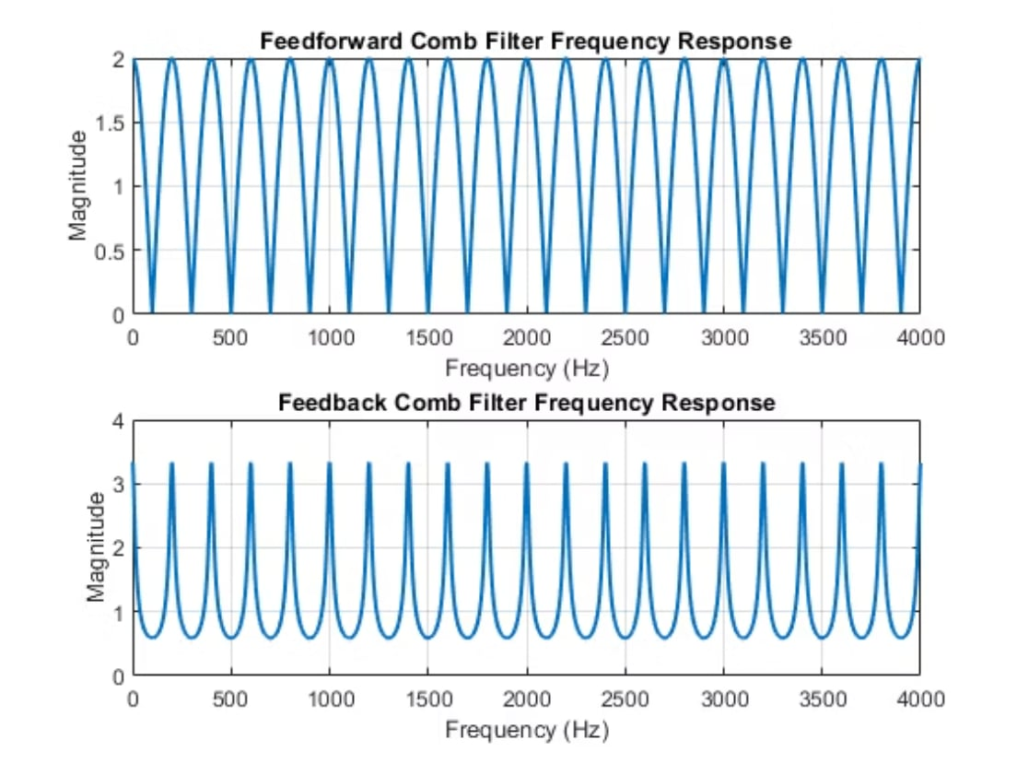

MATLAB RESULTS · FREQUENCY RESPONSE
Both Responses Repeat Every 200 Hz — But With Different Shapes
Feedforward (FIR)
Feedback (IIR)
Broad peaks and deep notches. The direct and delayed signals interfere cleanly, producing wide, symmetric lobes.
Narrow, stronger resonant peaks. Recursion amplifies specific frequencies, sharpening each tooth.
Both structures share the same periodicity: Δf ≈ 200 Hz

Slide 10


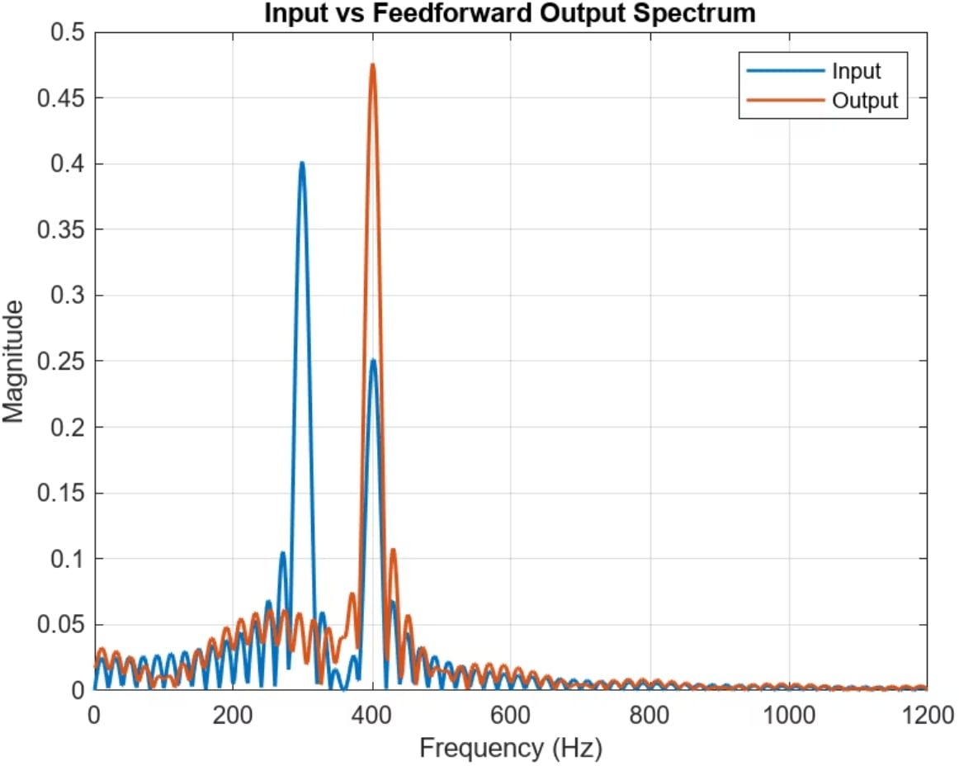
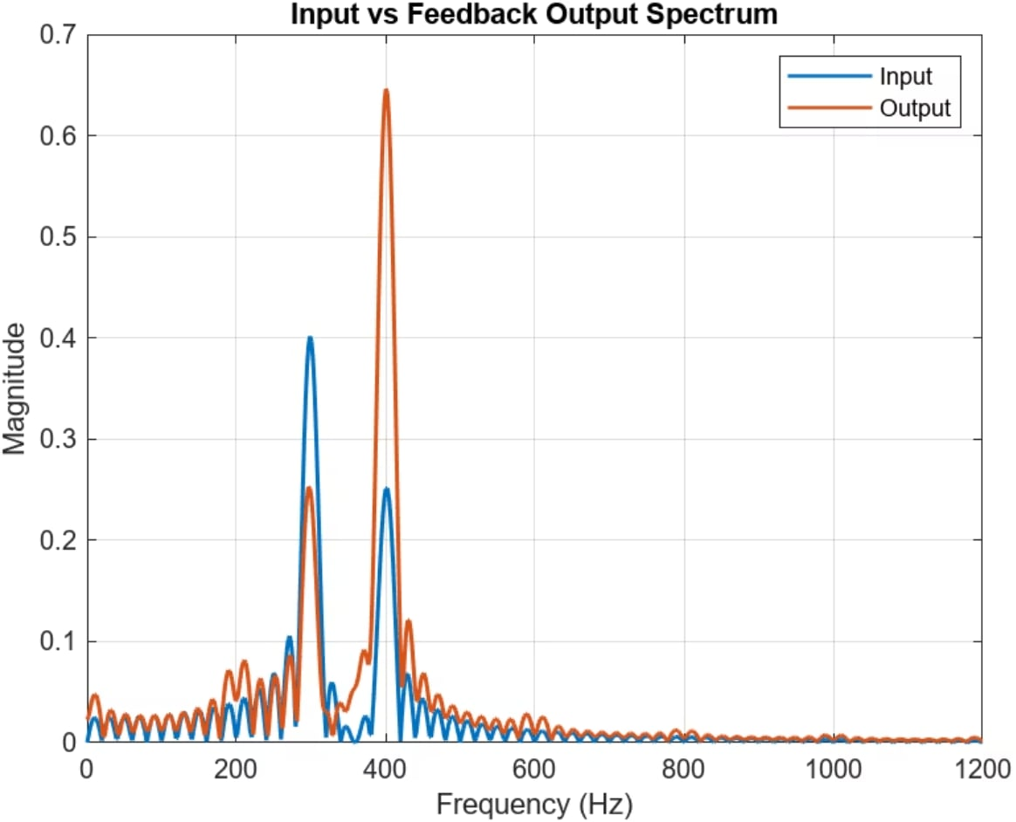
MATLAB RESULTS · SPECTRAL OUTPUT
The Spectra Connect Each Output Back to the Theory
300 Hz Behavior
Key Takeaway
Sits near a feedforward notch — attenuated in the FIR output. Feedback emphasizes resonant locations, altering relative amplitudes.
Both structures confirm Δf = 200 Hz spacing. Delay alone controls tooth placement; feedback controls peak sharpness.
Feedforward Output
Feedback Output

