Slide 1
SEG800 · DIGITAL SIGNAL PROCESSING
DELAY AS A SPECTRAL TOOL
Comb Filters
Theory · implementation · MATLAB evidence
x[n]
+
x[n−D]
REPEATED PEAKS + NOTCHES
Group #____ Member 1 · Member 2 · Member 3
Notes:
Introduce the topic and team.
Our goal is to connect the delay-based equations to visible MATLAB results.

Slide 2
SEG800 · COMB FILTERS
A delayed copy creates the filter’s “teeth”
A comb filter combines a signal with a delayed version of itself.
peaks
Phase determines the result
In phase → reinforcement Out of phase → reduction or cancellation
notches
frequency
SIGNAL LAB / 02
Notes:
The name comes from the regularly spaced peaks and notches.
Whether a frequency is reinforced or cancelled depends on the phase shift caused by the delay.

Slide 3
SEG800 · COMB FILTERS
Feedforward creates regularly spaced peaks and notches
y[n] = x[n] + a x[n−D]
Two signal paths
x[n]
+
y[n]
a
delayed-path gain
delay D · gain a
D
delay in samples
Finite impulse response · inherently stable
SIGNAL LAB / 03
Notes:
The output adds the current input to one delayed input copy.
The interference pattern repeats across frequency, producing peaks and notches.

Slide 4
SEG800 · COMB FILTERS
Feedback sharpens the repeated resonances
y[n] = x[n] + a y[n−D]
Recursive signal path
x[n]
+
y[n]
The delayed output is returned to the input.
Each pass reinforces the next, creating narrower and stronger resonant peaks.
stability
usually |a| < 1
Infinite impulse response
SIGNAL LAB / 04
Notes:
Feedback uses a delayed output, so it is recursive.
For this form, choosing the gain magnitude below one keeps the response stable.

Slide 5
SEG800 · COMB FILTERS
Delay sets the spacing between every tooth
Δf = Fₛ / D
8000 ÷ 40
200 Hz
Fₛ = 8000 Hz
D = 40 samples
Spacing is constant across the response
A longer delay packs the teeth closer together.
SIGNAL LAB / 05
Notes:
This is the key design relationship.
With an 8 kHz sample rate and 40-sample delay, adjacent teeth are 200 Hz apart.
The first feedforward notch occurs at 100 Hz.

Slide 6
SEG800 · COMB FILTERS
The MATLAB test isolates the effect of the delay
A simple two-tone signal makes attenuation and resonance easy to see.
INPUT
300 Hz + 400 Hz
SAMPLE RATE
8000 Hz
DELAY
40 samples
FEEDFORWARD GAIN
1.0
FEEDBACK GAIN
0.7
Expected tooth spacing: 200 Hz
SIGNAL LAB / 06
Notes:
Walk through the fixed parameters once.
The feedforward and feedback filters use the same delay, so both responses repeat every 200 Hz.

Slide 7
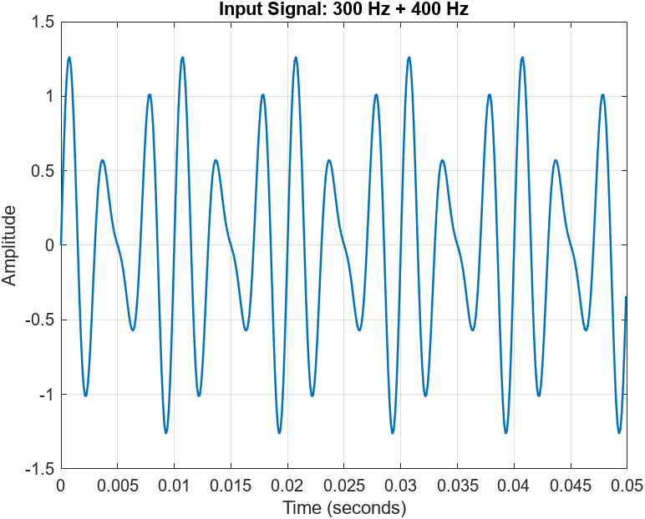
SEG800 · COMB FILTERS
The input contains only two known frequencies
300 Hz
larger component
400 Hz
smaller component
SIGNAL LAB / 07
Notes:
Figure 1 confirms the two-tone input before filtering.
The known frequencies make it straightforward to explain the changes in the output spectra.

Slide 8
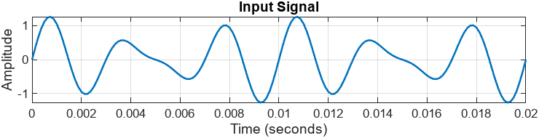
A 5 ms delay is visible within the short time window
DELAY
INTERPRETATION
40 samples ÷ 8000 samples/s = 5 ms
each delayed copy shifts the waveform by one quarter of this 20 ms view
Notes:
Figure 2 shows the input over the first 20 milliseconds.
The 40-sample delay equals 5 milliseconds, so the delayed copy is shifted by one quarter of the displayed window.
The next slides show how that delay changes the frequency response and spectra.

Slide 9
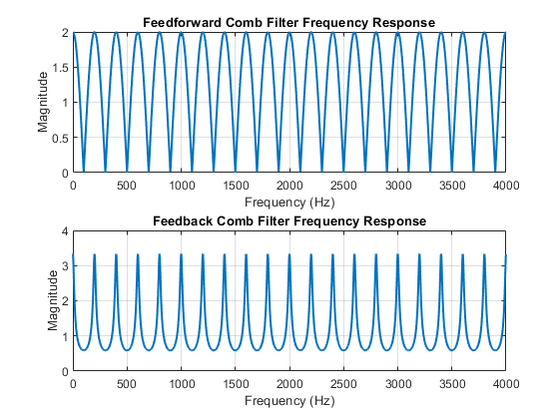
SEG800 · COMB FILTERS
Both responses repeat every 200 Hz—but with different shapes
FEEDFORWARD
broad peaks and deep notches
FEEDBACK
narrow, stronger resonant peaks
Δf ≈ 200 Hz
SIGNAL LAB / 09
Notes:
This is the central result slide.
Point out the repeated spacing first, then contrast the broad feedforward pattern with the sharp feedback resonances.

Slide 10
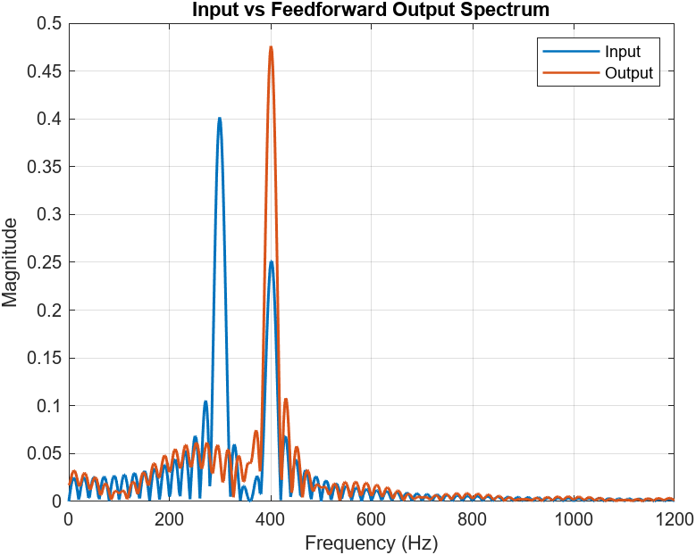
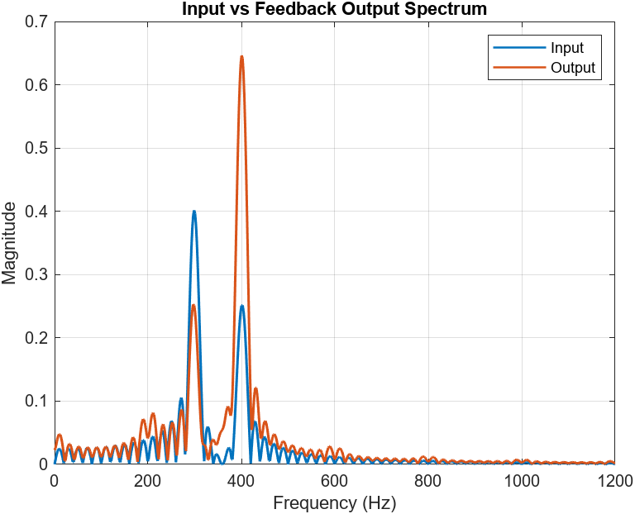
SEG800 · COMB FILTERS
The spectra connect each output back to the theory
FEEDFORWARD
FEEDBACK
300 Hz sits near a feedforward notch; feedback emphasizes resonant locations.
SIGNAL LAB / 10
Notes:
Figures 4 and 5 show the input and output spectra for each filter.
At 300 Hz the feedforward filter is at a notch, so that tone is strongly reduced.
The feedback case emphasizes frequencies near its repeated resonance peaks.

Slide 11
SEG800 · COMB FILTERS
One delay creates two distinct filtering behaviours
APPLICATIONS
Echo + delay Reverberation Periodic-noise removal Harmonic enhancement
THREE TAKEAWAYS
1
Delay creates the repeating frequency pattern.
2
Feedforward creates notches; feedback creates resonances.
3
The MATLAB results match the predicted 200 Hz spacing.
Comb filters turn a simple delay into a precise spectral pattern.
SIGNAL LAB / 11
Notes:
Close by connecting the mechanism, the two structures, and the MATLAB evidence.
Invite questions after the final synthesis.

