Slide 1
BTP610 – Mobile Applications
Week 10 — Session 1
Firebase Setup
& Sign Up
Firebase Console, firebaseConfig.ts, userAuthentication hook,
routing, CustomStyle, Book type, signUp screen

Slide 2
Today's Agenda
01
What is Firebase?
Services overview, Auth, Firestore, why we use it
02
Firebase Console Setup
Create project, enable Auth & Firestore, get config keys
03
Project setup & shared files
Create Expo app, firebaseConfig.ts, CustomStyle.ts, Book type
04
userAuthentication hook + routing
onAuthStateChanged, index.tsx redirect logic, _layout.tsx
05
Sign Up screen
createUserWithEmailAndPassword, setDoc, object state pattern, JSX

Slide 3
What is Firebase?
Firebase is a backend platform by Google — gives your app a database, user login, and more without writing server code.
Firebase Auth
Firestore
User sign up / sign in with email & password. Handles passwords securely — we never store them ourselves.
Cloud NoSQL database. Data stored as Documents inside Collections. Real-time updates built in.
What we use
Why Firebase?
Firebase Auth — for Sign Up and Sign In.
Firestore — for storing books and user profiles.
No server to write or maintain. Free tier (Spark plan) covers everything we need. Works directly from Expo.
npm install firebase
Notes:
Firebase is Google's all-in-one backend. Key selling point: no server to write. We use Auth for login and Firestore for data.

Slide 4
Firestore Data Model: Collections & Documents
Firestore stores data as Documents inside Collections — think of it like folders and files.
Firestore Database
│
├── BookDB (Collection — stores all books)
│ ├── abc123 (Document — one book, auto-generated ID)
│ │ ├── title: "The Alchemist"
│ │ ├── author: "Paulo Coelho"
│ │ ├── genre: "Fiction"
│ │ └── uid: "user456" ← who added this book
│ └── def456 (Document — another book)
│
└── userProfile (Collection — stores user profiles)
└── user456 (Document ID = Firebase Auth UID)
├── name: "John Doe"
├── email: "john@myseneca.ca"
├── contact: "416-555-0000"
└── location: "Toronto"
Collection
A group of related documents. Like a table in SQL. We have BookDB and userProfile.
Document
One record with an ID. BookDB → auto-generated ID. userProfile → we use the Firebase Auth UID.
Why UID as doc ID?
Saves the user profile with the UID as document ID so we can look it up easily later using that same UID.
Notes:
Most important concept before writing any code. Two collections: BookDB and userProfile. BookDB uses auto ID, userProfile uses the Firebase Auth UID as the document ID — this is the key link between Auth and Firestore.
Books → each book just needs to be unique, we don't need to look up a specific book by a known ID, so we let Firestore generate a random ID automatically.
User profile → we always need to find the profile of whoever is logged in, so we use their Firebase Auth UID as the document ID so we can look it up instantly.

Slide 5
Firebase Console Setup — Step by Step
Go to console.firebase.google.com
1
Sign in with your Google account. Follow the steps to create a new project. Name it e.g. GoodReadClub.
Enable Authentication
2
In the “Search for products” bar type “Authentication” → Get started → Email/Password → Enable → Save.
Enable Firestore
3
Databases & Storage → Firestore → Create database → Standard edition → Choose location (Toronto) → Start in test mode → Create.
Get Your config keys
4
Settings (gear icon) → General → Web (</>) → Register (type GoodReadClub as the nickname)→ Copy the firebaseConfig object → Click Continue to Console
Create Collections
5
Firestore → + Start collection → Type "BookDB" as the Collection ID→ Click Auto ID for the Document ID→ add any field (e.g. title: “test”) → click Save. Click + Start collection again→ Type “userProfile” as the Collection ID→ Click Auto ID for the Document ID→ add any field (e.g. title: “test”) → click Save.
Notes:
Test mode for Firestore means open access — fine for development. NEVER commit the firebaseConfig keys to GitHub.

Slide 6
Firebase Console Setup — Step by Step
Firebase project created
Authentication enabled
Firestore database created in test mode
Web app registered and config keys copied
BookDB and userProfile collections created

Slide 7

Step 0: Setting Up a New Project
1. Create a new project
2. Select SDK Version
3. Change directory to the project
4. Delete the demo code Expo gives you so you can start from a clean blank screen
5. Open the project folder in Visual Studio Code

Slide 8
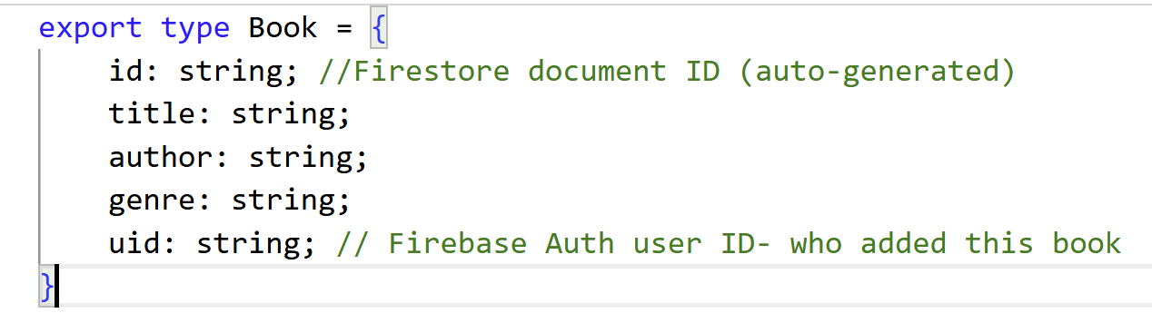
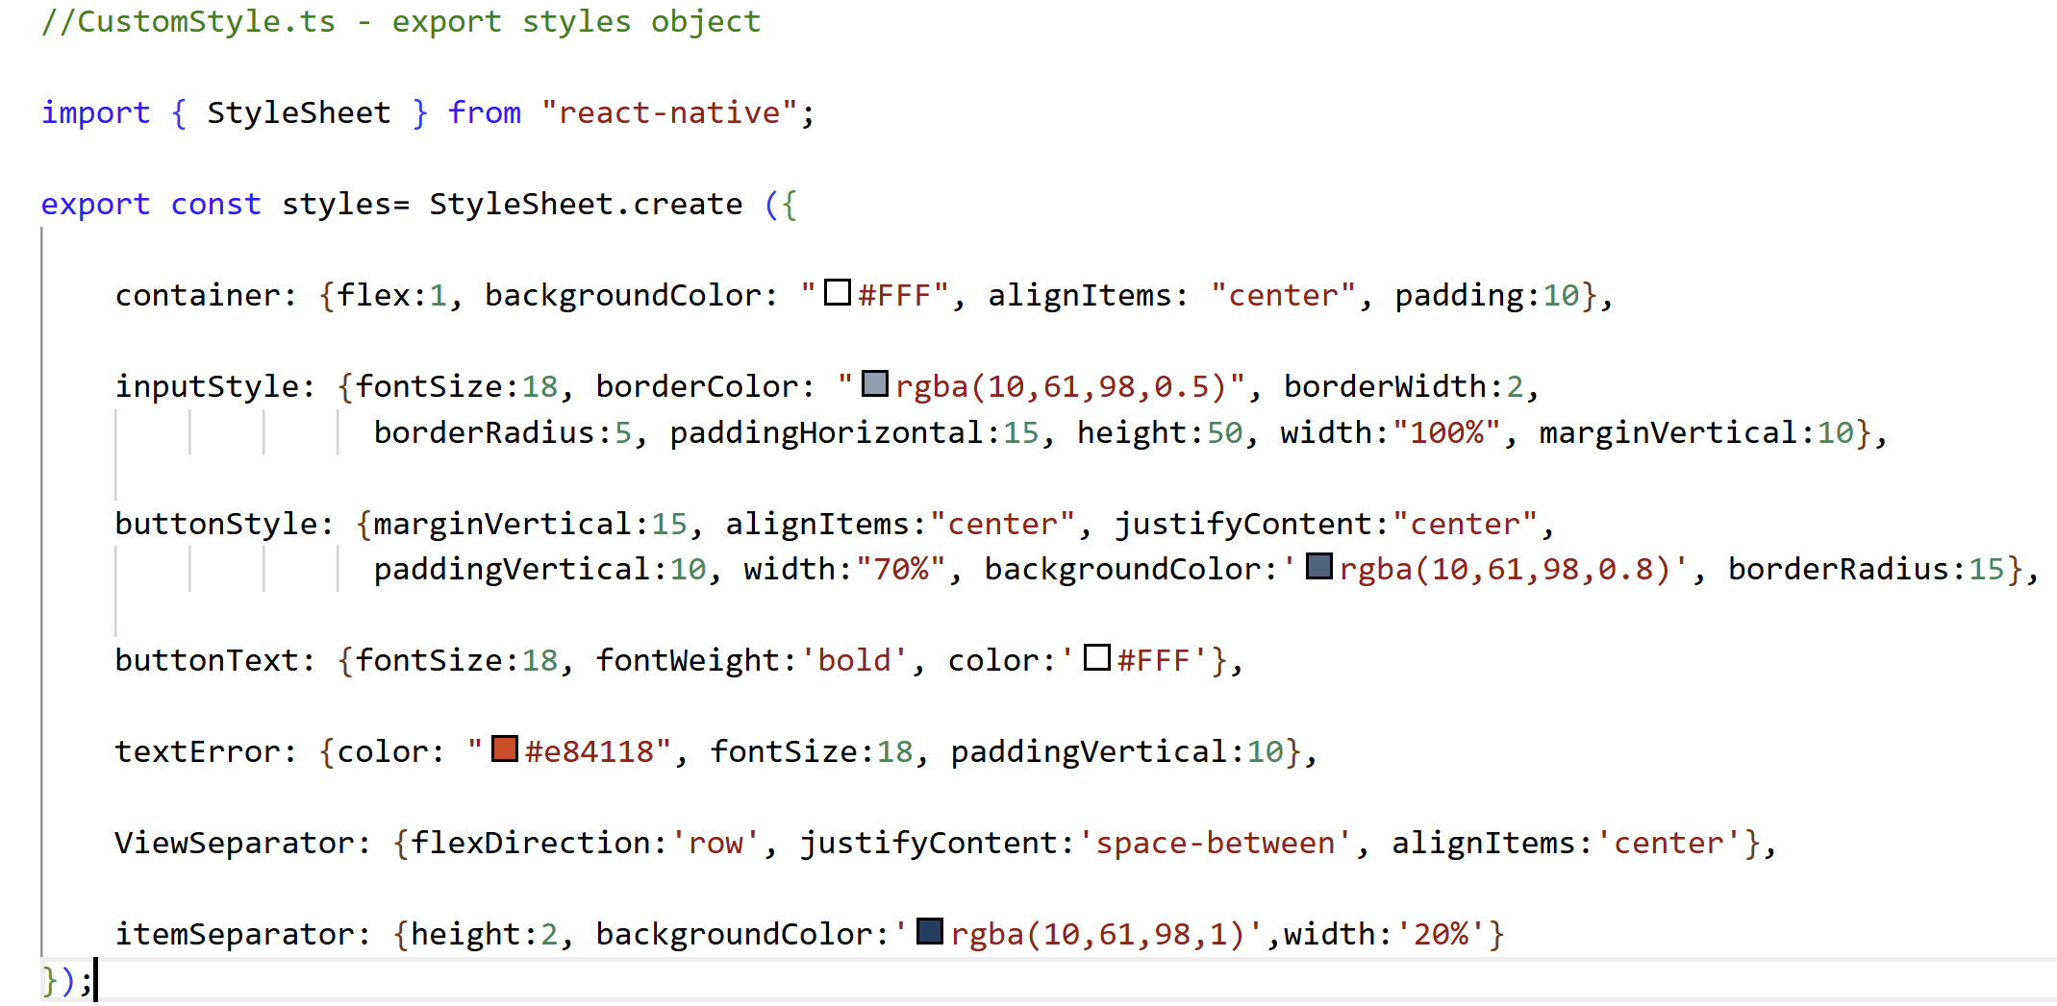
Step 1 — Create Shared Files
Install Firebase:
npm install firebase
types/Book.tsx- — TypeScript type shared across all screens
CustomStyle.ts — shared styles imported by all screens (under root of project)
uid field on Book
Stores the Firebase Auth UID of who added this book — used for permission-based features.
Shared styles
Instead of copy-pasting styles into every screen, we define them once and import them: import { styles } from '@/CustomStyle'
Notes:
Create the Expo project first, reset it, then install Firebase. Create the types/ folder and Book.tsx. Create CustomStyle.ts — all screens import from here so no copy-pasting styles. The @/ alias — it points to the project root (configured in tsconfig).

Slide 9
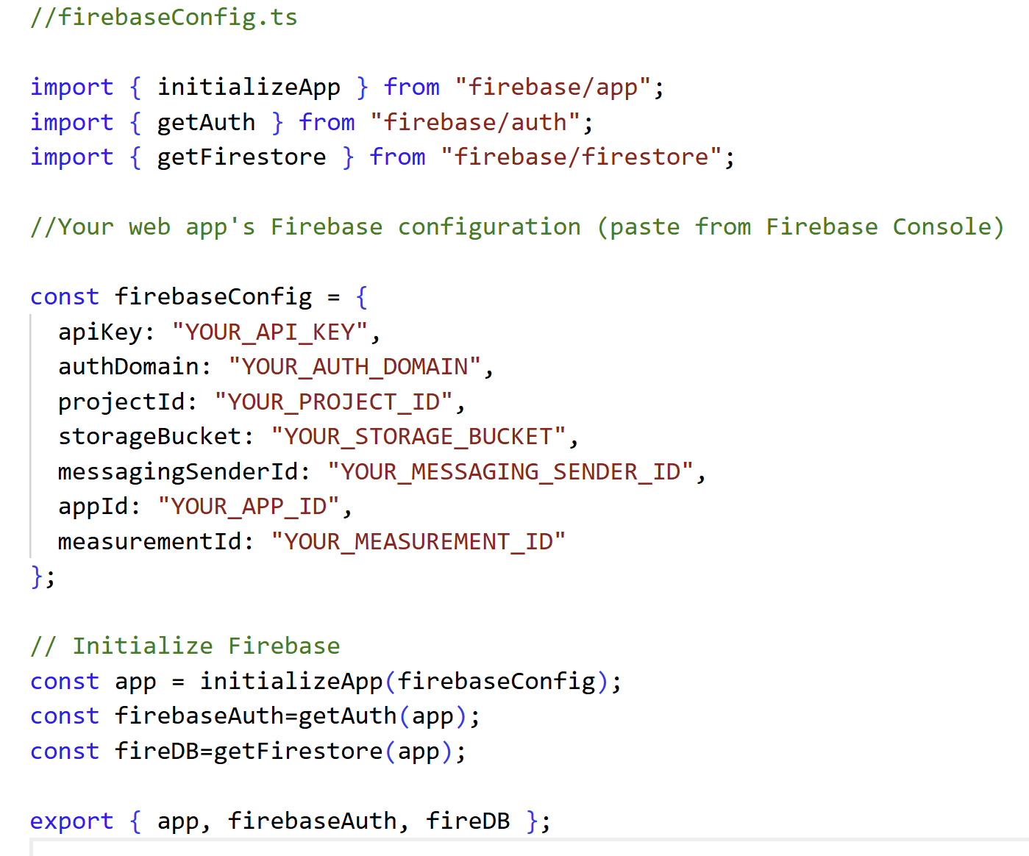
Step 2 — firebaseConfig.ts
Create this file in the project root. Paste your config keys from the Firebase Console.
initializeApp()
Connects your app to your Firebase project using the config keys from the Console.
getAuth(app)
Returns the Auth service — used for sign up, sign in, sign out.
getFirestore(app)
Returns the Firestore database — used for reading and writing data.
export { firebaseAuth, fireDB }
Any screen can import these two and use Firebase directly.
⚠ Never share your config keys
Don't post firebaseConfig.ts on GitHub or Discord. In a real project add it to .gitignore.
Notes:
Replace the placeholder strings with the actual values from the Firebase Console. The three init lines connect to Firebase — one for the app, one for Auth, one for Firestore. We export both so any screen can import them.
.gitignore is just a text file that lists files you want Git to ignore.
Each line is a file or folder name. Git sees that list and skips those files when uploading to GitHub.

Slide 10
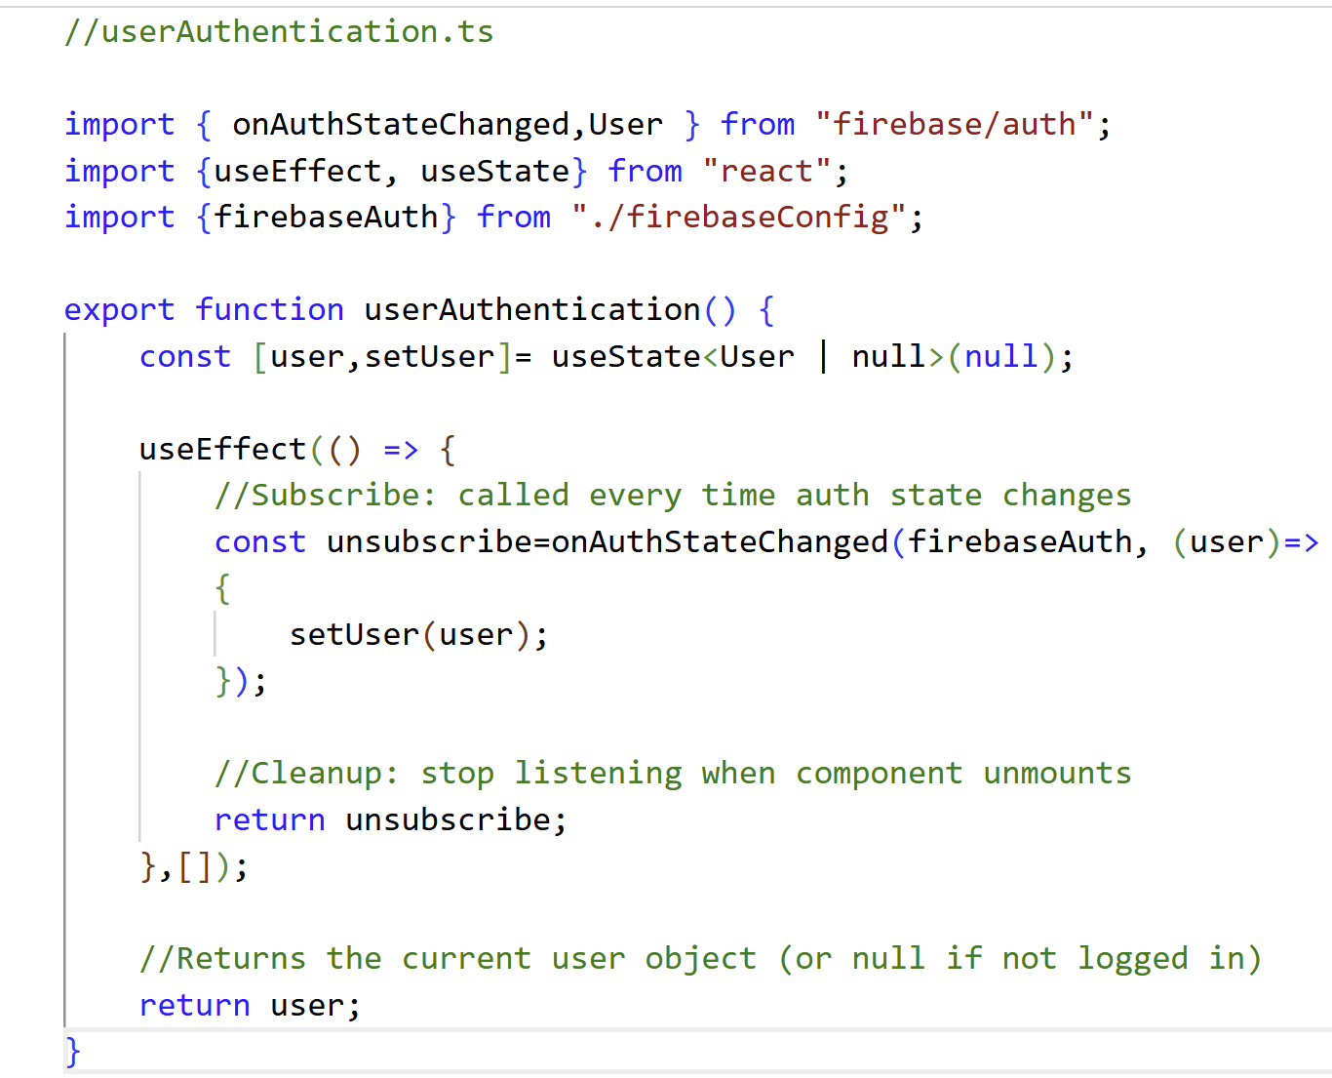
Step 3 — userAuthentication.ts (Custom Hook)
A custom hook that listens for auth state changes and returns the current user.
Custom hook
A function that uses React hooks. Any component calls userAuthentication() to get the current user.
onAuthStateChanged
Firebase function that fires every time the user logs in or out. We pass it a callback that updates state.
User | null
TypeScript union type. User = logged in. null = not logged in. Drives the routing in index.tsx.
return unsubscribe
Cleanup — stops listening when component unmounts. Prevents memory leaks.
Notes:
Custom hook — starts with lowercase 'user' not 'use’. onAuthStateChanged fires immediately with current state AND again on any login/logout. User | null drives the whole routing system. The cleanup return unsubscribe is important — without it you get memory leaks.
the component unmounts" means "that screen is no longer showing on the device.“
userAuthentication() is the custom hook
return unsubscribe — cleanup when screen closes
return user — the answer to "who is logged in right now?"
They never run at the same time. The first is cleanup, the second is the actual result of the hook.
return unsubscribe is inside the useEffect callback — it doesn't run immediately after onAuthStateChanged. React holds onto it and only calls it later when the component unmounts.
Think of it like leaving instructions
onAuthStateChanged → runs right now when screen loads
return unsubscribe → React saves it and runs it later when screen closes
So even though it's the next line in the code, it doesn't execute next. React sees it as "here's what to do when you're done with this component" — not "run this now."

Slide 11
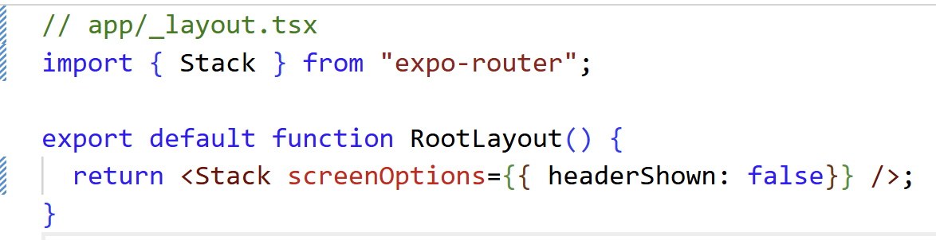
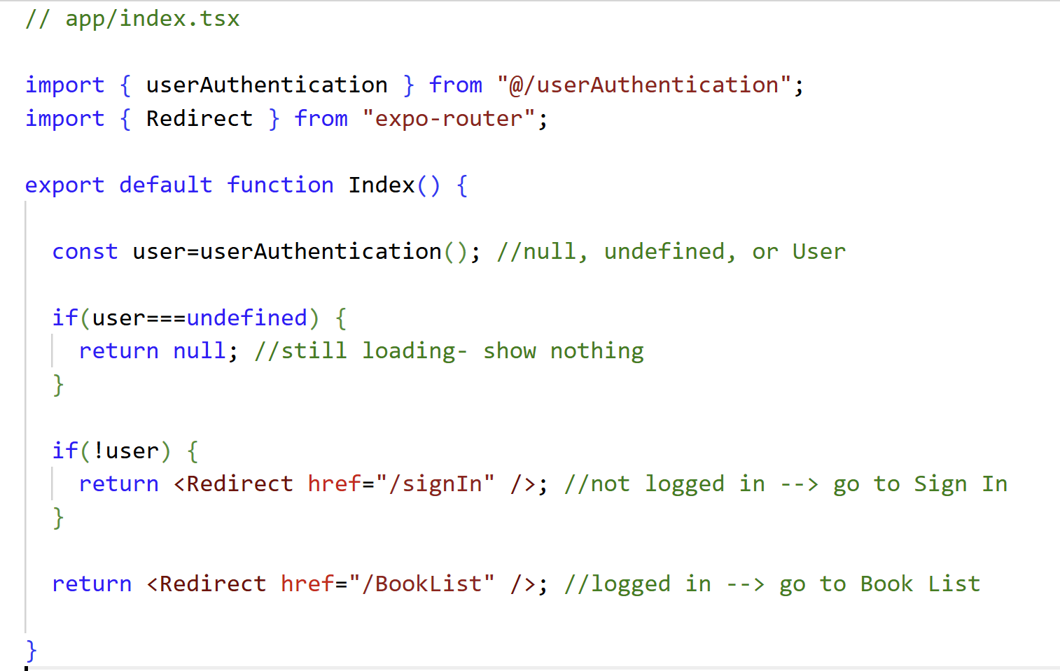
Step 4 — Routing: index.tsx, _layout.tsx & Folder Structure
app/_layout.tsx — Root layout, hides all default headers
Three states of user
undefined = auth loading (show nothing)
null = not logged in → signIn
User object = logged in → BookList
Route groups (auth)
app/index.tsx — Entry point: redirect based on auth state
Folder name with brackets = Expo Router group. Organises files but doesn't appear in the URL path.
Folder structure — create these now:
app/
├── _layout.tsx
├── index.tsx
└── (auth)/
├── _layout.tsx ← create now, code next
├── signIn.tsx ← placeholder for now
└── signUp.tsx ← build this session
Notes:
Create _layout.tsx first — headerShown false removes the default Expo header. index.tsx is the gatekeeper. Three states: undefined (loading), null (not logged in), User (logged in). Create the (auth) folder with brackets — brackets are Expo Router group syntax.
user === undefined — Firebase is still loading, we don't know yet !user (user is null) — Firebase checked and nobody is logged in → go to Sign In user exists — someone is logged in → go to BookList

Slide 12
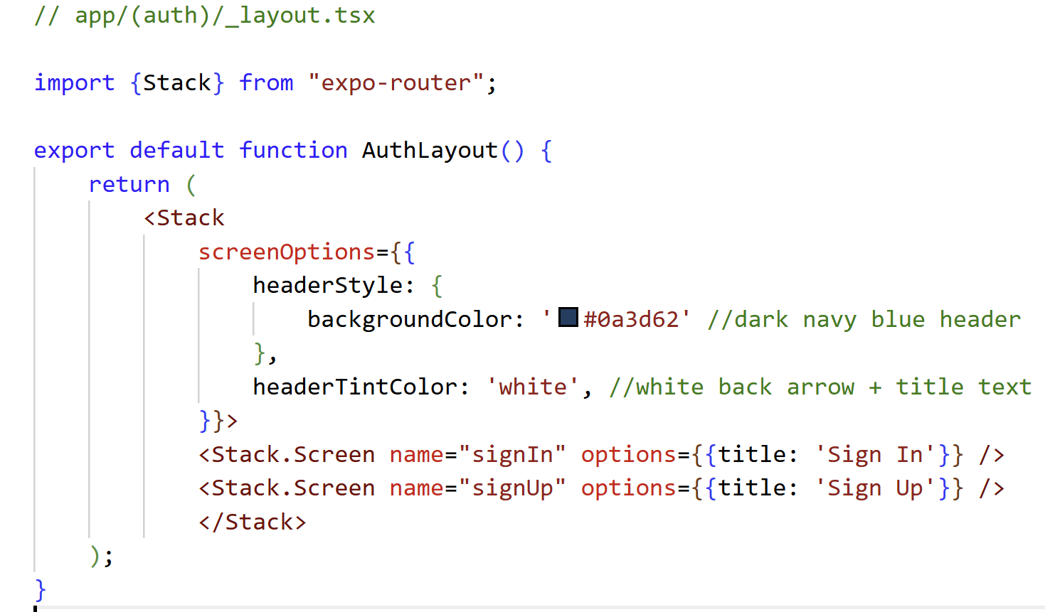
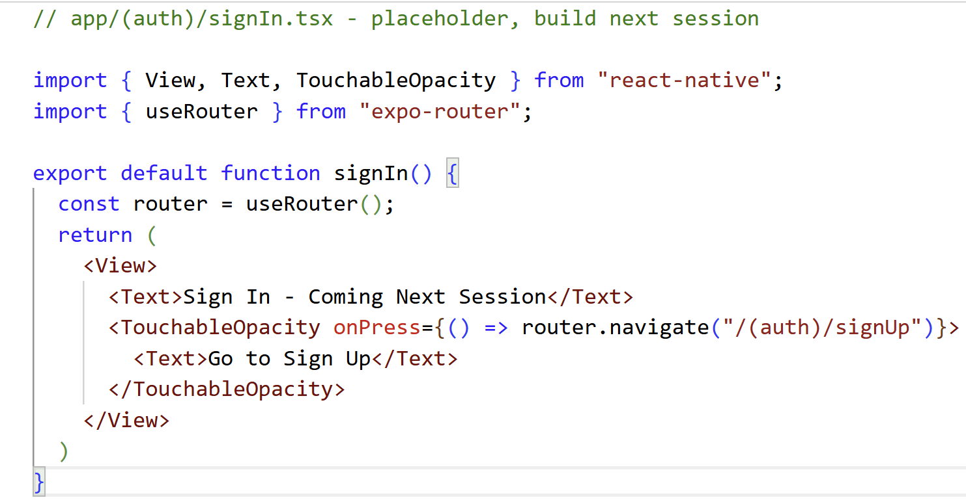
Step 5 — (auth)/_layout.tsx: Styled Header
Also create a placeholder signIn.tsx for now:
screenOptions
Stack.Screen name
headerTintColor
Applies the dark header style to ALL screens inside this Stack — both signIn and signUp get the same header.
Matches the filename. name='signIn' → signIn.tsx. Sets the title text shown in the header bar.
Colour of the back arrow and title text. White so it's visible on the dark navy background.
Notes:
Create the auth layout with the dark blue header. Both signIn and signUp get this header automatically via screenOptions. Create a placeholder signIn.tsx so the app doesn't crash when index.tsx redirects to it. We'll build the real signIn next session.
headerTintColor only works inside navigation screenOptions — you can't use it on regular components.
headerTintColor is specific to the navigation header. It controls:
The back arrow colour
The title text colour in the header

Slide 13
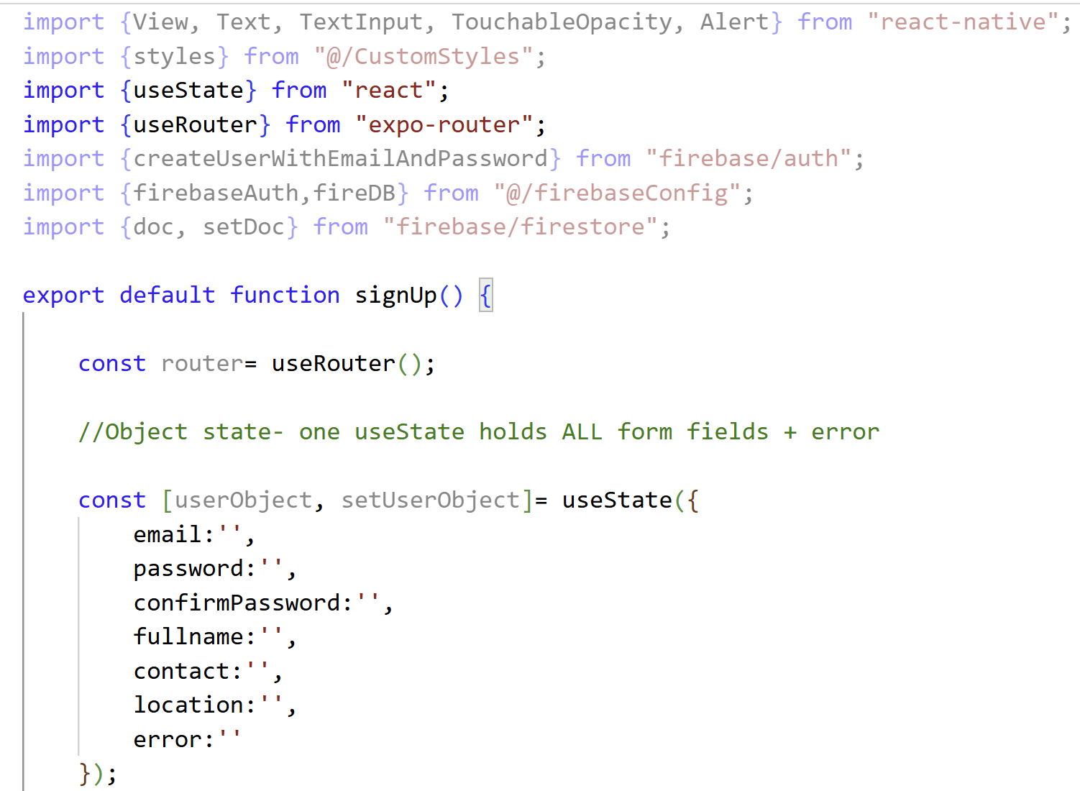
Step 6 — signUp.tsx: Imports & State
createUserWithEmailAndPassword
Firebase Auth function. Creates a new login account. Returns userCredential — contains the new user's UID.
setDoc
Writes a document to Firestore at a specific path we provide. We use the UID as the document ID.
Object state pattern
One useState holds ALL form fields. Update one field with spread:
setUserObject({ ...userObject, email: text })
error field in state
Error message lives in the same object. Empty string = hidden. Any text = shown in red on screen.
Notes:
object state pattern. Instead of 7 separate useStates, one object holds everything. Spread update: ...userObject copies all existing fields, then we override just the one that changed. Without the spread, setting email would wipe out password, name, etc.

Slide 14
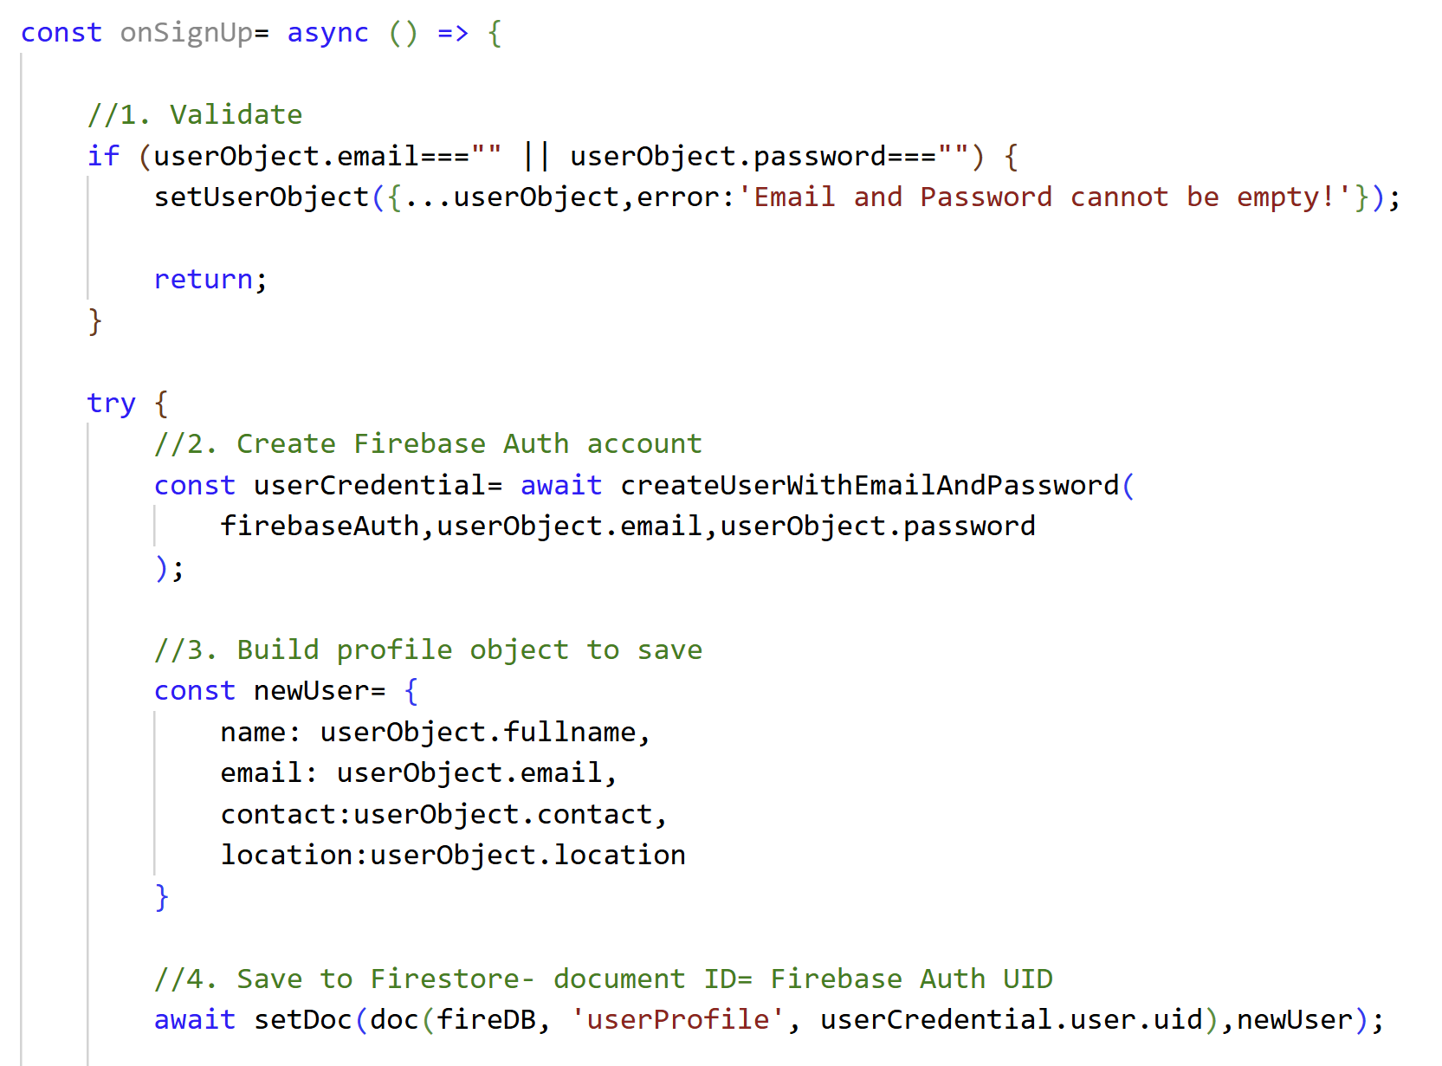
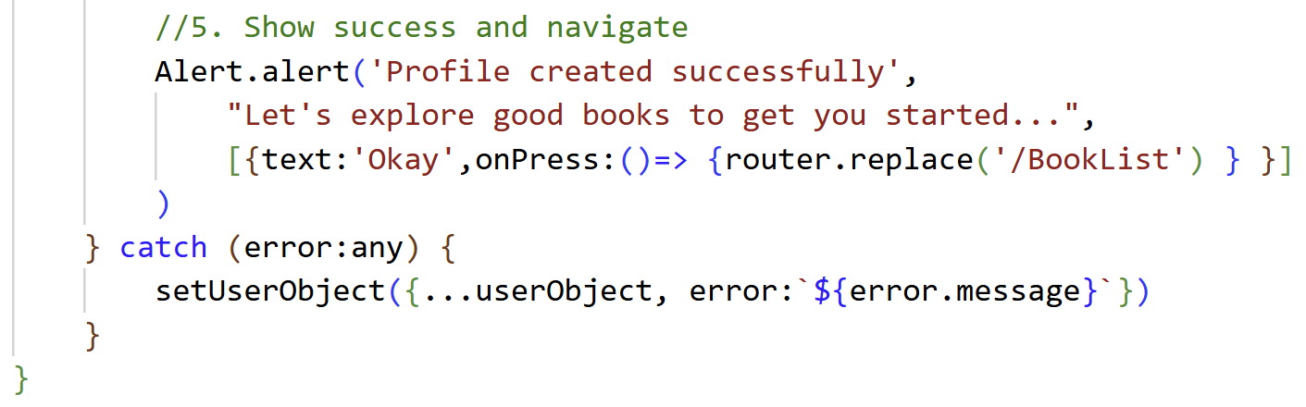
Step 6 — onSignUp() Function
Validation first
1
Check required fields before any Firebase call.
createUserWithEmailAndPassword
2
Returns userCredential. userCredential.user.uid = the new user's unique ID generated by Firebase.
setDoc to Firestore
3-4
doc(fireDB, 'userProfile', uid) creates the path. setDoc writes newUser to that document.
Alert then navigate
5
router.replace('/BookList') — replace so user can't go back to sign up.
Notes:
Key: createUserWithEmailAndPassword returns userCredential — userCredential.user.uid is the unique ID Firebase generates. We immediately use that UID as the Firestore document ID so we can find the profile later. router.replace vs navigate: replace removes signUp from the back stack.
{...userObject, error: 'Email and Password cannot be empty!'}
Spread pattern — copies all existing fields from userObject and only changes the error field.
wait createUserWithEmailAndPassword(firebaseAuth, userObject.email, userObject.password)
Creates the Firebase Auth account. Takes three arguments:
firebaseAuth — which Firebase project to use
userObject.email — the email the user typed
userObject.password — the password the user typed
Returns userCredential which contains the new user's UID.
const newUser = { name, email, contact, location }
Building a plain object from the form fields — this is what gets saved to Firestore. Notice password is NOT included — we never store passwords ourselves, Firebase handles that.
setDoc(doc(fireDB, 'userProfile', userCredential.user.uid), newUser)
Two things happening here:
doc(fireDB, 'userProfile', userCredential.user.uid) — creates the path: database → userProfile collection → document with UID as ID
setDoc(..., newUser) — writes the newUser object to that path

Slide 15
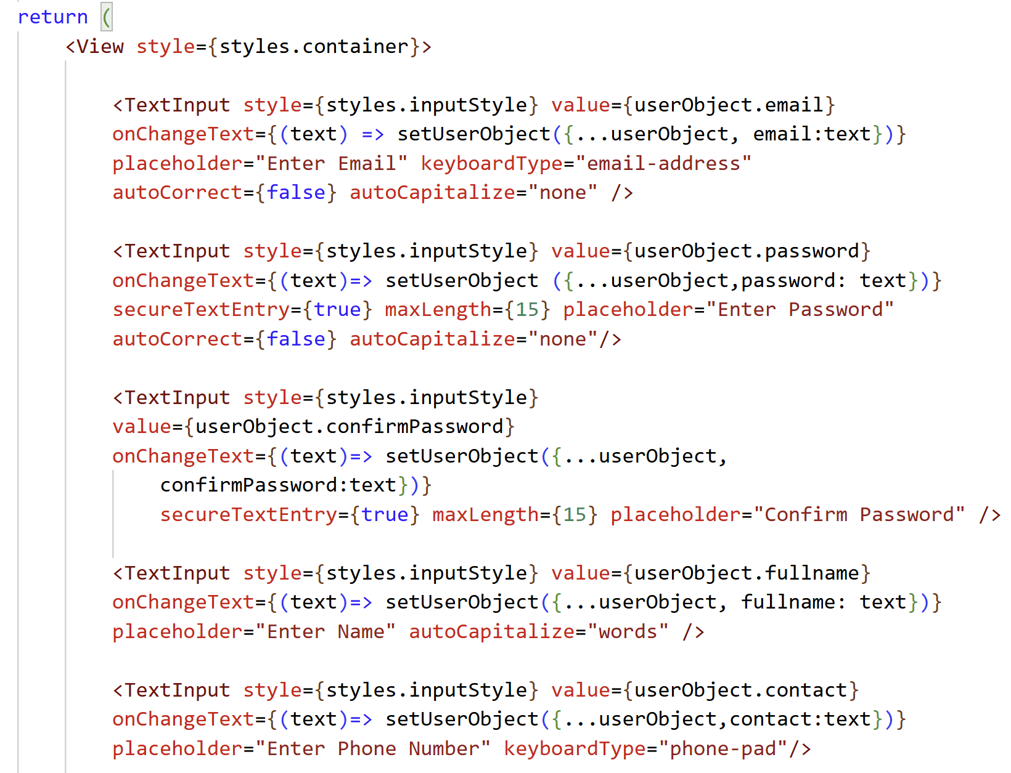
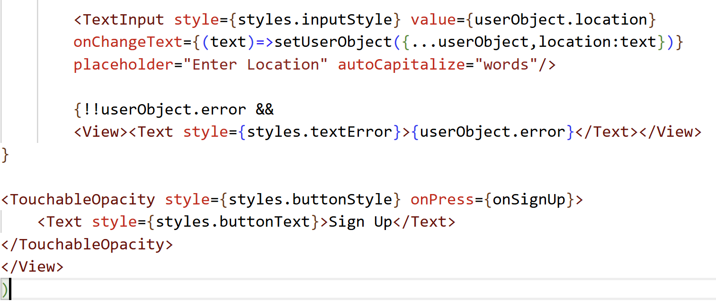
Step 6 — signUp.tsx: JSX
secureTextEntry={true}
keyboardType
!!userObject.error
autoCapitalize='none'
Hides characters — shows dots. Used for password fields.
"email-address" → shows @
"phone-pad" → numbers only
"default" → standard keyboard
Double bang converts string to boolean. Empty string = false (hidden). Any text = true (shown).
Critical for email — prevents iOS capitalising the first letter.
Notes:
After building JSX, run the app and create an account. Then open Firebase Console →Authentication to ensure the new account appeared. Open Firestore → userProfile collection to show the document was created with the UID as document ID.

Slide 16
Test It — Verify in Firebase Console
Run the app, create an account, then show students what appeared in Firebase.
1
App shows Sign Up screen
index.tsx → user is null → Redirect to /signIn → placeholder shows. Tap Sign Up button → navigate to signUp.
2
Fill in the form and tap Sign Up
Enter email, password, name, phone, location. Tap Sign Up.
3
Check Firebase Authentication
Firebase Console → Authentication → Users tab. You should see the new account with the email address.
4
Check Firestore
Firebase Console → Firestore → userProfile collection. You should see a document with the UID as the ID and the name, email, contact, location fields.
5
App navigates to /BookList
After sign up the Alert shows, tap Okay. App tries to go to /BookList — it will crash or show blank because that screen doesn't exist yet. That's expected — we build it in Week 12.
Notes:
Npx expo start
The /BookList crash is expected and normal —that's what we build in Week 12.

Slide 17
Project Folder Structure
GoodReadClub/
├── app/
│ ├── _layout.tsx ← Root layout (headerShown: false)
│ ├── index.tsx ← Entry point: redirect based on auth state
│ │
│ ├── (auth)/ ← Auth group: screens for login/signup
│ │ ├── _layout.tsx ← Auth header (dark blue style)
│ │ ├── signIn.tsx ← Sign In screen
│ │ └── signUp.tsx ← Sign Up screen
│ │
│ └── (welcome)/ ← Logged-in group
│ ├── _layout.tsx ← Welcome layout (hides header for tabs)
│ └── (tabs)/ ← Tab navigation
│ ├── _layout.tsx ← Defines 3 tabs: Books, Add Book, Profile
│ ├── BookList.tsx ← Tab 1: Read/Delete/Update books
│ ├── NewBook.tsx ← Tab 2: Add a new book
│ └── UserProfile.tsx ← Tab 3: Show user profile
│
├── firebaseConfig.ts ← Firebase init + exports
├── userAuthentication.ts ← Custom auth hook
├── CustomStyle.ts ← Shared StyleSheet
└── types/
└── Book.tsx ← Book TypeScript type
Route groups (auth) and (welcome) are Expo Router folder groups — they organize routes but don't appear in the URL path.
Notes:
Expo Router uses the file system for routing — the folder name IS the route. Parentheses in folder names are Expo Router 'groups' — they organise files but don't add to the URL. (auth)/signIn.tsx → navigated to as /signIn.

Slide 18
What We Covered Today
✓ Firebase Console — Auth + Firestore setup
Up Next
✓ firebaseConfig.ts — connects app to Firebase
→ Week 11 S1: signIn.tsx + auth layouts + tab navigation
✓ userAuthentication() custom hook — onAuthStateChanged
→ Week 11 S2: NewBook + BookList (add + read)
✓ index.tsx — redirects based on auth state
✓ (auth)/_layout.tsx — dark blue header
→ Week 12 S1: BookList (update/delete) + UserProfile
✓ Book type + CustomStyle.ts — shared files
✓ signUp.tsx — createUserWithEmailAndPassword + setDoc
✓ Account and profile visible in Firebase Console
BTP610 – Firebase Series

