Slide 1

BTP610 – Mobile Applications
Week 8
React Native Maps
Displaying maps, markers, and programmatic navigation
in your Expo React Native apps
Library: react-native-maps | Expo SDK ~54 | TypeScript + Expo Router
Notes:
Welcome to Week 8! Today we cover react-native-maps — how to display a map, add markers dynamically, and programmatically navigate the camera.

Slide 2
Today's Agenda
01
What is react-native-maps?
Library overview, platform support, installation
02
Core concepts
MapView, Region, Marker, useRef, animateToRegion
03
Project walkthrough – Step by step
Live coding the Week 8 MapView project
04
Key TypeScript patterns
Custom types, useState with arrays, useRef
05
Q & A / Wrap-up
Review, resources, next steps

Slide 3
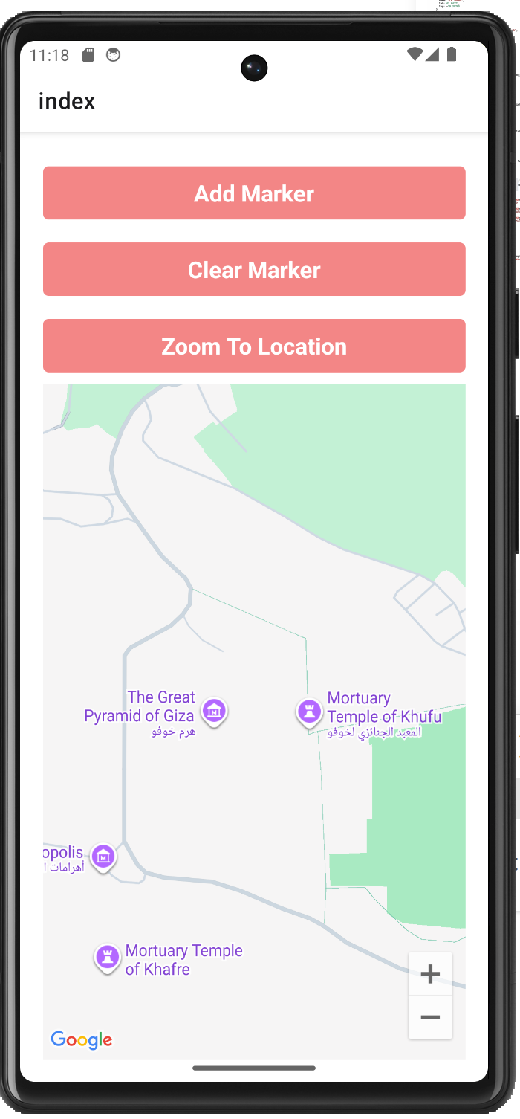
Project
This is a mobile app that displays a live interactive Google Map.
At the top we have three buttons, and below that the map fills the rest of the screen.
When the app opens, the camera starts pointed at the Great Pyramids of Giza — just to prove the map is working from the first second.
The app has a list of 6 real-world attractions hardcoded in the code — places like the Sydney Opera House, CN Tower, and the Great Barrier Reef. Each one has a name, a latitude, and a longitude.

Slide 4
Project
Tapping Add Marker randomly picks one of those attractions, drops a custom pin on the map, and flies the camera there smoothly. You can keep tapping it — pins accumulate.
Tapping Clear Marker wipes all the pins and flies back to Toronto.
Tapping Zoom To Location just moves the camera to Monaco — no pins — to show that camera movement and markers are two separate things.

Slide 5

Project: Week 8 MapView
Attractions Map — Add random world attractions as markers and navigate the map programmatically
MapView
Add Marker
Full-screen interactive map with zoom controls
Pick a random attraction → add custom icon pin + fly to it
Clear Markers
Zoom To Location
Remove all pins, reset camera to CN Tower
Jump camera to Monaco (hardcoded demo)
Notes:
This is the project we build today. 3 buttons + 1 full-screen map. Attractions list is hardcoded. Add Marker picks randomly from the list, adds it to state, and flies the camera. Clear resets everything. Zoom To Location demonstrates animateToRegion independently of markers.

Slide 6
Learning Objectives
What you're going to learn from this project:
  How to display a map using react-native-maps
  How to place custom markers on the map from a state array
  How to move the camera programmatically with animateToRegion
  How to use useRef to call methods directly on a component
By the end of today you will have a fully working map app running on your emulator.

Slide 7

Step 1: Setting Up a New Project
1. Create a new project
2. Select SDK Version
3. Change directory to the project
4. Delete the demo code Expo gives you so you can start from a clean blank screen
5. Open the project folder in Visual Studio Code

Slide 8


What is react-native-maps?
Third-party library
Installation
Not built into React Native — must be installed separately.
npm install react-native-maps
Google Maps (Android) /
Apple Maps or Google Maps (iOS)
Import in your component
Uses native mapping SDKs under the hood — real performance.
import MapView, { Marker, Region }
from 'react-native-maps';
Works with Expo Go
📖 Docs: docs.expo.dev/versions/latest/sdk/map-view
No extra native config needed for Expo managed workflow.
Notes:
react-native-maps is the standard community map library for React Native / Expo. On iOS it defaults to Apple Maps; on Android it uses Google Maps (may need API key for prod builds). In Expo Go it just works. One install command, one import.

Slide 9

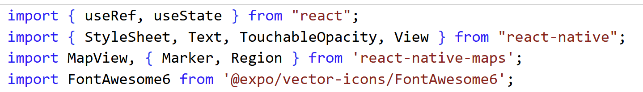
Step 2: Installations and Imports
1. From the terminal, install the third-party library:
2. Import under index.tsx:
What each import does
  MapView → The main map component
  Marker → Individual pins placed on the map
  Region → TypeScript type for { latitude, longitude, latitudeDelta, longitudeDelta }
  FontAwesome6 → Custom icon for our markers (from @expo/vector-icons)
    Webpage for icons: https://icons.expo.fyi/Index
Notes:
npm install react-native-maps@1.20.1

Slide 10
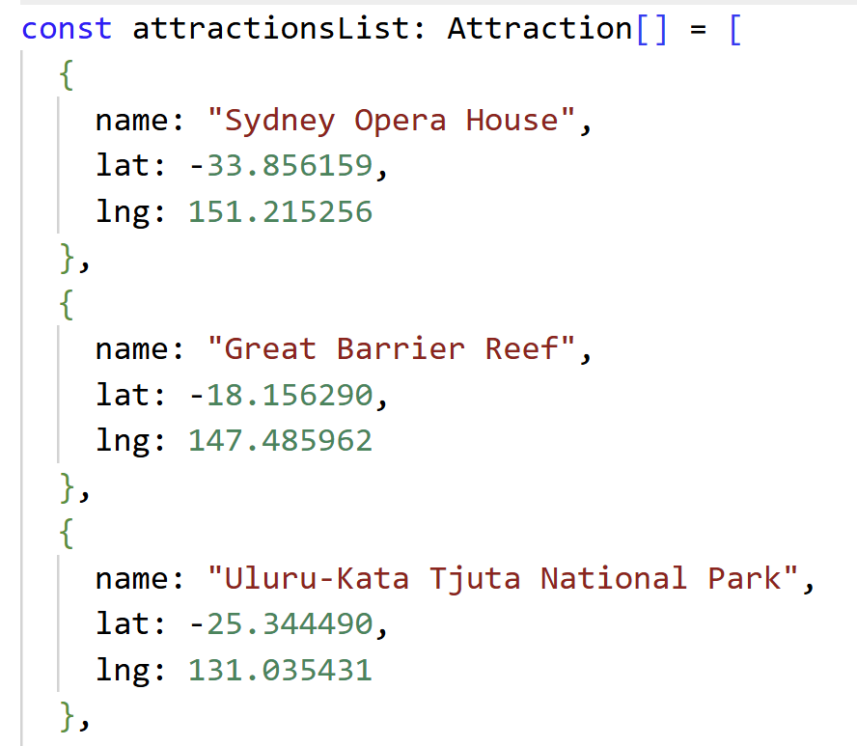
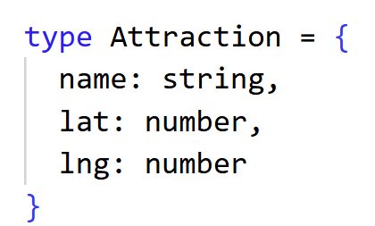
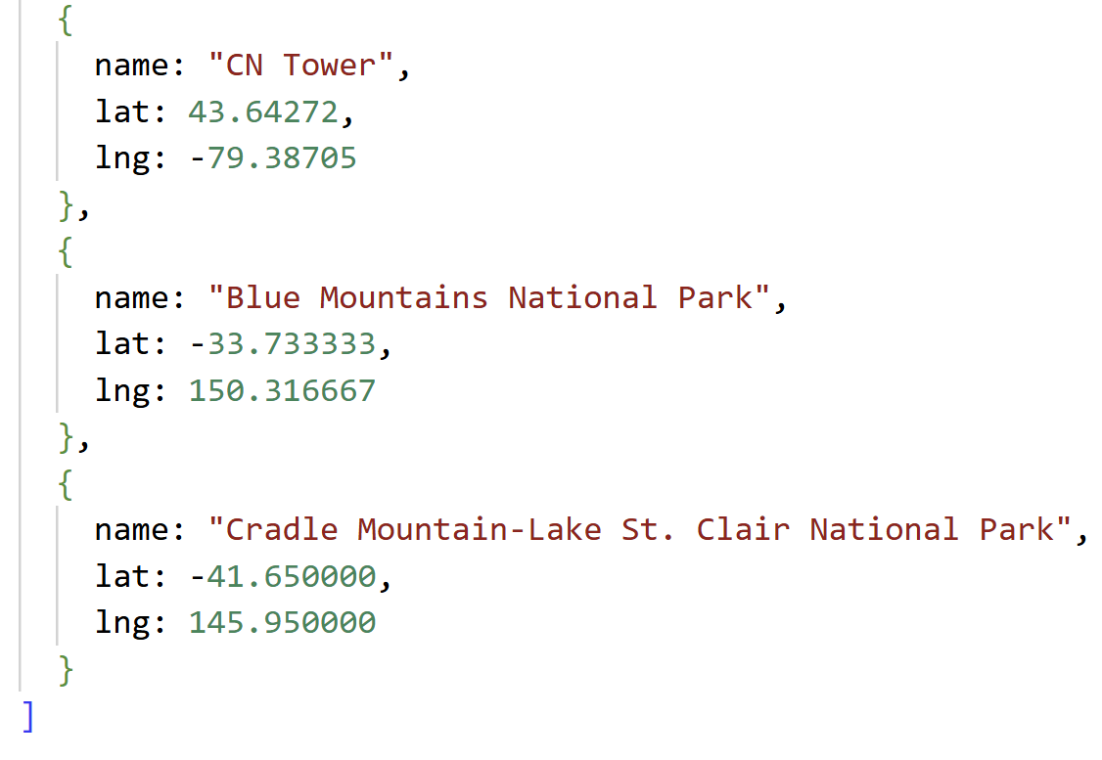
Step 3: Define the Data- Custom Type and Attractions List

Slide 11
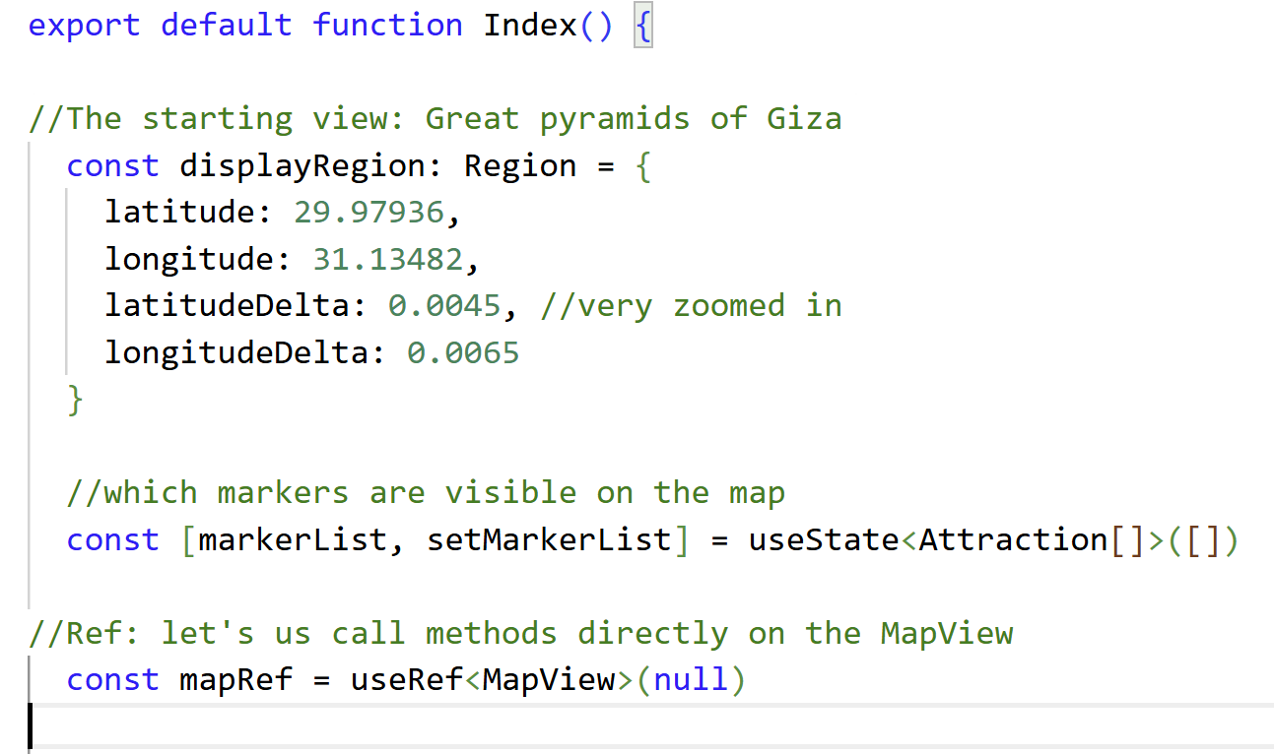
Step 4: Component State, Ref and Initial Region
displayRegion
displayRegion
displayRegion
Defined inside the component. A Region object that sets our initial camera position to the Pyramids of Giza.
markerList state
It starts empty. Every time you tap "Add Marker", one attraction gets written on that list. The map looks at that list and draws a pin for every item on it. When the list changes, the map automatically redraws.
markerList → the current list
setMarkerList → the only way to update the list
[] → starts empty
mapRef
We need to CALL A METHOD on the map (animateToRegion). useRef gives you a direct handle to the MapView component. Once you have that handle, you can call animateToRegion() on it to move the camera.
mapRef.current → the actual MapView component
.animateToRegion() → the method we call on it to fly the camera

Slide 12
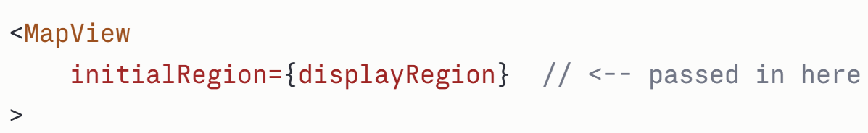
Core Concept: Region
A Region describes WHAT the map shows — center + zoom level.
const displayRegion: Region = {
latitude: 29.97936, // center lat (Great Pyramids)
longitude: 31.13482, // center lng
latitudeDelta: 0.0045, // zoom: smaller = more zoomed IN
longitudeDelta: 0.0065, // zoom: larger = more zoomed OUT
}
0.005 → ~Street level zoom
1.0 → ~City/region zoom
10.0 → ~Country zoom
Two ways to control the map view:
initialRegion — sets the starting view once, does NOT react to state changes
→ We use initialRegion + animateToRegion() for programmatic movement in this project.
Notes:
Region is the most important concept. Think of it like camera settings: latitude/longitude = where the camera points, deltas = how wide the lens is open. Small delta = zoomed in. We use initialRegion to set starting position, then useRef + animateToRegion to move programmatically.

Slide 13
Core Concept: Markers
What is a Marker?
A Marker is a pin that appears on the map at a specific location.
It needs two things:
WHERE to appear — the coordinate prop
WHAT it looks like — whatever you put inside it

Slide 14
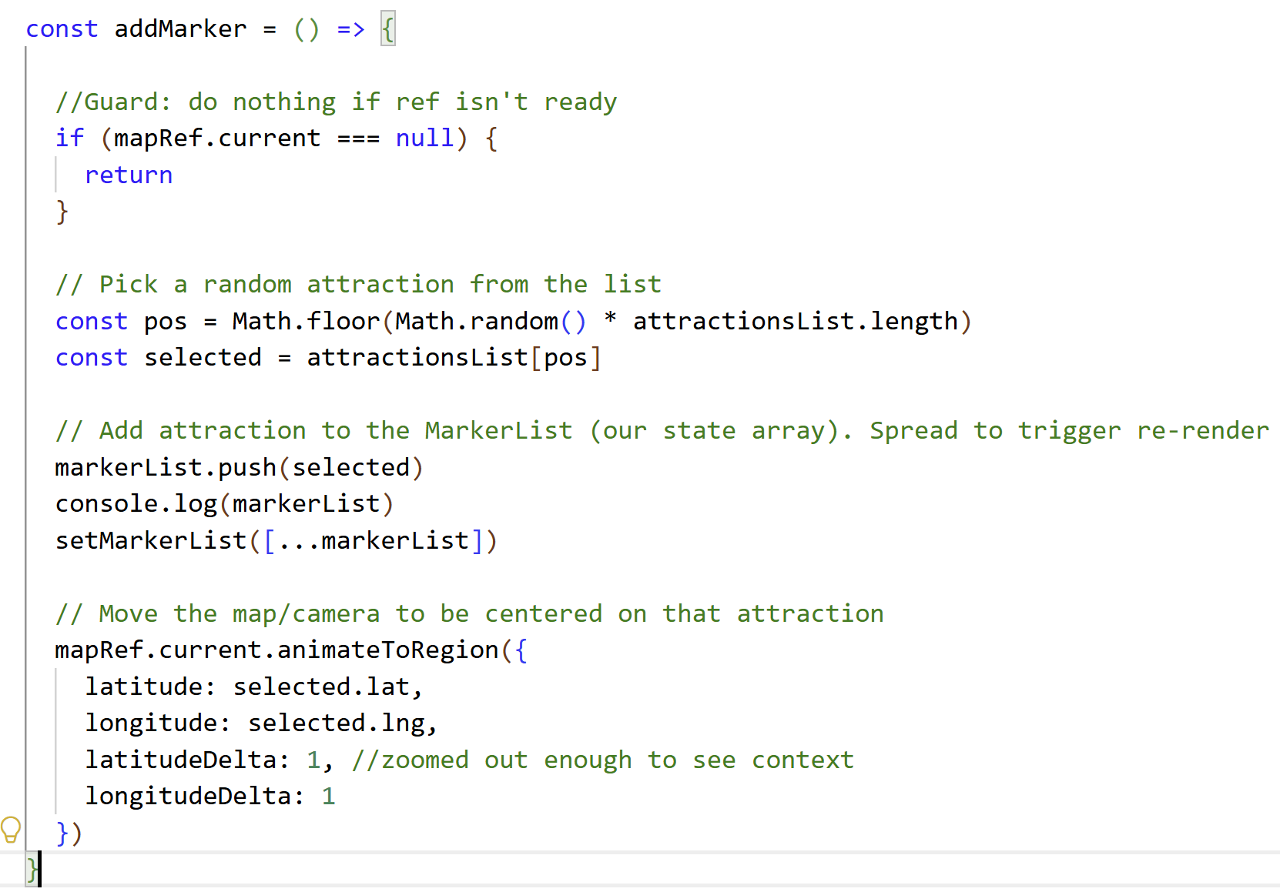
Step 5: Add Marker
1
Guard clause
Check mapRef.current === null first. Prevents errors before map mounts.
2
Random pick
Math.random() * array.length gives a random index. Math.floor drops the decimal.
3
Push + spread
push() mutates the array.
Spread [...markerList] creates a new reference so React detects the change.
Picks a random attraction from attractionsList, adds it to markerList state (which puts a pin on the map), then flies the camera to that location.
4
animateToRegion
Smoothly flies the camera.
latitudeDelta: 1 = country-level zoom so we can see where the attraction is.
Notes:
the push+spread pattern. If you just do setMarkerList(markerList) after push — won't re-render because the reference is the same. Need the spread [...markerList] to create a new array reference. Also animateToRegion — it takes a Region object, just like initialRegion.

Slide 15
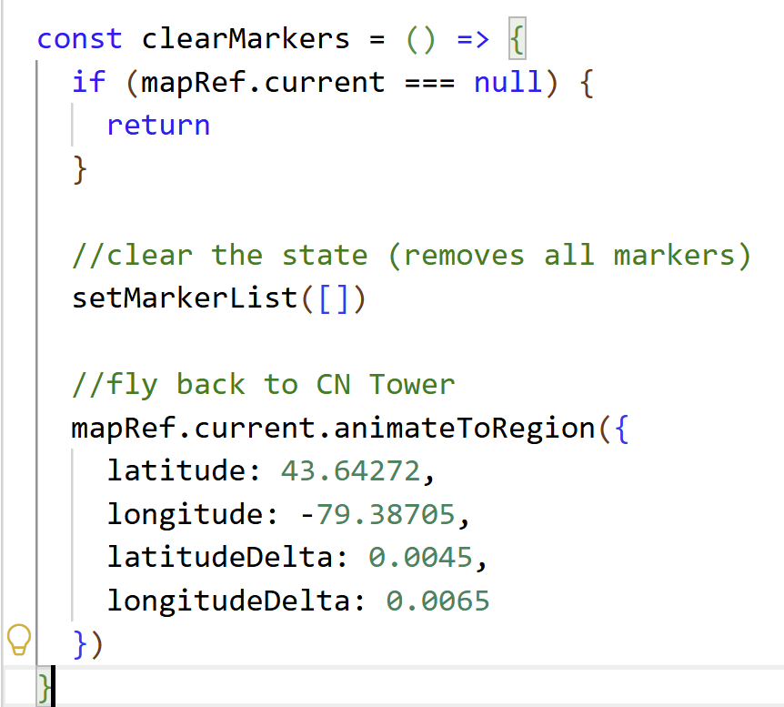
Step 6: Clear Marker
clearMarkers: setMarkerList([]) clears state — React re-renders, removing all Marker children from MapView.
Sets markerList back to an empty array — removes all pins — then flies the camera back to CN Tower in Toronto.

Slide 16
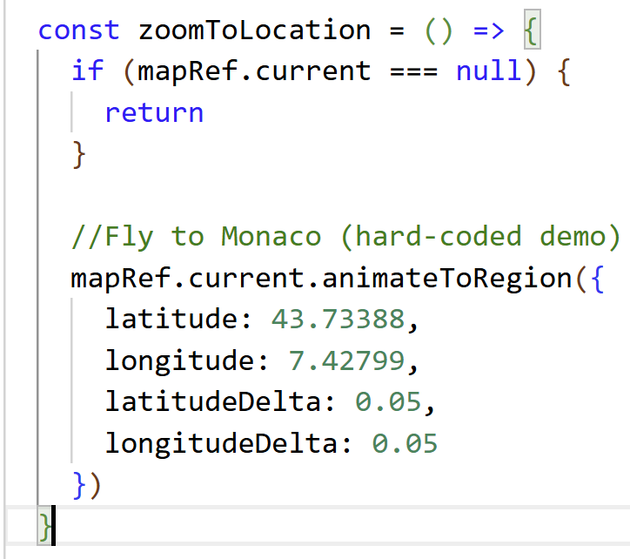
Step 7: Zoom To Location
zoomToLocation: Shows that animateToRegion works independently of markers — useful for 'go to my location' features.
Just moves the camera — no markers added or removed. It flies to Monaco. This demonstrates that animateToRegion works independently of markers.
Notes:
Both functions follow the same pattern: null check → do the thing. clearMarkers is simple: empty array in state = no markers. zoomToLocation shows that animateToRegion is independent — can navigate without adding markers. Good discussion: how would you zoom to the user's current GPS location? (expo-location)

Slide 17
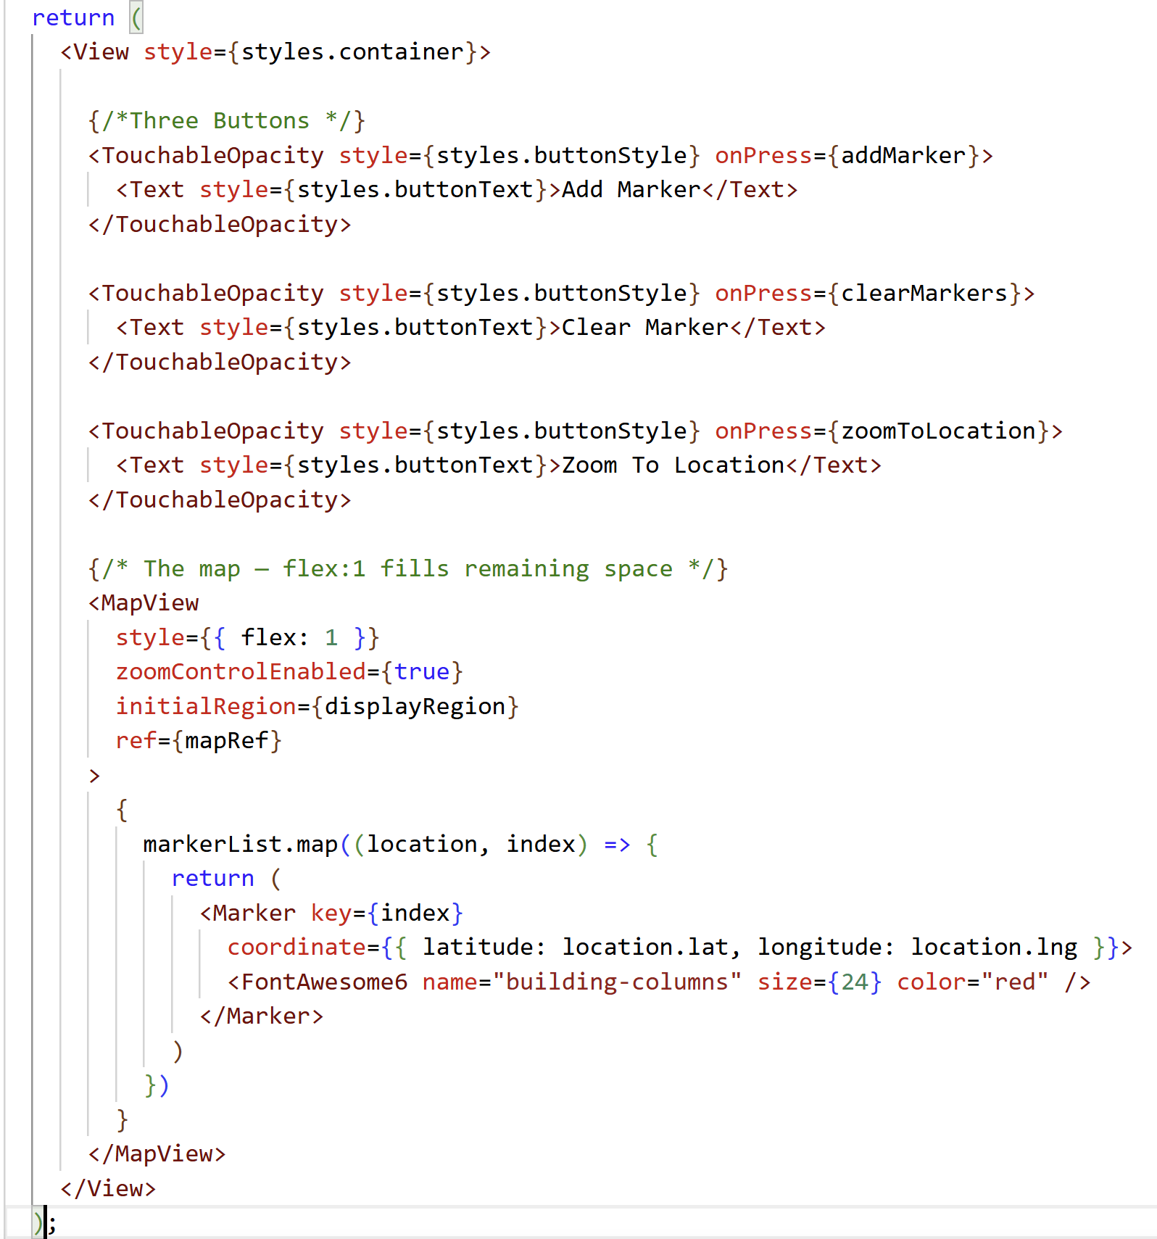
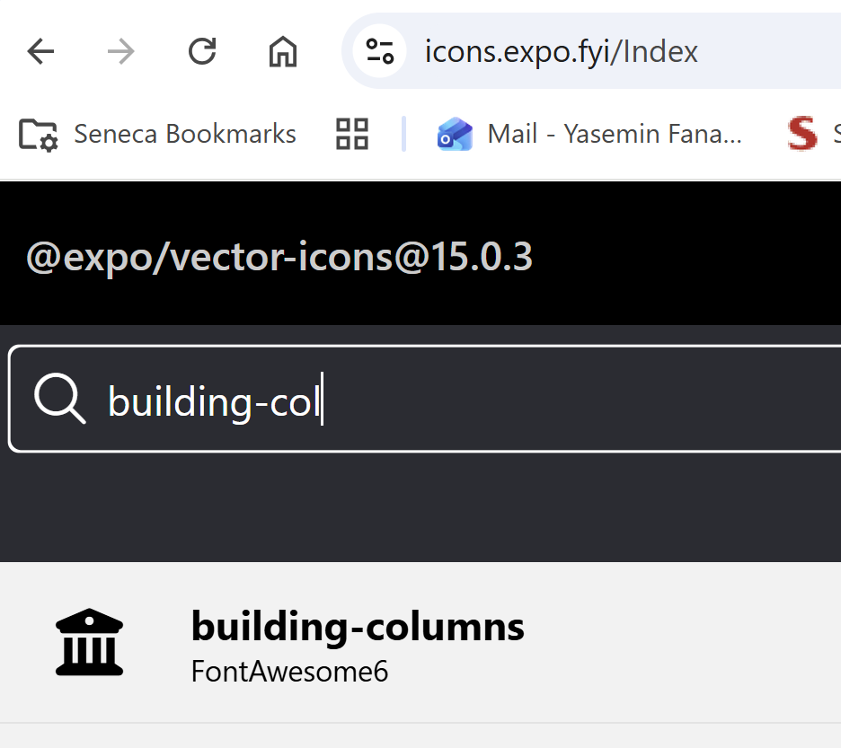
Step 8: Layout and MapView
Key points:
container View with flex:1 handles the full screen.
Buttons on top using TouchableOpacity.
MapView with flex:1 fills the rest.
Markers go INSIDE the MapView as children — that's how the library knows to place them on the map.
Note the rename: our data has .lat/.lng but coordinate expects .latitude/.longitude. Map it from our Attraction type.

Slide 18
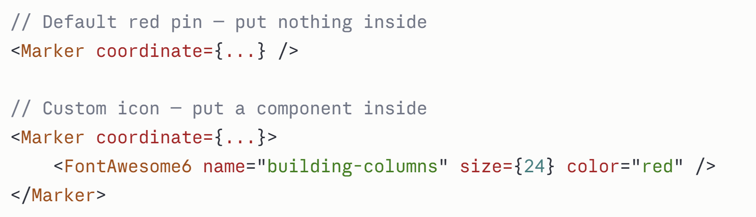


Core Concept: Markers (continued)
Markers are child components of MapView placed at a coordinate.
What is a Marker?
A Marker is a pin that appears on the map at a specific location.
It needs two things:
WHERE to appear — the coordinate prop:
WHAT it looks like — whatever you put inside it:
One rule — Markers must always go INSIDE <MapView> so the library knows to place them on the map.

Slide 19
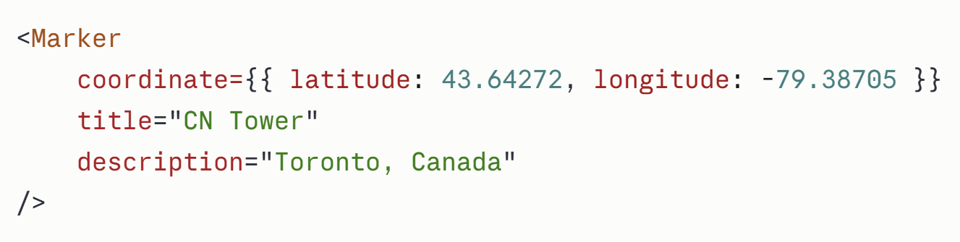
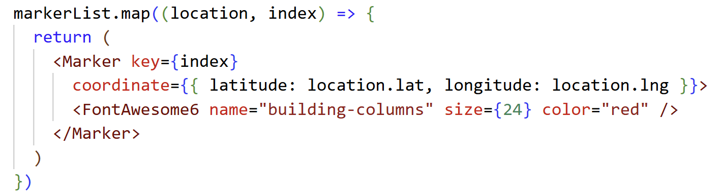
Core Concept: Markers (continued)
Basic Marker- This is the simplest way to use a marker — default red pin, with a title and description popup when tapped.
In our project — markers come from state. Every attraction in markerList gets its own pin.

Slide 20
Core Concept: Markers (continued)
markerList is our state array.
Every time you tap Add Marker, a new attraction gets added to it.
This .map() loops through that array and creates one <Marker> for each item.
location → represents one attraction from the list on each loop. It's a custom name we chose — we could have called it anything like item or attraction
index → the position number (0, 1, 2...) used for the key
location.lat → the lat field from our Attraction type
location.lng → the lng field from our Attraction type
But coordinate expects latitude and longitude — so we have to rename them here
This is why we write latitude: location.lat — we're taking our .lat value and passing it as latitude which is what Marker requires.

Slide 21
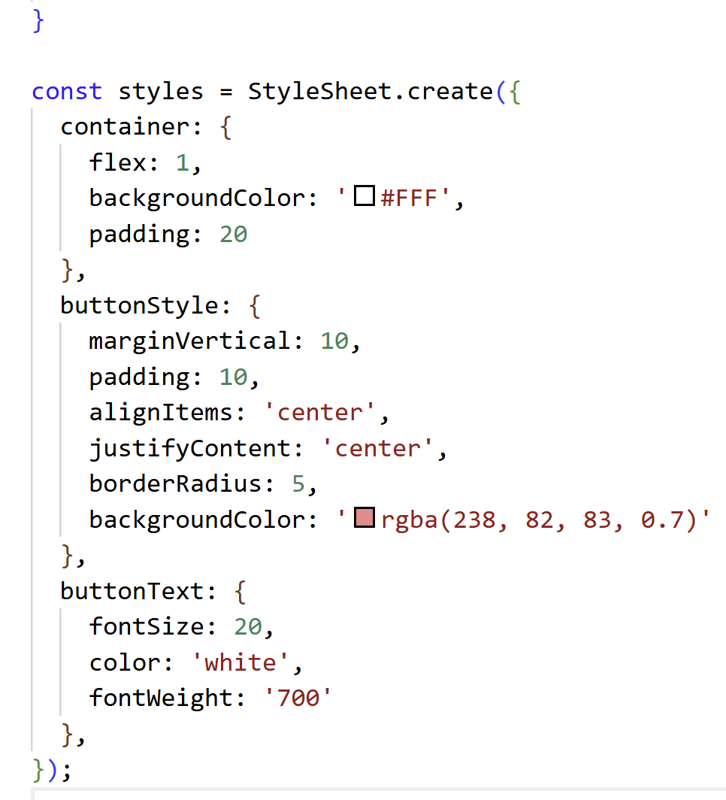
Step 9: StyleSheet
container: flex 1
Makes the screen fill the full height.
padding: 20 gives breathing room around buttons.
buttonStyle
marginVertical spaces buttons apart.
rgba() for a semi-transparent red background.
buttonText
fontWeight '700' = bold.
White text on red background for visibility.
Notes:
Styles are straightforward. Highlight rgba() for semi-transparent background — students should know this pattern. fontWeight must be a string in React Native: '700' not 700. Remind them the map uses inline style={{ flex: 1 }} directly, not StyleSheet.
npx expo start
npx expo start --clear
“r” command to reload application

Slide 22
Complete File Structure at a Glance
1
Imports
// 1. Imports
import MapView, { Marker, Region } ...
// 2-3. Type + Data (above component)
type Attraction = { name, lat, lng }
const attractionsList: Attraction[] = [...]
// 4. Inside component
const displayRegion: Region = {...}
const [markerList, setMarkerList] = useState<Attraction[]>([])
const mapRef = useRef<MapView>(null)
// 5. Handlers
const addMarker = () => { ... }
const clearMarkers = () => { ... }
const zoomToLocation = () => { ... }
// 6. JSX
return (
<View>
<TouchableOpacity onPress={addMarker}>...</TouchableOpacity>
<MapView ref={mapRef} initialRegion={displayRegion}>
{markerList.map(...)}
</MapView>
</View>
)
// 7. StyleSheet
react, react-native, react-native-maps, expo-icons
2
Type definition
type Attraction = { name, lat, lng }
3
Data array
const attractionsList: Attraction[] = [...]
4
Component: State & Ref
displayRegion, useState, useRef
5
Component: Event handlers
addMarker, clearMarkers, zoomToLocation
6
Component: JSX return
Buttons + MapView + Markers
7
StyleSheet
container, buttonStyle, buttonText
Notes:
Use this as a checkpoint before starting or after finishing to make sure students have all the pieces. The structure top-to-bottom: imports → types → data → component hook (state+ref) → handlers → JSX → styles. This pattern scales to any React Native screen.

Slide 23
Common Mistakes & Debug Tips
Map not visible
❌ <MapView />
✅ <MapView style={{ flex: 1 }} />
!
Ensure MapView has style={{ flex: 1 }} and parent View also has flex: 1
Markers don't appear after push()
❌ setMarkerList(markerList)
✅ setMarkerList([...markerList])
!
Use spread to create a new array reference: setMarkerList([...markerList])
animateToRegion crash / undefined
✅ if (mapRef.current === null) return
!
Always null-check mapRef.current before calling methods
latitude vs lat mismatch
coordinate={{ latitude: loc.lat, longitude: loc.lng }}
!
Marker coordinate prop uses 'latitude'/'longitude', our type uses 'lat'/'lng'
Notes:
These are the four most common issues. The push+spread one bites almost everyone the first time. The flex:1 issue is also very common — if the map appears to have zero height it's invisible. The latitude vs lat naming mismatch is a quick fix once you know.

Slide 24
Quick Reference — react-native-maps API
Component / Prop / Method | What it does | Example
<MapView> | The map container | <MapView style={{flex:1}} initialRegion={r} ref={mapRef}>
initialRegion | Starting camera view (one-time) | initialRegion={{ latitude, longitude, latitudeDelta, longitudeDelta }}
zoomControlEnabled | Show +/- buttons (Android) | zoomControlEnabled={true}
ref={mapRef} | Wire up the ref for method calls | const mapRef = useRef<MapView>(null)
<Marker> | A pin on the map | <Marker coordinate={{ latitude, longitude }}>
coordinate | Where to place the marker | coordinate={{ latitude: 43.6, longitude: -79.4 }}
animateToRegion() | Programmatically move the camera | mapRef.current.animateToRegion({ lat, lng, deltas })
📖 Full docs: https://github.com/react-native-maps/react-native-maps | https://docs.expo.dev/versions/latest/sdk/map-view/
Notes:
Keep this slide open during live coding as a quick reference. Students can screenshot it. The three columns — component/prop, what it does, example — are designed to be scannable.

Slide 25
What We Covered Today
✓ react-native-maps — installation & imports
✓ Region: latitude, longitude, latitudeDelta, longitudeDelta
✓ MapView — initialRegion, ref, zoomControlEnabled
✓ useRef<MapView> — calling animateToRegion()
✓ Marker — coordinate prop, custom icon children
✓ State management with arrays + spread pattern
✓ Three event handlers: addMarker, clearMarkers, zoomToLocation
BTP610 – Week 8 Complete

