Slide 1

BTP610 – Mobile Applications
Week 9
Expo Location
GPS coordinates, permissions, geocoding & reverse geocoding
with expo-location + react-native-maps
Library: expo-location | Also uses: react-native-maps | TypeScript + Expo Router
Notes:
Welcome to Week 9! Building on last week's maps knowledge. Today: expo-location for GPS + two geocoding features.

Slide 2
Today's Agenda
01
What is expo-location?
Library overview, installation, how it connects to Week 8
02
Core concepts
Permissions, async/await, getCurrentPosition, geocoding, reverse geocoding
03
Project walkthrough – Step by step
Live coding the Week 9 Location project
04
Key patterns
async functions, useState with Region | null, conditional rendering
05
Q & A / Wrap-up
Review, common mistakes, resources
Notes:
Walk through agenda. This session builds on Week 8 - MapView, markers, and animateToRegion. Today we add real device GPS and address lookup.

Slide 3


What is expo-location?
Expo SDK library
Installation
Official Expo library for accessing the device GPS. Included in Expo Go — no extra native config.
npx expo install expo-location
npx expo install react-native-maps
Works alongside react-native-maps
Import
expo-location gives you coordinates. react-native-maps displays them. They work together.
import * as Location from 'expo-location';
Requires permission
Why import * as Location?
The user MUST grant location permission before you can read GPS. We always ask first.
The library exports MANY functions (not just one default). Using * as Location puts them all under one name so you call Location.requestForegroundPermissionsAsync(), Location.getCurrentPositionAsync(), etc.
Notes:
expo-location is the official Expo library for GPS access. Use npx expo install (not npm install) so Expo picks the correct version. The * as Location import syntax gives access to ALL the functions under one namespace. last week we hardcoded coordinates — today we get them from the real device.

Slide 4
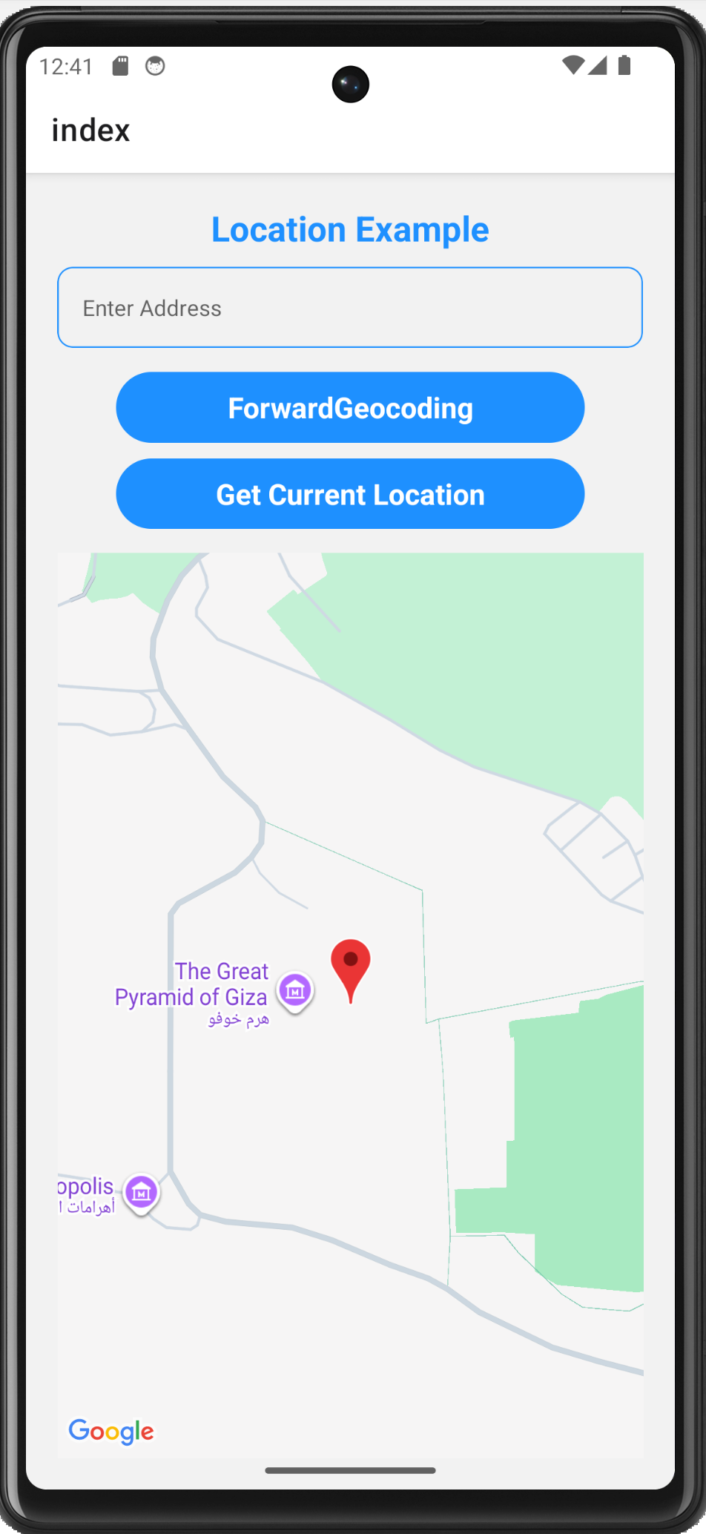
Today’s Project
This app does three things:
Gets your GPS location
Converts coordinates to an address
Converts an address to coordinates.
These are the three features we are going to build today.

Slide 5
Today’s Project
Opening screen
  When the app first opens you see a title, a text input, two buttons, and a map.
  The map is already showing - it's pointed at the Great Pyramids of Giza as a default starting position.

Slide 6
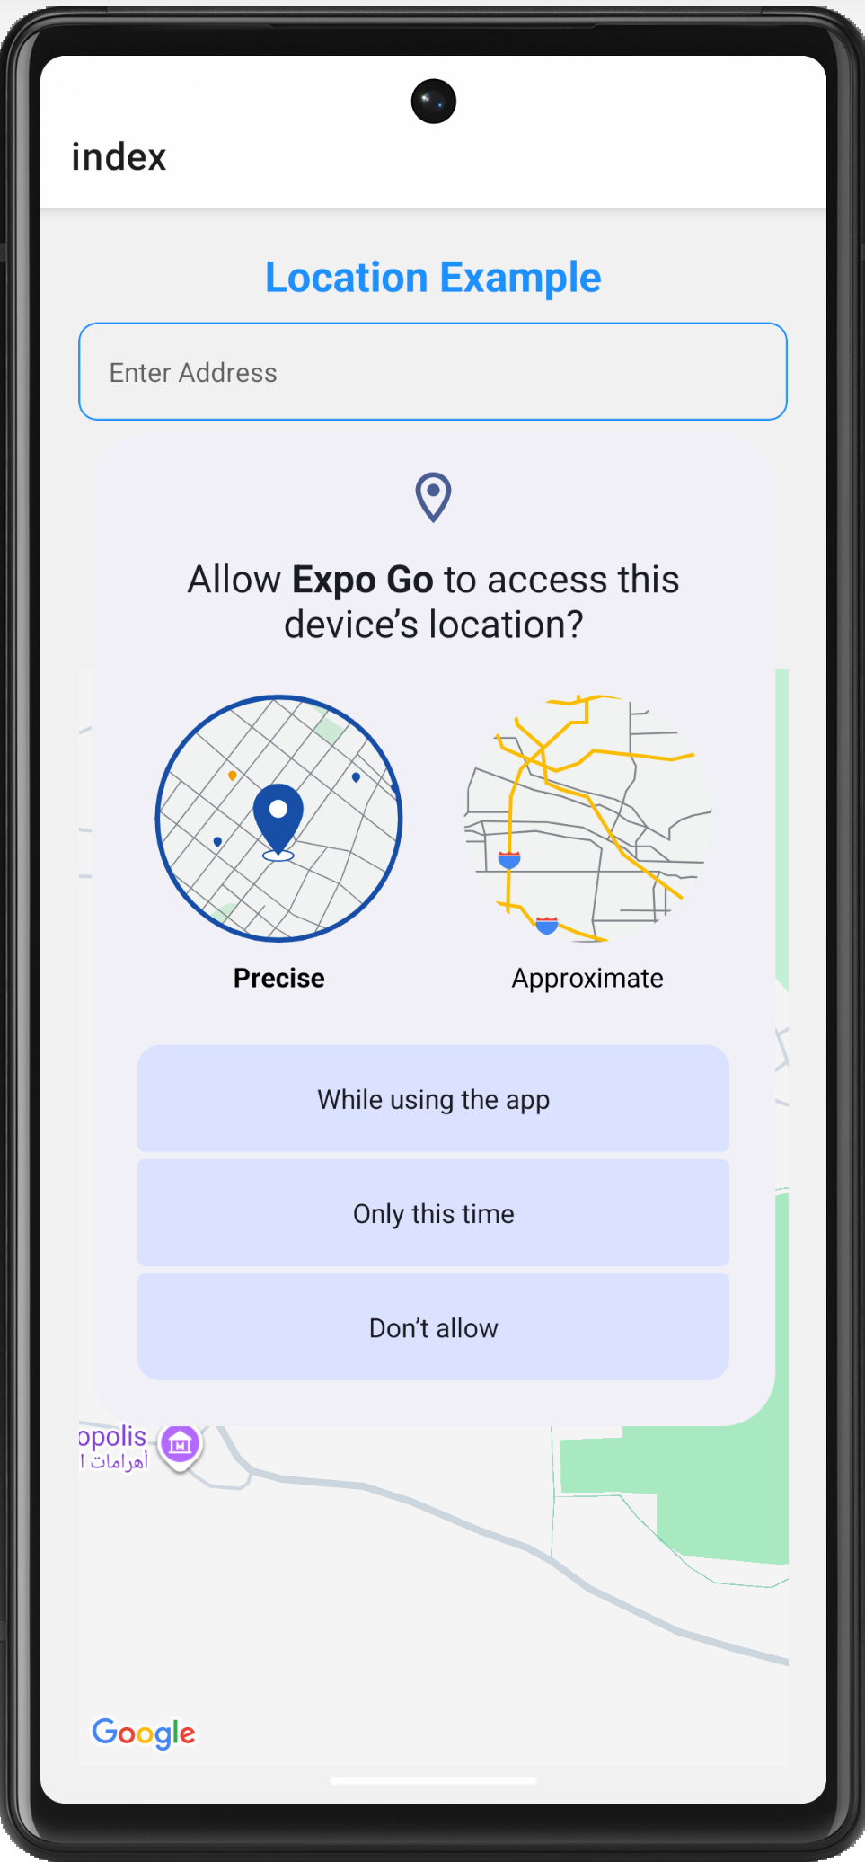
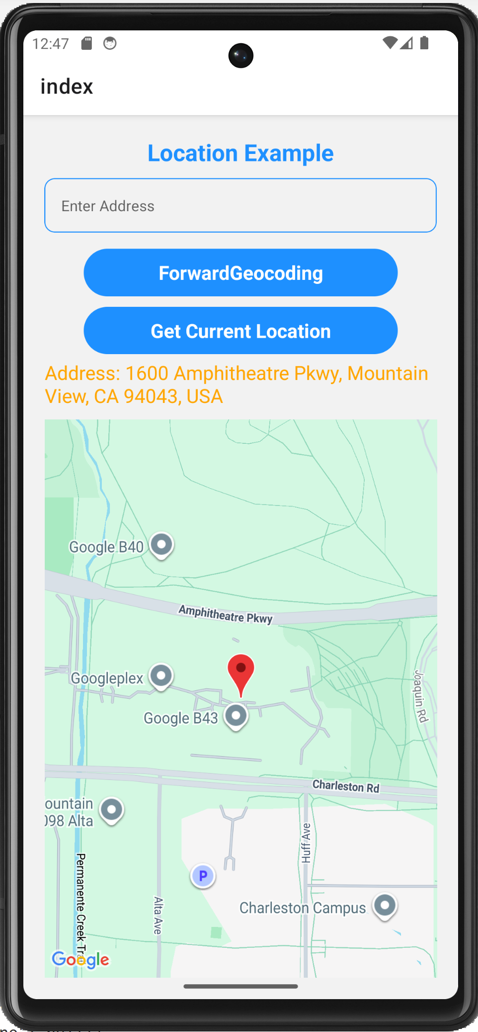
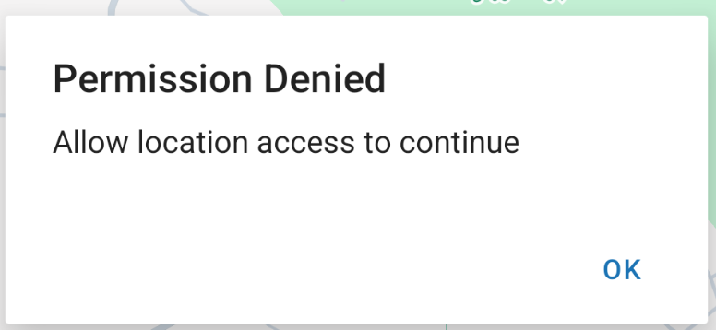
Today’s Project
“Get Current Location” button
  The app asks the device for permission to access GPS.
  If you click Don’t Allow, an alert will pop up.
  If you Allow:
    The map flies to your current location — whatever the emulator thinks your location is.
    Below the buttons you can see the actual street address printed in orange.
    That came from the GPS coordinates being converted to a readable address automatically.
Coordinates → Address (reverse Geocoding)
The emulator has a default hardcoded location built in. For most Android emulators it defaults to: Mountain View, California (Google's headquarters)
Notes:
On an emulator the GPS is simulated — it doesn't know your real location. The emulator has a default fake location set.
To set a custom location on the Android emulator:
Step 1 — Open the emulator settings
Click the three dots ... on the emulator sidebar (Extended Controls)
Step 2 — Go to Location
Click Location in the left menu
Step 3 — Set your location
Type your latitude and longitude manually, OR
Search for an address in the search box
Click Set Location
Step 4 — Tap Get Current Location again
The app will now return the coordinates you just set.

Slide 7
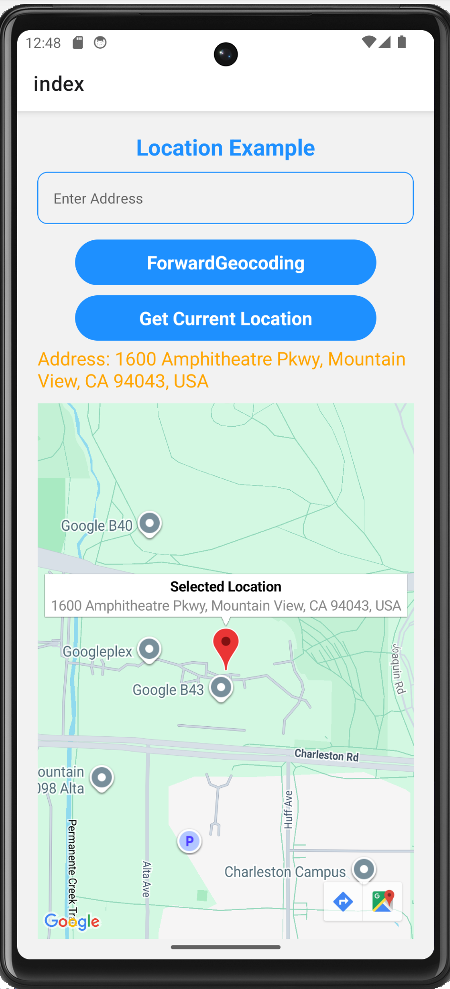
Today’s Project
Tap the pin
  If you tap the pin on the map, it shows a popup with the address as the description. That's connected to the same data.

Slide 8
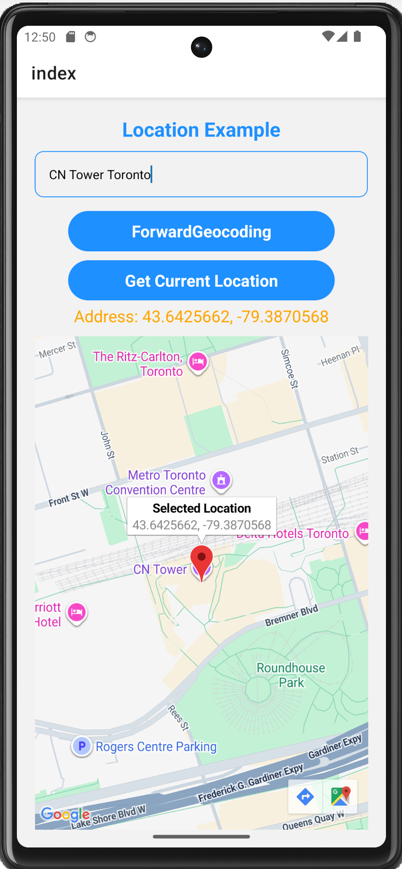
Today’s Project
“Forward Geocoding” button
  Type CN Tower Toronto in the text box, tap Forward Geocoding
  The map flew to CN Tower in Toronto and the coordinates are shown in orange - that's the latitude and longitude of CN Tower.
  Address → Coordinates (Forward Geocoding)

Slide 9
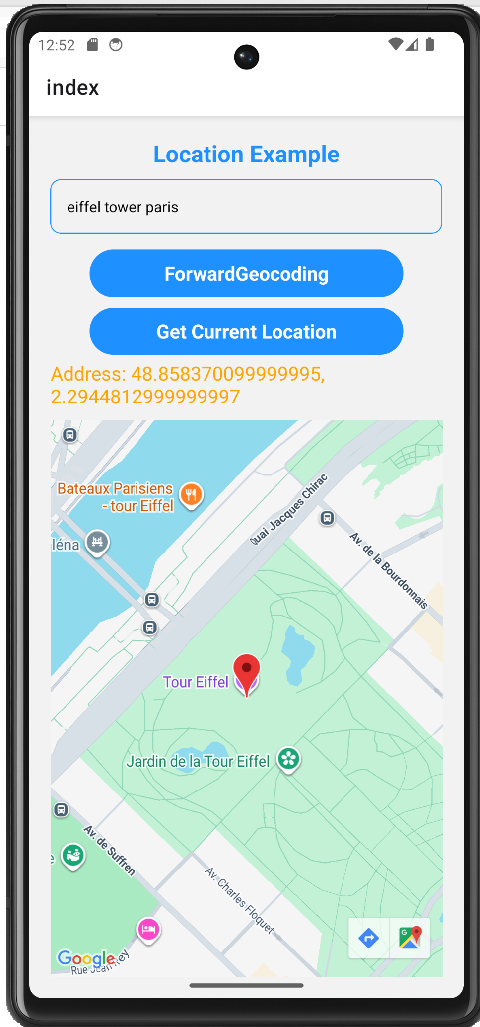
Today’s Project
Try another address
  Eiffel Tower Paris, tap Forward Geocoding
  The map moves to wherever you type and coordinates are shown

Slide 10
Today’s Project
Title — "Location Example"
Text input box — "Enter Address"
Forward Geocoding button
  Calls the forwardGeocoding() function.
Get Current Location button
Calls the getCurrentLocation() function. In the function it:
  Gets your GPS location
  Calls the reverseGeocode() function
    The reverseGeocode() function takes the coordinates and returns the address (shown in orange and on the pin description)
Orange address text
  Only appears when currentAddress state is not empty.
The map
  Controlled by the region state variable. Moves automatically whenever setRegion() is called.
The pin on the map
  Always placed at the center of the current region.
  The popup text comes from currentAddress.

Slide 11


Core Concept: Permissions
Apps must ASK the user for permission before accessing GPS. This is required by both Android and iOS.
const getCurrentLocation = async () => {
// 1. Ask the user for permission
const { status } = await Location.requestForegroundPermissionsAsync();
// 2. If they said no — show an alert and stop
if (status !== "granted") {
Alert.alert("Permission Denied", "Allow location access to continue");
return;
}
// 3. Permission granted — safe to get GPS now
const location = await Location.getCurrentPositionAsync({
accuracy: Location.Accuracy.Highest
});
}
Foreground permission
Allows location access while the app is open. This is what most apps need. We use requestForegroundPermissionsAsync().
Always check status first
status will be "granted" or "denied". Never skip this check — if you try to get GPS without permission the app will crash.
async / await
Both calls return Promises. We use async on the function and await to wait for each result before moving on.
Notes:
Permissions are the most important new concept. Without asking first = crash. requestForegroundPermissionsAsync() shows the system dialog. We destructure { status } from the result. If status !== 'granted' we show an Alert and return early. Only AFTER the check do we call getCurrentPositionAsync. async/await is also new concept.
We wait for permission and wait for GPS location. Both take time — that's why both need await. The code stops and waits at each one before moving to the next line.

Slide 12
Core Concept: async / await
GPS and geocoding take time to complete. async/await lets us WAIT for the result before continuing.
❌ Without async/await (broken)
✅ With async/await (correct)
const getLocation = () => {
// This returns a Promise, not the result!
const location = Location.getCurrentPositionAsync({})
console.log(location) // [object Promise]
}
const getLocation = async () => {
// await WAITS for the GPS result
const location = await Location.getCurrentPositionAsync({})
console.log(location.coords.latitude) // real number!
}
What getCurrentPositionAsync() returns:
location.coords.latitude // e.g. 43.64272
location.coords.longitude // e.g. -79.38705
location.coords.accuracy // accuracy in metres
location.timestamp // when it was read
Accuracy levels
Lowest → ~3 km
Low → ~1 km
Balanced → ~100m
High → ~10m
Highest → best possible
Notes:
async/await is essential for this project — every Location call is async. Simple analogy: ordering food. You don't get the burger instantly — you WAIT (await) for it. async on the function means 'this function contains waiting'. await on the call means 'wait here until done'. The project uses Accuracy.Highest for best precision.

Slide 13
Core Concept: Accuracy Levels
Accuracy levels tell the device how hard to try to get a precise location. Higher accuracy = more battery used.
Lowest
~3 km off
→
good enough to know what city you're in
Low
~1 km off
→
good enough to know what neighbourhood you're in
Balanced
~100m off
→
good enough for most apps
High
~10m off
→
good for navigation
Highest
Best possible
→
what we use in this project ✓
In this project we use Location.Accuracy.Highest — we want the most precise coordinates for geocoding.

Slide 14
Core Concept: Geocoding & Reverse Geocoding
Forward Geocoding
Reverse Geocoding
Address → Latitude & Longitude
Latitude & Longitude → Address
// User types: "CN Tower Toronto"
const result = await Location.geocodeAsync(address);
const lat = result[0].latitude; // 43.64272
const lng = result[0].longitude; // -79.38705
// We have: lat = 43.64272, lng = -79.38705
const result = await Location.reverseGeocodeAsync({
latitude: lat,
longitude: lng
});
// result[0].formattedAddress
// "290 Bremner Blvd, Toronto, ON M5V 3L9"
reverseGeocodeAsync returns an array of address objects. We use result[0]:
result[0].formattedAddress // "290 Bremner Blvd, Toronto, ON M5V 3L9, Canada"
result[0].city // "Toronto"
result[0].region // "Ontario"
result[0].country // "Canada"
result[0].street // "Bremner Boulevard"
result[0].postalCode // "M5V 3L9"
Notes:
Two geocoding directions. Forward = text to coordinates (user types address → we find lat/lng → move map). Reverse = coordinates to text (we have GPS lat/lng → convert to readable address). Both return arrays — always use [0]. Note: result can be empty if address not found — always check result.length > 0 or result.length === 0.
geocodeAsync is a built-in function that comes with the expo-location library. You don't write it yourself, you just call it:
(import * as Location from 'expo-location’;)
(const result = await Location.geocodeAsync(address);)
Same for reverseGeocodeAsync — both are built into expo-location. Expo handles all the complex work of talking to the mapping service behind the scenes. You just pass in the address or coordinates and it returns the result.

Slide 15

Project: Week 9 Location Example
Find your location, look up any address, and display everything on a live map with a pin
TextInput
Forward Geocoding
User types any address into a text field
Converts typed address to lat/lng → moves map to that location
Get Current Location
Reverse Geocoding
Gets real GPS coordinates → moves map → reverse geocodes to address
Converts GPS coordinates to a readable street address
MapView + Marker
Conditional rendering
Map always shows a pin at the current region — updates automatically
Address text and map only show when there is data to display
Notes:
Project overview. Key difference from Week 8: the map uses region (controlled) instead of initialRegion because it needs to update every time. Also new: TextInput, async functions, conditional rendering.

Slide 16

Step 0: Setting Up a New Project
1. Create a new project
2. Select SDK Version
3. Change directory to the project
4. Delete the demo code Expo gives you so you can start from a clean blank screen
5. Open the project folder in Visual Studio Code

Slide 17
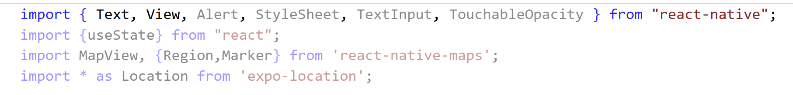
Step 1 — Project Setup & Imports
A Install both libraries
npx expo install expo-location
npx expo install react-native-maps
B Imports at the top of index.tsx
C New imports vs Week 8
NEW
Alert → Shows a popup when permission is denied
NEW
TextInput → The address input field
NEW
* as Location → All expo-location functions under one name
SAME
Region (from maps) → TypeScript type — same as Week 8
SAME
Marker → Pin on the map — same as Week 8
Notes:
Use npx expo install not npm install for both libraries. Highlight what's new vs Week 8. Alert is from React Native — shows a native dialog box. TextInput is the text field. Location import uses * as to get all functions.

Slide 18
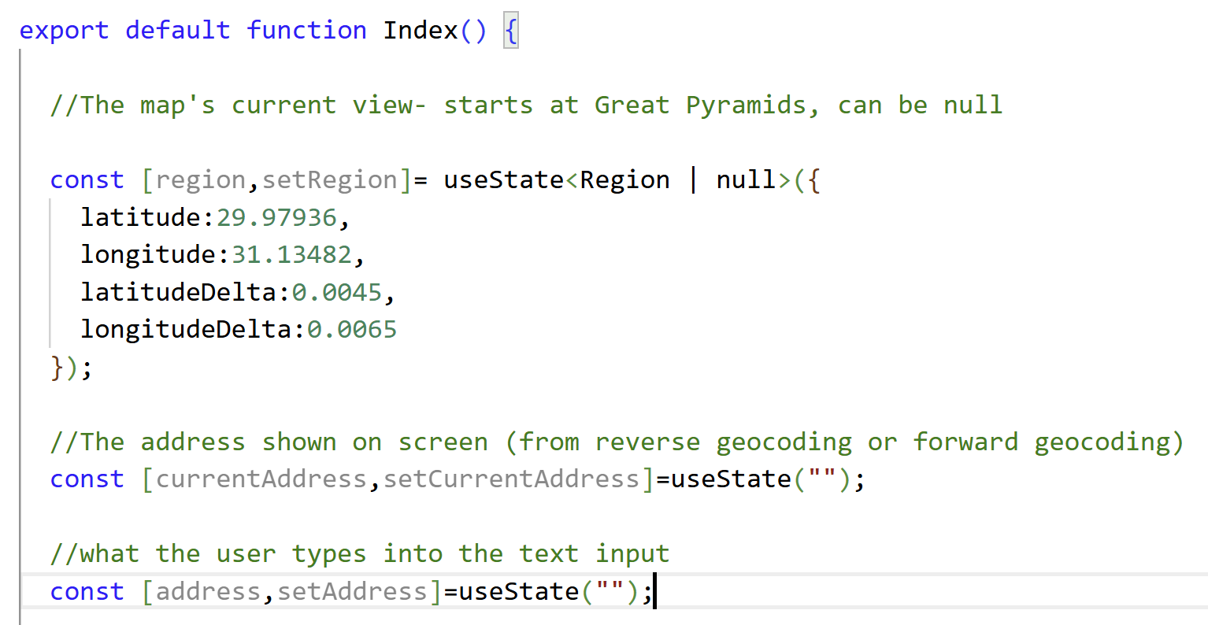
Step 2 — State Variables
Region | null
The map region can be null — meaning 'no location yet'. We use | null so TypeScript allows it to be either a Region or nothing.
currentAddress
Stores the address to display on screen. Starts empty. Updated by both geocoding functions.
address
Tracks what the user is typing in the TextInput. Updated live via onChangeText.
Key difference from Week 8:
Week 8 used a const displayRegion (never changes). This week region is STATE — it changes every time the user looks up a location. That's why the map uses region={region} instead of initialRegion.
Notes:
When Forward Geocoding is tapped:
address = text the user typed → "CN Tower Toronto"
currentAddress = coordinates that came back → "43.64272 , -79.38705"
When Get Current Location is tapped:
address = whatever is in the text box (doesn't matter, not used)
currentAddress = street address that came back → "290 Bremner Blvd, Toronto, ON“
region && means — only render the MapView if region is not null. So if region is null, the map is completely hidden until the user taps one of the buttons. In our project, we start with the Pyramids so the map is shown immediately.

Slide 19
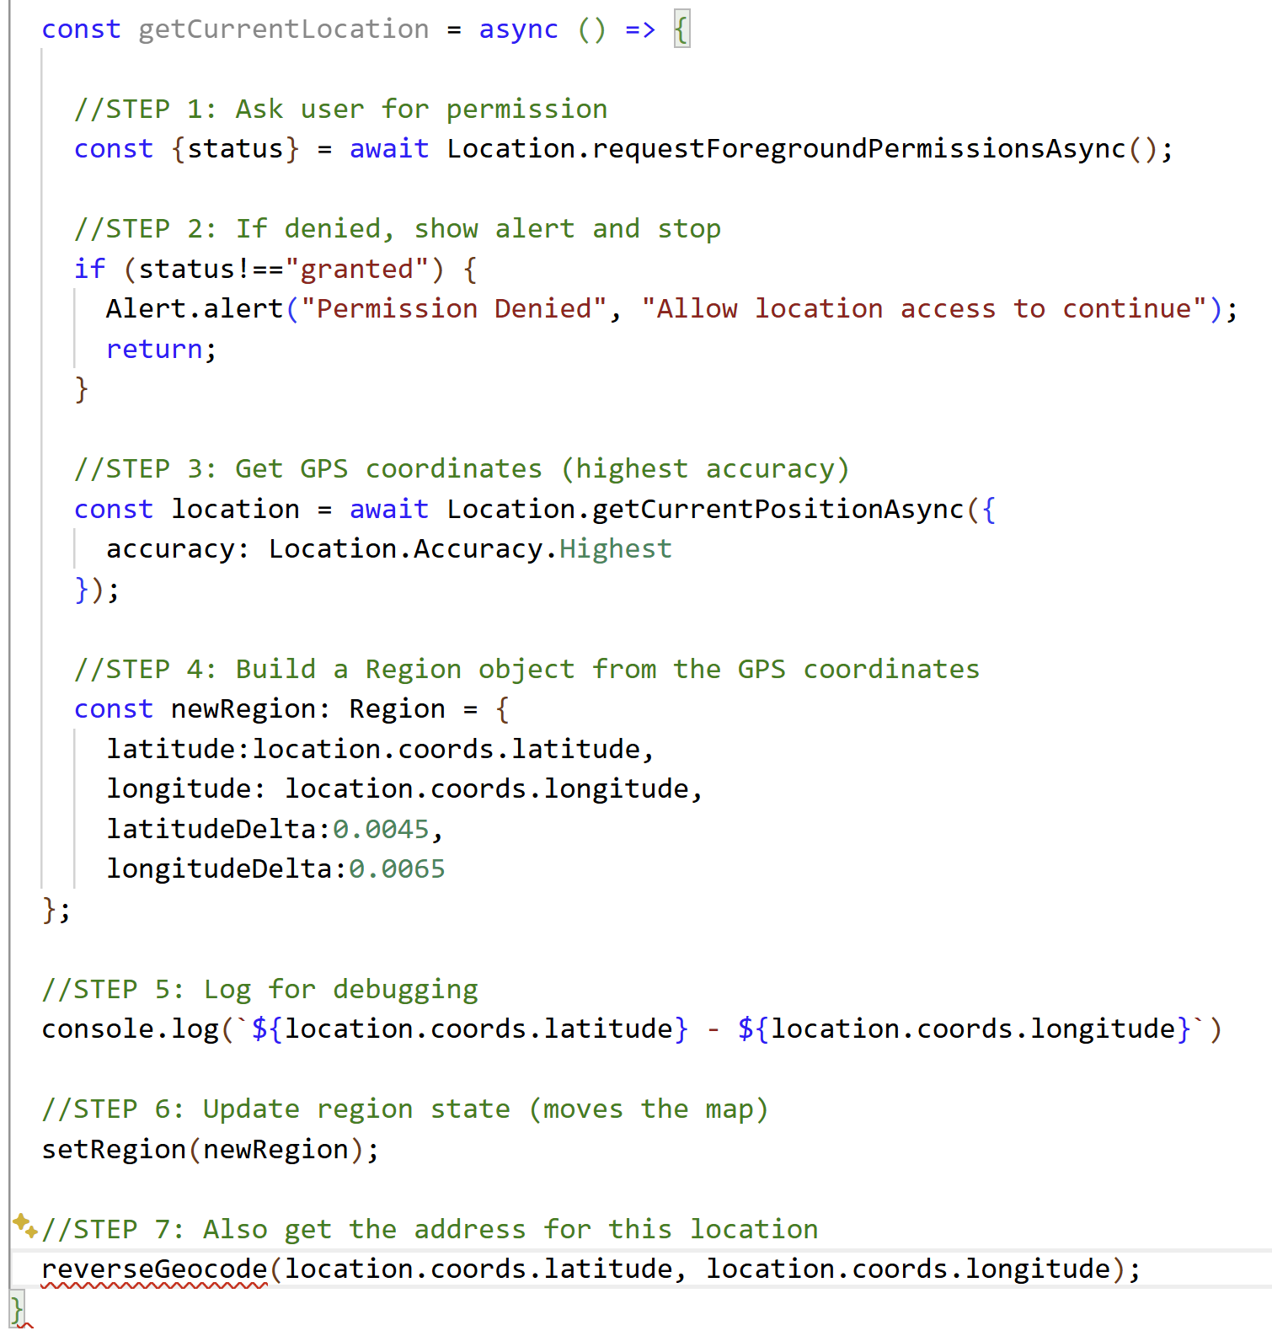
Step 3 — getCurrentLocation() Function
Permission first
1-2
Always ask before using GPS. Denied = show Alert and return early.
Get coordinates
3
getCurrentPositionAsync with Accuracy.Highest. Takes a moment — that's why we await.
Build Region
4
Wrap the GPS coords in a Region object (same format as Week 8).
Update state & address
6-7
setRegion moves the map. Then call reverseGeocode to get the street address.
Notes:
Walk through every step carefully. The async keyword on the function is required because we use await inside. Destructuring { status } from the permission result. Location.Accuracy.Highest is an enum value from expo-location. The reverseGeocode call at the end is a separate function we'll write next.

Slide 20
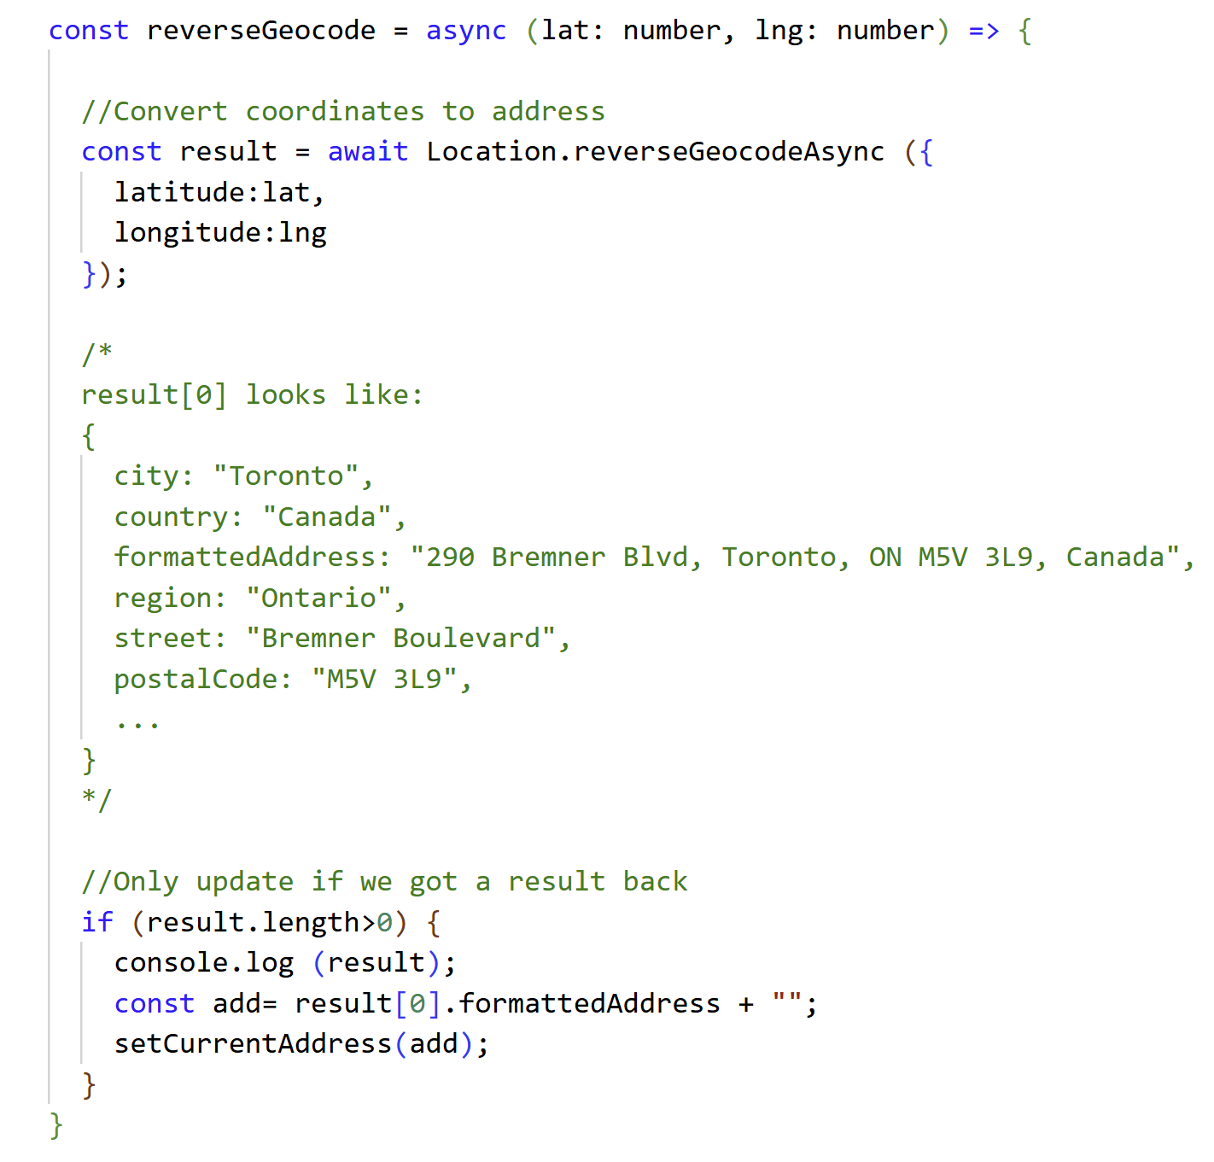



Step 4 — reverseGeocode() Function
Takes lat & lng as parameters
Called from getCurrentLocation. We pass the coordinates we just got from GPS.
Returns an array
reverseGeocodeAsync always returns an array. We use result[0] for the first (and usually only) result.
result.length > 0 check
If the coordinates can't be resolved to an address, the array comes back empty. Always check before using result[0].
formattedAddress + ""
The + "" converts the value to a string safely — formattedAddress can sometimes be null on iOS.
Notes:
reverseGeocode is a separate function because we call it from two places — getCurrentLocation and potentially elsewhere. It takes lat and lng as typed parameters (: number). The result array can have multiple matches — we always take [0].

Slide 21
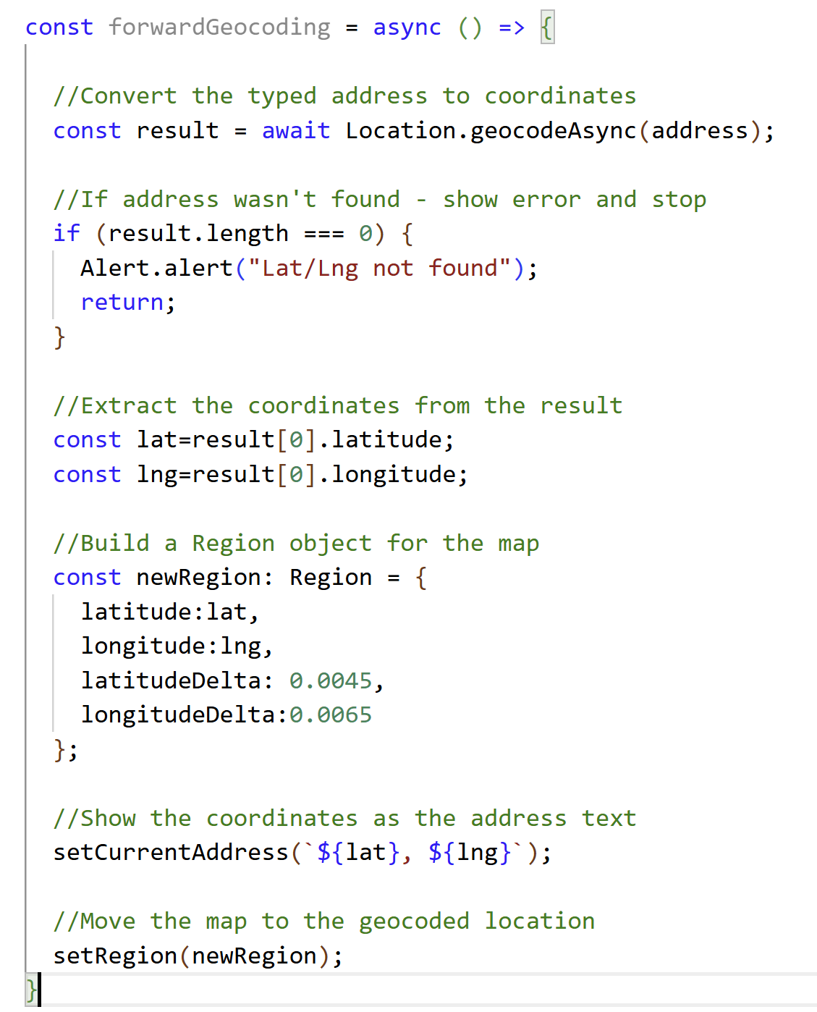

Step 5 — forwardGeocoding() Function
Uses address state
address is what the user typed in the TextInput. It's passed directly to geocodeAsync().
Check for empty result
If the address isn't recognized, result is an empty array. result.length === 0 catches this — show Alert and return.
Shows coords as address
Unlike reverseGeocode, this sets currentAddress to the lat/lng numbers, not a street address.
Template literal string
`${lat} , ${lng}` — backtick string with variables embedded using ${}. Shows something like "43.64272 , -79.38705".
Notes:
Forward geocoding is the opposite direction to reverse. User types 'Eiffel Tower Paris' → we get lat/lng → move the map. Note we display the raw coordinates as the address text. Template literal `${lat} , ${lng}`

Slide 22
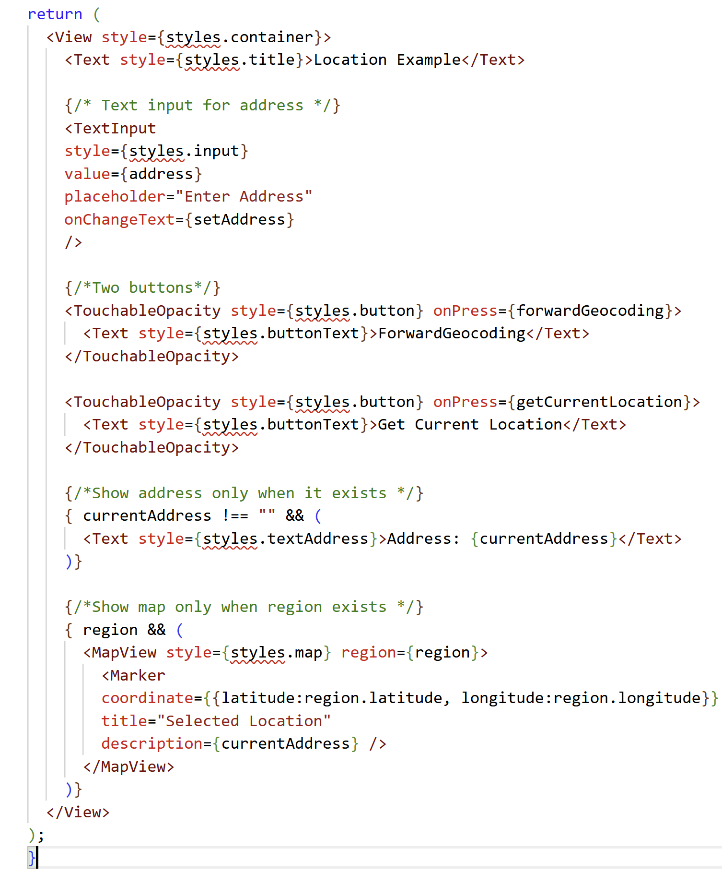
Step 6 — The JSX Return
TextInput
value={address} shows the current value. onChangeText={setAddress} updates state on every keystroke.
Conditional rendering
currentAddress !== '' && (...) — only renders the Text if there is an address. region && (...) — only renders the map if region is not null.
region={region} not initialRegion
The map is controlled by state. Every time setRegion is called the map moves to the new location automatically.
Marker description
description={currentAddress} shows the address as a popup when the pin is tapped.
Notes:
JSX key points: (1) TextInput — value and onChangeText work together, two-way binding.
Every keystroke updates the address state variable.
(2) Conditional rendering with && — very common React pattern
(3) region={region} is controlled mode — map updates whenever state changes.
(4) Marker has description prop that shows on tap
region && means — only render the MapView if region is not null. So if region is null, the map is completely hidden until the user taps one of the buttons.
Read it as: currentAddress !== "" && ( "IF currentAddress is not empty, THEN show the Text"

Slide 23
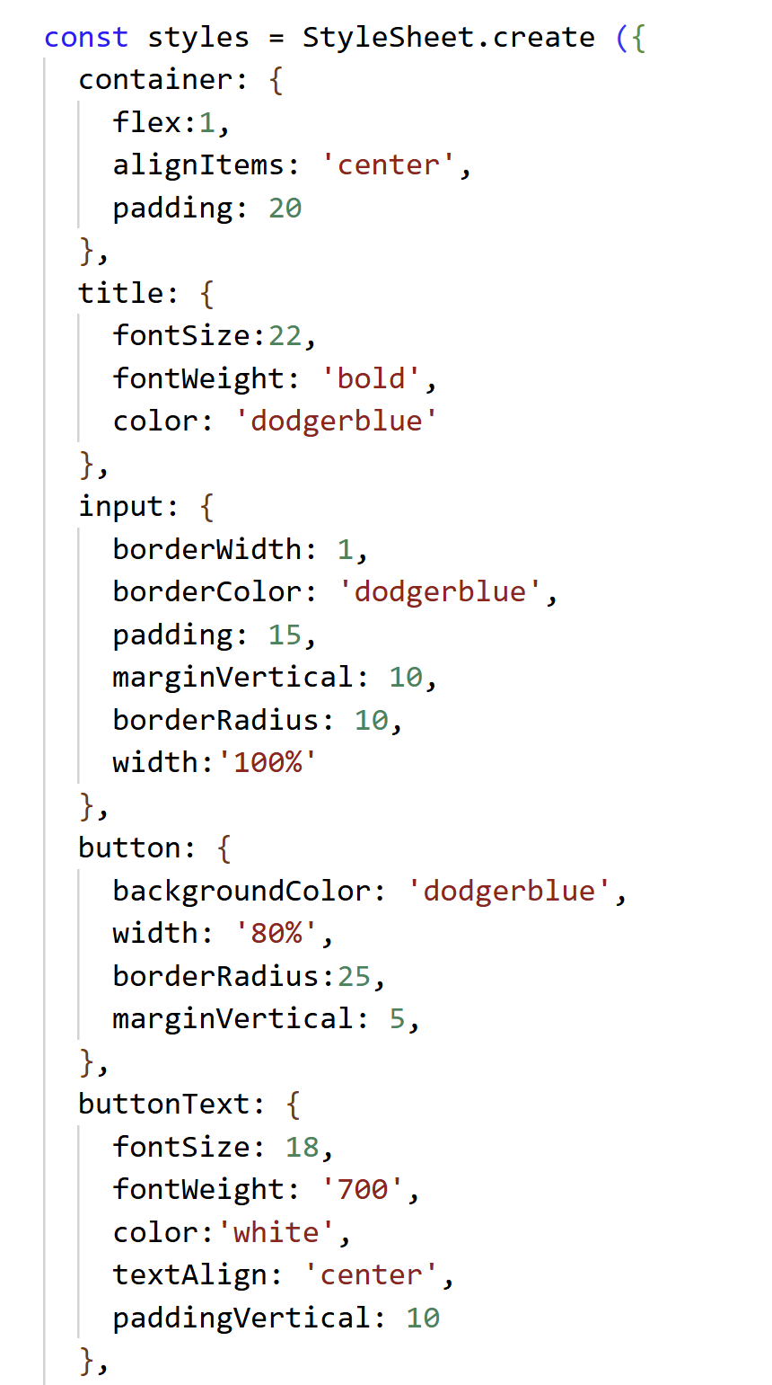
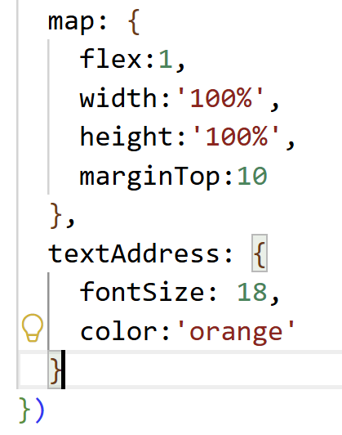
Step 7 — StyleSheet
container
alignItems: 'center' centres everything horizontally. No justifyContent so content stacks from top.
input
borderWidth + borderColor gives the outlined look. width: '100%' stretches to full container width.
button
borderRadius: 25 makes the pill shape. width: '80%' so it doesn't reach the edges.
map
flex: 1 + width/height 100% fills all remaining space below the buttons. Same idea as Week 8.
textAddress
Orange colour to make the address stand out. Shown conditionally — only appears when there is an address.
Notes:
Styles are cleaner and more polished than Week 8. dodgerblue theme throughout. Key new styles: input with border, pill-shaped buttons (borderRadius 25), map with flex + percentage sizes. textAddress only visible when conditional rendering shows it.
npx expo start --clear

Slide 24
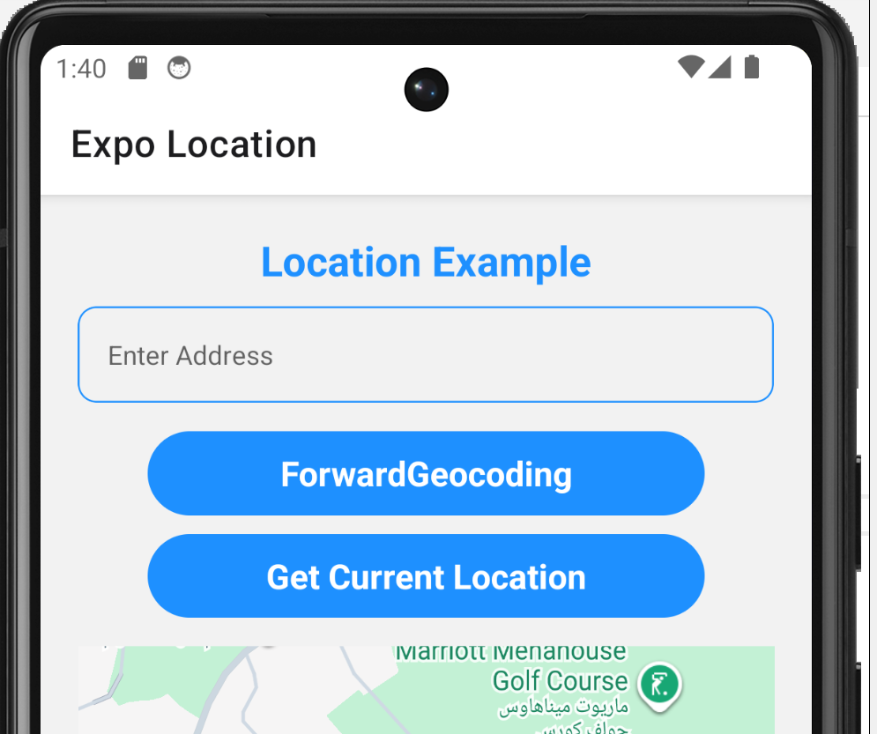
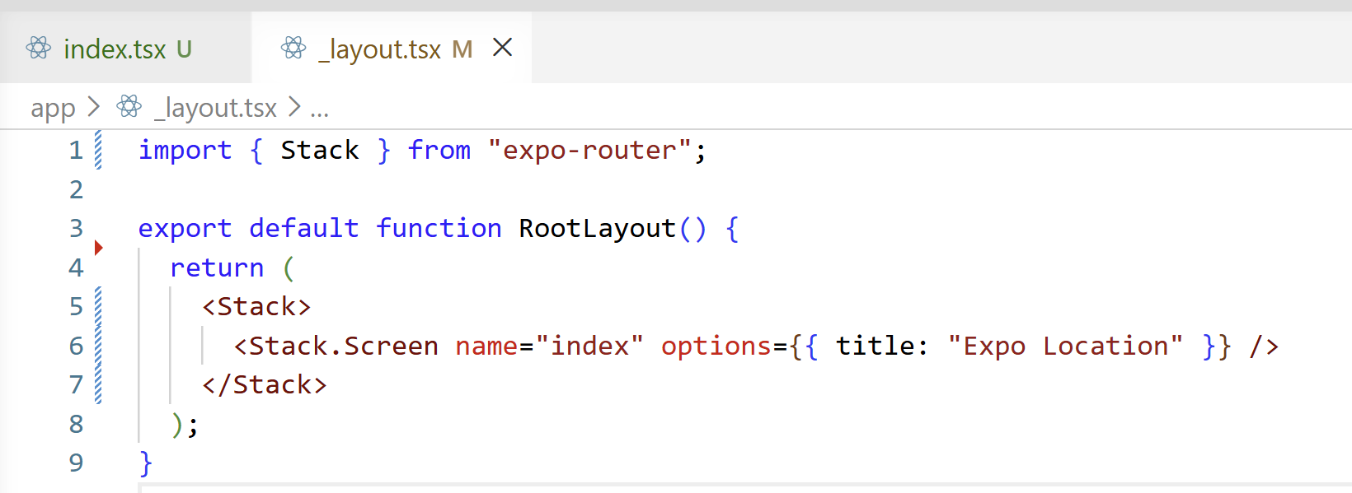

Slide 25
Complete File Structure at a Glance
1
Imports
// 1. Imports
import * as Location from 'expo-location';
import MapView, { Region, Marker } from 'react-native-maps';
// 2. State
const [region, setRegion] = useState<Region | null>({...})
const [currentAddress, setCurrentAddress] = useState("")
const [address, setAddress] = useState("")
// 3. getCurrentLocation — async
const getCurrentLocation = async () => {
const { status } = await Location.requestForegroundPermissionsAsync()
if (status !== "granted") { Alert.alert(...); return }
const location = await Location.getCurrentPositionAsync({...})
setRegion({ latitude: ..., longitude: ... })
reverseGeocode(lat, lng)
}
// 4. reverseGeocode — async
const reverseGeocode = async (lat, lng) => {
const result = await Location.reverseGeocodeAsync({latitude, longitude})
if (result.length > 0) setCurrentAddress(result[0].formattedAddress)
}
// 5. forwardGeocoding — async
const forwardGeocoding = async () => {
const result = await Location.geocodeAsync(address)
if (result.length === 0) { Alert.alert(...); return }
setRegion({ latitude: result[0].latitude, ... })
}
// 6. JSX + // 7. StyleSheet
useState, Alert, TextInput, MapView, Region, Marker, * as Location
2
State variables (inside component)
region (Region | null), currentAddress, address
3
getCurrentLocation()
async — permission → GPS → Region → setRegion → reverseGeocode
4
reverseGeocode(lat, lng)
async — coordinates → address string → setCurrentAddress
5
forwardGeocoding()
async — address string → coordinates → Region → setRegion
6
JSX return
Title, TextInput, 2 buttons, conditional address text, conditional MapView+Marker
7
StyleSheet
container, title, input, button, buttonText, map, textAddress
Notes:
All three functions are async. The data flows: user action → async function → update state → UI re-renders. This is the core React pattern.

Slide 26
Common Mistakes & Debug Tips
Error: location permission not granted
!
Always await the permission call first
requestForegroundPermissionsAsync() was skipped or not awaited
result is undefined / crash on result[0]
!
if (result.length > 0) { ... }
Didn't check result.length before accessing [0]
Function never finishes / undefined returned
!
const fn = async () => { await Location.xyz() }
Missing async or await on the function
Map doesn't move after setRegion
!
<MapView region={region}> not initialRegion
Using initialRegion instead of region prop

Slide 27
Quick Reference — expo-location API
Method | What it does | Returns
requestForegroundPermissionsAsync() | Asks user for location permission | { status: "granted" | "denied" }
getCurrentPositionAsync({ accuracy }) | Gets current GPS location once | location.coords.latitude / .longitude
reverseGeocodeAsync({ latitude, longitude }) | Converts coords → address | Array of address objects → use [0].formattedAddress
geocodeAsync(addressString) | Converts address text → coords | Array of locations → use [0].latitude / .longitude
Location.Accuracy.Highest | Enum for best GPS accuracy | Pass as accuracy option to getCurrentPositionAsync
📖 Docs: https://docs.expo.dev/versions/latest/sdk/location/
Conditional Rendering Patterns Used in This Project:
{ currentAddress !== "" && <Text>{currentAddress}</Text> } // show only if not empty string
{ region && <MapView region={region}>...</MapView> } // show only if region is not null
Notes:
two different types: !== '' checks a string, && null check for an object. Both are common React patterns.

Slide 28
What We Covered Today
✓ expo-location — installation & import syntax
✓ requestForegroundPermissionsAsync — always ask first
✓ getCurrentPositionAsync — get real GPS coordinates
✓ reverseGeocodeAsync — coordinates → street address
✓ geocodeAsync — address text → coordinates
✓ async / await pattern for all location functions
✓ Conditional rendering with && in JSX
✓ region (controlled) vs initialRegion (one-time)
BTP610 – Week 9 Complete
Notes:
'What real app would you build with GPS + geocoding?' — food delivery, parking finder, friend tracker. Enable location on their emulator (Android: Settings > Location) to test.

