Slide 1
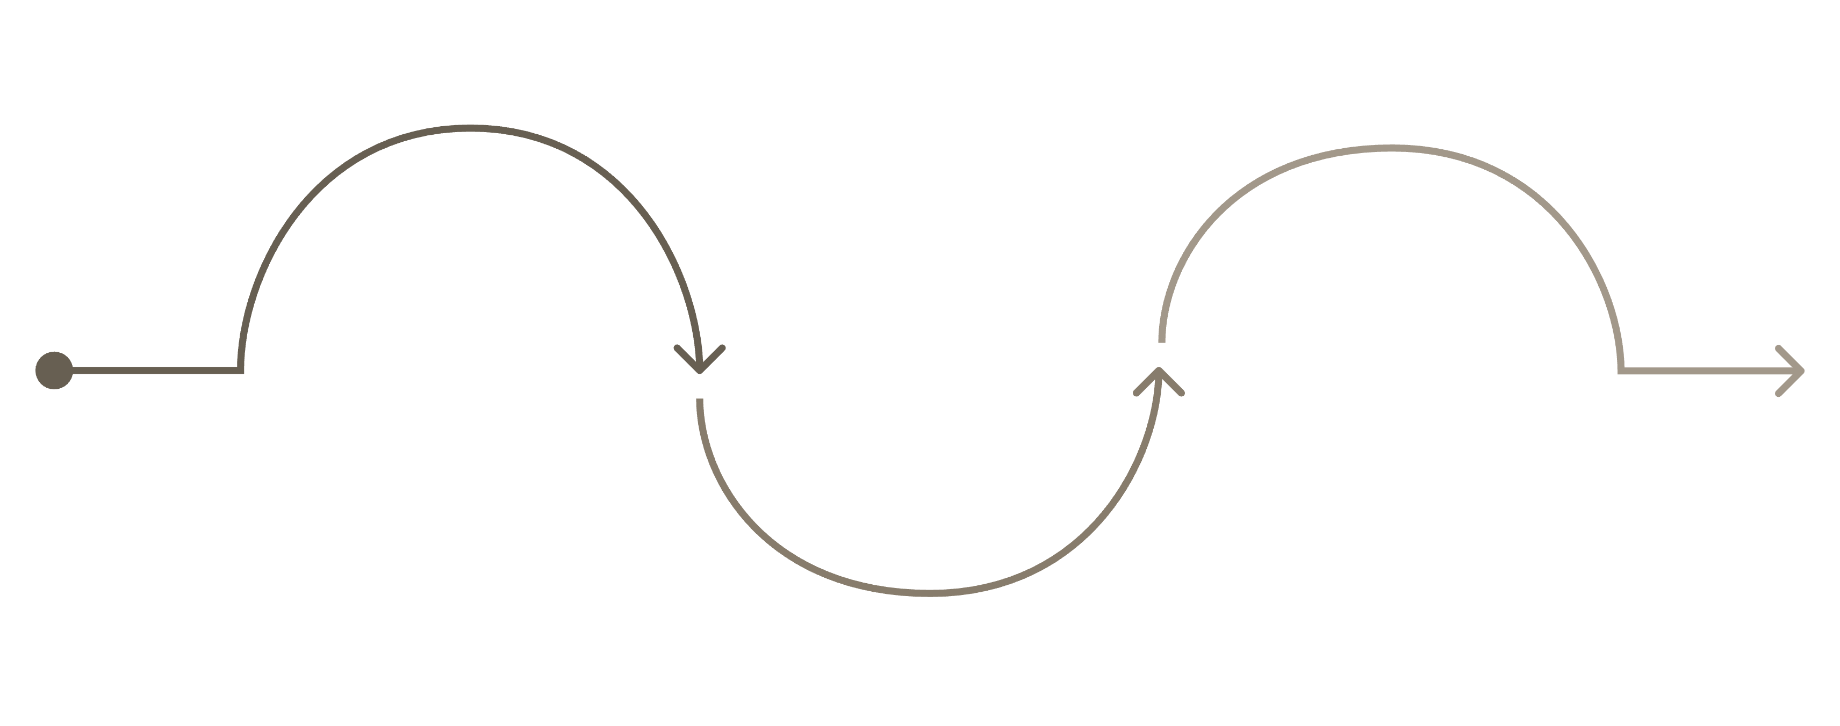
CASE STUDY
KRACK: When WPA2's Handshake Failed the World
In October 2017, researchers exposed a critical Wi-Fi flaw — leaving millions of devices silently vulnerable. The encryption wasn't broken. The implementation was.
Discovery
Impact
Oct 2017: WPA2 flaw disclosed
Scope
Decryption, hijacking, injection
Millions of devices worldwide
How a protocol is implemented matters as much as the algorithm it uses.

Slide 2
Background: The Anatomy of the Vulnerability
WPA2 uses AES encryption — mathematically secure to this day. The vulnerability wasn't in the algorithm, but in the Four-Way Handshake used to authenticate and establish encryption keys.
What the Handshake Is Supposed to Do
What KRACK Exploited
Mutually verify identity and negotiate a fresh, unique encryption key for each session.
Attackers forced the client to reinstall an already-used key — destroying AES's security guarantees and turning strong encryption into a broken one.

Slide 3





What Attackers Could Do
Once within Wi-Fi range, an attacker could force key reinstallation with no special hardware required.
Decrypt Traffic
Replay Packets
Read "protected" communications in plaintext.
Re-send captured data to manipulate sessions.
Hijack TCP Sessions
Inject Malicious Content
Take over active connections mid-session.
Insert attacker data into HTTP responses.
Highest-risk environments: airports, hotels, coffee shops, and university campuses.

Slide 4
Ask the Class
If WPA2 used AES — still considered secure today — how was this attack even possible?
The Common Assumption
The Correct Answer
If the algorithm is secure, the system must be secure. AES is unbroken, so WPA2 is safe. Intuitive — and dangerously wrong.
Encryption is only as strong as the authentication that establishes its keys. KRACK didn't break AES — it subverted the handshake that handed AES its keys.

Slide 5

INCIDENT RESPONSE EXERCISE
Let's Investigate Like Incident Responders
You're the security team at a Canadian university. Thousands of reports flood the help desk in a single morning. Symptoms are strange and inconsistent:
🔌 Repeated Disconnects
🔐 Unexpected Login Prompts
🌐 Browser Redirects
Students drop from campus Wi-Fi repeatedly — but mobile data works fine.
Random credential prompts appear mid-session with no clear trigger.
Browsers redirect to unfamiliar pages. No malware, no alerts, nothing in Active Directory.
Standard tools show nothing. You need to diagnose and contain fast — where do you start?

Slide 6



Small Group Exercise
Time: 10 minutes. Four groups, each investigating a different dimension of the incident. Be specific — you are the responders.
1
2
Indicators of a Wireless Attack
How Would You Investigate?
What symptoms point to a wireless attack over malware or insider threat? What typical malware indicators are absent?
Where do you look? Wireless logs, packet captures, AP logs, auth logs, rogue AP detection. What tools do you use?
3
4
Immediate Containment Actions
Would Changing the Wi-Fi Password Help?
What do you do right now? Consider: disabling vulnerable clients, patching AP firmware, segmenting users, sending notifications.
Classic instinct. Defend your answer technically — what does a password change protect, and what doesn't it?
After discussion: What would your incident report recommend to university leadership?

Slide 7

INDUSTRY RESPONSE
Enter WPA3
KRACK wasn't just a vulnerability — it was an indictment of WPA2's design. The industry's response wasn't a patch. It was a redesign.
WPA2 Flaw
Core design weakness exposed
Industry Redesign
Trust model rethought and rebuilt
WPA3 Launch
SAE, forward secrecy, protected frames
WPA3 redesigned how devices establish trust from the ground up.

Slide 8




How WPA3 Addresses KRACK's Weaknesses
Each WPA3 improvement directly targets a failure mode exposed by KRACK — revealing the depth of what was broken and what was learned.
SAE Replaces the Four-Way Handshake
Forward Secrecy
Eliminates the vulnerable handshake entirely. Both parties generate keys independently via Diffie-Hellman — key reinstallation becomes impossible.
Each session uses a unique key. Capturing traffic today won't help an attacker who obtains the password later.
Protected Management Frames (Mandatory)
Stronger Enterprise Cryptography
Management frames are now cryptographically protected, blocking the deauthentication attacks KRACK relied on.
WPA3-Enterprise mandates 192-bit encryption suites, aligning Wi-Fi security with government and defense standards.

Slide 9
CLASS DEBATE
WPA2 vs. WPA3: The Real-World Transition Debate
You have five minutes to build your argument, two minutes to present. Think like a practitioner.
🔴 Team A — "Disable WPA2 Now"
🔵 Team B — "Transition Is Realistic"
Position: Organizations should immediately disable WPA2 across all infrastructure.
Position: A managed transition is the responsible business decision.
Known, unpatched risk exposure
Regulatory compliance obligations
Reputational and legal impact
Legacy devices that can't be upgraded
IoT ecosystems with no WPA3 support
Budget cycles and operational risk

Slide 10
If You Were the CISO — What Would You Decide?
Step out of the debate and into the decision-maker's chair. The CISO has constraints, stakeholders, and accountability — not perfect answers.
01
02
Assess Your Exposure
Define a Transition Timeline
Audit every device. Identify what supports WPA3 today, what can be updated, and what's permanently locked to WPA2.
Set a firm WPA2 phase-out deadline. Communicate it to leadership and vendors. A transition without a deadline is just a delay.
03
04
Implement Compensating Controls
Document and Report
While WPA2 is live: segment networks, enforce HTTPS, require VPNs for sensitive access, and monitor for handshake anomalies.
Document every decision. Risk acceptance and timelines create an audit trail that protects the org and demonstrates governance.
The best security decision isn't the most technically pure one — it's the one your organization can actually execute while minimizing real-world risk.

