Slide 1
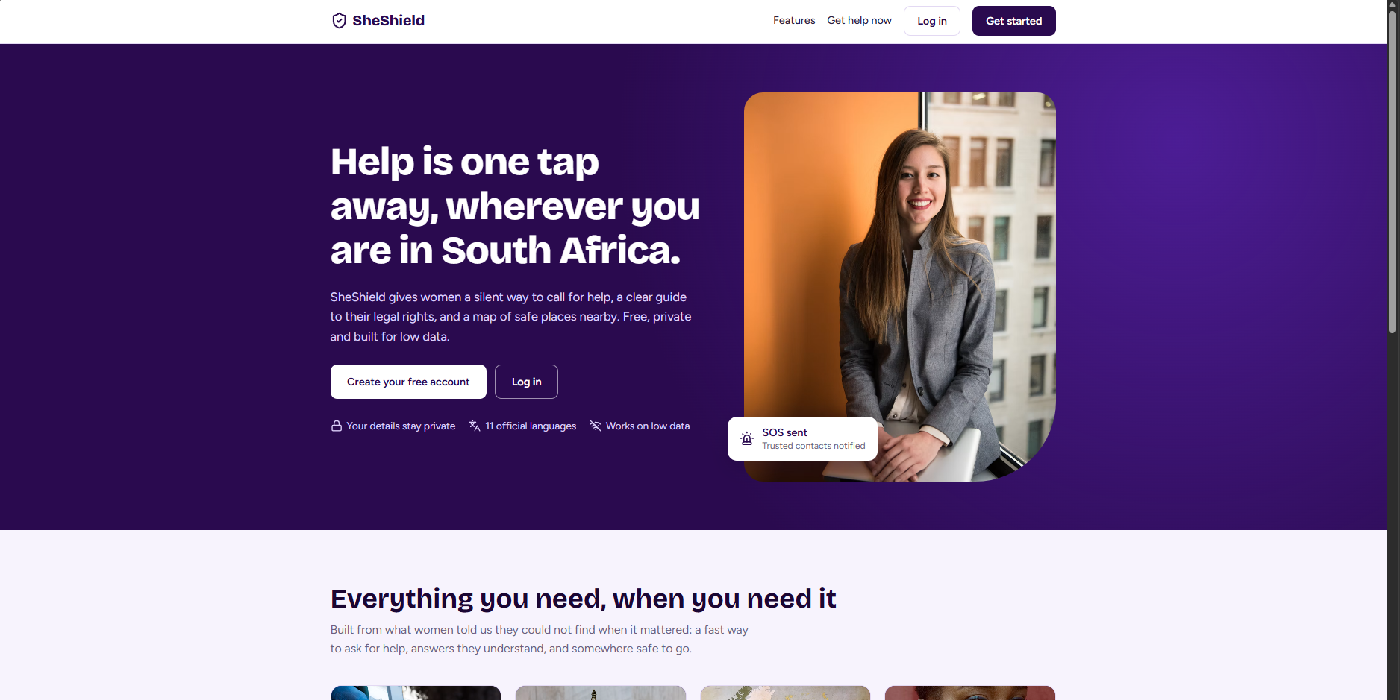
SHESHIELD | SAFER COMMUNITIES • GBV RESPONSE
Safety should be accessible — even when seeking help is risky
A discreet, free-to-use South African GBV support platform
SOS preparation • Calculator disguise • Audio evidence tools • Legal guidance • Anonymous reporting
Prototype • Progressive Web App
01 / 11

Slide 2
SHESHIELD • FNB HACKATHON 2026
The problem we are solving
Seeking help can be visible
Support is fragmented
Witnesses need a pathway
A person experiencing abuse may be watched or may not be able to open an obvious safety application.
Emergency contacts, legal rights, evidence tools and nearby services often require different channels.
People who witness suspected abuse may want to raise concerns without publicly identifying themselves.
Our design priority: discreet access, clear information and user-controlled actions.
02 / 11

Slide 3
SHESHIELD • FNB HACKATHON 2026
Our solution at a glance
Shake-to-SOS
Audio recording
Calculator disguise
Optional shake gesture while the PWA is active; prepares an alert.
Opt-in SOS recording with microphone permission and legal guidance.
An optional everyday-looking calculator with PIN entry.
Legal guide
Safe-space mapper
Anonymous report
Plain-language, currently rule-based information; live AI requires funding.
Location-based search for support services; depends on permissions and data.
A pathway for witnesses or survivors to submit concerns.
03 / 11

Slide 4
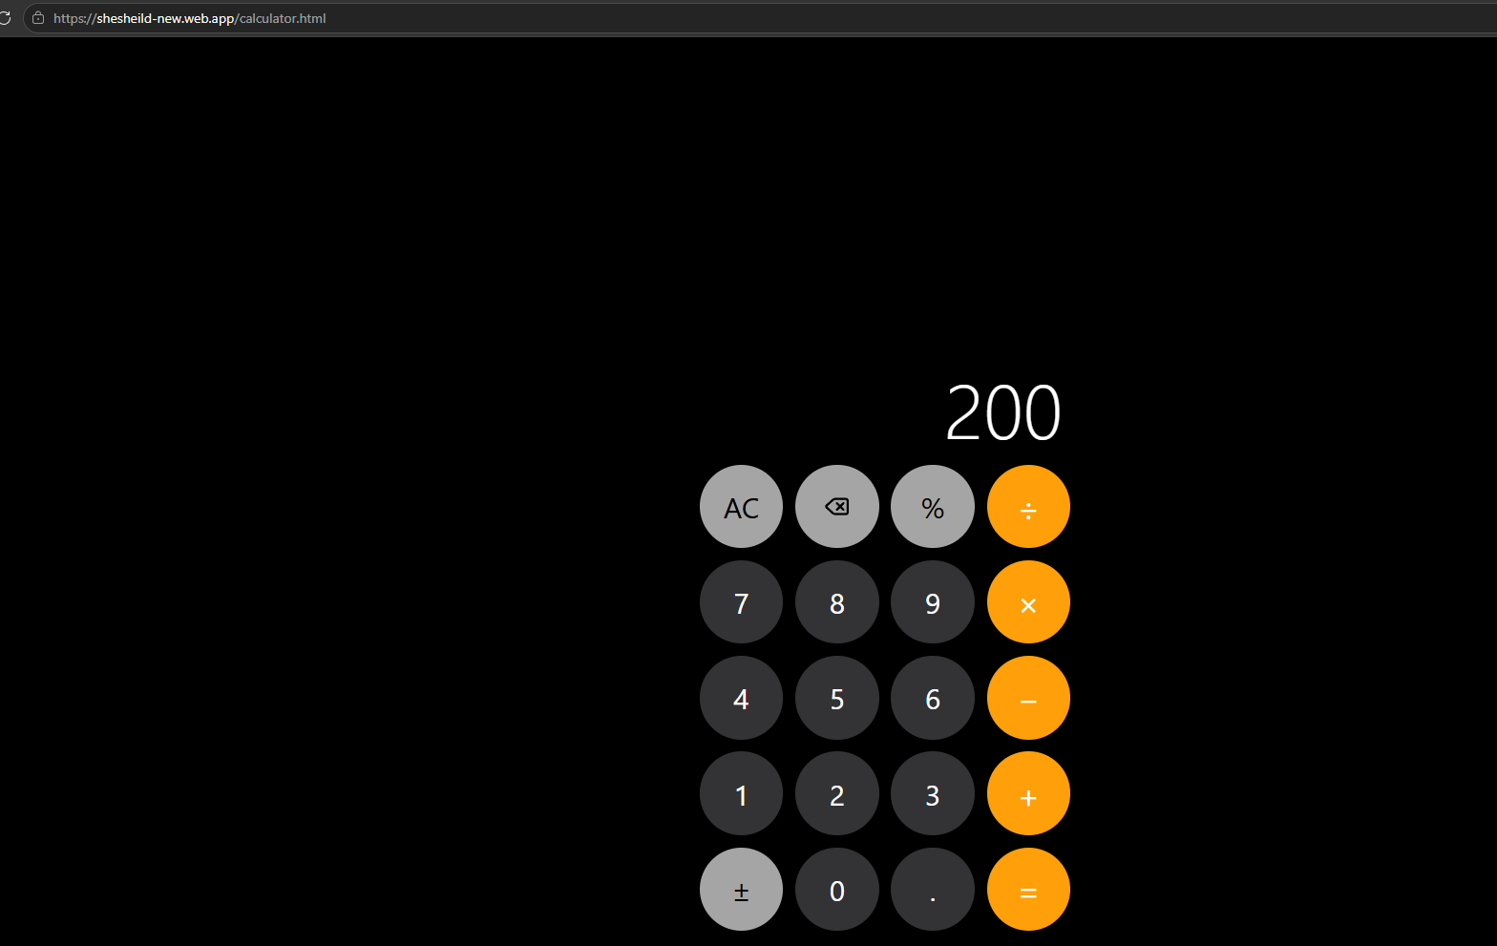
SHESHIELD • FNB HACKATHON 2026
Discreet access: the calculator disguise
WHY WE BUILT IT
When someone checks your phone, an obvious safety app may increase risk.
Our intended return journey:
1. Open the installed PWA
2. See the calculator
3. Enter a private PIN and press =
4. Unlock the saved signed-in session
A disguise reduces casual discovery; it does not guarantee secrecy.
04 / 11

Slide 5
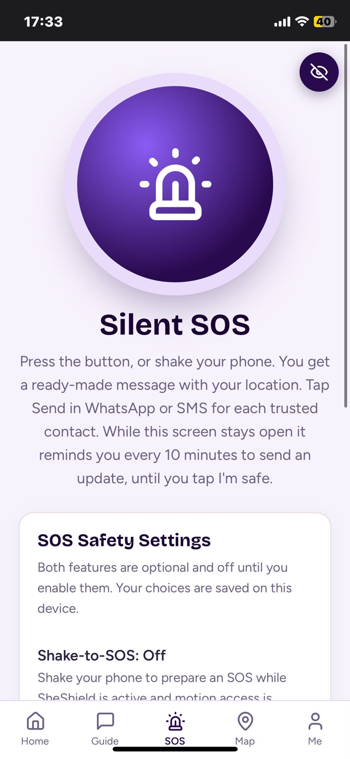
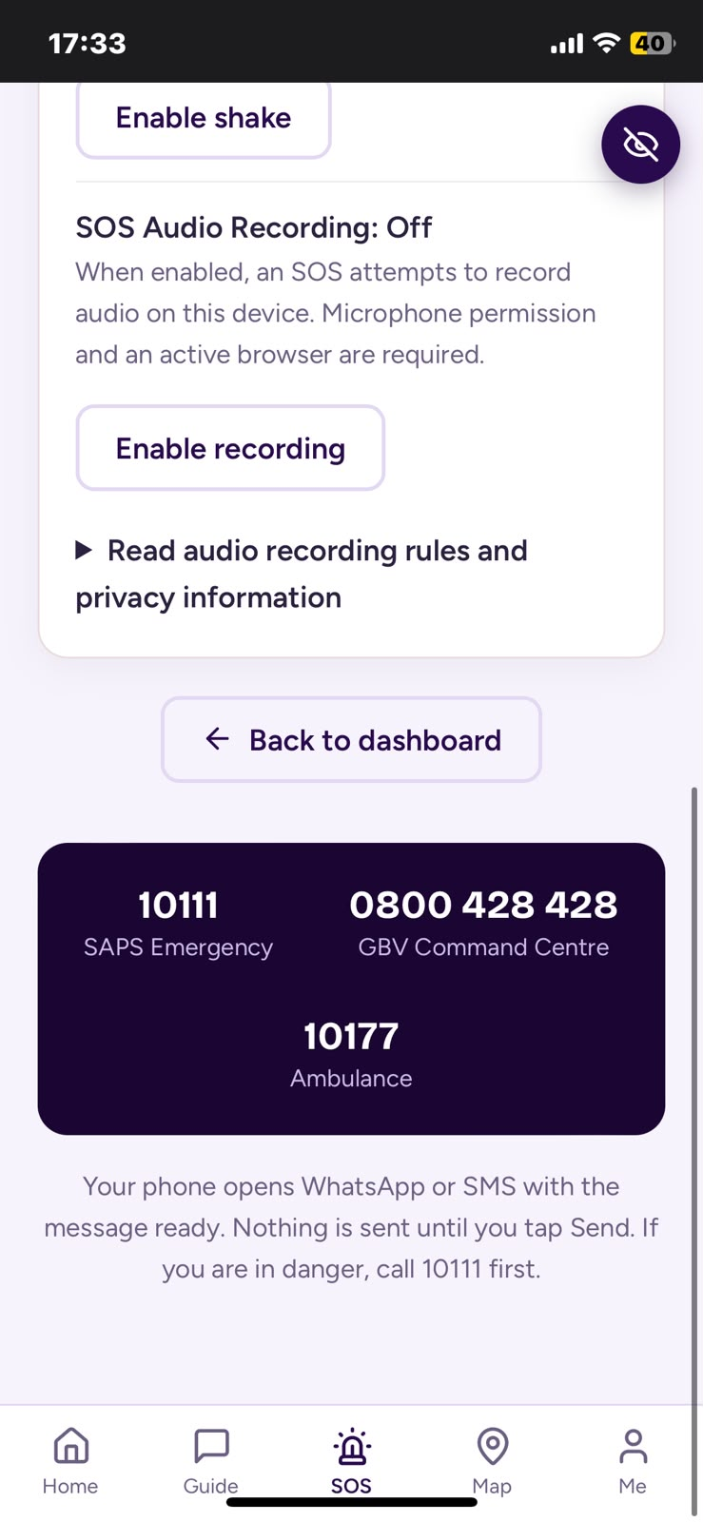
SHESHIELD • FNB HACKATHON 2026
SOS: a user-controlled emergency workflow
SHAKE OR TAP
The SOS screen prepares a location-based message for trusted contacts.
WhatsApp / SMS opens with a draft. The user must press Send. Shake detection is limited to an active page with motion access.
05 / 11

Slide 6
SHESHIELD • FNB HACKATHON 2026
Recording and trusted contacts
Recording is optional
The user enables it on the SOS page; microphone permission and browser activity are required.
Evidence handling and safety
Recording must follow applicable law and privacy rules. We do not claim court-certified evidence or uninterrupted recording.
Trusted contacts receive nothing until the user sends the prepared message.
06 / 11

Slide 7
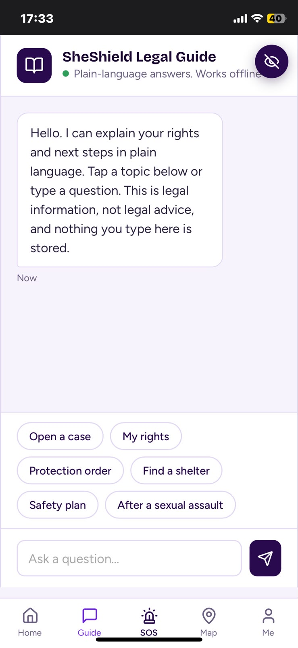
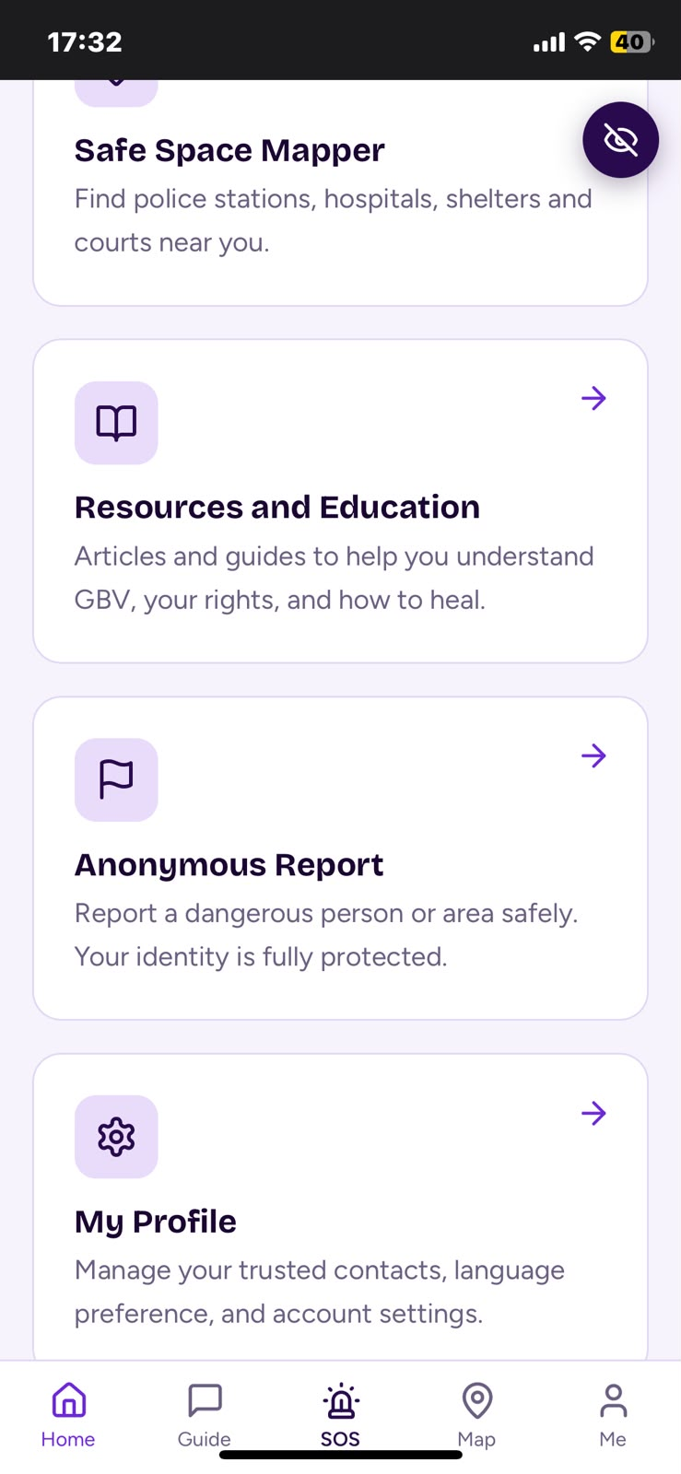
SHESHIELD • FNB HACKATHON 2026
Legal guide and witness reporting
LEGAL GUIDANCE
Current prototype: topic-based, plain-language information — not professional legal advice.
ANONYMOUS REPORTING
Survivors and witnesses can raise concerns. Anonymity and downstream response must be carefully validated.
07 / 11

Slide 8
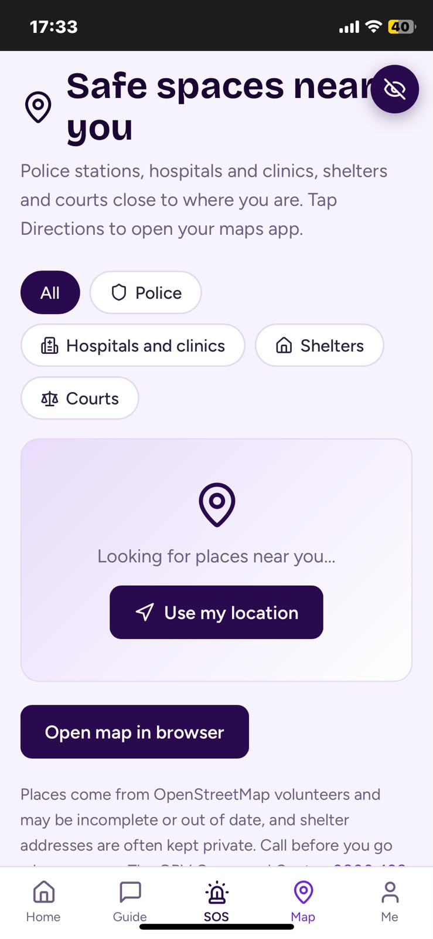
SHESHIELD • FNB HACKATHON 2026
Safe spaces and South African support
Nearby support discovery
Search categories include police stations, clinics, hospitals, shelters and courts. Results depend on GPS permission and available map data.
Emergency resources
The interface also provides direct South African emergency contact information.
Map availability and results require further real-device testing.
08 / 11

Slide 9
SHESHIELD • FNB HACKATHON 2026
Technical architecture
FRONT END
IDENTITY + DATA
PWA LAYER
HTML • CSS • JavaScript
Responsive mobile-first UI
Firebase Authentication
Firestore and local device preferences
Manifest • Service worker
Installable browser application
DEVICE APIs
EXTERNAL ACTIONS
Geolocation • Motion sensors
Microphone permissions
WhatsApp / SMS compose links
OpenStreetMap-based discovery
09 / 11

Slide 10
SHESHIELD • FNB HACKATHON 2026
User journey: first use and returning use
First-time setup
Returning use
Open public welcome page → create account / sign in → configure trusted contacts → choose calculator PIN → optionally enable Shake-to-SOS and recording.
Launch installed PWA → calculator appears → enter PIN → access dashboard using the remembered Firebase session. Sign-out requires login again.
Prototype note: browser storage or authentication changes can require re-login.
10 / 11

Slide 11
SHESHIELD • FNB HACKATHON 2026
Roadmap, demo and partnership opportunity
What funding would unlock
Demo access
• Native Android/iOS development for more reliable background capabilities
• Secure hosted AI guidance and token/API costs
• Better evidence integrity and security review
• Accessibility, testing and referral partnerships
Live prototype: https://sheshield-new.web.app/
Demo email: [ADD DEMO ACCOUNT EMAIL]
Password: provided privately to judges
Team / contact: [ADD TEAM DETAILS]
SheShield aims to make it easier to seek help — discreetly, accessibly and without a subscription for core features.
11 / 11

