Slide 1
DEMYSTIFY MACH-O
EXECUTABLES ON DARWIN

Slide 2
Who am I?
Garrigan Stafford
Engineer at Microsoft
Work on Intune MAM SDK, provides transparent security for iOS apps

Slide 3
Roadmap
What is Mach-O and why should you care?
Deep dive into the Mach-O format
Code example

Slide 4
What is Mach-O?
Mach-O is the file format used to describe executables on Darwin Systems
MacOS, iOS, tvOS, watchOS
Architecture Independent
All Swift and Obj-C apps on *OS will end up as a Mach-O object
Every program that doesn’t use an interpreter or VM will
Notes:
Purpose of the talk is explain what Mach-O is, what it looks like, and why/how you look at it
All iOS apps end up as Mach-O binaries.
*OS is shorthand for apple OSes

Slide 5
Why look at Mach-O files?
Reading executables at runtime
Custom build tooling
Disassembly
Hooking Symbol Tables
Reverse Engineering

Slide 6
Mach-O File
Bytes
Notes:
Mach-O is a binary format so at first a file is just a bunch of bytes. As we go through the talk we will fill in this block of bytes

Slide 7
Fat Binaries
Mach-O objects are typically contained in a fat binary
Packages multiple Mach-O objects for different architectures into one file
For example, providing both 32 and 64 bit versions
Once loaded, only the most compatible object is mmaped
In memory footprint is only the needed object while file footprint can be much bigger
Binaries can be a fat binary even if they only have one architecture
Notes:
A little confusing, but MACH-O files are typically Fat Binaries that contain Mach-O objects.
IIRC it is not strictly necessary to have a Fat header if the file only has one architecture, but in my expirence almost every file will have a fat header of some sort.

Slide 8
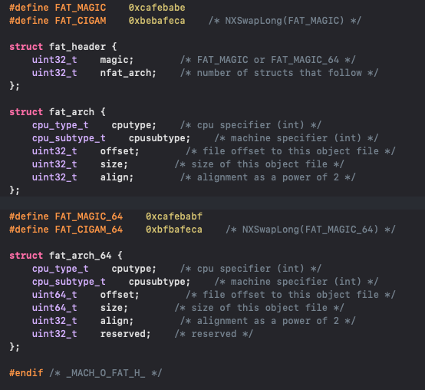
Fat Binaries
Defined in <mach-o/fat.h>
If the file is a fat binary, it will start with a fat header
Can use magic number to determine if fat and for endianness
After the header follows nfat_arch number of fat_arch specifications
OS grades the slices and chooses most compatible
cpu_type_t and cpu_subtype_t are defined in <mach-o/machine.h>
APIs for grading are in <mach-o/arch.h>
Notes:
Purpose of the magic number: Can existence check that this is a FAT binary and can check for endiannes
Each arch specification contains the cpu type and subtype. The OS uses this to determine which slice to choose by grading and ranking the available archs.
Once it chooses a slice, it can use the offset and sizes field to determine what range of the file to mmap
Each arch slice is aligned to an integer multiple of its underlying arch page size so it can be easily mmaped

Slide 9
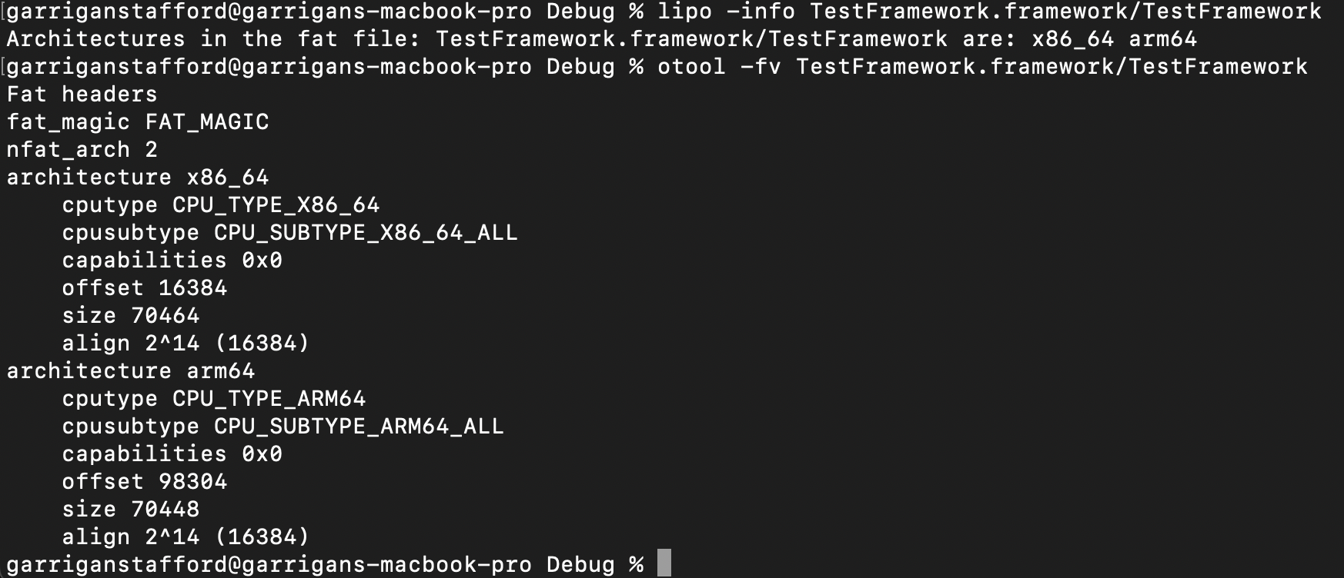
Fat Binaries
lipo – command line tool to work with Fat binaries
otool –f can be used to dump fat headers
Notes:
Using –v alongside –f will give you more words and constants instead of just the hex values

Slide 10
Mach-O File
fat header
fat arch 0
fat arch 1
Mach-O Object arch 0
Mach-O Object arch 1
Notes:
Here we see the fat header first, followed by two archs say 32bit and 64bit arm, and then the corresponding objects one after another with each arch specification pointing to where in the file the object starts

Slide 11
Mach-O Object
The entire object is split into segments, each of which has their own memory protections and space to be mapped
A Mach-O objects begins with a header and then is followed by load commands.
The load commands define the segments of the file __TEXT, __DATA etc..
Segments can be split into sections
We will go through the definitions of each of these, they can all be found in <mach-o/loader.h>
Can use otool to view the various segments and sections of a file
Notes:
We will talk about the common segments and some of their sections.
All the well known sections and segments are in loader.h but there are some extra

Slide 12
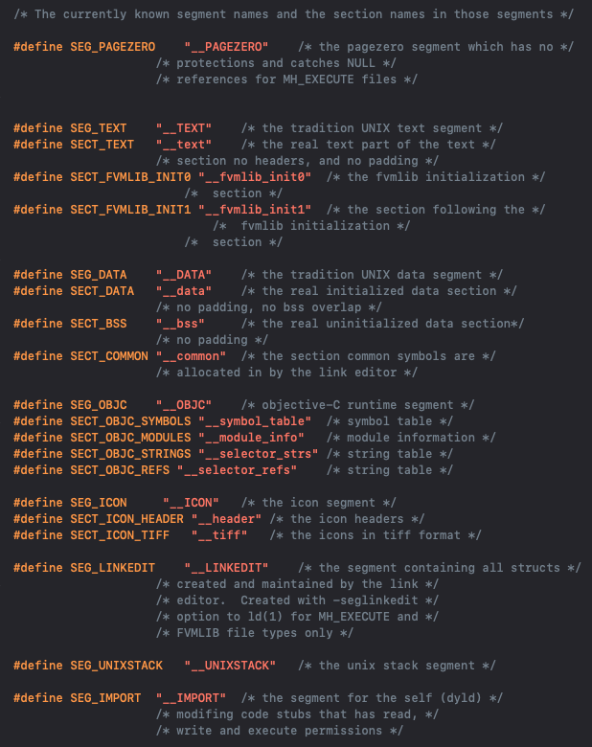
Common Segments
__PAGEZERO (---/---)
__TEXT
(r-x/r-x) on iOS
(r-x/rwx) on macOS
__text, __stubs, __cstring
__DATA
(rw-/rw-) on iOS
(rw-/rwx) on macOS
__data, __bss
__DATA_CONST
(rw-/rw-) on iOS
(r--/r--) on iOS 17*
(rw-/rwx) on macOS
Is like __DATA, but dyld mprotects it to const once done loading
__const, __got, __objc_classlist
“Fixed” with SG_READ_ONLY iOS 17
__LINKEDIT
Notes:
(init/max)
Segments are slices of the file that will be mmaped defined by the segment load command and have initial and max memory protections assigned.
Sections are defined within segments after the segment load command
Page zero is only found in executables. Defines the first page of memory to have no perms.
Not actually mapped but is used to assign no perms to act as a null pointer trap.
In 64bit apps page zero occupies all of 32 bit address space to prevent mapping 32 bit libs into 64bit space and from derefencing 32bit pointers
Text is the first segment of the file and contains the program code. Starts at the beginning of the file and includes the mach header
All the contents of TEXT are what get codesigned, so you can embed read only data into __TEXT to ensure integrity with signing, but it will be executable.
The __TEXT.__text section contains the actual code. There are also sections for stubs, the stubs helpers, c strings, const data
__DATA is the segment for mutable data with __data containing the .
You might be wondering why __DATA_CONST is writeable.
__DATA_CONST is a segment that was added because __DATA did not have actual const sections. Instead it just had a section for data that was assumed to be const that contained the global offset table and symbol pointers. This was fixed in Darwin 19 with the __DATA_CONST which has the const data, initializers, the GOT and more, is not const upon loading so dyld can fix them up as needed, but then mprotected to be non-writeable afterwards. Note that you can still make __DATA__CONST writeable. In iOS 17 apple has now added support o make DATA_CONST actually const via DYLD flags and no longer writeable via mprotect. By default now when building with xcode the new SG_READ_ONLY flag is added which has the kernel stop the program from mprotecting data_const to writeable. However you can remove this flag from the binary if needed and then still make const writeable. However you would need to resign you code if you removed the flag.
__LINKEDIT is a generic container for file contents not in __TEXT or __DATA. It is not sectioned and is instead described by linkedit_datac_commands which only describe the offset into LINKEDIT and the size
Note that these aren’t the only possible segments and sections, more like the common/required ones. As you can see in the list to the right that there is also an OBJ-C segment that is possible to contain obj-c runtime info and other segments could be defined or added. Known segments can be found in <mach-o/loader.h>

Slide 13
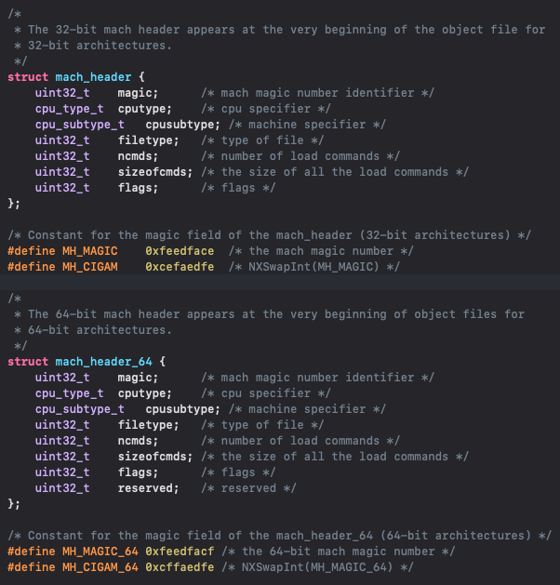
Mach Header
Fixed size beginning with a magic number
Contains arch info
File type
Contains number of load commands that follow and how large the entire list is
Load commands can be of variable size
Flags
MH_NOUNDEFS, MH_PIE, MH_HAS_OBJC, MH_DYDLD_LINK, MH_TWOLEVEL
Notes:
Begins with a magic number, can use this to determine endianness with MH_MAGIC being little endian and MH_CIGAM being big endian
File type defines what type of object this is, we will look at all the types
Flags is a 32bit field that are used by dyld and ld. Most flags are not super useful, either just used by ld or deprecated. Here are some ones you will probably see
MH_NOUNDEFS
Fully Linked
MH_PIE
0x00200000
Position Independent executable
MH_HAS_OBJC
Has Obj-C sections
MH_DYLDLINK
Object meant for dyld linking
MH_TWOLEVEL
Two Level linking
Creates a namespace for linked libraries to avoid collisions

Slide 14
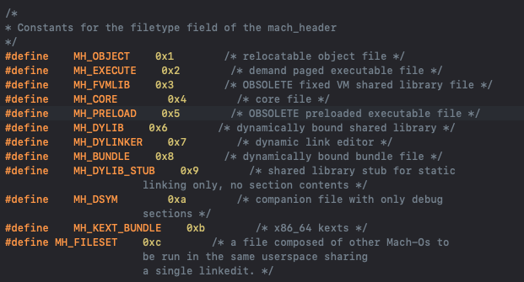
Mach File Types
Notes:
MH_OBJECT
Intermediate compliaction result from gcc -c
MH_EXECUTE
Executable files
MH_FVMLIB
Non relocatable library files
No longer supported
MH_CORE
Core dumps
MH_PRELOAD
Preloaded executable file
No longer supported by XNU Kernel
MH_DYLIB
Dynamic Library file
Must be loaded into an executable either implicitly by LC_LOAD commands or explicitly with dlopen
MH_DYLINKER
The dynamic linker
Typically dyld or dyld_sim for simulator
Providing this can allow an executable to have a custom dynamic linker
MH_BUNDLE
Plugin files generated by gcc -bundle
Explictly loaded by dlopen or NSBundle or Bundle(swift)
Must be loaded explicitly into an executable
MH_DYLIB_STUB
Linking stubs only, contains no code
Was used for *OS SDK until TBD files
MH_DSYM
Companion dsym files
Generated by gcc -g
MH_KEXT_BUNDLE
Kenrel extension

Slide 15
Mach-O File
fat header
mach header
fat arch 0
Load commands
fat arch 1
sizeofcmds
Mach-O Object arch 0
__TEXT
__text
?
__stubs
__DATA
__data
?
Mach-O Object arch 1
__bss
__DATA_CONST
?
__LINKEDIT
?
Notes:
So we now know that there are some segments with various sections in them and that these sections are inside these segments. But how do we know where thse segments are? And how do we know their memory protections?
We noted that these are not the only possible sections and segments that could exist. So these are not assumed hardcoded structres or values.
The answer is in the load commands

Slide 16

Load Commands
Load commands define the segments and sections of the object
Load commands can also provide extra information or commands to programs like the loader and dyld
For example, a command telling dyld to load a dynamic library
Load commands are variable in size and structure
Each load command starts with a command type and then the size of the command
Notes:
Load commands essentially layout the Mach O object
Due to the variable size of load commands, you need to iterate through them one by one.
There are a lot of load commands so we won’t go over them exhaustively. Instead we will look at a few common and important ones.

Slide 17
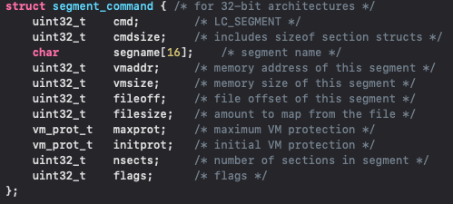
LC_SEGMENT[_64]
The total mapped memory for this segment is vmsize
Starting at fileoff, filesize bytes will be mapped to vmaddr
vmaddr is filled in when the Mach Object is in virtual memory
If nsects > 0
There will be nsects section structs directly following this command
Notes:
Segment command, with the type LC_SEGMENT, defines a segment of the Mach-O object. There is also a 64bit version of this command
It first has the segment name, next is the virtual memory address and size of the memory to map. Next is the offset in the file where the segment begins and its size. So we will be taking fileOffset->fileOffset+fileSize and then mapping it to vmaddr->vmaddr+vmsize
Vmaddr is where the image starts in memory if it is loaded into memory, reading off disk or mmap a disk image will not fill this value.
We next have the maximum and initial memory protections
Next we have the number of sections in the segment. If nsects > 0 then there will be nsects section structs following this command.
Cmdsize takes into account the amount of sections following the command so you don’t need to iterate through the sections to skip the command.

Slide 18
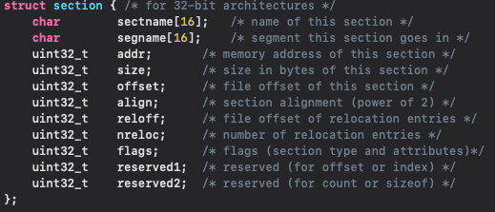
section[_64]
Flags
8 least significant bits determine section type
S_CSTRING_LITERALS
24 remaining bits determine attributes
S_ATTR_DEBUG
Sections are naïve
Can create custom sections
__attribute__((used,section(“SEGNAME, SECTNAME”))) in code
--sectcreate SEGNAME SECTNAME file to linker
Notes:
The section struct is also very similar to the and similarly has its offset and and size of the file to be mapped to a certain address
There are quite a few section types and attributes. So we won’t be going over them here but for example we can see a type might be like S_CSTRING_LITERALS which is a section that is a list of cstrings. Or S_ATTR_DEBUG which marks a section as a debug section.
Section types and attributes are defined in <mach-o/loader.h>
Sections are naiive in that there is nothing stopping sections from being defined outside of their segments or overlapping each other

Slide 19
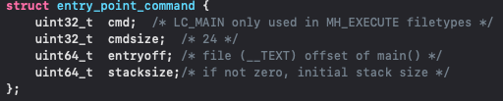
LC_MAIN
Notes:
LC_MAIN defines the entry point for an executable and initial stack size

Slide 20
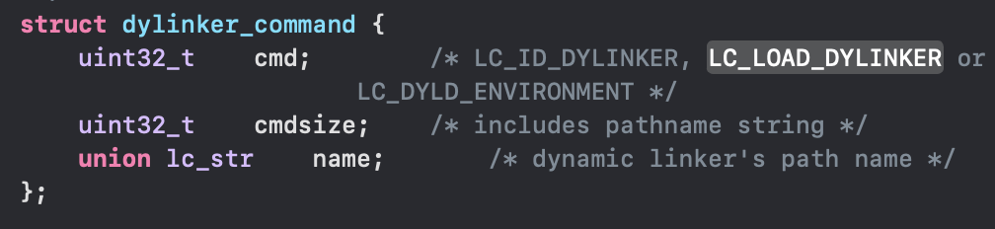
LC_LOAD_DYLINKER
Notes:
This command will almost always be pointing to dyld. However it is interesting to note that you can supply a custom dynamic linker, you just need a path to the Mach-O object of type MH_DYLINKER. Apple uses this to specify when to use dyld for device vs simulator

Slide 21
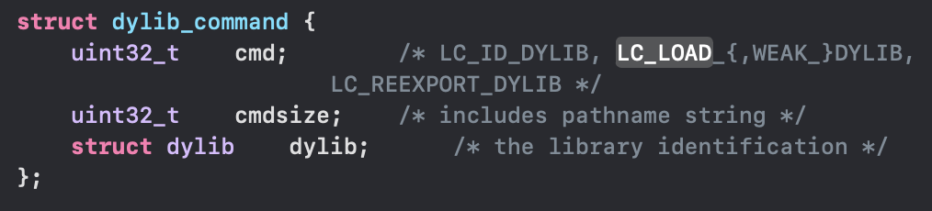
LC_LOAD_DYLIB
Notes:
The LC_LOAD_DYLIB command tells dyld to load a particular dylib to resolve external symbols
There are multiple varieties such as load weak, load lazy, reexport.

Slide 22
Mach-O File
fat header
mach header
……
fat arch 0
LC_SEG __TEXT
fat arch 1
nsects
SECT __text
Mach-O Object arch 0
SECT __stubs
fileoff
LC_LOAD_DYLIB
sizeofcmds
…
__TEXT
__text
(initProt/maxprot)
Mach-O Object arch 1
__stubs
__DATA
__DATA_CONST
Notes:
So here we see the LC commands defining the __TEXT seg and the sections within. I only showed the relation ship for the first segment as it was getting quite cluttered.
Here we can see the LC_SEGMENT and section structs defining the structre of the __TEXT segment and sections. For each segment in the file you would a LC_SEGMENT command, with some potential sections.
I am not aware if there is a guaranteed or defined order of the load commands
This is the overall structre of the Mach-O file. When your executable runs, the loader loads it up and mmaps the specified arch into memory, then iterates through the load commands as needed. Dyld will then look through the load commands to find out which dylibs to load and then perform any fix-ups, set __DATA_CONST to readonly if it exists, and then finish. Then the instruction pointed at by LC_MAIN is loaded

Slide 23
Code Example
To show how to parse Mach-O, we will create a program that visualizes the Obj-C class hierarchy loaded into the process
In the samples shown, I have removed lots of error checking and other unrelated code for brevity
Assumed 64 bit for brevity
Notes:
Good to note that this code does more work than it needs to since we know that the textSeg starts at offset 0. However kept in the code to look for it as an example.
We ended up not doing this exact technique due to the overhead of reading the SDK of disk

Slide 24
Obj-C Class Hierachy Exporter
Create a program that can parse all the modules loaded in memory and produce a graph showing its Obj-C Class hierarchy
Obj-C only has single inheritance and root object NSObject

Slide 25
Resources
Headers
<mach-o/loader.h> definitions of Mach-O Header, Load Commands, Segment names etc..
<mach-o/fat.h> definitions for Fat headers and arch slices
<mach-o/arch.h> APIs around selecting architectures
<mach-o/machine.h> CPU type and subtype definition
Tools
otool – Command line utility to work with object files
lipo – Command line utility to work with fat binaries
Books
*OS Internals: Volume 1 User Space by Jonathan Levin

Slide 26
Questions?

