Slide 1
Monte-Carlo Simulation and Calibration of a Discrete Term Structure Model and Valuation of Interest Rate Derivatives
Group 05
(Xinyi Wang, Mateo Argudo)

Slide 2
Statespace
Basic interface StateSpace for the state space, serve as object oriented design
4 methods:
applyStateSpaceTransform, applyStateSpaceTransformInverse,
getDriftAdjustment, getOneStepMeasureTransformAdjustment
Abstract class ParametricStateSpace implements Statespace to implement state spaces with parameters (in case of displaced lognormal)

Slide 3
StateSpace (interface )
Normal
displaced lognormal
Lognormal
Parametric state space(abstract)
constant displacemt
displacements

Slide 4
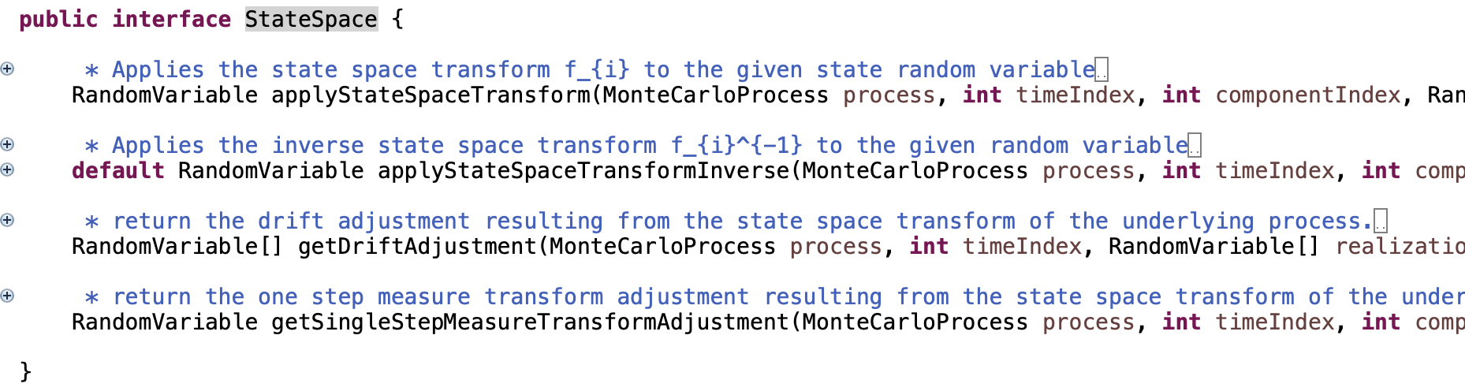

Slide 5
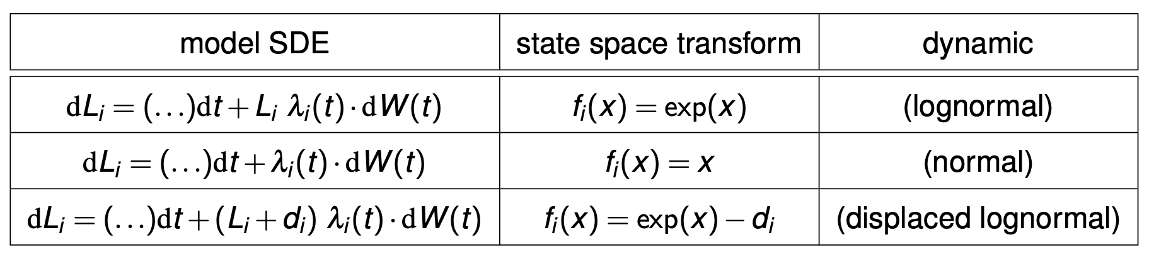
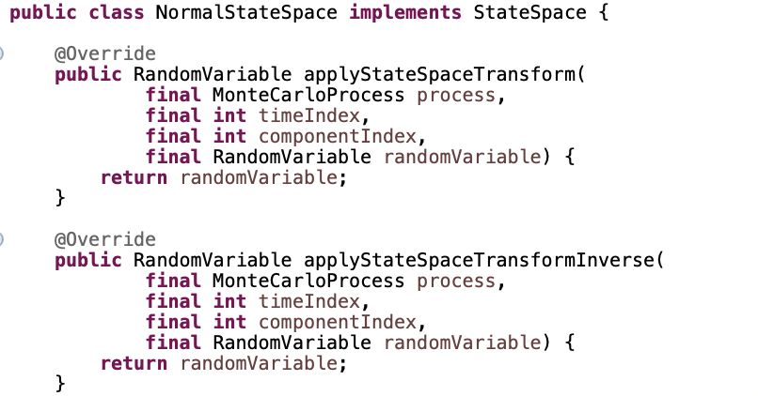
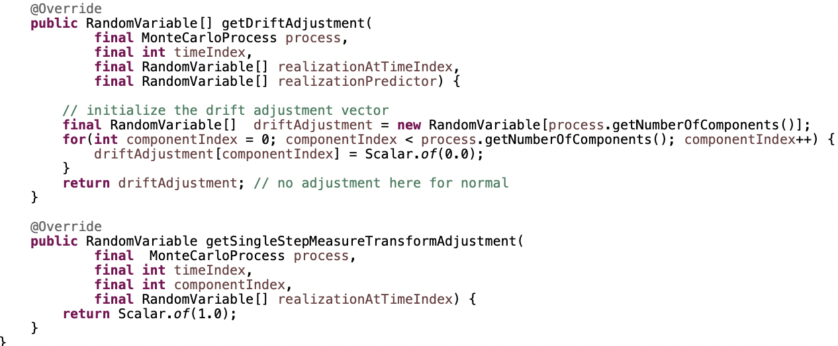
(Skript: 459)

Slide 6
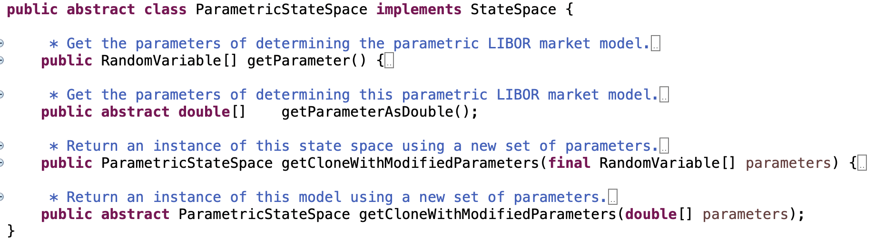

Slide 7
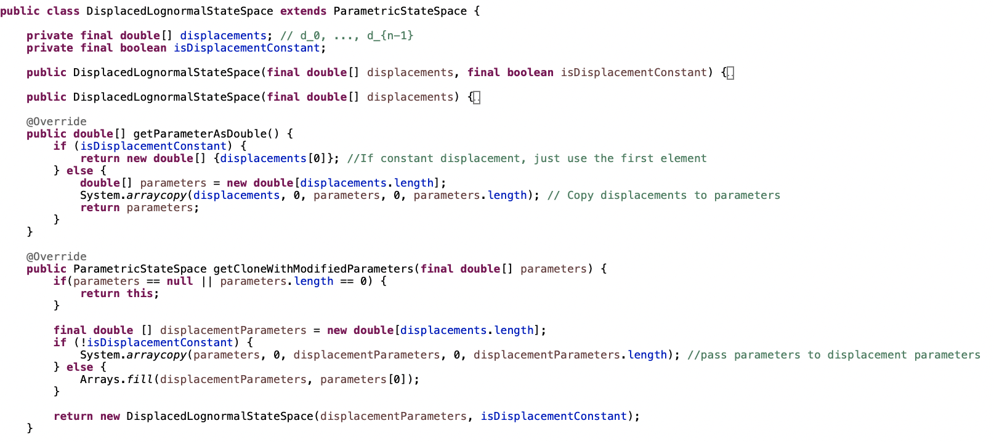

Slide 8
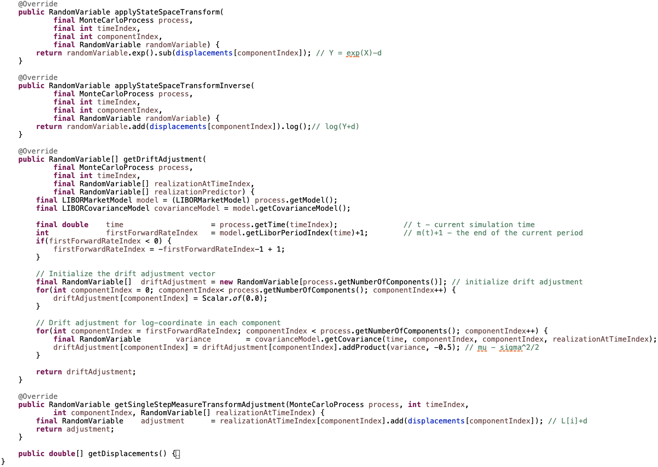

Slide 9
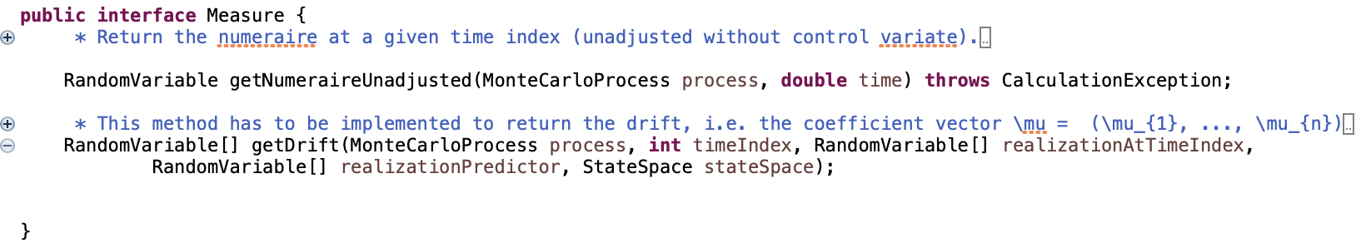
Measures
Object oriented design => basic interface for the measure
Contains two methods : getNumeraireUnadjusted, getDrift
Can be implemented to 3 specific measures

Slide 10
Measure (interface)
Terminal
Spot
Statespace
Tk-forward
Terminal measure is the same as the T_k forward measure with
k = numberOfLIBOR
spot measure is the same as the T_0 terminal measure

Slide 11
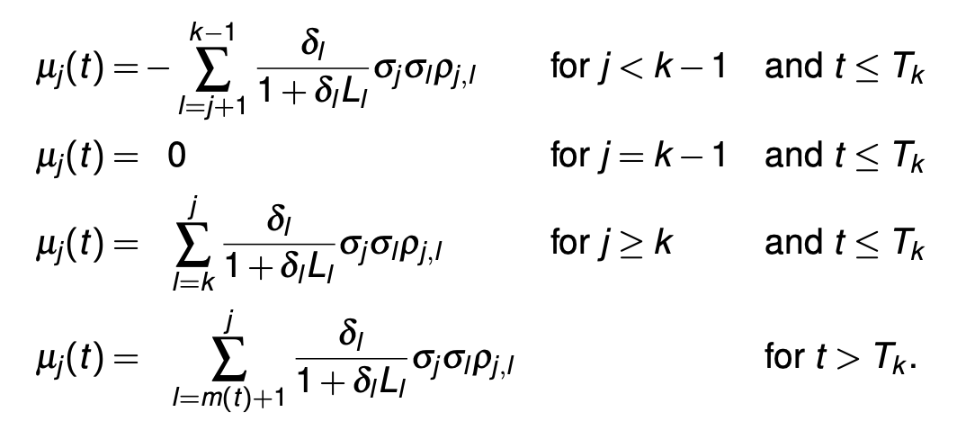
Drift term under the Tk-forward Measure
Private component maturityIndex
Statespace space as parameter of the method getdrift()
Algorithm:
backwards starting at k-1 till first Forward Rate Index
forward from k till n-1
forward from m(t) + 1 till n-1

Slide 12
Models and Implementation

Slide 13
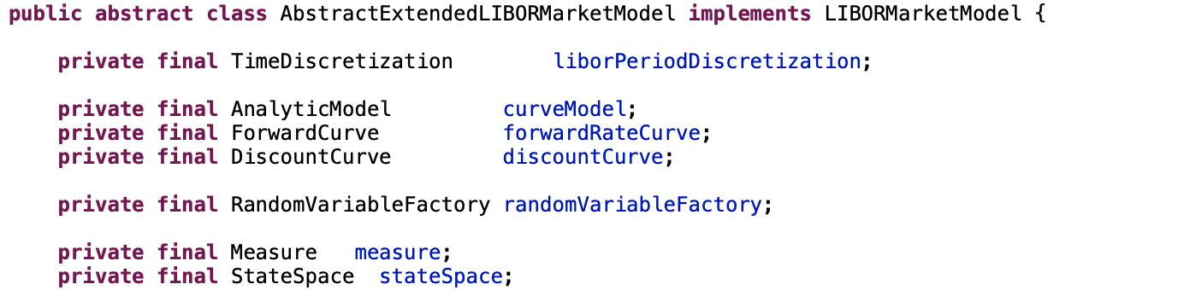
Extended LIBOR Market Model
AbstractExtendedLIBORMarketModel: Added given stateSpace and measure.
ExtendedLIBORMarketModelFromCovarianceModel extends our class AbstractExtendedLIBORMarketModel.
It extends it with the parameters:
calibrationProducts: The vector of product, target value and weight for the objective function sum weight(i) * (modelValue(i)-targetValue(i)).
properties : Key value map with keys: interpolationMethod, simulationTimeInterpolationMethod, liborCap.

Slide 14
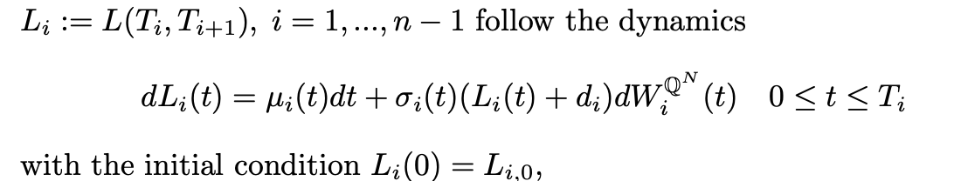
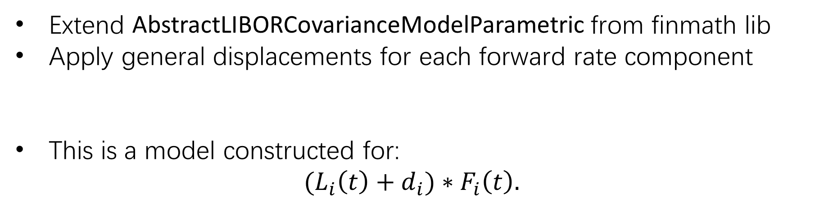
Multi Curve Displaced Local Volatility Model
Extend AbstractLIBORCovarianceModelParametric from finmath lib
Apply general displacements for each forward rate component
This is a model constructed for:
$${(L}_{i}\left(t\right)+d_{i})∗F_{i}\left(t\right).$$

Slide 15
General LIBOR Market Model Factory
Creates a Euler-scheme simulation of the generalized LIBOR market model
We can specify the pricing measure(spot, terminal and or Tk-forward) and the state space dynamics under which the simulation is performed

Slide 16
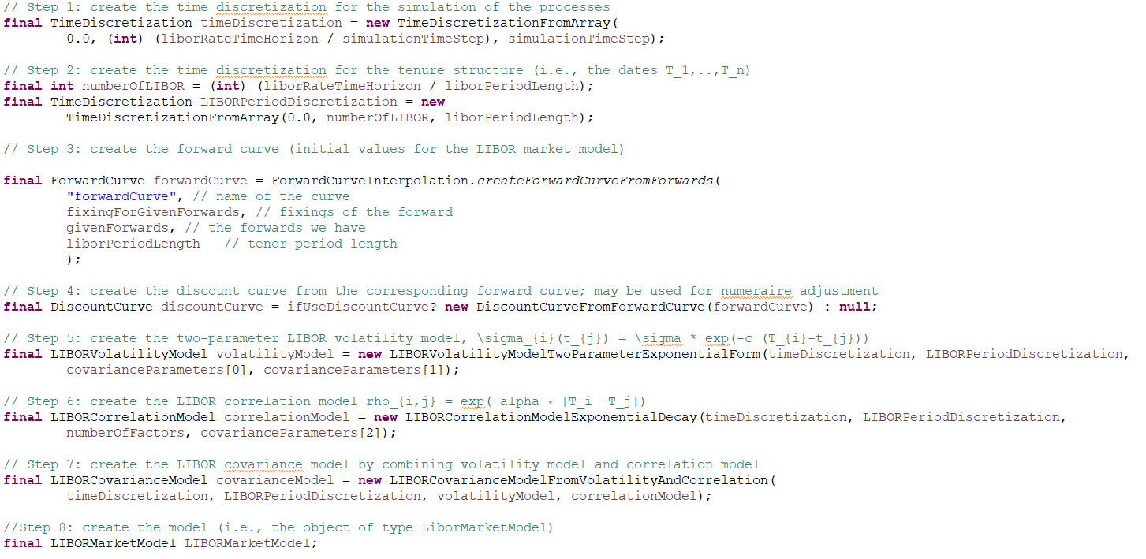
General LIBOR Market Model Factory

Slide 17
General LIBOR Market Model Factory
Set the properties: Interpolation Method: Linear, Simulation Time Interpolation Method: round_down.
Set empty calibration array for Extended LIBOR Market Model.
Parameter UseLinearVolatilityModel: Tells us wether we use displacements or not.

Slide 18
Test Results
We check the absolute error between the montecarlo and the analytic value.

Slide 19
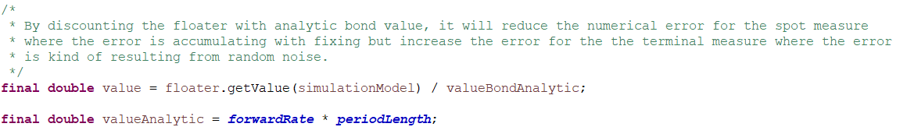
Test Results
The closer to the terminal error, the larger the forward rate error. Also the use of a linear local volatility model without state space transformation increases the error.

Slide 20
Test Results

Slide 21
Thank you for listening.

