Slide 1

FINANCE
Team 4:
Analysis Total Loan, Credict Score with Customer Information
Trainers:
Nguyễn Quỳnh Mai
Bùi Văn Long
Trainees:
Hoàng Hoàng Thúc
Lê Quang Nhật

Slide 2


Menu:
Introduction.
Relate Work.
Enviroment.
Flow.
Schema
Setting.
Demo.
Visualization.

Slide 3

Introduction:
Finance company A with has started lending.
They want to combine some information from the data. To orient the camptain and new KPIs.

Slide 4
Reference
Project 1:
- Phạm Quốc Đệ - Team 5. HCM_FR_Data02.
- Trần Trọng Nghĩa - Team 5. HCM_FR_Data02.

Slide 5



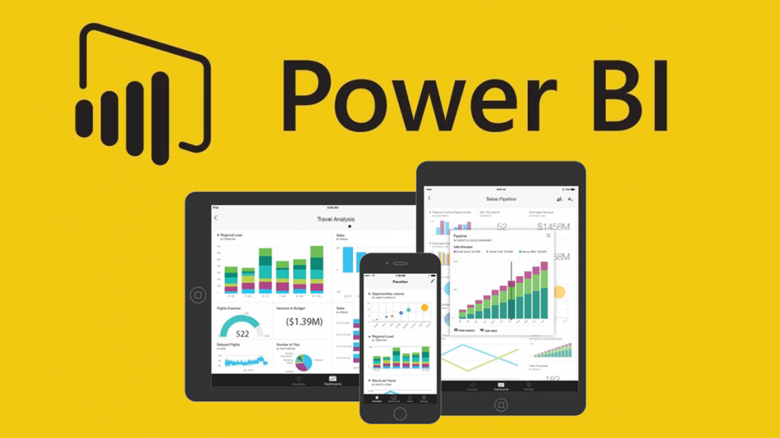

Requirment

Slide 6
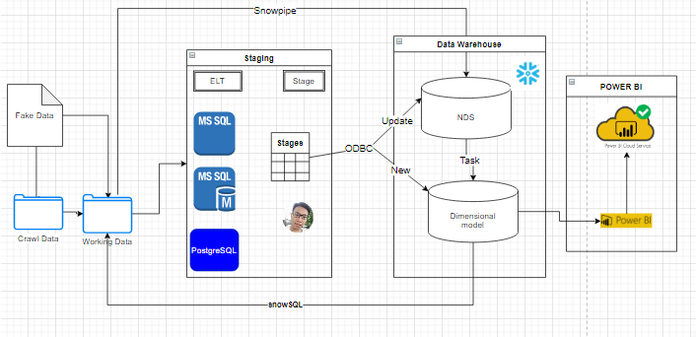
Flow

Slide 7
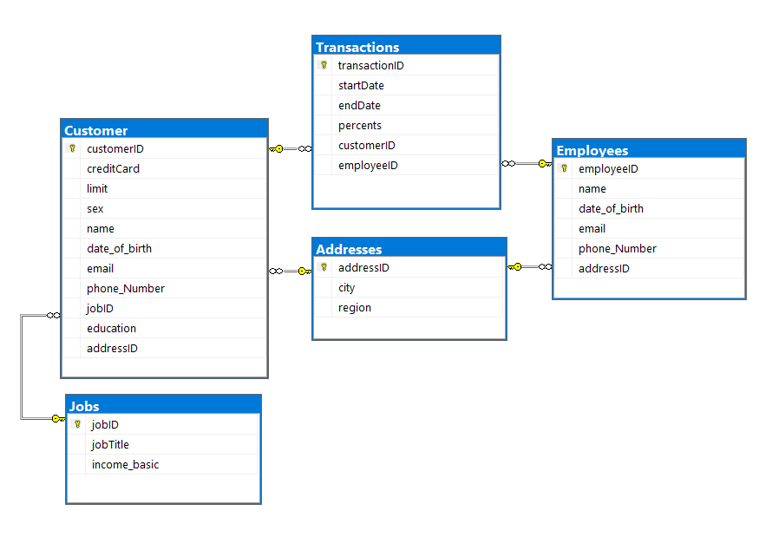
Data Finance Original.

Slide 8
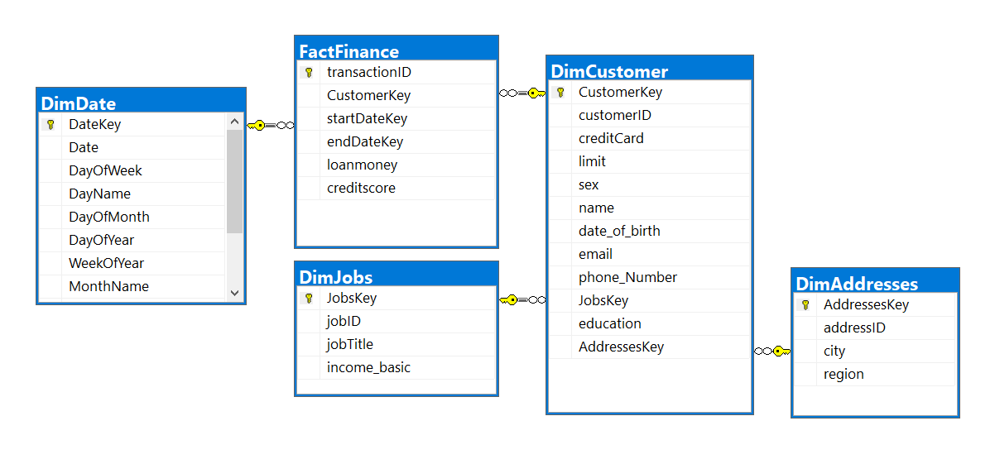
Data Warehouse Finance

Slide 9
Setting
Folder:
.\resources
.
\rawData\: include data upload,download,raw, workdata,Object(run python)
\Solution\: SSIS Project and file(log run…). File Finance.sln to open SSIS In Visual Studio.
.\powerBI: powerBI pakage and dashboard.
.\src\: Folder include Folder MSSQL, Snowflake, Snowpipe.
.\doc\: schema, flow, computation

Slide 10

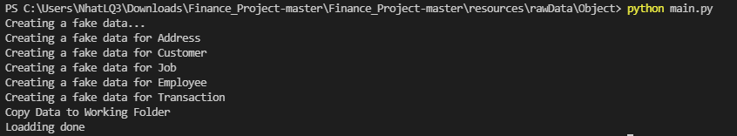
Make Raw Data
- Create fake data: Address, Customer, Job, Employee, Transation. Output: file Csv.
B1. Go to folder, Install the required module to run the python package file:
B2. Run the python package file:
Result:

Slide 11
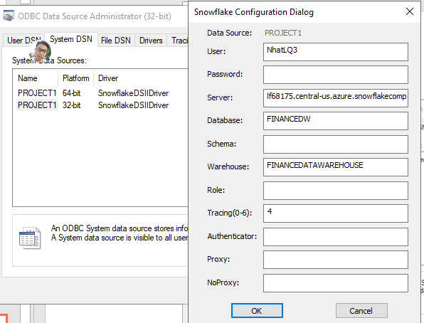
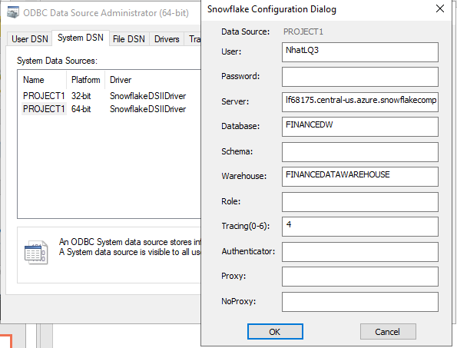
ODBC
Here
- Make connection Snowflake with local to run SSIS.
Download ODBC.
Set ODBC account: System DSN 32bit,64bit

Slide 12
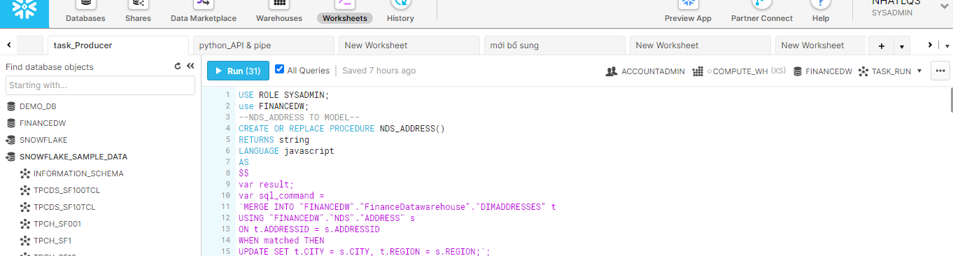
Snowflake
- The Complete Cloud Data Platform
Go and login:
https://lf68175.central-us.azure.snowflakecomputing.com/console
Upload and run:
init_snowflake.sql (Create table, credentials)
task_procedure.sql (Create produre, task)
Snowpipe.sql (Start connect snowpipe)

Slide 13

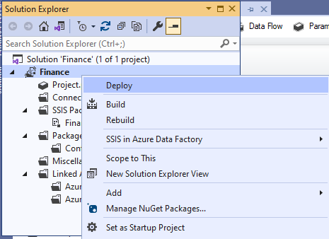
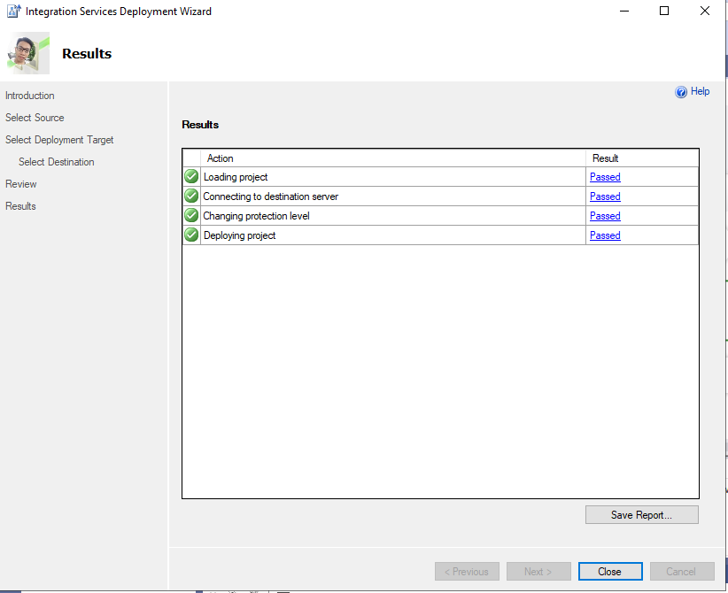
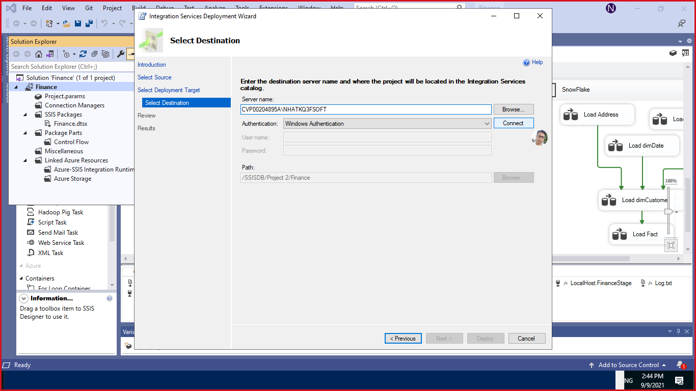
SSIS Deploy
B1. Deploy Pakage
Deploy SSIS pakage in SQL Server Agent
B3. Wait to finish pakages.
Process, ETL Data, Convert, Computating, Making Stage Data and Upload to Cloud,…
B2. Set server connection

Slide 14

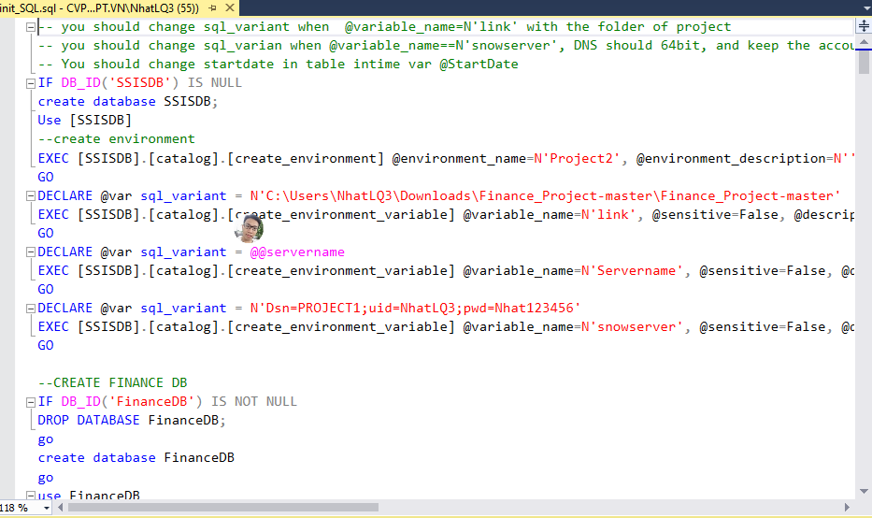
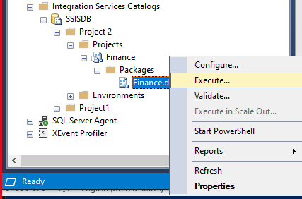
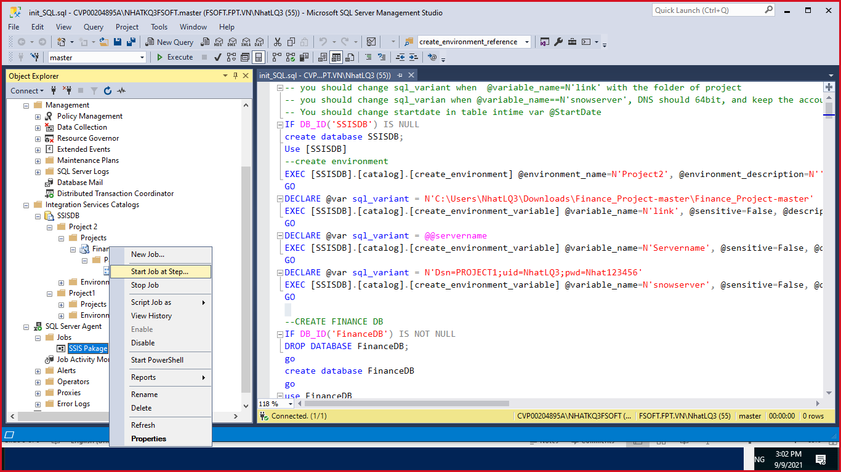
SQL
Create table, job, schedule to EXECUTE pakage SSIS in SQL.server
1. Change variable and run init
2. Refresh SSISDB and run execute pakages.
3. Start Job at Step…

Slide 15
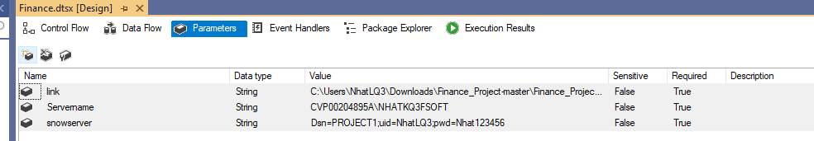

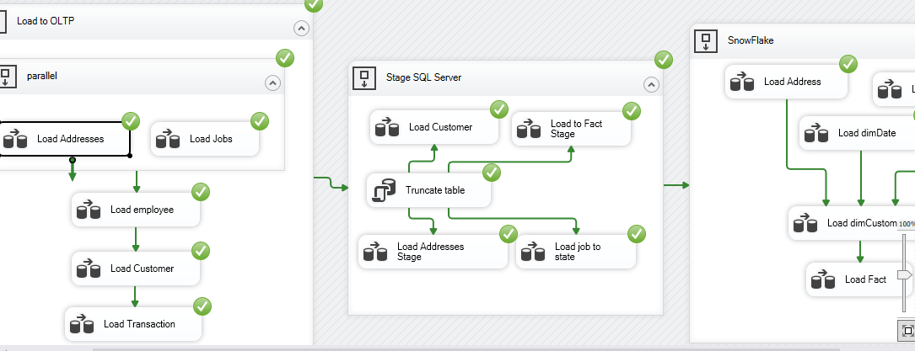
SSIS Run VS
Run SSIS in VS.
B1. Set Paramter
B2. Click

Slide 16

Snowpipe
Upload Finance.csv data to snowflake by snowpipe and python API.
Download data from Snowflake to local by snowsql and python API.
B1.Go to folder, Install the required module to run the python package file:
B2.Run the python package file:

Slide 17
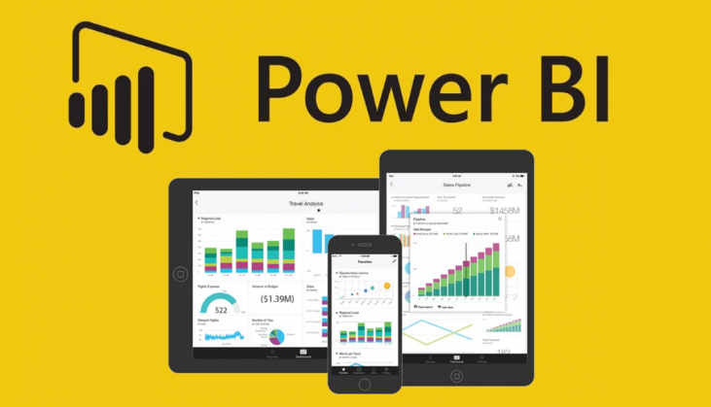
PowerBI
- Visualization Data Warehouse from Snowflake
Run file in desktop
Access the link online in Github.
- Schedule refresh data:
6.AM Daily
9.AM Daily
12.AM Daily
3.PM Daily
6.PM Daily

Slide 18

DEMO

