Slide 1
Capacitated Arc Routing Problem
Matouš Pelikán

Slide 2
Problem Definition – Capacitated arc routing problém (CARP)
Less studied than vehicle routing problems (travelling saleman problém)
Combinatorial optimization problem defined in a connected undirected graph
Edges have non-negative costs and demands
Fleet of vehicles with limited capacity that must service all edges with positive demand (required edges)
Objective: search for a set of minimum cost tours that begin and end in a distinguished node, called depot, while satisfying all the demands of requried edges

Slide 3
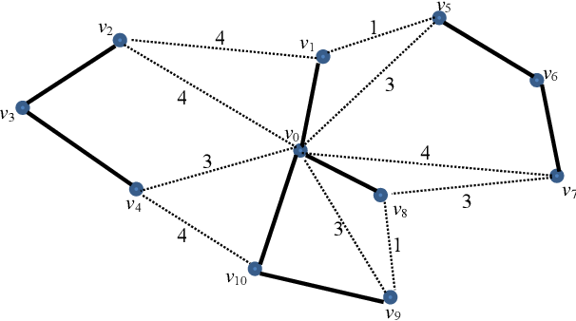
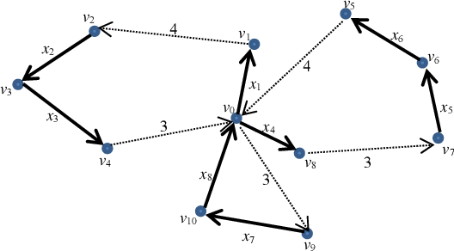
CARP
Edges in bold are required and have to be included in final tour
Required edges have associated cost for their traversal and specific demand which a vehicle has to satisfy
Dotted lines are optional and have only their cost specified
Example of task input
One of many possible solutions

Slide 4
Existing methods
Large instances usually solved by metaheuristic approaches
Ant-colony metaheuristic - inspired by ant colonies that finds the best solution by making probabilistic choices based on a pheromone trail.
Tabu search - avoids local optima by preventing revisiting "tabu" solutions.
Iterated local search – iteratively improves solutions through iterative local search and occasional perturbation to escape local optima.
Genetic algorihms - inspired by the principles of natural selection and genetics that finds the best solution by iteratively recombining, mutating, and selecting a population of candidate solutions.
Many others including simulated annealing, variable neighborhood search, guided neighborhood search

Slide 5
MAENS
K. Tang, Y. Mei and X. Yao, "Memetic Algorithm With Extended Neighborhood Search for Capacitated Arc Routing Problems," in IEEE Transactions on Evolutionary Computation, vol. 13, no. 5, pp. 1151-1166, Oct. 2009
Our approach will draw inspiration from MAENS algorithm and its operators
Memetic algorithm with extended neighborhood search
Traditional move operators:
Single insertion
Double insertion
Swap
2-opt
Novel MS (Merge-split) operator
capable of searching using large step sizes and is less likely to become trapped in locally optimal solutions

Slide 6
CARP benchmarks
Number of public testing instances are available
Updated lower and upper bound values and integer solutions for well-known CARP benchmark instances, including the KSHS, GDB, BBCM, EGL, EGL-large, and BMCV are all widely accessible
Most of the research reports their result on these datasets -> easy comparison
This testing data varies in number of vehicles, number of required edges and the proportion of required edges to the total number of edges
Number of edges goes up to 200 in the biggest instances

Slide 7
IREANN
Jiří Kubalík and Michal Snížek, A novel evolutionary algorithm with indirect representation and extended nearest neighbor constructive procedure for solving routing problems, 2014 14th International Conference on Intelligent Systems Design and Applications, IEEE, 2014, pp. 156–161.
Efficient evolutionary algorithm for routing problems
IREANN represents the foundation for our CARP implementation
IREANN was originally proposed for the Traveling salesman problém (TSP)
Principal components:
Indirect representation
Extended nearest neighbor contructive procedure (NNCP)
Crossover operator
Evolutionary algorithm
Standard iterated evolutionary process involving selection, mutation, crossover

Slide 8
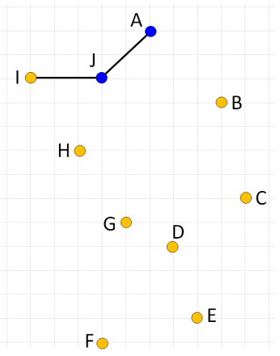
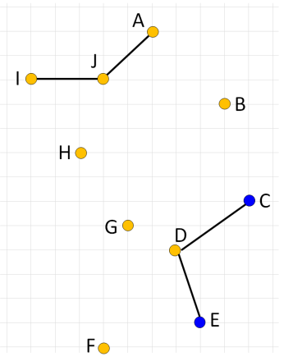
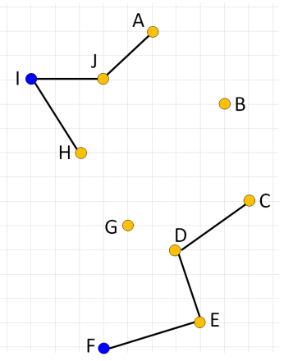
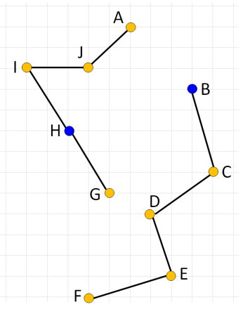
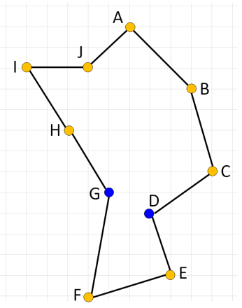
IREANN Constructive procedure
In each step, an element from the priority list is picked and the component it is part of is connected to another component via the nearest neighbor heuristic
The number of solutions that can be constructed using the NNCP is limited
The optimum might get unreachable with the NNCP
P = {A, J, C, E, I, F, B, H, G, D}
A, J
A, J, C, E
A, J, C, E, I, F
A, J, C, E, I, F, B, H
A, J, C, E, I, F, B, H, G, D

Slide 9
IREANN for CARP
Deals with edges instead of nodes
Modifications to the constructive procedure are needed
Distinguish which ends of an edge have to be considered as possible candidates for expansion
MS operator from MAENS
Randomly selects p routes, creates 5 different ordered lists of tasks, which are then passed to an exact splitting procedure which outputs the best one according to the objective function

Slide 10
IREANN extension
Algorithm is to be extended with a mechanism that identifies high-level solution components on the fly during the evolutionary process
Use them as new elements that can be used in the priority lists
Mechanism looks for similar patterns in population of candidates among the individuals with the best fitness score and them treats those parts the same way as it treats individual edges
Determine optimal size of such parts

