Slide 1

RISHI
A teacher inside every book.
Make dense material easier to understand through explanations, conversation, reading, and listening.
Google AI Lab application • First draft
01

Slide 2
THE PROBLEM
A book often assumes the reader already has a teacher.
Dense material can be difficult to follow, break down, remember, and discuss.
THE QUESTION
What if the guidance you need lived inside the book?
When a learner gets stuck, progress often stops—not because they lack motivation, but because the explanation is missing.
Learning should not stop at the moment a reader gets stuck.
RISHI • GOOGLE AI LAB • FIRST DRAFT
02

Slide 3
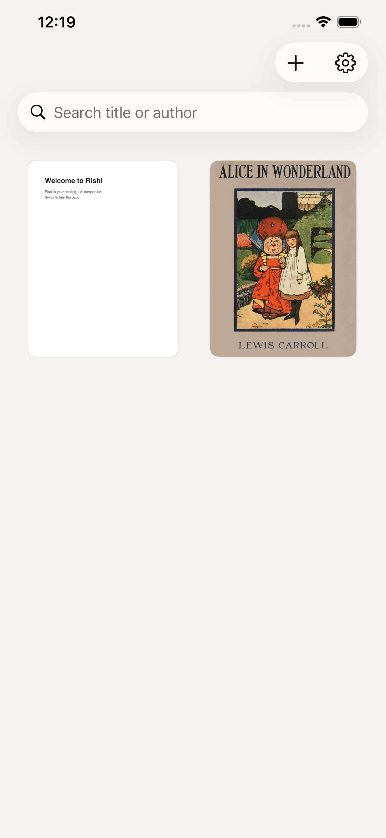
THE IDEA
A teacher-like assistant, inside the reading experience.
Ask for an explanation. Break down a difficult passage. Explore the meaning in context.
Rishi turns the moment of confusion into a next step.
The goal is simple: make learning easier for anyone with a book.
RISHI • GOOGLE AI LAB • FIRST DRAFT
03

Slide 4
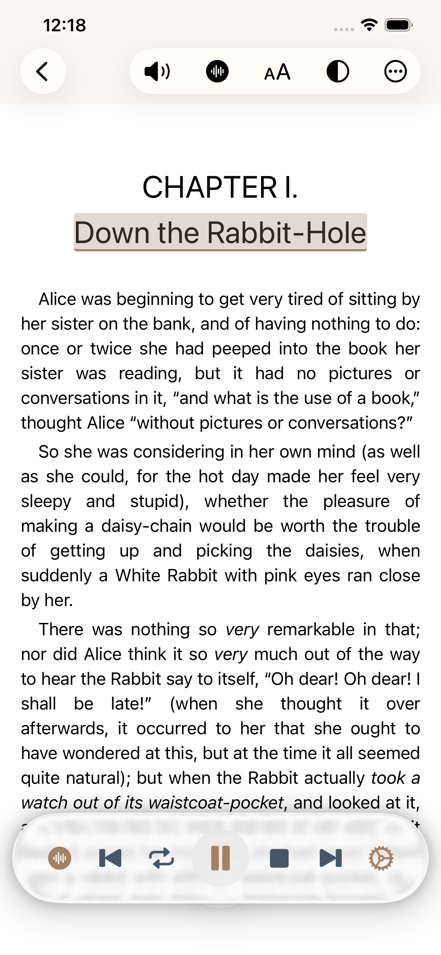
TWO WAYS TO LEARN
See the material. Hear the material. Keep moving.
READ
LISTEN
Follow the page, highlight ideas, search the text, and stay in context.
Use text-to-speech to hear the material while reading, walking, commuting, or reviewing.
Rishi makes learning more flexible by bringing visual and auditory modes together.
RISHI • GOOGLE AI LAB • FIRST DRAFT
04

Slide 5
CONTEXTUAL AI
The assistant is grounded in the book you are reading.
Rishi is designed to help a reader move from “I’m stuck” to “I understand” without leaving the material.
Book-specific conversations
Text and semantic/vector search
Retrieval and embeddings/indexing
Explanations connected to current material
This is not about replacing teachers. It is about making guidance available in the moment a learner needs it.
RISHI • GOOGLE AI LAB • FIRST DRAFT
05

Slide 6
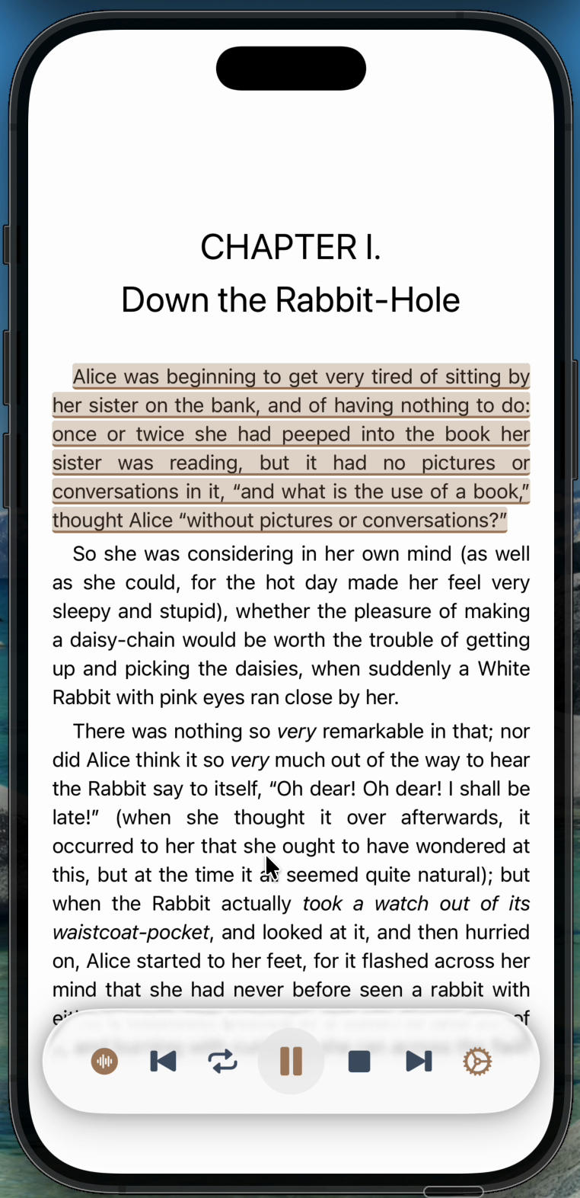
PRODUCT DEMO
A 68-second journey from page to assisted learning.
The recording shows the real iPhone experience: open a book, stay with the page, listen, and keep moving.
WATCH THE RECORDING
[Insert public demo-video link]
RISHI • GOOGLE AI LAB • FIRST DRAFT
06

Slide 7
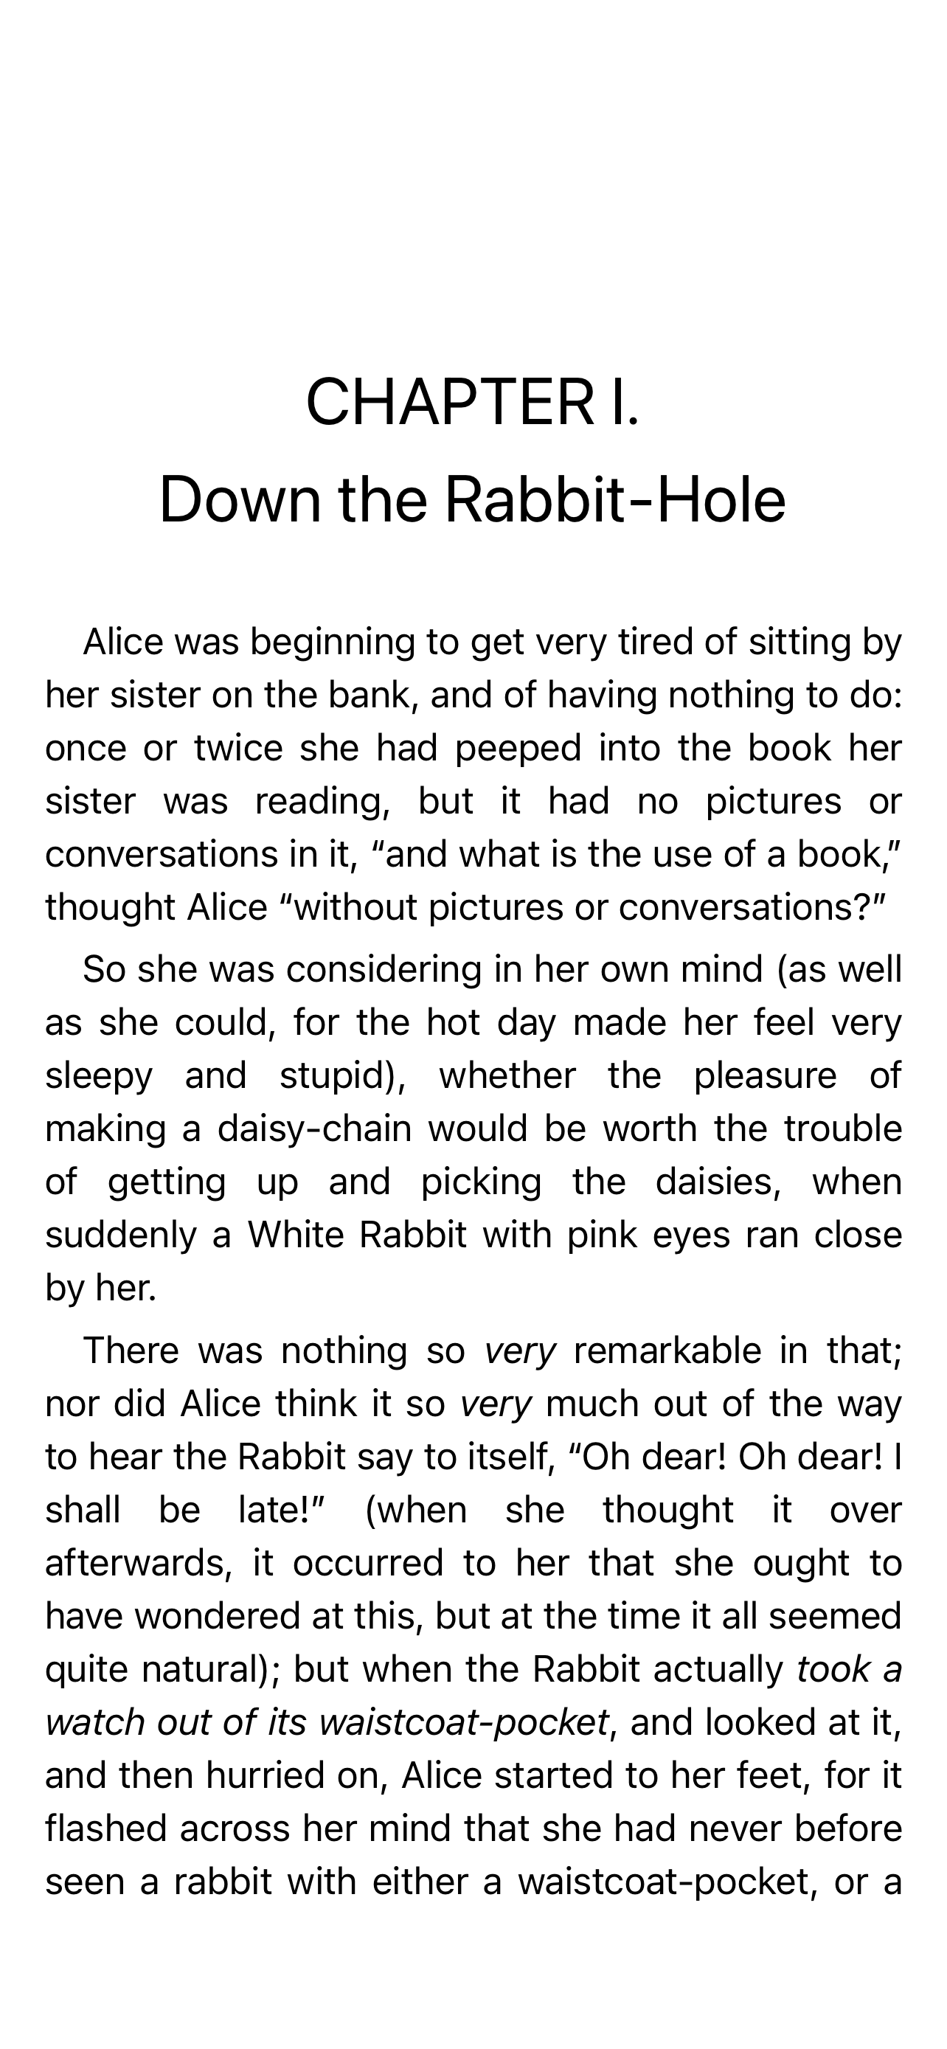
FROM BOOK TO UNDERSTANDING
Turn reading into an active learning workflow.
Choose a book → Read and listen → Ask for an explanation Search and revisit → Highlight and bookmark the insight
The product brings the teacher, the page, and the voice into one continuous experience.
RISHI • GOOGLE AI LAB • FIRST DRAFT
07

Slide 8
GO-TO-MARKET
Win Apple first. Expand from a position of strength.
Rishi’s first ecosystem is Apple: iPhone for everyday learning, iPad for deeper reading, and App Store distribution for a focused launch.
NOW
NEXT
LATER
iPhone App Store launch
iPad Long-form reading
Other platforms After Apple fit
[Add exact App Store status and date]
RISHI • GOOGLE AI LAB • FIRST DRAFT
08

Slide 9
MEASUREMENT
We are pre-revenue. Launch is where the learning begins.
We do not yet have meaningful usage or validation metrics. At launch, we will establish baselines for:
01
02
03
04
Activation and books imported
Reading and listening sessions
AI questions and explanations
Retention and feedback
RISHI • GOOGLE AI LAB • FIRST DRAFT
09

Slide 10
WHY RISHI / WHY NOW
Knowledge should feel less solitary—and Apple is the right first home.
Conversational AI can make the act of learning feel guided, responsive, and human.
APPLE-FIRST ADVANTAGE
A coherent iPhone + iPad reading experience, shipped and refined before expanding.
Rishi brings that guidance directly into the book—so the learner can ask, listen, revisit, and understand in context.
FOUNDER STORY
[Add founder story and location]
RISHI • GOOGLE AI LAB • FIRST DRAFT
10

Slide 11
THE ASK
Help us make understanding easier for anyone with a book.
We are seeking support to turn a launch-ready prototype into a reliable daily learning tool.
NEXT STEP
AI product and model guidance
Evaluation expertise for explanations and grounded answers
Launch mentorship and feedback
[Refine the specific Google AI Lab request]
RISHI • GOOGLE AI LAB • FIRST DRAFT
11

