Slide 1

SPANISH
BERRIES MARKET ANALYSIS

Slide 2
Weekly Spanish prices paid to farmers in euros per kilogram
Data Source: Junta de Andalucía
Data kind: weekly prices of raspberry fruit paid to farmers (at the farm gate)
Historical depth: +4 years
Cumulated average price of the year for evolution analysis
Boxplot graph showing
Box covering interquartile range (Q1/25th percentile – Q3/75th percentile)
Edges for minimum -Q1 -1.5*IQR- and máximum -Q3 + 1.5*IQR-)
Points for outliers

Slide 3

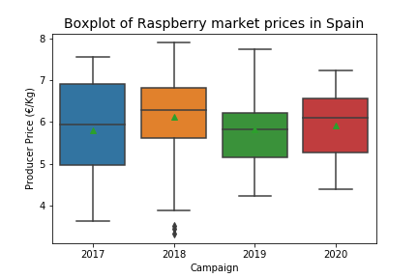
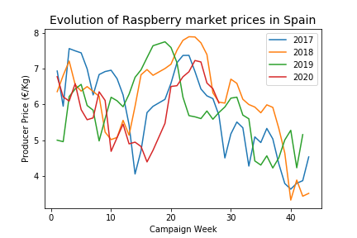
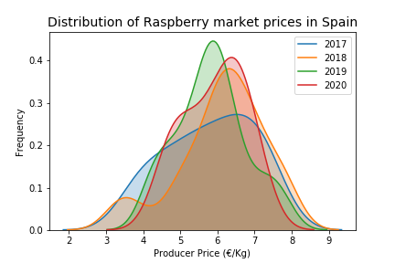
Spanish raspberry fruit insights

Slide 4

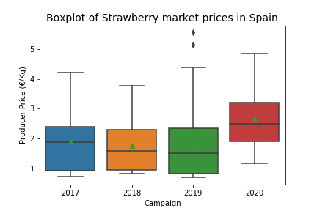
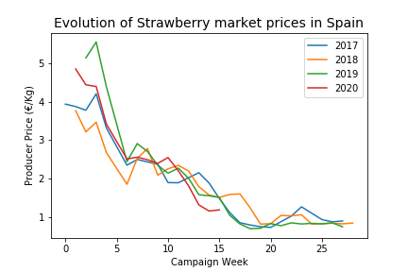
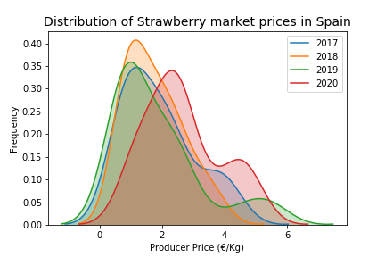
Spanish strawberry fruit insights

Slide 5

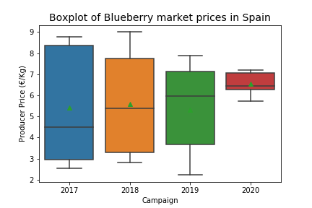
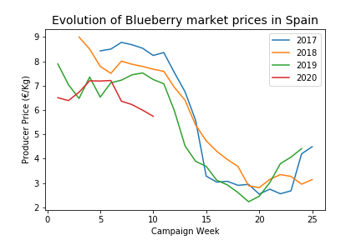
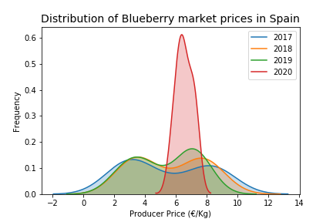
Spanish blueberry fruit insights

