Slide 1
On the Xi/pi as of <dN/dh>
Thanks Livio!

Slide 2
Poor mans scaling with ~area: 1/sqrt(Npart)
Only AA points dN/dh scaled

Slide 3
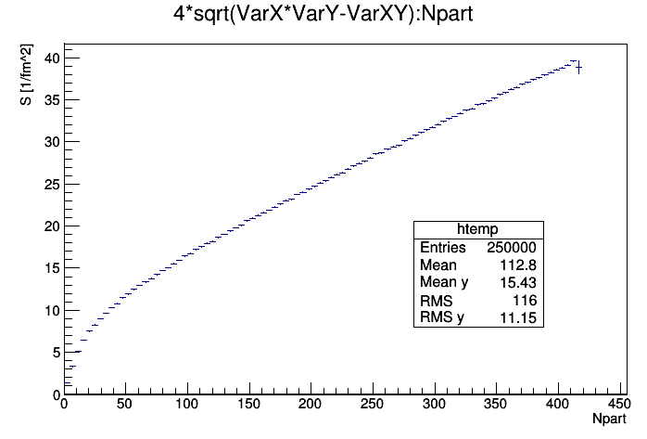
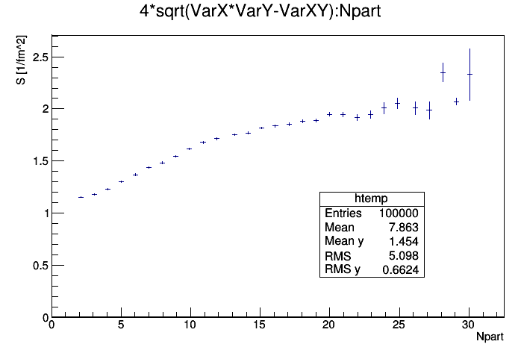
Area_{T}
Thanks Constantin!
PbPb
pPb
Numbers from: dN/deta (centrality) -> Npart -> S

Slide 4
On the Xi/pi as of <dN/dh>

Slide 5
On the Xi/pi as of <dN/dh>/S

Slide 6
On the Xi/pi as of <dN/dh>/S
ALL pp, pPb, PbPb <dN/dh> scaled by S

Slide 7
On the Xi/pi as of <dN/dh>

