Slide 1


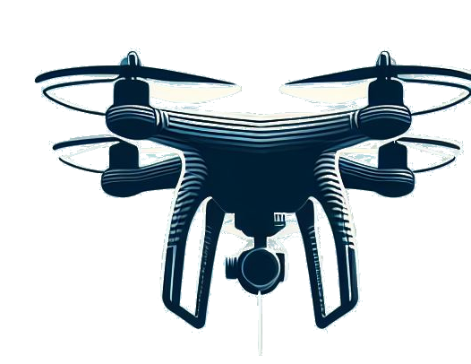
Programming Environment for Human-Drone Interaction: EasyFly
SCUOLA DI INGEGNERIA INDUSTRIALE E DELL’ INFORMAZIONE
LAUREA MAGISTRALE IN
COMPUTER SCIENCE ENGINEERING
Author: Matteo Plona
Student ID: 952967
Advisor: Prof. Luca Mottola Academic Year: 2022-23

Slide 2




The Solution
Contribution
?
The Problem
State of Art
Evaluation

Slide 3



The Problem: Programming HDI
HDI
Minimal human presence
Techology
progress
Simple and repetitive interactions
Complex and expansive programming environments
Advanced
Application

Slide 4








The Solution
Simple usage
EasyFly
Reduce cost
Modular
Reduce time
Strategies
Objectives
Nano drones
Facilitate interactions

Slide 5

State of The Art
The field of HDI is an active and evolving area of research.
It is a multidisciplinary field with two main research areas: technological and sociological.
Researchers in sociological area usually have less familiarity with programming tools.

Slide 6





EasyFly’s Base Platform
EasyFly
crazyflie-firmware
crazyflie-lib-python
write
read
write
read
CRTP packet
radio communications
CRTP packet

Slide 7
Extended CrazyFlie
ECF
Centralization to a single component for all the functionality provided inside the programming environment.
Communication Framework
Coordination Framework
Automation of all processes that are usually performed in most drone applications.
ECF Module
..
ECF Module
..
ECF Module

Slide 8
Communication Framework
Communication Framework is a software component hosted on the ground station.
Handle all the communication between the ground station and the flying drone.
Manages the communication stream into two separate flows: parameter setting and telemetry logging.
Composed of 2 publish/subscribe systems: Parameter and Logging Managers.

Slide 9
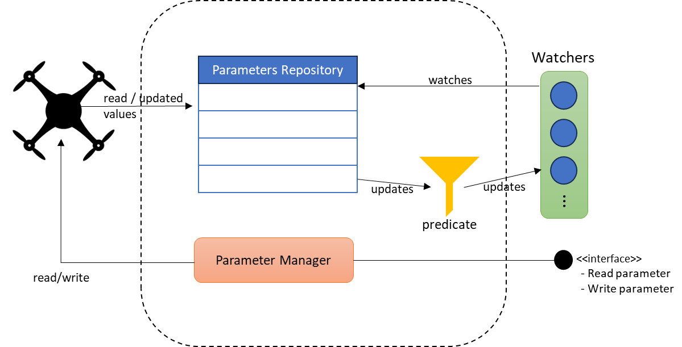
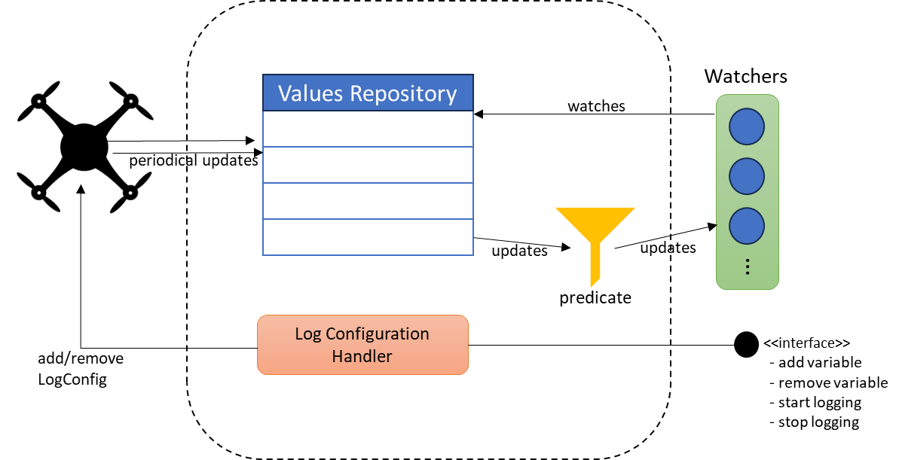
Communication Framework
Logging Manager
Parameters Manager

Slide 10



Coordination Framework
Coordination Framework is a software component hosted on the ground station.
Coordination Framework
Observable
notify
It is a centralized entity that synchronize different parts of the same application.
Producer
Observer
add/update
create/update
Coordination Manager
subscribe
It is designed as an event-based system.

Slide 11


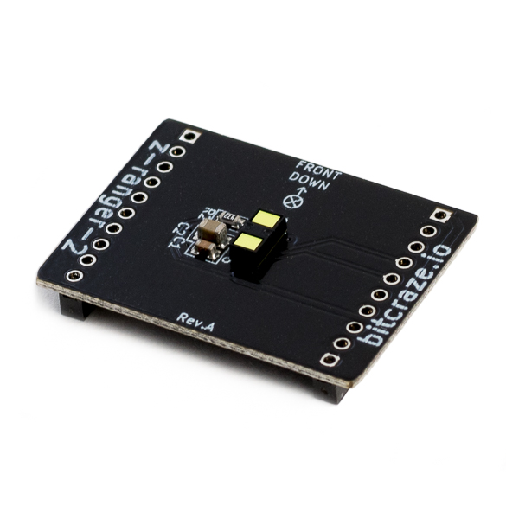
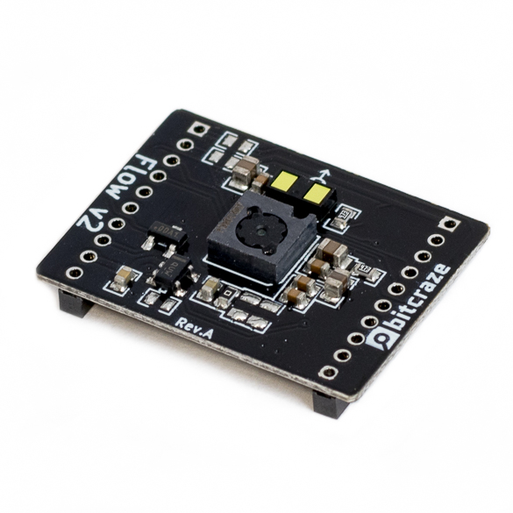
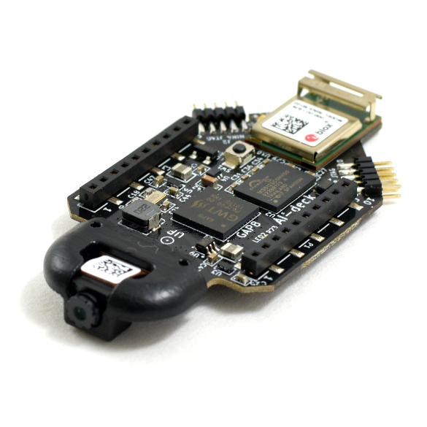
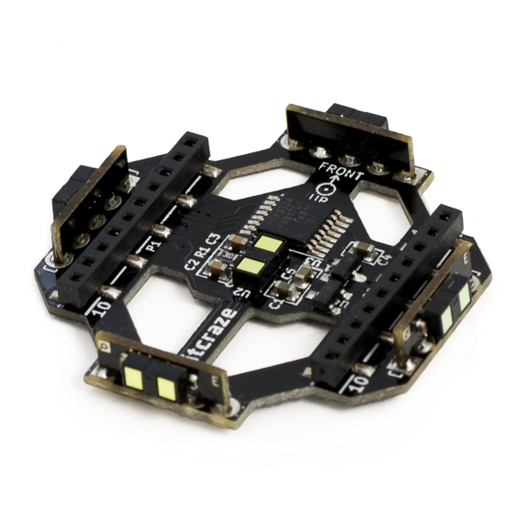
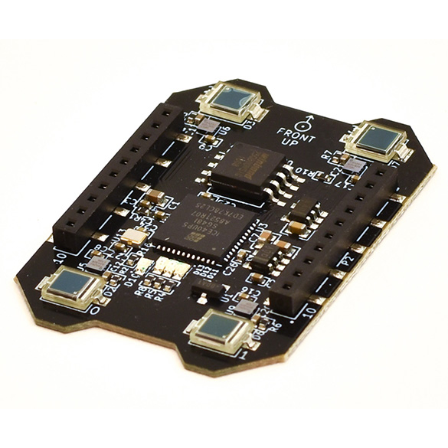
ECF Modules
The ECF Modules are the software components hosted on the ground station.
They are an encapsulated set of functionality, that operates on a specific feature of the programming environment.
They automatize most of operation for deck usage

Slide 12



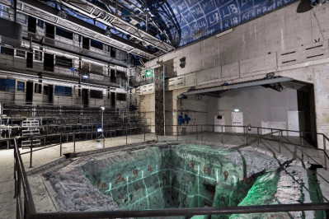

Qualitative Analysis
To evaluate EasyFly we had the possibility to participate to the Drone Arena project.
Goal: measure the impact of using EasyFly on users with different background.
The solution developed with EasyFly was cleaner and more advanced with respect to other solution with the base Crazyflie platform.
KTH’s Reactor Hall, Stockholm.

Slide 13

Ground Station Performance Analysis
We compared EasyFly with the implementation using the base Crazyflie platform across two real example applications used in HDI research.
Goal: ensure complexity reduction and small increase of system load.
Metrics
Complexity | System load
Lines of Codes (LOC) | Memory (RAM) consumption
Cyclomatic Complexity (CC) | Max and Average CPU consumption
Halstead Metrics (HAL) | Network load

Slide 14
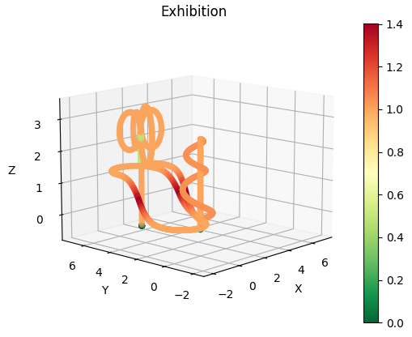
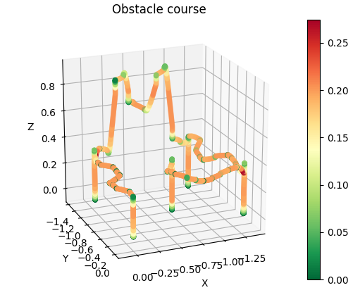
Simulation Environment
EasyFly Script
CRTP via radio
CrazyFlie 2.1
CRTP via local UDP channel
Virtual CrazyFlie

Slide 15
Results
HAL
Scenario | η | N | V | D | E
Exhibition with cflib | 33 | 45 | 226,99 | 4,04 | 916,72
Exhibition with EasyFly | 38 | 48 | 251 | 3 | 755,7
Obstacle course with cflib | 171 | 296 | 2195,68 | 8,74 | 19187,8
Obstacle course EasyFly | 108 | 168 | 1134,82 | 7,66 | 8696,31

Slide 16
Results
CPU Load
Scenario | CPU Average (%) | CPU MAX (%)
Exhibition with cflib | 0.570 | 12.829
Exhibition with EasyFly | 0.266 | 16.449
Obstacle course with cflib | 0.540 | 18.423
Obstacle course EasyFly | 0.625 | 22.340

Slide 17
Thank you for your attention

