Slide 1


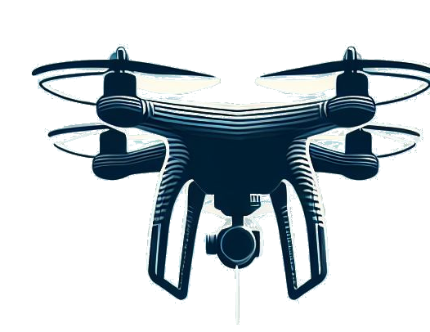
Programming Environment for Human-Drone Interaction: EasyFly
SCUOLA DI INGEGNERIA INDUSTRIALE E DELL’ INFORMAZIONE
TESI DI LAUREA MAGISTRALE IN COMPUTER SCIENCE ENGINEERING
Author: Matteo Plona
Student ID: 952967
Advisor: Prof. Luca Mottola Academic Year: 2022-23

Slide 2
Summary

Slide 3



The Problem: Programming HDI
Minimal human presence
Simple and repetitive interactions
Complex and expansive programming environments
HDI
Techology progress
Advanced Application
Notes:
- HDI definition and purposes
- Modern Application are in contrast with HDI reasearch

Slide 4








The Solution
Simple usage
EasyFly
Reduce cost
Modular
Reduce time
Strategies
Objectives
Nano drones
Facilitate interactions

Slide 5
State of The Art
The field of HDI is an active and evolving area of research.
It is a multidisciplinary field with two main research areas: technological and sociological.
Researchers in sociological area usually have less familiarity with programming tools.

Slide 6
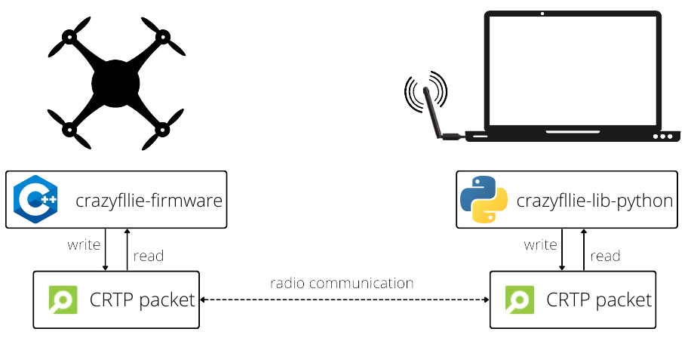
EasyFly’s Base Platform
EasyFly
Notes:
Modular drone
Nanodrone CrazyFlie 2.1

Slide 7
Extended CrazyFlie
Centralization to a single component for all the functionality provided inside the programming environment.
Automation of all processes that are usually performed in most drone applications.
ECF
Communication Framework
Coordination Framework
ECF Module
..
ECF Module
..
ECF Module

Slide 8
Communication Framework
Communication Framework is a software component hosted on the ground station.
Handle all the communication between the ground station and the flying drone.
Manages the communication stream into two separate flows: parameter setting and telemetry logging.
Composed of 2 publish/subscribe systems: Parameter and Logging Managers.

Slide 9
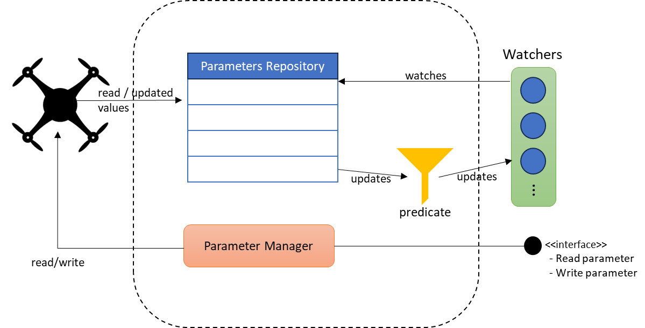
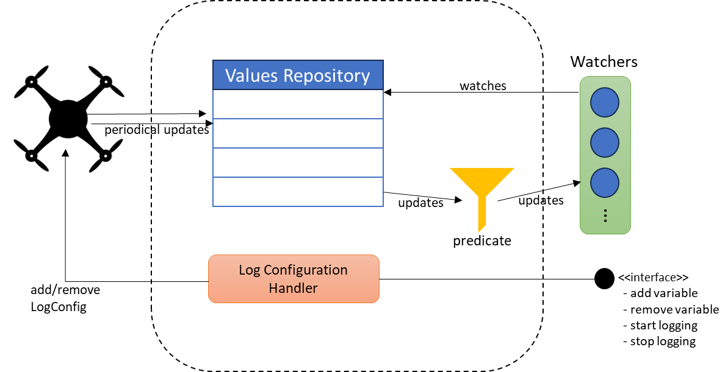
Communication Framework
Logging Manager
Parameters Manager

Slide 10
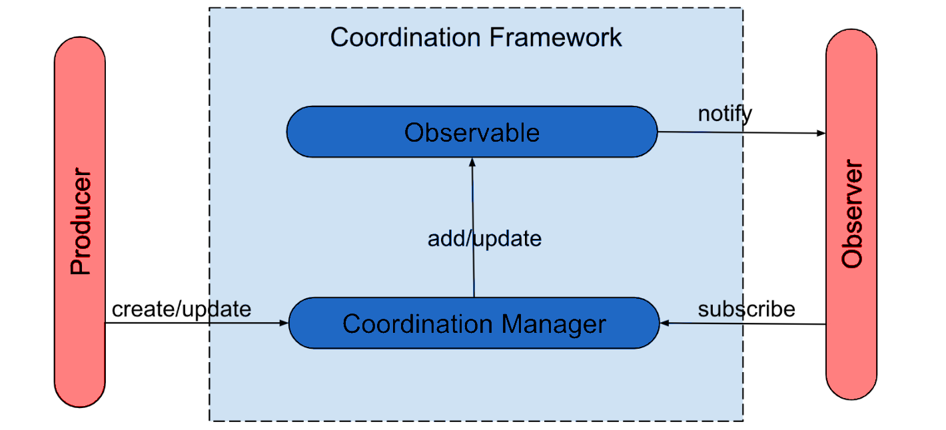
Coordination Framework
Coordination Framework is a software component hosted on the ground station.
It is a centralized entity that synchronize different parts of the same application.
It is designed as an event-based system.

Slide 11
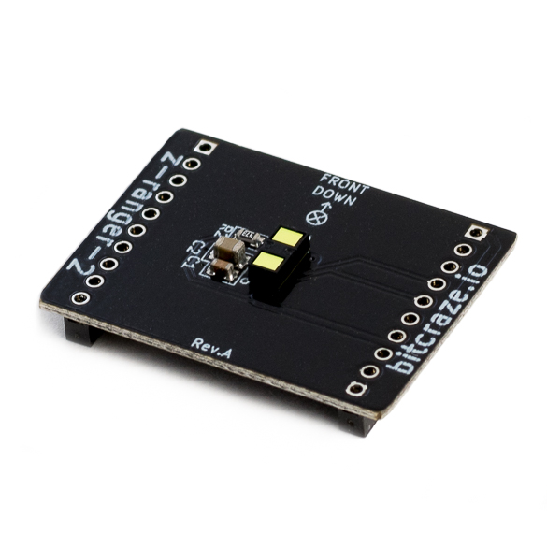
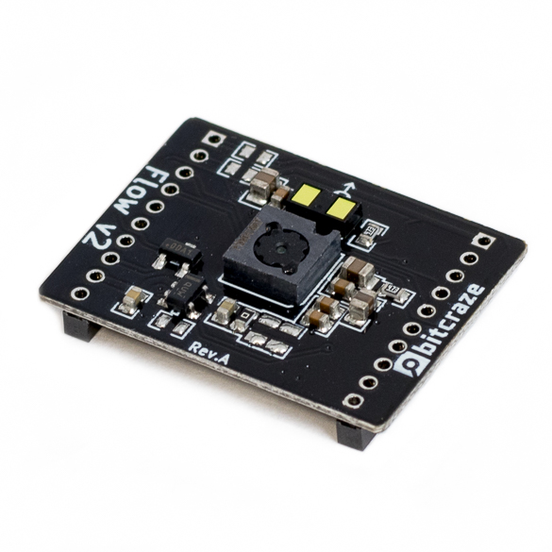
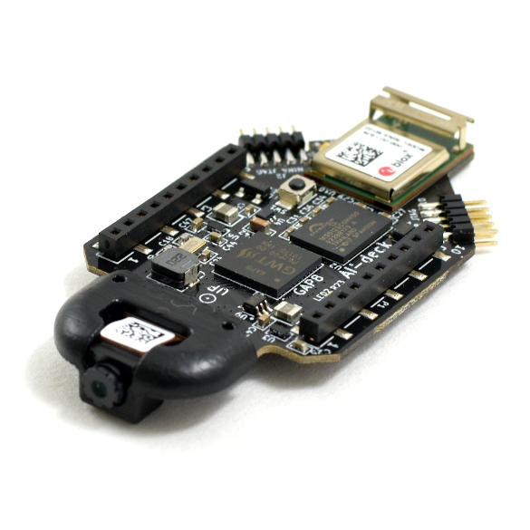
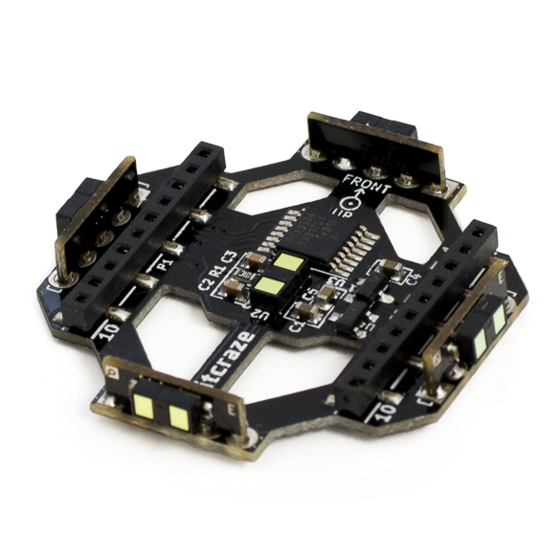
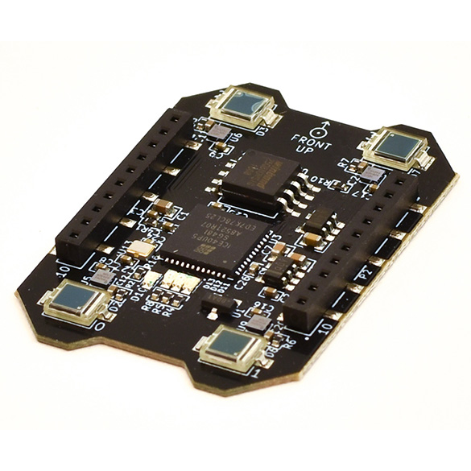
ECF Modules
The ECF Modules are the software components hosted on the ground station.
An encapsulated set of functionality, that operates on a specific feature of the programming environment.
They automatize most of operation for deck usage

Slide 12
Evaluation Overview

Slide 13
Qualitative Analysis

Slide 14
Ground Station Performance Analysis

