Slide 1




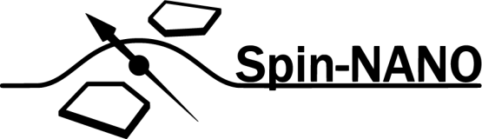
A Multi-Node Quantum Network with Defects in Diamond
Ph.D. Proposal - Matteo Pompili

Slide 2
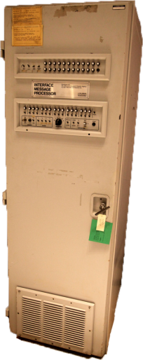

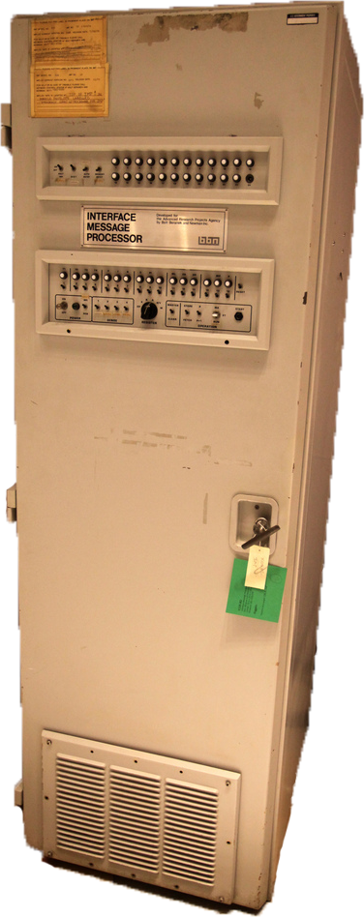

What is a (Quantum) Network?

Slide 3

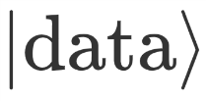
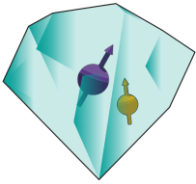

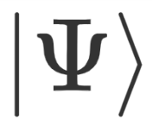
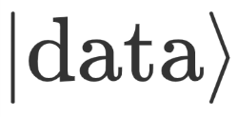

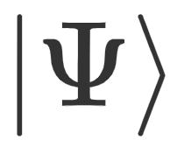

What is a (Quantum) Network?

Slide 4




What is a (Quantum) Network?
Known applications:
Quantum Key Distribution (QKD)
Blind quantum computation
Distributed quantum computation
Clock Synchronization
Leader election
…

Slide 5
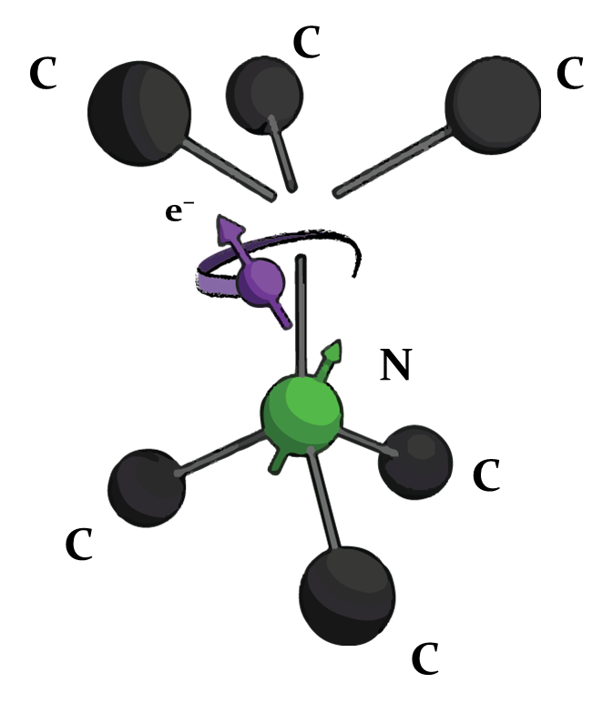

The Nitrogen Vacancy Centre in Diamond
C¹³
C¹³

Slide 6
Research goals
Demonstration of quantum applications on a multi-node network
Generation of genuine multipartite entangled states,
Proof of principle demonstration of the Link layer of the future Quantum Internet stack,
Teleportation of entanglement in a four node network,
Client-Server secure delegation of quantum computation.

Slide 7
Genuine Multipartite Entanglement

Slide 8
Link Layer Demonstration

Slide 9
Teleportation of Entanglement

Slide 10
Client-Server Secure Delegation

Slide 11
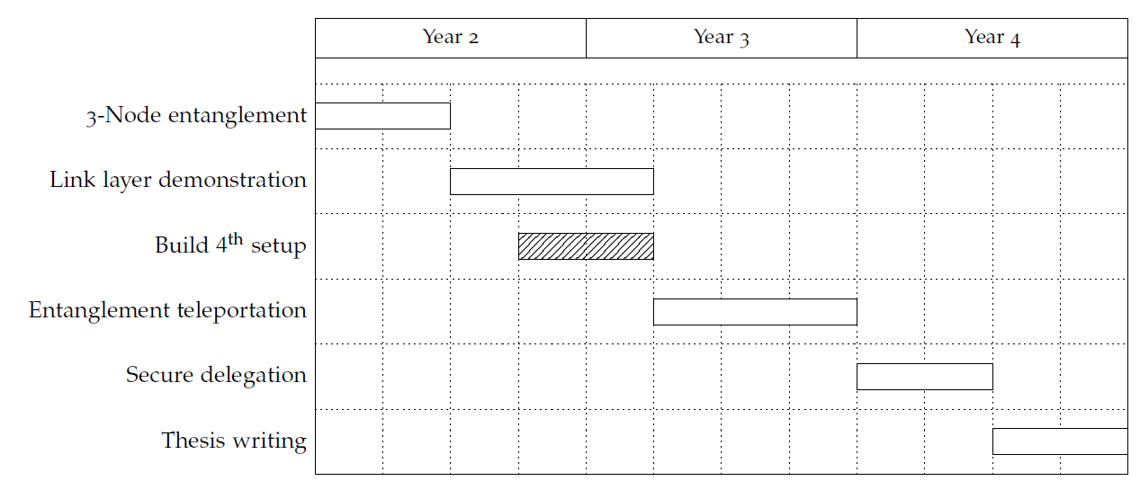
Proposed Ph.D. Timeline

