Slide 1




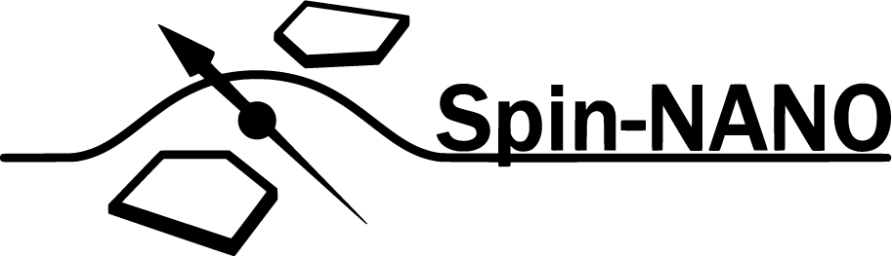
A Multi-Node Quantum Network with Defects in Diamond
Ph.D. Proposal - Matteo Pompili

Slide 2
What is a Quantum Network?

Slide 3
The Nitrogen Vacancy Centre in Diamond

Slide 4
Research goals
Demonstration of quantum applications on a multi-node network
Generation of genuine multipartite entangled states,
Proof of principle demonstration of the Link layer of the future Quantum Internet stack,
Teleportation of entanglement in a four node network,
Client-Server secure delegation of quantum computation.

Slide 5
Genuine Multipartite Entanglement

Slide 6
Link Layer Demonstration

Slide 7
Teleportation of Entanglement

Slide 8
Client-Server Secure Delegation

Slide 9
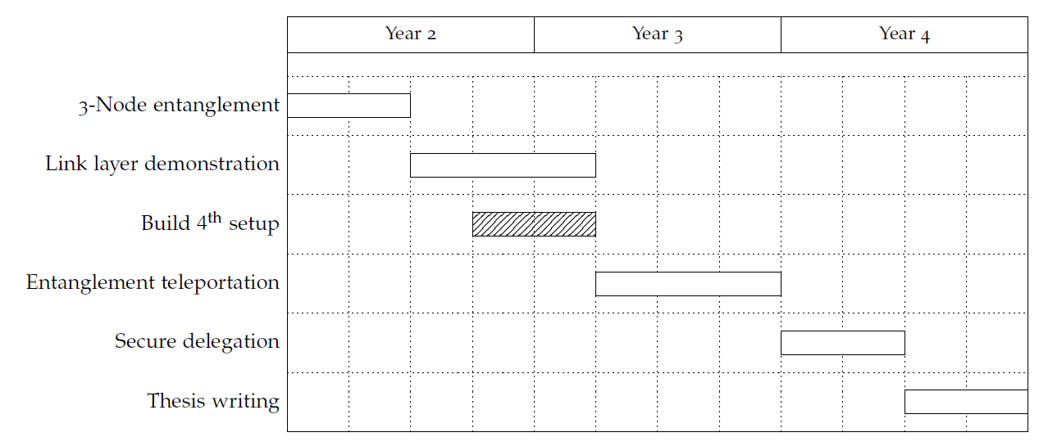
Proposed Ph.D. Timeline

