Slide 1


AWARENESS CLUB
Food Waste
Zero Hunger

Slide 2


World Hunger
Don’t waste food!
Phase 1
Phase 2
It’s a major problem
It’s already happening

Slide 3

Food Wastage
A Nonsensical Problem
According to the Food and Agriculture Organization (FAO) of the United Nations, an estimated 1.3 billion tonnes of food is wasted globally each year, amounting to one-third of all food produced for human consumption. Some common culprits include buffets, restaurants, and even households, for reasons including having purchased too much or even more absurdly, that the food doesn’t look good.
Food Wastage in Events
In Big events like Weddings in India, people are tend to prepare extra food for guests
Ordering via the internet
It's not just limited to events; nowadays, people order food online, and if there's a packaging flaw or a few extra spices, the food is rejected by the customer who paid for it, and it's useless for the restaurant owner as well; he can't deceive his customers by reselling the same item, so the food ends up in the trash.
Purchasing or preparing too much
Many times we have extra servings of food left with us, we can donate it

Slide 4
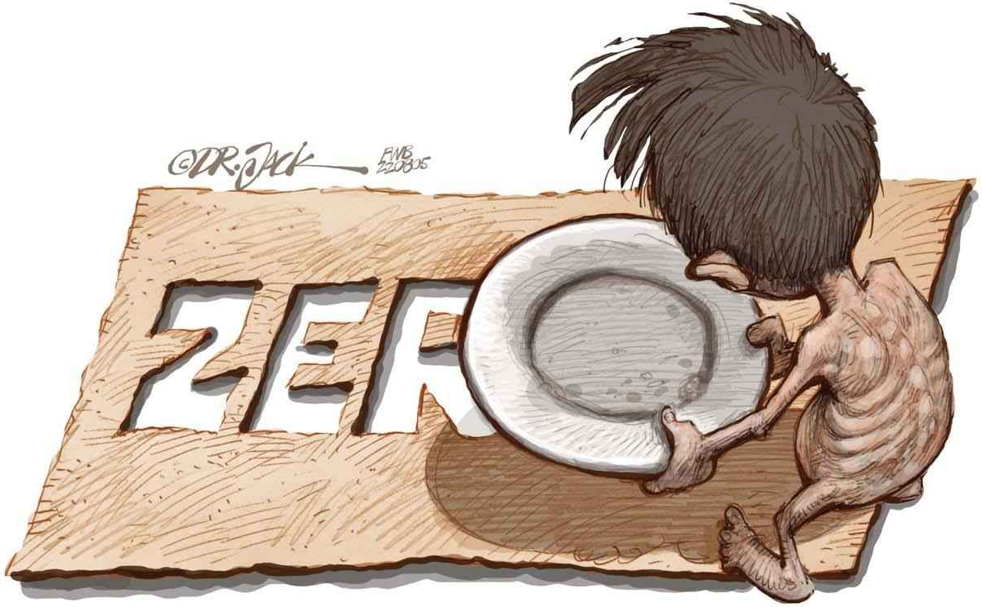
How do we prevent it?
Points to consider.
Sustainable Agriculture
Promote organic farming practices.
Food Security Problems
Educate communities on nutrition.
Support Economic Development
Create job opportunities in rural areas.

Slide 5
STATs
70% of the people want to donate food.
20% want to donate money.
10% want to donate clothes.
2% don’t want to donate.
15%
want to donate via money.

