Slide 1



INTERVIEW QUESTION
This Photo by Unknown Author is licensed under CC BY-SA

Slide 2
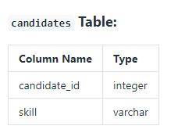
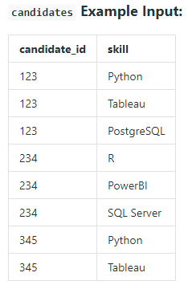
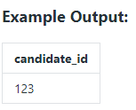
Question 1: DATA ANALYST SKILLS
Given a table of candidates and their skills, you're tasked with finding the candidates best suited for an open Data Analyst job. You want to find candidates who are proficient in Python, Tableau, and SQL.
Write a query to list the candidates who possess all of the required skills for the job. Sort the the output by candidate ID in ascending order.
Assumption:
There are no duplicates in the candidates table.

Slide 3
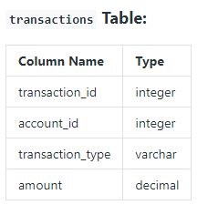
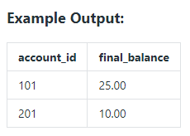
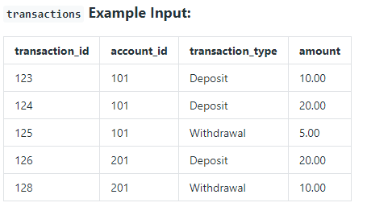
Question 2 : FINAL ACCOUNT BALANCE
Given a table of bank deposits and withdrawals,
Return the final balance for each account.
Assumption:
All the transactions performed for each account are present in the table; no transactions are missing.

Slide 4
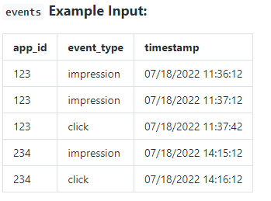
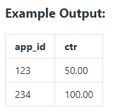
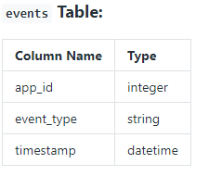
Question 3:App Click-through Rate (CTR)
Assume you have an events table on app analytics.
Write a query to get the app’s click-through rate (CTR %) in 2022.
Output the results in percentages rounded to 2 decimal places.
Notes:
To avoid integer division, you should multiply the click-through rate by 100.0, not 100.
Percentage of click-through rate = 100.0 * Number of clicks / Number of impressions

Slide 5
Question 4: Spotify Streaming History
You're given two tables on Spotify users' streaming data. songs_history table contains the historical streaming data and songs_weekly table contains the current week's streaming data.
Write a query to output the user id, song id, and cumulative count of song plays as of 4 August 2022 sorted in descending order.
Definitions:
song_weekly table currently holds data from 1 August 2022 to 7 August 2022.
songs_history table currently holds data up to to 31 July 2022.
The output should include the historical data in this table.
Assumption: There may be a new user or song in the songs_weekly table not present in the songs_history table.

Slide 6
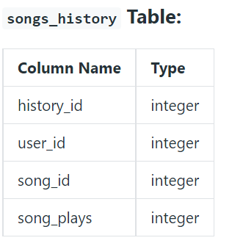
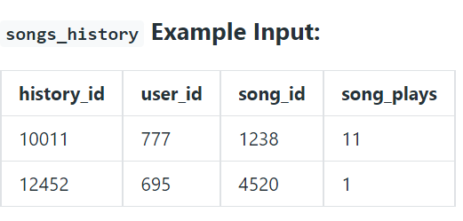
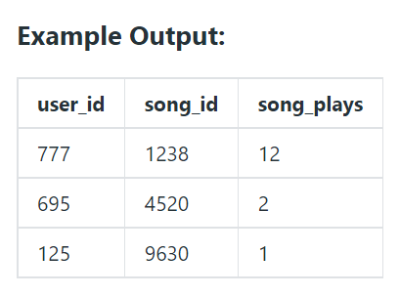
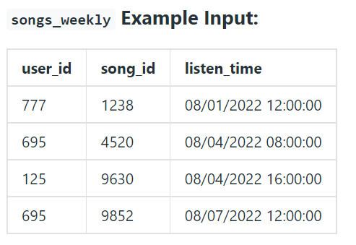
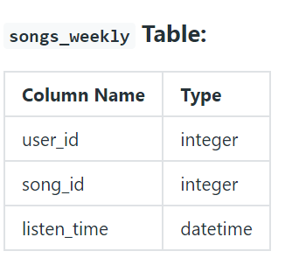
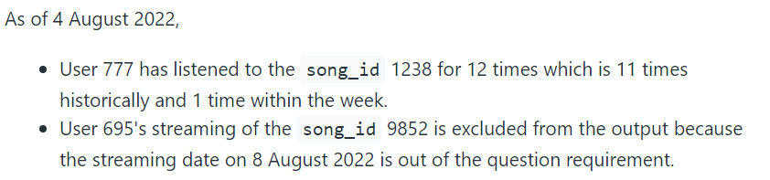
Question 4: Spotify Streaming History

Slide 7
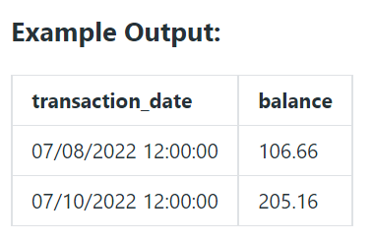
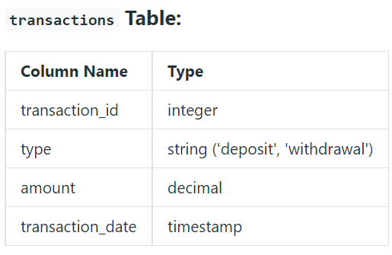
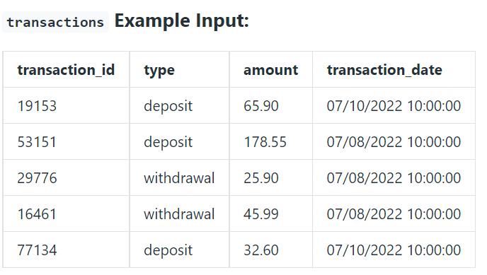

Question 5: Monthly Merchant Balance
Say you have access to all the transactions for a given merchant account.
Write a query to print the cumulative balance of the merchant account at the end of each day, with the total balance reset back to zero at the end of the month.
Output the transaction date and cumulative balance.

Slide 8






This Photo by Unknown Author is licensed under CC BY-SA-NC

