Slide 1
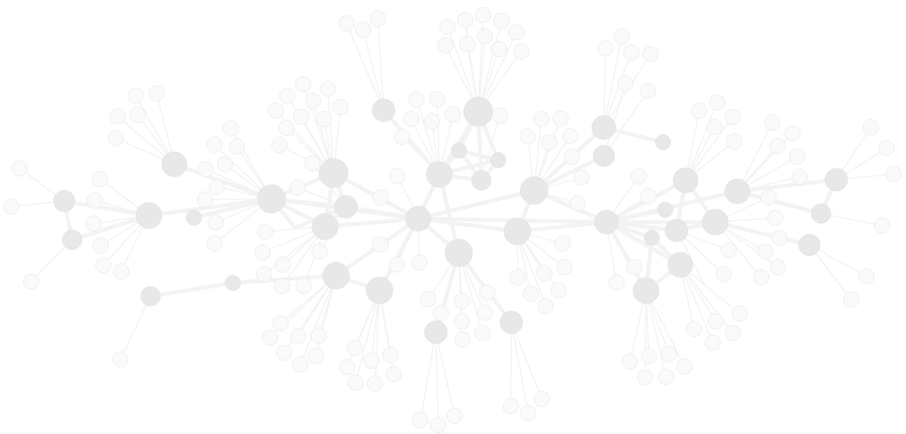

An Open Standard for Decentralised, Distributed Communication
oddvar@matrix.org

Slide 2
Agenda:
What is the problem?
What is Matrix?
Current status and what’s next?

Slide 3
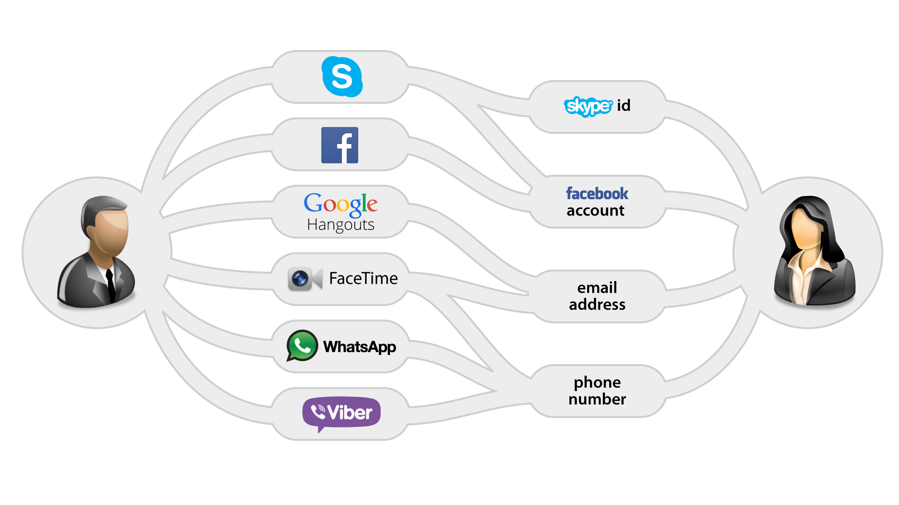

Slide 4
Enter Matrix: Open Decentralised Eventually Consistent Cryptographically Secure Messaging Database with JSON-over-HTTP API.

Slide 5
Architecture
Clients
Home Servers
Identity
Servers
Application
Services

Slide 6
Demo https://matrix.org/beta

Slide 7



Current Progress
Funded May 2014
Launched alpha Sept 2014
Entered beta Dec 2014
May 2014: v1.0 release?!
Remaining:
Performance improvements in reference impls
Build more gateways
Finalise spec
End-to-End Encryption
v2 Client-Server API
Won Audience Choice & Best Social Integration awards at WebRTC Expo 2014 and Best Innovation at WebRTC Paris 2014

Slide 8
We need help!
We need more people using it!
We need people to run their own homeservers
We need feedback on the APIs

Slide 9
For more information:
Talk tomorrow: Enhancing your web app with decentralised communication via Matrix
12:00pm–12:30pm Wednesday, 04/22/2015
Location: Salon 10
Exhibition booth #208
http://matrix.org

Slide 10
Thanks!
http://matrix.org
matrix: @oddvar:matrix.org
mail: oddvar@matrix.org
twitter: @matrixdotorg

