Slide 1

Decentralised Persistent Communication
matthew@matrix.org
http://www.matrix.org

Slide 2
Open Decentralised Persistent Eventually Consistent Cryptographically Secure Messaging Database with JSON-over-HTTP API.

Slide 3
Matrix is for: Group Chat (and 1:1) WebRTC Signalling Bridging Comms Silos Internet of Things Data …and anything else which needs to pubsub persistent data to the world.

Slide 4
1st law of Matrix: Conversation history and Group comms are the 1st class citizens.

Slide 5
2nd law of Matrix: No single party own your conversations – they are shared over all participants.

Slide 6
SIP was built to initiate 1:1 sessions. (inspired by the use cases of the PSTN)

Slide 7
XMPP was built to pass messages. (inspired by the use cases of AIM, ICQ, MSN)

Slide 8
Matrix was built to liberate and synchronize conversation history. (inspired by the use cases of Slack, Hangouts, Lync, FB, WhatsApp)

Slide 9
Why?

Slide 10
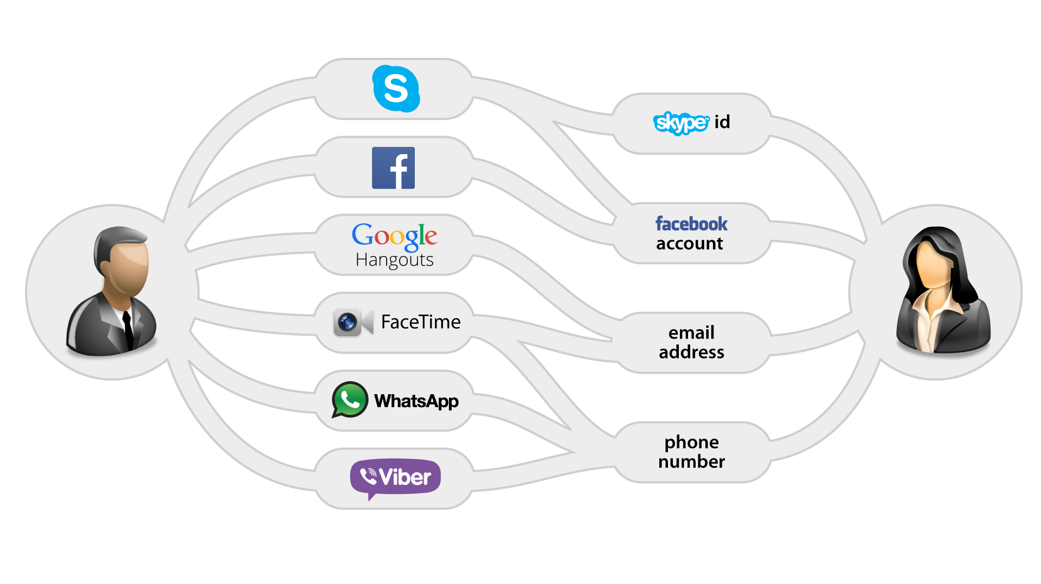

Slide 11
The Matrix Ecosystem
Matrix Web Console
Matrix iOS Console
Android Console
Other Clients
matrix-angular-sdk
MatrixKit (iOS)
matrix-android-sdk
client-side
matrix-js-sdk
matrix-ios-sdk
The Matrix Specification (Client/Server API)
Synapse (Reference Matrix Server)
Matrix Application Services
Other Servers and Services
server-side

Slide 12
Matrix is:
Non-profit Open Source Project
De-facto Open Standard HTTP APIs:
Client <-> Server
Server <-> Server
Application Services <-> Server
Apache-Licensed Open Source Reference Impls
Server (Python/Twisted)
Client SDKs (iOS, Android, JS, Angular, Python, Perl)
Clients (Web, iOS, Android)
Application Services (IRC, SIP, XMPP, Lync bridges)
A whole ecosystem of 3rd party servers, clients & services

Slide 13
What does it look like?

Slide 14
Demo time!
http://matrix.org/beta

Slide 15
Matrix Architecture
Clients
Home Servers
Application
Servers
Identity
Servers

Slide 16
Functional Responsibility
Clients: Talks simple HTTP APIs to homeservers to push and pull messages and metadata. May be as thin or thick a client as desired.
Homeservers: Stores all the data for a user - the history of the rooms in which they participate; their public profile data.
Identity Servers: Trusted clique of servers (think DNS root servers): maps 3rd party IDs to matrix IDs.
Application Services: Optional; delivers application layer logic on top of Matrix (Gateways, Conferencing, Archiving, Search etc). Can actively intercept messages if required.

Slide 17
How does it work?
http://matrix.org/#about

Slide 18
The client-server API
To send a message:
curl -XPOST -d '{"msgtype":"m.text", "body":"hello"}' "https://alice.com:8448/_matrix/client/api/v1/rooms/ROOM_ID/send/m.room.message?access_token=ACCESS_TOKEN"
{
"event_id": "YUwRidLecu"
}

Slide 19
The client-server API
To set up a WebRTC call:
curl -XPOST –d '{\
"version": 0, \
"call_id": "12345”, \
"offer": {
"type" : "offer”,
"sdp" : "v=0\r\no=- 658458 2 IN IP4 127.0.0.1…"
}
}' "https://alice.com:8448/_matrix/client/api/v1/rooms/ROOM_ID/send/m.call.invite?access_token=ACCESS_TOKEN"
{ "event_id": "ZruiCZBu” }

Slide 20
Basic 1:1 VoIP Matrix Signalling
Caller Callee
m.call.invite ----------->
m.call.candidate -------->
[more candidates events]
User answers call
<------ m.call.answer
[media flows]
<------ m.call.hangup

Slide 21
The client-server API
To persist some MIDI:
curl -XPOST –d '{\
"note": "71",\
"velocity": 68,\
"state": "on",\
"channel": 1,\
"midi_ts": 374023441\
}' "https://alice.com:8448/_matrix/client/api/v1/rooms/ROOM_ID/send/org.matrix.midi?access_token=ACCESS_TOKEN"
{ "event_id": “ORzcZn2” }

Slide 22
The server-server API
curl –XPOST –H ‘Authorization: X-Matrix origin=matrix.org,key=”898be4…”,sig=“j7JXfIcPFDWl1pdJz…”’ –d ‘{
"ts": 1413414391521,
"origin": "matrix.org",
"destination": "alice.com",
"prev_ids": ["e1da392e61898be4d2009b9fecce5325"],
"pdus": [{
"age": 314,
"content": {
"body": "hello world",
"msgtype": "m.text"
},
"context": "!fkILCTRBTHhftNYgkP:matrix.org",
"depth": 26,
"hashes": {
"sha256": "MqVORjmjauxBDBzSyN2+Yu+KJxw0oxrrJyuPW8NpELs"
},
"is_state": false,
"origin": "matrix.org",
"pdu_id": "rKQFuZQawa",
"pdu_type": "m.room.message",
"prev_pdus": [
["PaBNREEuZj", "matrix.org"]
],
"signatures": {
"matrix.org": {
"ed25519:auto": "jZXTwAH/7EZbjHFhIFg8Xj6HGoSI+j7JXfIcPFDWl1pdJz+JJPMHTDIZRha75oJ7lg7UM+CnhNAayHWZsUY3Ag"
}
},
"origin_server_ts": 1413414391521,
"user_id": "@matthew:matrix.org"
}]
}’ https://alice.com:8448/_matrix/federation/v1/send/916d630ea616342b42e98a3be0b74113

Slide 23
Application Services (AS)
Extensible custom application logic
They have privileged access to the server (granted by the admin).
They can subscribe to wide ranges of server traffic (e.g. events which match a range of rooms, or a range of users)
They can masquerade as 'virtual users'.
They can lazy-create 'virtual rooms'
They can receive traffic by push.

Slide 24
Uses for AS API
Gateways to other comms platforms
Data manipulation
Filtering
Translation
Indexing
Mining
Visualisation
Orchestration
Application Logic (e.g. bots, IVR services)
…

Slide 25
A trivial application service
import json, requests # we will use this later
from flask import Flask, jsonify, request
app = Flask(__name__)
@app.route("/transactions/<transaction>", methods=["PUT"])
def on_receive_events(transaction):
events = request.get_json()["events"]
for event in events:
print "User: %s Room: %s" % (event["user_id"], event["room_id"])
print "Event Type: %s" % event["type"]
print "Content: %s" % event["content"]
return jsonify({})
if __name__ == "__main__":
app.run()

Slide 26

Matrix Bridging with ASes
Existing App

Slide 27
Kamailio SIP<->Matrix GW
SIP->Matrix ingress call:
---------------------------------------------------
-> SIP INVITE
<- SIP 100
create Matrix room inviting other party (reuse existing one if available)
-> PUT m.call.invite
<- PUT m.call.answer
<- 200 OK
-> ACK
---------------------------------------------------
-> SIP BYE
m.call.hangup
<- SIP 200 OK
---------------------------------------------------
<- m.call.hangup
-> BYE
<- 200 OK
---------------------------------------------------

Slide 28
Kamailio SIP<->Matrix GW
Use utils and json modules with http_query() or OEJ's curl module to relay to Matrix
Use xhttp module and event_route[xhttp:request] to receive traffic from Matrix and relay to SIP via txm t_reply_callid() or dlg_bye()?

Slide 29
Current Progress
Funded May 2014
Launched alpha Sept 2014
Entered beta Dec 2014
Stable v0.9 Beta May 2014
July 2014: v1.0 release?!
Remaining:
Build more gateways
Polish spec
End-to-End Encryption
v2 Client-Server API

Slide 30
What's next?
End-to-end encryption
Reusable web UI components and improving the web client
Multi-way VoIP
Lots more Application Services
Landing V2 APIs
Use 3rd party IDs by default
Yet more performance work
Spec polishing
New server implementations!

Slide 31
We need help!!

Slide 32

We need people to try running their own servers and join the federation.
We need people to run gateways to their existing services
We need feedback on the APIs.
Consider native Matrix support for new apps
Follow @matrixdotorg and spread the word!

Slide 33
Thank you! matthew@matrix.org http://matrix.org @matrixdotorg

Slide 34
Federation Design #1
No single point of control for chat rooms.
Any homeserver can publish a reference to a chat room (although typically the address is the homeserver of the user who created the room).
Room addresses look like:
#matrix:matrix.org
(pronounced hash-matrix-on-matrix-dot-org)
The IP of the matrix.org homeserver is discovered through DNS (SRV _matrix record if available, otherwise looks for port 8448 of the A record).

Slide 35
Federation Design #2
When a user joins a room, his HS queries the HS specified in the room name to find a list of participating homeservers via a simple GET
Messages form a directed acyclic graph (DAG) of chronologicity, each crypto-signed by the origin HS
The user's HS pulls in messages via GETs from participating HSs by attempting to walk the DAG
Each HS caches as much history as its users (or admin) desires
When sending a message, the HS PUTs to participating homeservers (currently full mesh, but fan-out semantics using cyclical hashing in development)

Slide 36
Identity Design
We don't want to be yet another identity system (e.g. JIDs)
So we aggregate existing 3rd party IDs (3PID) and map them to matrix IDs (MXIDs) by Identity Servers, whose use in public is strictly optional.
And so login and user discovery is typically done entirely with 3rd party IDs.
ID servers validate 3rd party IDs (e.g. email, MSISDN, Facebook, G+) and map them to MXIDs. MXIDs look like:
@matthew:matrix.org

Slide 37
Security Design #1
Server-server traffic is mandatorily TLS from the outset
Can use official CA certs, but automagically self-sign and submit certs to matrix ID servers as a free but secure alternative
Server-client traffic mandates transport layer encryption other than for tinkering
Clients that support PKI publish their public keys, and may encrypt and sign their messages for E2E security.
"Well behaved" clients should participate in key escrow servers to allow private key submission for law enforcement.
End-to-end encryption for group chat is supported through a per-room encryption key which is shared 1:1 between participating members

Slide 38
Security Design #2
SPAM is contained by mandating invite handshake before communication
Invite handshakes are throttled per user
Homeservers and users may be blacklisted on identity servers
ID servers authenticating 3PIDs are obligated to mitigate bulk registration of users via CAPTCHAs or domain-specific techniques (e.g. 2FA SMS for MSISDNs)

Slide 39
Application Services: Spec & API
Still in development; some early prototypes
"Passive AS-API" Builds on the client-server API
Service registers a URL for inbound events to be PUT to
Allows a service to register for traffic on behalf of a namespace of virtual users and virtual rooms
Adds "superuser" permissions to subscribe to arbitrary filters of events on the homeserver, and inject arbitrary events
Modeled loosely after IRC Services
Also: Active AS API for intercepting inbound events on a HS, and Storage API for exposing existing conversation DBs to Matrix via a HS.
Notes:
Feedback?

Slide 40
AS Example: Matrix/SMS Gateway
matrix.org runs a homeserver.
Matrix/SMS gw AS is registered to the homeserver, masquerading for the 'sms.matrix.org' domain.
@447968722968:sms.matrix.org routes to the homeserver from anywhere in Matrix, which passes events for *:sms.matrix.org through to the AS
Matrix/SMS Gateway then relays via SMS aggregators to send SMS to +447968722968
The reverse path is symmetrical, with the Matrix/SMS AS injecting events into the HS on behalf of @447968722968:sms.matrix.org
Notes:
Feedback?

Slide 41
AS Example: Matrix/SIP Gateway
Similarly, AS can implement a SIP gateway, posing as a range of virtual matrix users.
Events such as 'm.call.invite' and 'm.call.candidates' are PUT to the AS by the HS
AS converts directly into SIP signalling (reINVITEing to advertise new ICE candidates)
Media flows out-of-band to Matrix as typical WebRTC SRTP.
We've already written a basic Matrix/Verto gateway (using client-service API – see matrix.org/blog)
Notes:
Feedback?

Slide 42
Why not XMPP?
We used to use XMPP (ejabberd, OpenFire, Spectrum, psyced, Psi, Pidgin, ASmack, Spark, XMPP.Framework)
We built an alternative because:
Single server per MUC is single point of control
Synchronised history is a very 2nd class citizen
Stanzas aren't framed or reliably delivered
XMPP stacks are not easy to implement in a web environment
Jingle is complicated and exotic
XML is needlessly verbose and unwieldy
The baseline feature-set is too minimal
JIDs haven't taken off like Email or MSISDNs
Not designed for mobile use cases (e.g. push; low bw)
Well documented spam and identity/security issues
ejabberd

