Slide 1
Matcha Event/Action flow of epubReader
Md. Saiful Alam
2015/10/05
Contact Detail
Homepage : www.bjitgroup.com, Email: saiful.alam@bjitgroup.com
BJIT Inc (Japan) , Tel : +813-3523-9137, Fax : +813-3523-9138
BJIT Ltd (Bangladesh), Tel : +8802-9889820, Fax : +8802-9889830
BJIT Oy (Finland), Tel : +8190-1555-8666
BJIT Singapore, Tel : +8190-4455-3569

Slide 2
Agenda
Important interfaces
Important implementation classes
Class diagram of interfaces
Event calling from UI to Griffin
Event calling from Griffin to UI

Slide 3
Important interfaces
List of interfaces
IEpubReader
IReadingView
IEpubView
IGriffinObserver
IEpubMarkable
IGriffinListener

Slide 4
Important implementation classes
List of implementation classes from the interfaces
EpubReaderActivity -> IEpubReader
XWalkreadingViewFragment -> IReadingView
EpubView -> IEpubView, IEpubMarkable
EpubViews -> IEpubView, IEpubMarkable
GriffinObserverFactory -> IGriffinObserver
GrigginEventAcceptor -> take the event from javascript layer by setResult() func.
ReaderJSActivity -> EpubReaderActivity

Slide 5
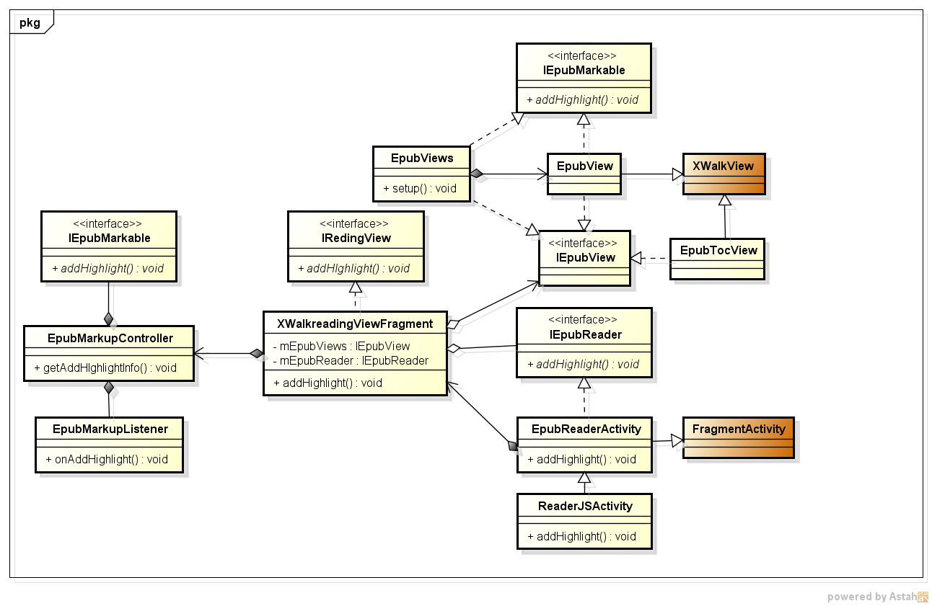
Class diagram of interfaces
The class diagram for introduction with reader, reading view and view[xwalk]
See the sequence how this classes are involved in addHighlight() method.

Slide 6
Event calling from UI to Griffin JS layer
Event calling from activity to javascript layer
Event caught in Activity
Event pass to XWalkRedingViewFragment
Event pass to corresponding view, View call the java script layer function by evaluatejavascript().
This function call the java script code
ReaderJSActivity
EpubReaderActivity
XWalkReadingViewFragment
EpubView
Evaluatejavascript()
XWalkView
Library Code
Call the function of javascript
Griffin JS layer

Slide 7
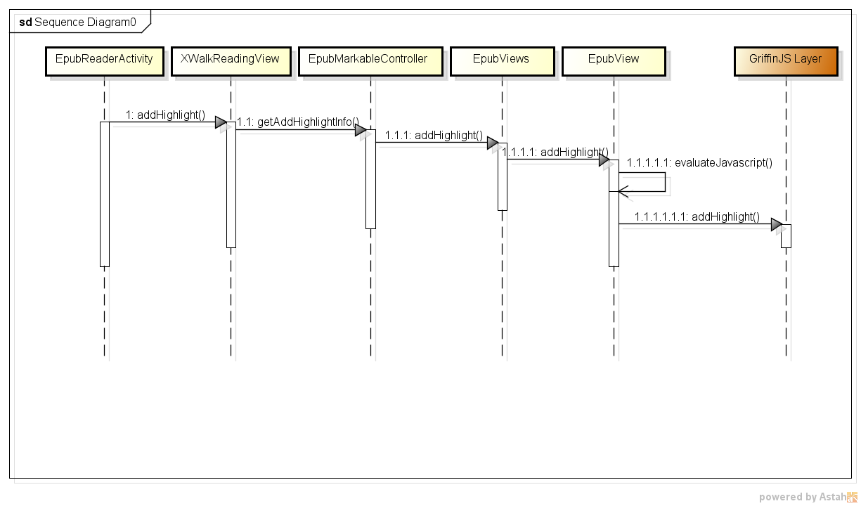
Event calling from UI to Griffin
Event calling from UI to Griffin: Example addHighlight()

Slide 8
Event calling from griffin to UI
Event calling from javascript to activity
Event prepared in Epubreader named sendSonyReaderNotification()
Event pass to GriffinEventAcceptor
Event pass to corresponding listener
EpubReader.JS
GriffinEventAcceptor
sendSonyReaderNotification()
GriffinObserverFactory
setResult()
This method called from JS layer
EpubView
XWalkReadingViewFragment
ReaderJSActivity

