Slide 1
Create Video from Image/Audio/Text
Md. Milan Mia
2015/11/26
Contact Detail
Homepage : www.bjitgroup.com, Email: milan.mia@bjitgroup.com
BJIT Inc (Japan) , Tel : +813-3523-9137, Fax : +813-3523-9138
BJIT Ltd (Bangladesh), Tel : +8802-9889820, Fax : +8802-9889830
BJIT Oy (Finland), Tel : +8190-1555-8666
BJIT Singapore, Tel : +8190-4455-3569

Slide 2
Agenda
Create video merging images, audio and text

Slide 3
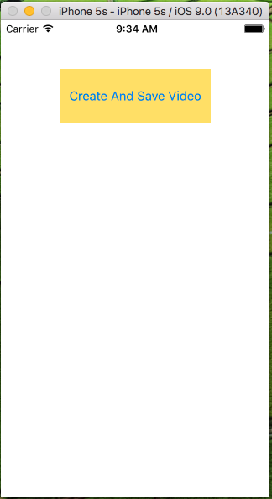
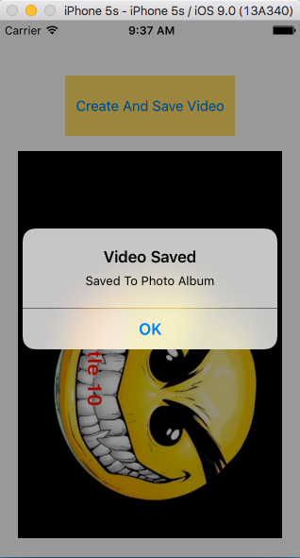
What we are going to do?
Description of project
Start Screen
Final Screen
We are going to create a application that will take images, Audio and array of string as input and output a video file. In our testing app we took 10 image, 10 audio, 10 string and output a video of length 1.40min. Each image run for 10sec and so the audio and subtitle string.

Slide 4
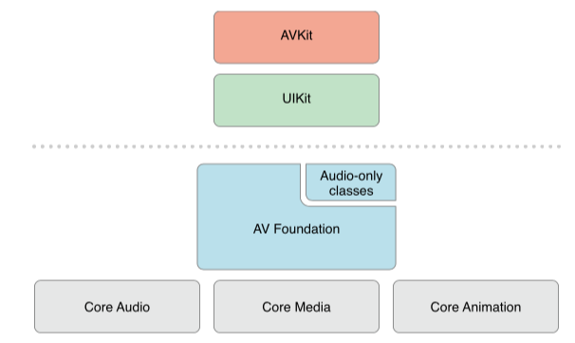
AVFoundation
Basics of AVFoundation
AVFoundation is one of several frameworks that you can use to play and create time-based audiovisual media. It provides an Objective-C interface you use to work on a detailed level with time-based audiovisual data. For example, you can use it to examine, create, edit, or reencode media files.
AVFoundation stack on iOS

Slide 5
AVFoundation
Basics of AVFoundation
Asset Writer
AVFoundation allows us to create new representations of an asset in several ways. We can simply reencode an existing asset, or—in iOS 4.1 and later—We can perform operations on the contents of an asset and save the result as a new asset. We use an export session to reencode an existing asset into a format defined by one of a small number of commonly-used presets. If we need more control over the transformation, in iOS 4.1 and later we can use an asset reader and asset writer object in tandem to convert an asset from one representation to another. As we are going to convert the images to video using asset writer we are going to cover only AssetWriter part.

Slide 6
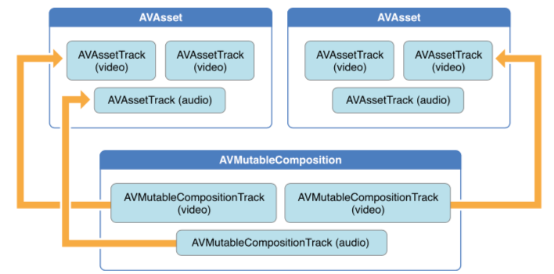
AVFoundation
Editing
AVFoundation uses compositions to create new assets from existing pieces of media (typically, one or more video and audio tracks). We use a mutable composition to add and remove tracks, and adjust their temporal orderings. We can also set the relative volumes and ramping of audio tracks; and set the opacity, and opacity ramps, of video tracks. A composition is an assemblage of pieces of media held in memory. When we export a composition using an export session, it’s collapsed to a file. We can also create an asset from media such as sample buffers or still images using an asset writer.

Slide 7
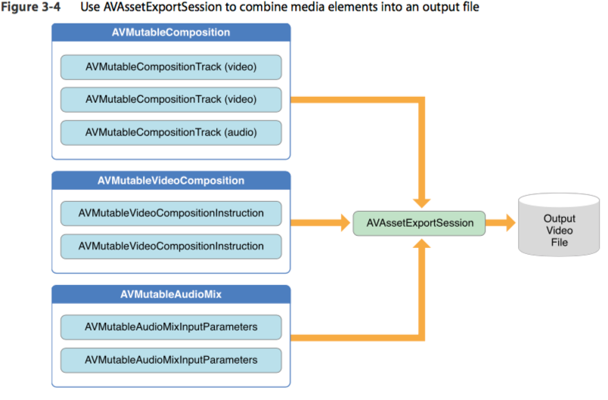
AVFoundation
Output structure

Slide 8
Creating the Application
Steps to create the App
Create the project
Take inputs
Add text(subtitle) to the images
Convert image to video using AssetWriter
Add audio with video using AVMutableCompostion
Export the video to library

Slide 9
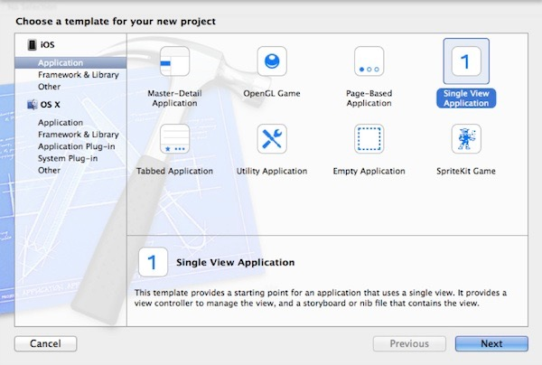
Creating the Project
Create Single View project:
Launch Xcode and create a new Project by using the Single View Application template. Give a name of project and set other properties and click next.
Add a button in viewController, name the button “Create and Save Video” and add action method
to the button.

Slide 10
Add text(Subtitle) to image
UIGraphicsImageContext
UIGraphicsImageContext is used to edit images. We are going to add text over image using UIGraphicsImageContext. To do that we need to specify the size, text position and text attributes.
Here is the method to add text over image:
- (UIImage*)image:(UIImage*)image withText:(NSString*)text atPoint:(CGPoint)point {
CGSize size = CGSizeMake(640, 480);
CGRect rect = CGRectMake(0, 0, size.width, size.height);
UIGraphicsBeginImageContextWithOptions(rect.size, NO, 1.0);
[image drawInRect:rect];
NSDictionary *attributes = @{NSFontAttributeName: [UIFont fontWithName:@"Helvetica-Bold" size:36.0f],
NSForegroundColorAttributeName : [UIColor redColor],
NSStrokeColorAttributeName : [UIColor whiteColor],
NSStrokeWidthAttributeName : [NSNumber numberWithFloat:-2.0]};
[text drawAtPoint:CGPointMake(size.height/2, size.width/2) withAttributes:attributes];
UIImage *newImage = UIGraphicsGetImageFromCurrentImageContext();
newImage = [UIImage imageWithCGImage:newImage.CGImage scale:1.0 orientation:UIImageOrientationRight];
UIGraphicsEndImageContext();
return newImage;
}
//This will return a image with text.

Slide 11
Create Video from image
Initializing AVAssetWriter
The writer has an input of type AVAssetWriterInput, which in turn has a method called appendSampleBuffer: that lets you add individual frames to a video stream. Essentially you’ll have to:
NSError *error = nil;
AVAssetWriter *videoWriter = [[AVAssetWriter alloc] initWithURL:
[NSURL fileURLWithPath:somePath] fileType:AVFileTypeQuickTimeMovie
error:&error];
NSParameterAssert(videoWriter);
NSDictionary *videoSettings = [NSDictionary dictionaryWithObjectsAndKeys:
AVVideoCodecH264, AVVideoCodecKey,
[NSNumber numberWithInt:640], AVVideoWidthKey,
[NSNumber numberWithInt:480], AVVideoHeightKey,
nil];
AVAssetWriterInput* writerInput = [[AVAssetWriterInput
assetWriterInputWithMediaType:AVMediaTypeVideo
outputSettings:videoSettings] retain]; //retain should be removed if ARC
NSParameterAssert(writerInput);
NSParameterAssert([videoWriter canAddInput:writerInput]);
[videoWriter addInput:writerInput];

Slide 12
Create video from image
Start a Session
Write some samples
Finish the Session
[videoWriter startWriting];
[videoWriter startSessionAtSourceTime:…] //use kCMTimeZero if unsure
// Or you can use AVAssetWriterInputPixelBufferAdaptor.
// That lets you feed the writer input data from a CVPixelBuffer
// that’s quite easy to create from a CGImage.
[writerInput appendSampleBuffer:sampleBuffer];
[writerInput markAsFinished];
[videoWriter endSessionAtSourceTime:…]; //optional can call finishWriting without specifiying endTime
[videoWriter finishWriting]; //deprecated in ios6
/*
[videoWriter finishWritingWithCompletionHandler:...]; //ios 6.0+
*/

Slide 13
Create video from images
Pixel Buffer
I think that the only really hard remaining part is getting a pixel buffer from a CGImage:
- (CVPixelBufferRef) newPixelBufferFromCGImage: (CGImageRef) image{
NSDictionary *options = [NSDictionary dictionaryWithObjectsAndKeys:
[NSNumber numberWithBool:YES], kCVPixelBufferCGImageCompatibilityKey,
[NSNumber numberWithBool:YES], kCVPixelBufferCGBitmapContextCompatibilityKey,
nil];
CVPixelBufferRef pxbuffer = NULL;
CVReturn status = CVPixelBufferCreate(kCFAllocatorDefault, frameSize.width,
frameSize.height, kCVPixelFormatType_32ARGB, (CFDictionaryRef) options,
&pxbuffer);
NSParameterAssert(status == kCVReturnSuccess && pxbuffer != NULL);
CVPixelBufferLockBaseAddress(pxbuffer, 0);
void *pxdata = CVPixelBufferGetBaseAddress(pxbuffer);
NSParameterAssert(pxdata != NULL);
CGColorSpaceRef rgbColorSpace = CGColorSpaceCreateDeviceRGB();
CGContextRef context = CGBitmapContextCreate(pxdata, frameSize.width,
frameSize.height, 8, 4*frameSize.width, rgbColorSpace,
kCGImageAlphaNoneSkipFirst);
NSParameterAssert(context);
CGContextConcatCTM(context, frameTransform);
CGContextDrawImage(context, CGRectMake(0, 0, CGImageGetWidth(image),
CGImageGetHeight(image)), image);
CGColorSpaceRelease(rgbColorSpace);
CGContextRelease(context);
CVPixelBufferUnlockBaseAddress(pxbuffer, 0);
return pxbuffer;
}

Slide 14
Add audio to video
AVMutableComposition
Adding the Assets
To create your own composition, you use the AVMutableComposition class. To add media data to your composition, you must add one or more composition tracks, represented by the AVMutableCompositionTrack class. The simplest case is creating a mutable composition with one video track and one audio track:
AVMutableComposition *mutableComposition = [AVMutableComposition composition];
// Create the video composition track.
AVMutableCompositionTrack *mutableCompositionVideoTrack = [mutableComposition
addMutableTrackWithMediaType:AVMediaTypeVideo
preferredTrackID:kCMPersistentTrackID_Invalid];
// Create the audio composition track.
AVMutableCompositionTrack *mutableCompositionAudioTrack = [mutableComposition
addMutableTrackWithMediaType:AVMediaTypeAudio
preferredTrackID:kCMPersistentTrackID_Invalid];
An empty composition does you no good. Add the two video asset tracks and the audio asset track to the composition.
AVAssetTrack *firstVideoAssetTrack = [[firstVideoAsset tracksWithMediaType:AVMediaTypeVideo] objectAtIndex:0];
AVAssetTrack *secondVideoAssetTrack = [[secondVideoAsset tracksWithMediaType:AVMediaTypeVideo] objectAtIndex:0];
[videoCompositionTrack insertTimeRange:CMTimeRangeMake(kCMTimeZero, firstVideoAssetTrack.timeRange.duration)
ofTrack:firstVideoAssetTrack atTime:kCMTimeZero error:nil];
[videoCompositionTrack insertTimeRange:CMTimeRangeMake(kCMTimeZero, secondVideoAssetTrack.timeRange.duration)
ofTrack:secondVideoAssetTrack
atTime:firstVideoAssetTrack.timeRange.duration error:nil];
[audioCompositionTrack insertTimeRange:CMTimeRangeMake(kCMTimeZero, CMTimeAdd(firstVideoAssetTrack.timeRange.duration, secondVideoAssetTrack.timeRange.duration)) ofTrack:[[audioAsset tracksWithMediaType:AVMediaTypeAudio] objectAtIndex:0] atTime:kCMTimeZero error:nil];

Slide 15
Export
AVExportSession
//Export Session
AVAssetExportSession* _assetExport = [[AVAssetExportSession alloc] initWithAsset:mixComposition presetName:AVAssetExportPresetHighestQuality];
//Export
_assetExport.outputURL=outputFileUrl;
_assetExport.outputFileType = AVFileTypeQuickTimeMovie;
_assetExport.shouldOptimizeForNetworkUse = YES;
[_assetExport exportAsynchronouslyWithCompletionHandler:^{
dispatch_async(dispatch_get_main_queue(), ^{
[self exportDidFinish:_assetExport];
});
}];

Slide 16
References
Web references:
http://stackoverflow.com/questions/19715205/adding-cross-dissolve-effect-ios-video-creation
https://github.com/BradLarson/GPUImage/tree/master/examples/iOS
Apple documentation
http://iphonedevsdk.com/forum/iphone-sdk-development/66085-avmutablecompositiontrack-combining-2-sound-tracks-issue.html
http://tuohuang.info/video-merging-with-avfoundation-and-opengl-es-on-ios--multiple-audio-tracks-merge/#.VlbGc7yfcuU
http://stackoverflow.com/questions/19622404/nsattributedstring-draws-no-stroke-with-nsstrokecolorattributename-and-nsstrokew

