Slide 1
Bezier Constant Speed
B(t) = (1 - t) P₀ + t P₁.
B(t) = (1 - t) ((1 - t) P₀ + t P₁) + t ((1 - t) P₁ + t P₂).
B(t) = (1-t)³P0 + 3t(1-t)²P1 + 3t²(1-t)P2 + t³P3 =
t³(-P0 + 3P1 – 3P2 + P3) + t²(3P1 – 6P2 + 3P3) + t(-3P0 + 3P1) + P0
dM/dt = t²(-3A + 9B - 9C + 3D) + t(6A - 12B + 6C) + (-3A + 3B)
v1 = -3A + 9B - 9C + 3D
v2 = 6A - 12B + 6C
v3 = -3A + 3B
t = t + L / length(t * t * v1 + t * v2 + v3);

Slide 2
Catmull-Rom Splines
cubic interpolating splines -<三次插值曲线>
Rules : the tangent at each point p i is calculated using the previous and next point on the spline, τ(p i+1 −p i−1 ).

Slide 3
Catmull VS Bezier
Catmull 只绘制中间两点， Bezier绘制四个点
Catmull 中间点的朝向由后点和前点确认， Bezier起点和终点朝向由中间点确认

Slide 4
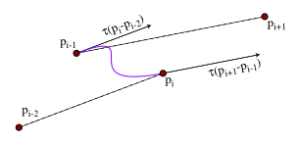

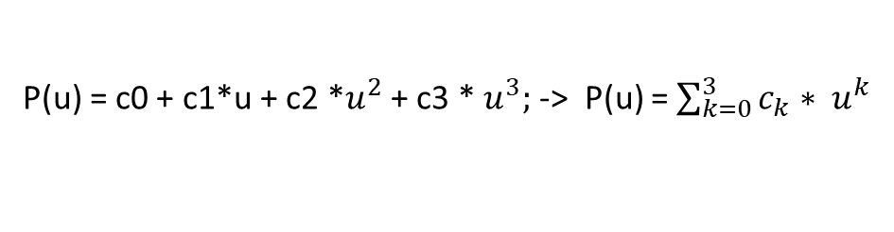



Catmull
P(u) = c0 + c1*u + c2 *$u^{2}$ + c3 * $u^{3};$ -> P(u) = $\sum_{k=0}^{3}{c_{k}∗ u^{k}}$
i和u是两码事
U = 0的点(i = 1的点)
$p_{(0)}$= $p_{i −1}$(绘制起点)
$p_{(1)}$= $p_{i}(绘制终点)$
${p′}_{(0)}^{} = r ∗(p_{i} −p_{i −2})$(起点方向)
推导一下c0, c1, c2, c3
$${p′}_{(1)}^{} = r ∗(p_{i+1} −p_{i −1})(终点方向)$$

Slide 5
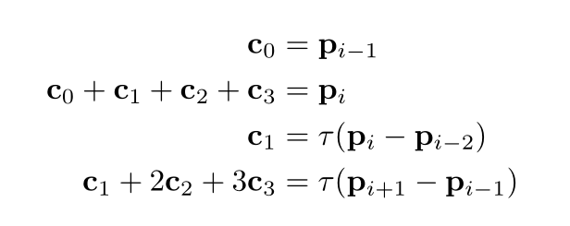
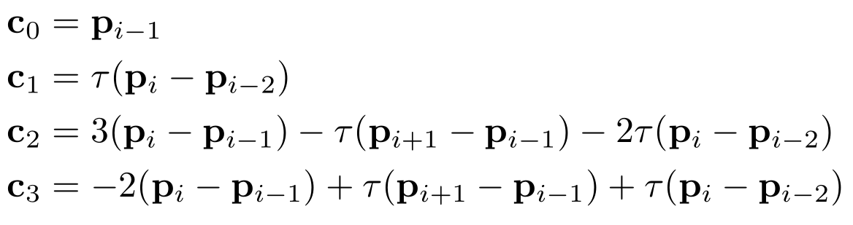

Slide 6
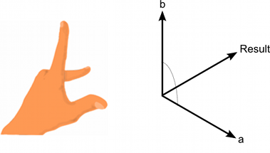
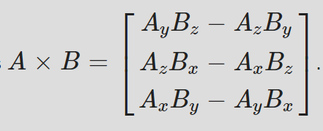
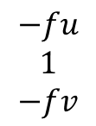
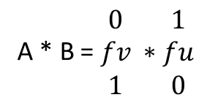
Cross Product
Result = B * A
B * A = - A * B
A * B = $\begin{matrix}0 \\ fv \\ 1\end{matrix} ∗\begin{matrix}1 \\ fu \\ 0\end{matrix}$
$$\begin{matrix}−fu \\ 1 \\ −fv\end{matrix}$$
=

Slide 7
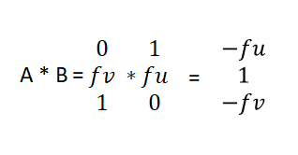
Vector Rotate 90
X = R * Cos(a)
Y = R * Sin(a)
X = R * Cos(a + 90) = R * Sin(a)
Y = R * Sin(a + 90) = -R * Cos(a)
原理和向量旋转90度一样。
(1, fu) -> 旋转90度 -> (-fu, 0)

