Slide 1
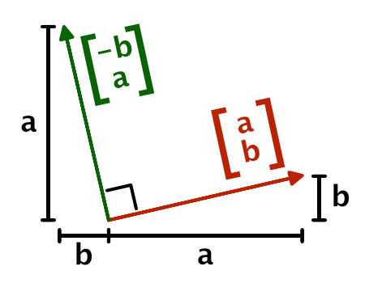
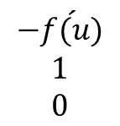
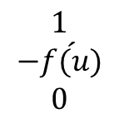
normal
$$\begin{matrix}−\acute{f(u)} \\ 1 \\ 0\end{matrix}$$
tangent
$$\begin{matrix}1 \\ −\acute{f(u)} \\ 0\end{matrix}$$
Rotate 90 degrees

Slide 2
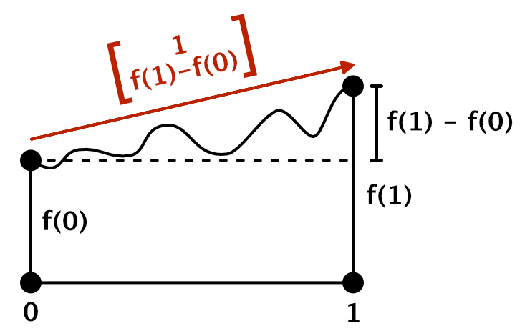





Slide 3
From Tangent to Normal
What value could we use for £ in our shader?
_TexelSize variable :
For example, in case of a 256×128 texture,
it will contain (0.00390625, 0.0078125, 256, 128).

Slide 4
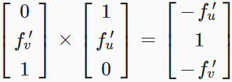
When you calculate the cross product with the tangent vectors, you'll see that

Slide 5
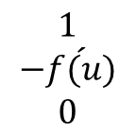
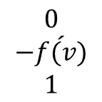
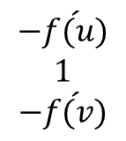
$$\begin{matrix}0 \\ −\acute{f(v)} \\ 1\end{matrix}$$
$$\begin{matrix}1 \\ −\acute{f(u)} \\ 0\end{matrix}$$
$$\begin{matrix}−\acute{f(u)} \\ 1 \\ −\acute{f(v)}\end{matrix}$$
N + 1
2

Slide 6
Y
红线代表A点的切线向量
绿线代表A点的法线向量
A
O
X
B
每一个点都有自己的切线向量和法线向量
切线向量和法线线向量相差90度

