Slide 1

Design patterns supplements
Factory
Method

Slide 2

Contents
Pattern improvement
Pattern case
Pattern review

Slide 3
Classes and objects
Base* object = new Derived;
Notes:
面向对象程序中如何多态得创建对象？
class是由程序员产生的静态信息，无法在执行期产生类，Derived是一个类名，代表一个类型
object是由程序产生的动态信息，无法在编译期产生对象，object是一个对象，代表一个值
动态类型语言中class本身是个object，具有first class状态，可以拷贝、保存和传递，进而可以在运行期动态得产生对象
C++是静态类型语言，type和value之间存在gap，想要动态得创建对象需要“object-type-object”的交易
第一个object代表了类型标识符，标识了type，第二个object代表type所对应的对象
工厂方法又名虚构造器virtual constructor

Slide 4
intent
Defines an interface for creating an object
Lets the subclasses decide which class to instantiate
Notes:
工厂方法：定义一个用于创建对象的接口，让其子类决定实例化哪一个类。

Slide 5
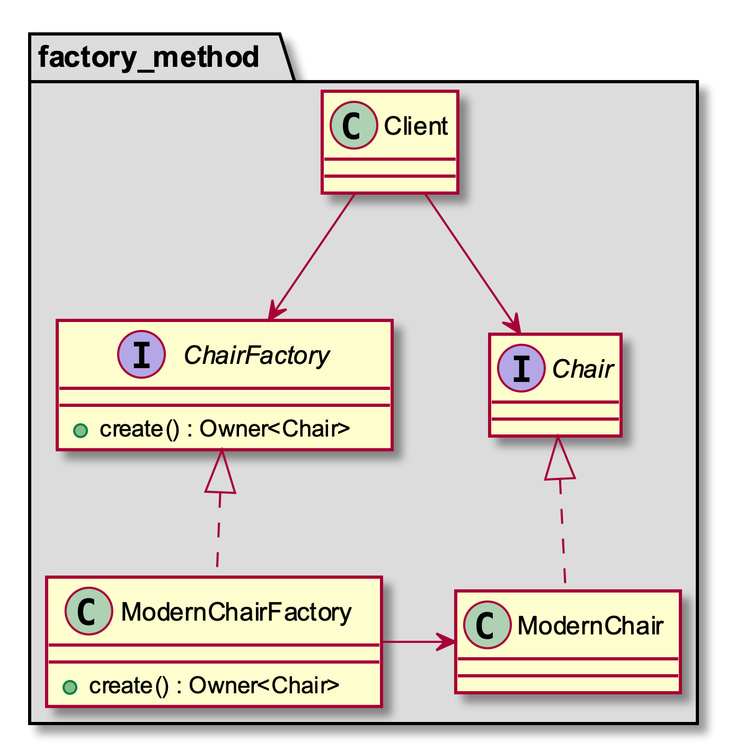
structure
Notes:
工厂接口类包含至少两个可以被泛化的设计决策点
显然生产的产品类型是其中之一
其二是工厂接口的返回值含有转移产品所有权的含义，应采用何用类型表示该所有权转移

Slide 6
interface
template <class T>
using UniquePtr = unique_ptr<T>;
template <class T, class = enable_if_t<is_pointer_v<T>>>
using Owner = T;
template <class T>
using OwnerPtr = Owner<add_pointer_t<T>>;
template <
class Product,
template <class> class Owner,
class… Args
>
class Factory
{
public:
virtual ~Factory() = default;
virtual Owner<Product> create(Args&&… args) = 0;
};
Notes:
工厂方法的返回值包含有转移生产物所有权的含义
通常有两种情况：unique pointer或者raw pointer
用unique pointer有两个优势：（1）显式排他（2）资源管理

Slide 7
co-variant return type
class ModernChair : public Chair {};
using ChairFactory = Factory<Chair, OwnerPtr>;
class ModernChairFactory : public ChairFactory
{
public:
// co-variant return type
ModernChair* create() override
{
return new ModernChair;
}
};
Notes:
raw pointer的优势是可以利用协变返回类型在具有一定程度的抽象的同时又保留获取具体类型信息的可能。

Slide 8
parameterized interface
template <
class Product,
template <class> class Owner,
class ProductIdentifier,
class… Args
>
class ParamFactory
{
public:
virtual ~ParamFactory() = default;
virtual Owner<Product> create(
const ProductIdentifier& id, Args&&… args) = 0;
};
enum class eProductId { kRegular, kLuxury };
using ChairFactory =
ParamFactory<Chair, UniquePtr, eProductId>;
Notes:
实际使用中工厂方法往往包含调用参数
除了构造对象所需要的参数以外，还有一个特别的参数是用来抉择产生哪种具体类型的
也就是最初提到的object-type-object转换中的第一个用作类型标示符的对象

Slide 9
parameterized implement
class ModernChairFactory : public ChairFactory
{
public:
Owner<Chair> create(const eProductId& id) override
{
// if-else method
if (id == eProductId::kRegular) {
return Owner<Chair>(new RegularModernChair);
} else if (id == eProductId::kLuxury) {
return Owner<Chair>(new LuxuryModernChair);
} else {
return nullptr;
}
}
};
Notes:
if-else实现违反了OCP（Open for extension, Closed for modification）
期望实现一个可伸缩的工厂，每当定义新的Chair派生类，只需“增加”新文件，不必“修改”旧文件

Slide 10
scalable factory
class ModernChairFactory : public ChairFactory
{
public:
Owner<Chair> create(const eProductId& id) override
{
// find creator in map-like associative container
// regardless of multi-thread access
const auto creator = registration_.find(id);
if (creator == registration_.end())
{
return nullptr;
}
else
{
return (creator->second)();
}
}
};
Notes:
工厂本身并不知道任何具体的产品类型，只是根据产品类型标示符去产品注册目录里寻找对应的构造器
将真正的生产任务委托给具体类型的构造器
自然引出三个决策点：
产品类型如何注册
构造器应该是何种类型的对象
map-like的关联型容器如何选择

Slide 11
registration
class ModernChairFactory : public ChairFactory
{
public:
static bool registerType(eProductId id, Creator creator)
{
// regardless of multi-thread accessing
using ValueType = AssociativeContainer::value_type;
return registration_.insert(ValueType(id, creator)).second;
}
private:
static AssociativeContainer registration_;
};
Notes:
由于产品注册属于实现层面的需求，所以应该作为具体工厂类的成员或者静态成员函数，而不应该出现在工厂接口类里
这里假设同一类型的具体工厂能够生产的产品集合是相同的，基于这一假设采用静态成员函数作为注册函数

Slide 12
free function
using OwnerType = invoke_result_t<
decltype(&ModernChairFactory::create)(
ModernChairFactory, const eProductId&)>;
OwnerType createRegularChair() {
return OwnerType(new RegularChair);
}
class RegularChair : public Chair {
protected:
RegularChair() {}
private:
friend OwnerType createRegularChair();
};
void startup() {
ModernChairFactory::registerType(
eProductId::kRegular, reateRegularChair);
}
Notes:
Creator的类型选择基本上有三个选项：
自由函数
成员函数
仿函数/函数对象

Slide 13
member function
class RegularChair : public Chair
{
protected:
RegularChair() {}
public:
static OwnerType create()
{
return OwnerType(new RegularChair);
}
};
void startup()
{
ModernChairFactory::registerType(
eProductId::kRegular, &RegularChair::create);
}
Notes:
成员函数的实现

Slide 14
function object
class RegularChair : public Chair {
protected:
RegularChair() {}
private:
friend class RegularChairCreator;
};
struct RegularChairCreator {
OwnerType operator()() {
return OwnerType(new RegularChair);
}
};
void startup() {
ModernChairFactory::registerType(
eProductId::kRegular, RegularChairCreator());
}
Notes:
仿函数的实现

Slide 15
creator
class ModernChairFactory : public ChairFactory
{
public:
// applies to ANY callable target – functions,
// lambda expressions, bind expressions,
// function objects, pointers to member functions
// and pointers to data members
using Creator = function<Owner<Chair>()>;
};
Notes:
无论是哪种实现方式，归根结底我们需要的是某种类型，它接受不带参数的调用，并返回一个“可被转换为OwnerType类型”的对象。
Creator用std::function可以获得较大的泛用性，之前看到的三种实现均可进行适配

Slide 16
associative container
class ModernChairFactory : public ChairFactory
{
public:
// STL associative containers are good for:
// 1. collection is quite large
// 2. insertions and lookups have same order of magnitude
// 3. insertions are in random order
// 4. insertions and lookups are interleaved
using AssociativeContainer =
AssociativeVector<eProductId, Creator>;
};
Notes:
可伸缩工厂实现的另一个抉择点是关联型容器的选择
比较标准容器中的两个可选项（multi-key的两个类型不符合需求）
map： 占用内存相对少，insert O(logN)，find O(logN)，要求Key类型支持operator <
unordered_map：占用内存相对多，insert best O(1), worst O(N), find best O(1), worst O(N)，取决于hash函数的实现优良与否，要求Key类型提供hash计算支持，以及operator ==
根据性能测试，当元素较少（至少小于10万）的时候map和unordered_map的插入及查询操作性能相差无几（插入十几毫秒，查询几十纳秒）
观察工厂类的使用场景，发现对于容器的访问需求是查询为主，修改为辅，另一个重要特性是可以划分为明确的设置和查找阶段
sorted vector insert O(N)，find O(logN) – lower_bound二分法

Slide 17
associative vector
template <class Key, class T, class Compare = less<Key>>
class AssociativeVector
{
public:
using key_type = Key;
using mapped_type = T;
using value_type = pair<Key, T>; // not pair<const Key, T>
using key_compare = Compare;
using iterator = typename vector<value_type>::iterator;
private:
vector<value_type> v_;
};
Notes:
注意value_type是pair<Key, T>而非标准map的pair<const Key, T>
这里用了组合的实现方式，其实还可以使用继承的方式来实现

Slide 18
associative vector
template <class Key, class T, class Compare = less<Key>>
class AssociativeVector {
private:
struct DataCompare : private Compare {
bool operator()(const key_type& a, const value_type& b) const {
return Compare::operator()(a, b.first);
}
bool operator()(const value_type& a, const key_type& b) const {
return Compare::operator()(a.first, b);
}
bool operator()(const value_type& a, const value_type& b) const {
return Compare::operator()(a.first, b.first);
}
} cmp_;
};

Slide 19
associative vector
template <class Key, class T, class Compare = less<Key>>
class AssociativeVector
{
public:
pair<iterator, bool> insert(const value_type& value)
{
auto iter = lower_bound(v_.begin(), v_.end(), value, cmp_);
if (iter == v_.end() || cmp_(value, *iter))
{
return make_pair(v_.insert(iter, value), true);
}
else
{
return make_pair(iter, false);
}
}
};
Notes:
lower_bound返回排序序列中不小于value的第一个元素的位置，如果存在的这样的元素的话

Slide 20
associative vector
template <class Key, class T, class Compare = less<Key>>
class AssociativeVector
{
public:
iterator find(const key_type& key)
{
auto iter = lower_bound(v_.begin(), v_.end(), key, cmp_);
if (iter != v_.end() && cmp_(key, *iter))
{
iter = v_.end();
}
return iter;
}
};

Slide 21
container comparison
OS | 100 Elements | Map | Unordered Map | Associative Vector
OSX | Insertion | 12-26 us | 13-56 us | 8-30 us
 | Lookup | 46-94 ns | 46-70 ns | 3563-4823 ns
WIN | Insertion | 14-33 us | 16-37 us | 10-19 us
 | Lookup | 5105-7094 ns | 364-1459 ns | 5105-8752 ns
Linux | Insertion | 11-64 us | 12-29 us | 6-15 us
 | Lookup | 3642-8082 ns | 920-13926 ns | 3616-18124 ns
Notes:
100个pair<uint32_t, uint32_t>，每个元素各不相同，以随机顺序插入容器，以另一个随机顺序全部查找一遍
执行100次测试后的用时范围，在100个元素规模的情况下，插入效率差不多，查询则是标准容器远胜于vector
vector的主要优势在于遍历非常快（虽然工厂方法不需要遍历），另一个主要优势是内存占用的overhead很少

Slide 22
Policies
Owner type
Unique pointer
Raw pointer
Product identifier
Enumeration
Associative container
Map
Unordered map
Sorted vector
Product creator
Free function
Member function
Function object
Notes:
至此我们看到了关于factory method实现的各种可能性，其中可以概括为以下几个方面的问题：
左边一列api层面
工厂生产的产品的所有权如何转移（排他指针、原生指针）
产品类型标示符的类型（枚举）
右边一列实现层面
产品创建器的类型（自由函数、成员函数、函数对象）
关联型容器的类型（map、unordered map、元素是键值对的sorted vector）
为何要泛化：因为托尔斯泰说过“幸福的家庭总是相似的，而不幸的家庭则各有各的不幸”，泛化就是将这种“幸福家庭”的模式抽取出来，变成可复制的成功案例，从而避免各种不幸的发生

Slide 23
policy based factory
template <class Factory,
template <class, class> class AC = AssociativeVector>
class ScalableFactory : public Factory
{
public:
using ProductIdentifier = typename Factory::identifier;
using OwnerType = typename Factory::owner_type;
using Creator = function<OwnerType()>;
private:
using Container = AC<ProductIdentifier, Creator>;
static Container registration_;
};
template <class Factory, template <class, class> class AC>
typename ScalableFactory<Factory, AC>::Container
ScalableFactory<Factory, AC>::registration_;
Notes:
需要对factory接口做一些改动，增加两个内部类型identifier和owner_type

Slide 24
policy based factory
template <class Factory, template <class, class> class AC>
class ScalableFactory : public Factory {
public:
static bool registerType(const ProductIdentifier& id, Creator creator) {
using ValueType = typename Container::value_type;
return registration_.insert(ValueType(id, creator)).second;
}
OwnerType create(const ProductIdentifier& id) override {
const auto creator = registration_.find(id);
if (creator == registration_.end()) {
return nullptr;
} else {
return (creator->second)();
}
}
};
using ScalableModernChairFactory = ScalableFactory<ChairFactory>;
Notes:
梦想照进现实，成功得实现了理想中的可伸缩工厂

Slide 25
registration delegate
template <class T, class Factory, int32_t Id>
class SelfRegistration {
private:
using OwnerType = typename Factory::OwnerType;
static OwnerType create() {
return OwnerType(new T);
}
static bool registered_;
protected:
SelfRegistration() { (void)registered_; }
};
template <class T, class Factory, int32_t Id>
bool SelfRegistration::registered_ =
Factory::registerType(
static_cast<typename Factory::ProductIdentifier>(Id),
&SelfRegistration<T, Factory, Id>::create);
Notes:
registered_是模版中的静态成员变量，如果不使用的话会被优化调，便无法起到在程序启动时完成注册的作用了
只需简单的读一下registered_，便能阻止其被移除，即便是最高级别的优化下
volatile关键字不能阻止编译器移除registered_
有些编译器有__attribute__((unused))也可以起到同样的作用，如GNUC
由于registration_和registered_都是全局静态变量，要注意不同翻译单元的初始化顺序问题。
需要对eProductId做一些修改，使其成为旧式枚举类型，从而可以隐式转换成整型
Id用static_cast转一下使得id作为一个字面量可以被绑定到常量左值引用上

Slide 26
self- registration type
class RegularChair
: public Chair
, private SelfRegistration<
RegularChair, ScalableModernChairFactory, eProductId::kRegular>
{
private:
// Registration delegate
friend class SelfRegistration<
RegularChair, ScalableModernChairFactory, eProductId::kRegular>;
protected:
RegularChair() {}
};

Slide 27
case study
Google test v1.8.0
Qt v5.14.1

Slide 28
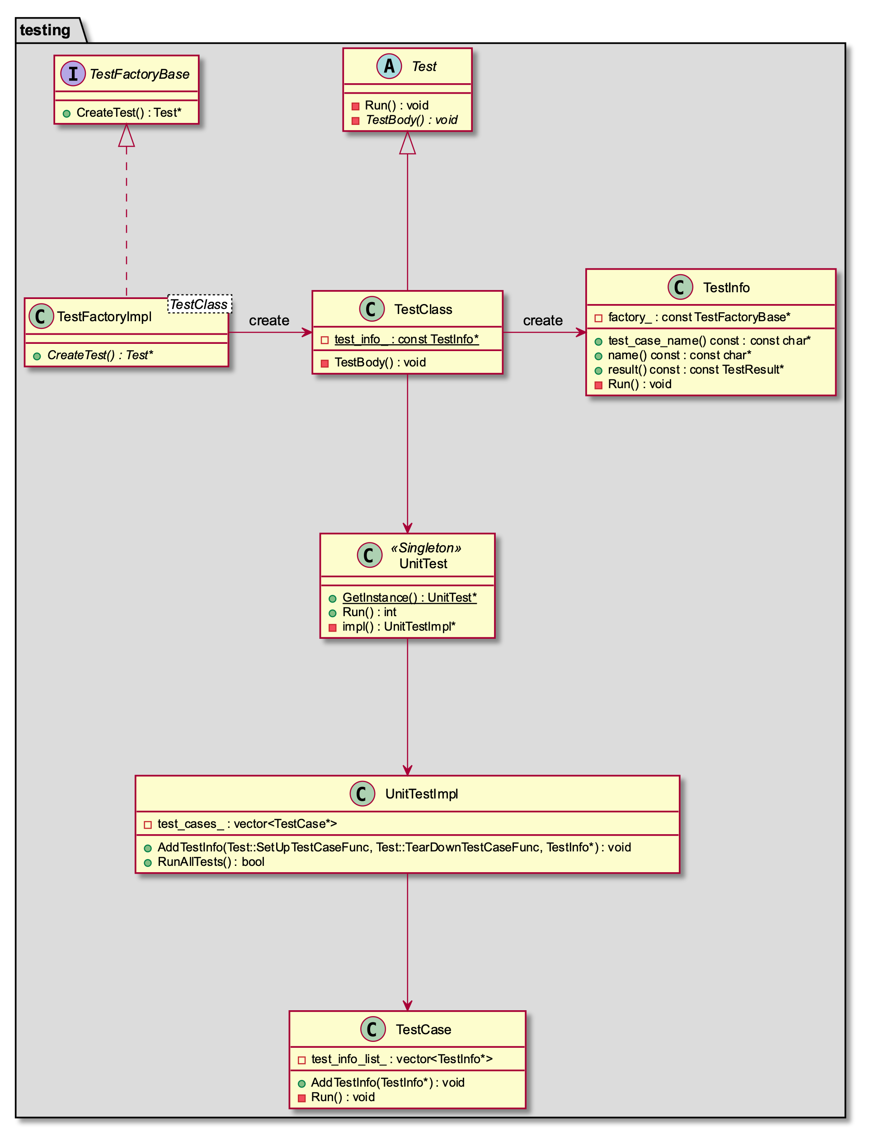
google test
Notes:
实例是以TEST及TEST_F方式注册的test case
带有测试参数的TEST_P方式的注册更加复杂一些，TestFactoryBase的实例不是简单的new出来的，而是由一个更高阶的工厂（TestMetaFactory）生成的
同样是在初始化test class的静态成员变量时，将测试用例信息注册到UnitTestImpl的另一个内部容器里vector<ParameterizedTestCaseInfoBase*>

Slide 29
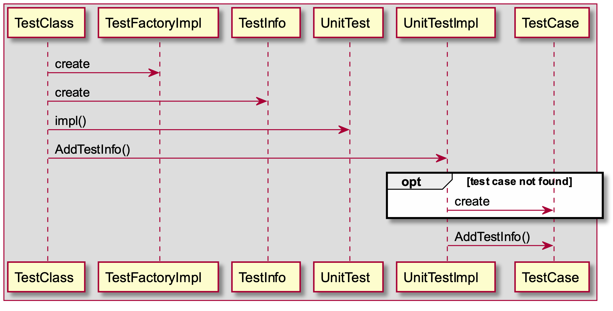
register tests

Slide 30
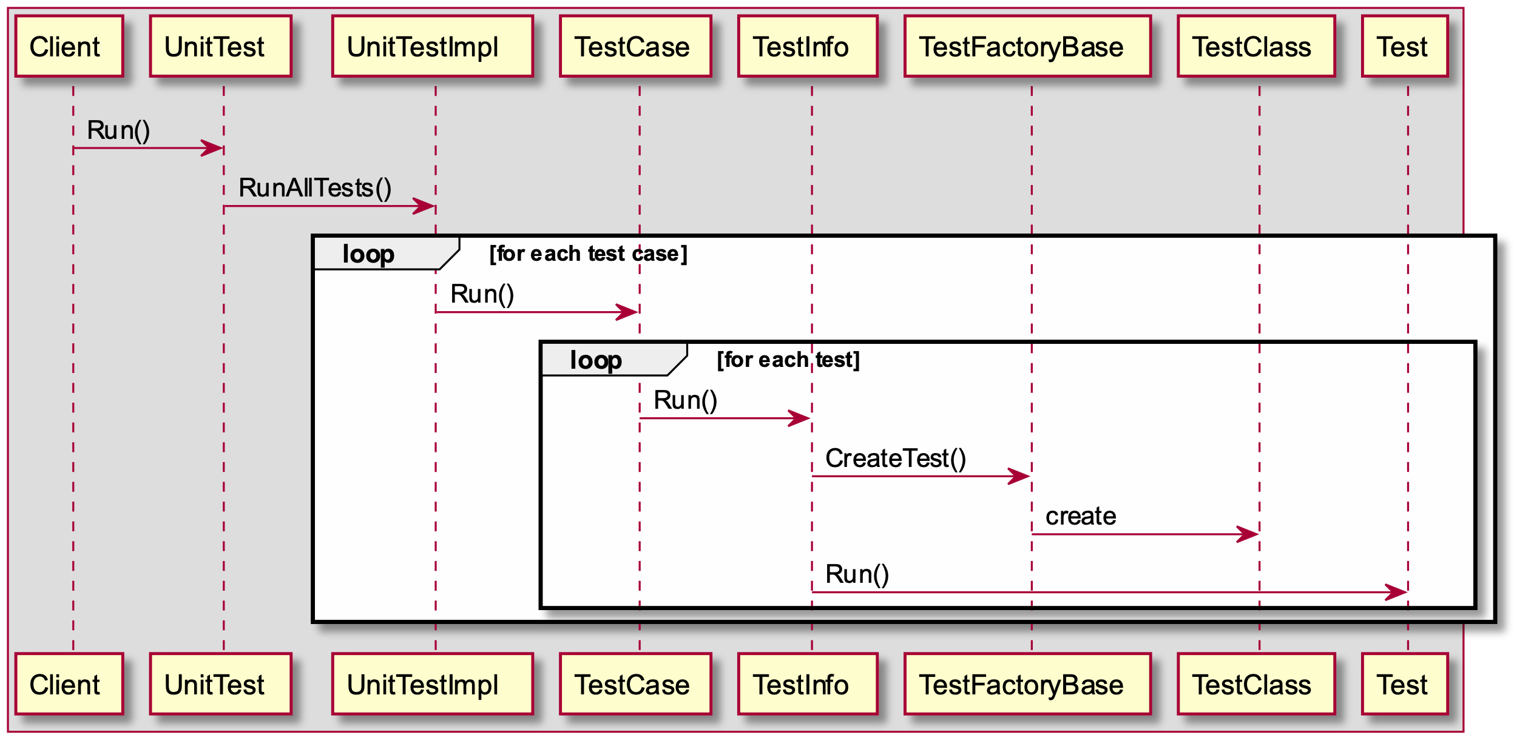
run tests

Slide 31
define test
// Defines a test.
#define TEST(test_case_name, test_name)\
GTEST_TEST_(test_case_name, test_name, \
::testing::Test, ::testing::internal::GetTestTypeId())
// Helper macro for defining tests.
#define GTEST_TEST_(test_case_name, test_name, parent_class, parent_id)\
class GTEST_TEST_CLASS_NAME_(test_case_name, test_name)\
: public parent_class {\
public:\
GTEST_TEST_CLASS_NAME_(test_case_name, test_name)() {}\
private:\
virtual void TestBody();\
static ::testing::TestInfo* const test_info_ GTEST_ATTRIBUTE_UNUSED_;\
};\
\ // to be continued

Slide 32
register test
\ // continue
::testing::TestInfo* const GTEST_TEST_CLASS_NAME_(\
test_case_name, test_name)\
::test_info_ =\
::testing::internal::MakeAndRegisterTestInfo(\
#test_case_name, #test_name, NULL, NULL, \
::testing::internal::CodeLocation(__FILE__, __LINE__), \
(parent_id), \
parent_class::SetUpTestCase, \
parent_class::TearDownTestCase, \
new ::testing::internal::TestFactoryImpl<\
GTEST_TEST_CLASS_NAME_(test_case_name, test_name)>);\
void GTEST_TEST_CLASS_NAME_(test_case_name, test_name)::TestBody()

Slide 33
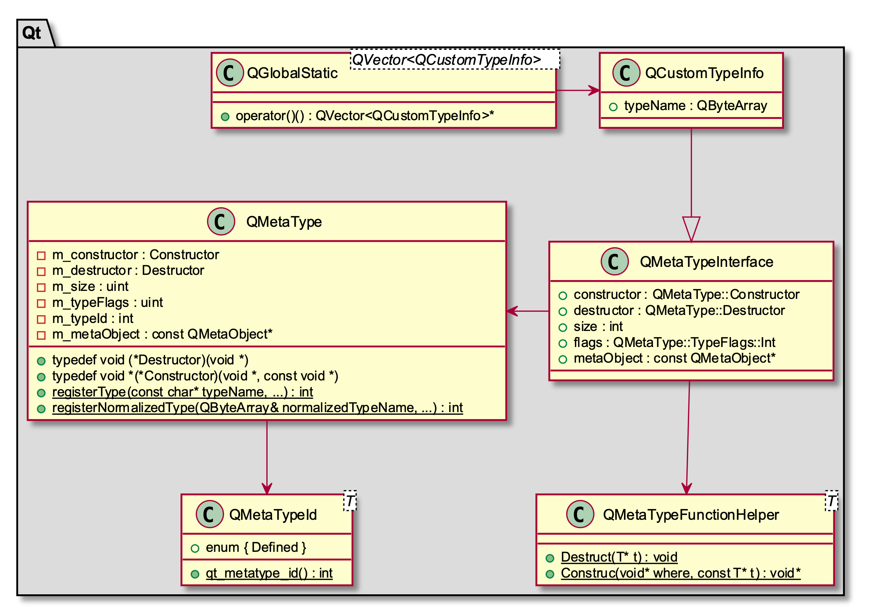
qmetatype
Notes:
QMetaType是一个类型系统，用于将用户自定义类型对象储存于QVariant以及异步信号槽的消息队列中。
相较于google test，它的对象创建方法更加的泛化，因为用户自定义类型并不都继承自同一个父类，所以无法给出一个统一的工厂方法其返回的对象类型是一个确定的类型。
泛化之后的工厂其实就是QMetaType，其工厂方法就是Construtor函数

Slide 34
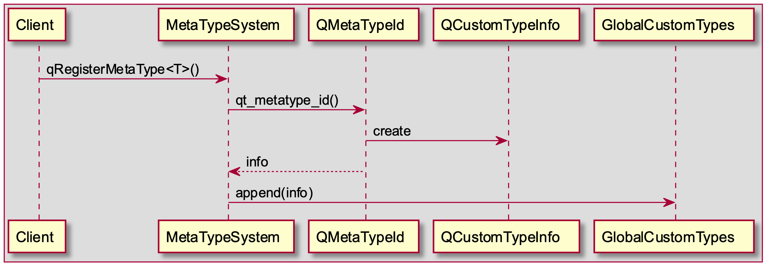
register types

Slide 35
declare metatype
#define Q_DECLARE_METATYPE_IMPL(TYPE) \
QT_BEGIN_NAMESPACE \
template <> \
struct QMetaTypeId< TYPE > \
{ \
enum { Defined = 1 }; \
static int qt_metatype_id() \
{ \
static QBasicAtomicInt metatype_id = \
Q_BASIC_ATOMIC_INITIALIZER(0); \
if (const int id = metatype_id.loadAcquire()) \
return id; \
const int newId = qRegisterMetaType< TYPE >(#TYPE, \
reinterpret_cast< TYPE *>(quintptr(-1))); \
metatype_id.storeRelease(newId); \
return newId; \
} \
}; \
QT_END_NAMESPACE
Notes:
Q_DECLARE_METATYPE用于让所有的基于模板的函数以及QVariant能够使用该类型

Slide 36
register metatype
// modified for easy-reading
template <typename T>
int qRegisterMetaType(const char *typeName, T * dummy = nullptr)
{
::QByteArray normalizedTypeName =
QMetaObject::normalizedType(typeName);
return qRegisterNormalizedMetaType<T>(
normalizedTypeName, dummy);
}

Slide 37
register metatype
// modified for easy-reading
template <typename T>
int qRegisterNormalizedMetaType(
const ::QByteArray &normalizedTypeName, T *dummy = 0)
{
QMetaType::TypeFlags flags(
QtPrivate::QMetaTypeTypeFlags<T>::Flags);
const int id = QMetaType::registerNormalizedType(normalizedTypeName,
QtMetaTypePrivate::QMetaTypeFunctionHelper<T>::Destruct,
QtMetaTypePrivate::QMetaTypeFunctionHelper<T>::Construct,
int(sizeof(T)),
flags,
QtPrivate::MetaObjectForType<T>::value());
return id;
}

Slide 38
register metatype
// modified for easy-reading
static int registerNormalizedType(const ::QByteArray &normalizedTypeName,
QMetaType::Destructor destructor, QMetaType::Constructor constructor,
int size, QMetaType::TypeFlags flags, const QMetaObject *metaObject)
{
QVector<QCustomTypeInfo> *ct = customTypes(); // global static
QCustomTypeInfo inf;
inf.typeName = normalizedTypeName;
inf.constructor = constructor;
inf.destructor = destructor;
inf.size = size;
inf.flags = flags;
inf.metaObject = metaObject;
int idx = ct->size() + QMetaType::User;
ct->append(inf);
return idx;
}

Slide 39
constructor and destructor
namespace QtMetaTypePrivate {
template <typename T, bool Accepted = true>
struct QMetaTypeFunctionHelper
{
static void Destruct(void *t)
{
Q_UNUSED(t)
static_cast<T*>(t)->~T();
}
static void *Construct(void *where, const void *t)
{
if (t)
return new (where) T(*static_cast<const T*>(t));
return new (where) T;
}
};
} // namespace QtMetaTypePrivate
Notes:
MetaType的作用之一就是创建和销毁注册的Type，其中Construct既可以作为默认构造使用，又可以作为拷贝构造使用
显然对于注册类型T就有三个基本要求，要求有pubic的默认构造函数，拷贝构造函数和析构函数

Slide 40
trigger registration
template <typename T>
inline constexpr int qRegisterMetaType()
{
return qMetaTypeId<T>();
}
template <typename T>
inline constexpr int qMetaTypeId()
{
return QMetaTypeId2<T>::qt_metatype_id();
}
template <typename T>
struct QMetaTypeId2
{
enum { Defined = QMetaTypeId<T>::Defined, IsBuiltIn = false };
static inline constexpr int qt_metatype_id() {
return QMetaTypeId<T>::qt_metatype_id();
}
};
Notes:
qRegisterMetaType()需要被调用，如果需要使用queued connection signal and slot

Slide 41
conclusion
C++ Language: Polymorphic/Dynamic Construction
Design Principle: Dependency Inversion and Open-Closed

Slide 42
References
Erich Gamma, Richard Helm, Ralph Johnson, John Vlissides. Design Patterns: Elements of Reusable Object-Oriented Software, Addison-Wesley, 1994
Andrei Alexandrescu. Modern C++ Design: Generic Programming and Design Patterns Applied, Addison-Wesley, 2001
Scott Meyers. Effective STL: 50 Specific Ways to Improve Your Use of Standard Template Library, Addison-Wesley, 2001
Eric Freeman, Elisabeth Freeman, Kathy Sierra, Bert Bates. Head First Design Patterns, O’Reilly, 2004
Mattthew H. Austern. “Why you shouldn't use set (and what you should use instead)”, available at http://lafstern.org/matt/col1.pdf, 2000
Various authors. “More C++ Idioms/Virtual Constructor”, available at https://en.wikibooks.org/wiki/More_C%2B%2B_Idioms/Virtual_Constructor, 2017
Bartlomiej Filipek. “Factory With Self-Registering Types”, available at https://www.bfilipek.com/2018/02/factory-selfregister.html, 2018
Andrei Alexandrescu. Loki, available at https://github.com/dutor/loki
Qt. Qt, available at https://www.qt.io/download-open-source
Google. Googletest, available at https://github.com/google/googletest
Microsoft. GSL, available at https://github.com/microsoft/GSL
Facebook. Folly, available at https://github.com/facebook/folly

Slide 43
Q & A
I’d like to know...
Notes:
关于多线程，多线程安全关联型容器，vector迭代器失效问题
找不到某种类型的创建器时的错误处理也可以成为一个设计决策点
ScalableFactory略去了用于具体类型构造的可变长度参数类型
对应于多态构造，还有多态拷贝，也就是原型模式，利用原型模式可以实现克隆工厂

