Slide 1





Ecommerce Website

Slide 2
Objectives
Development of Full Stack Website which people can use to buy products online.
Benefits
Buyers will be able to buy goods and services online.
Variety of products are available.
Good marketplace for sellers to place their products.
People can buy/sell anywhere globaly.

Slide 3

Problem
To Organizations:
High cost of entry and operating cost is high
Reach limited to a locality
Unable to provide efficient service
To Customers:
Long waiting time
Noisy, crowded and narrow waiting environment

Slide 4

Solution
To Organisations
Global reach
Cost reduction and low cost of entry
24/7 access
To Customers
A variety of products and services to choose from
Cheaper products and services
Information availability
No privacy

Slide 5
Key Features
This Project was made using React Js Frontend. All the website components are loaded on the single hence it makes the navigation between different pages smoother and faster.
Redux is a react library which was used to make a temporary storage of the frontend side, due to which the api is called once and the things gets displayed on the multiple pages in no time.
Backend is using the MongoDB database which is flexible and faster.
User Inferface is very friendly, intuitive easy to understand for naive users.
User can add the products to the cart, this cart is dynamic and the products can be added or removed as requirements.

Slide 6
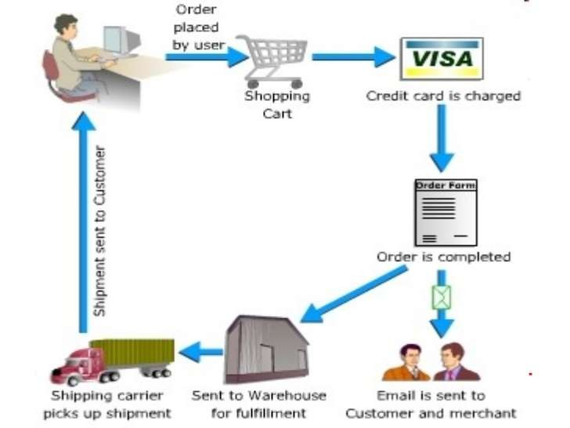
eCommerce Process Flow

Slide 7


Three-tier Architecture (MVC)
View
API
Client Side
REACT
Server Side
NodeJS
Database
MongoDB

Slide 8
Languages & Tools
Node JS & Express JS (Backend),
React JS & Material-UI (Frontend)
MongoDB (Database)
JWT Authentication

Slide 9
Frequent Q&A
Q) Does this webapp works on mobile ?
The website is fully responsive and works perfectly on mobile devices.
Q) What is the complete flow of your project?
User can see the products on the homepage itself. Also user can search for the specific products in the search box above . After clicking on the product, the description page appears and from there user can add it to the cart or buy it immediately.
Q) How to create account on website ?
There is login button on the top of the homepage and there one can find create account option .

