Slide 1

Superposition with Combinators
Ahmed Bhayat

Slide 2

Higher-order Logic as a First-order Theory
Assume a polymorphic first-order logic. Higher-order logic can be completely axiomatized by adding axioms for the logical connectives along with:

Slide 3

Problems with the Approach
For all common orderings, the two sides of the combinator axiom will be incomparable. Consider the axiom in applicative form:
Consequences:
Inferences have to be carried out on the right-hand side of the axiom
Other axioms can superpose onto the right-hand side
Not graceful at all

Slide 4

Lambda-free HOL (Bentkamp et. al. 2018)
Exactly like first-order logic, but now have ‘prefix’ subterms to deal with:
In the presence of a term order that is compatible with arguments:
there is no problem. Superposition is exactly as in the first-order case.

Slide 5





Lambda-free HOL - Challenges
If the term-order is not compatible with arguments, difficulties arise:
Lose completeness. Assume , but . Cannot derive a contradiction from:
To rule out superposition at variables in standard completeness proof, we require for ground and grounding . This no longer holds.

Slide 6



Lambda-free HOL - Solutions
Do not superpose at ‘prefix’ terms. Rather use ArgCong to grow terms:
Carry out some limited superposition at variables.

Slide 7






Lambda-free HOL – Modified Completeness Proof

Slide 8
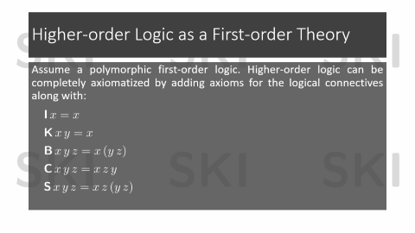
Back to Combinators
If superposition is parametrised by an ordering that orients all instances of combinator axioms left-to-right, no inferences amongst the axioms.
No simplification ordering known with this property

Slide 9





The Ordering
For terms and , if:

Slide 10


Compatibility with Contexts
Lacks two monotonicity properties:
Compatibility with arguments, e.g.,
Compatibility with ‘unstable contexts’, e.g.,

Slide 11
The Challenges
Further problems with completeness:
Cannot even rule out superposition underneath variables:

Slide 12



Solutions
Do not carry out superposition beneath fully applied combinators.
Carry out limited superposition beneath variables:
Condition:
is a variable or combinator

Slide 13

Modification to Floor Encoding
Fully applied combinator terms are translated to constants
Thus, the floor of all combinator and extended combinator axioms is of the form:

Slide 14


Peculiar Difficulty in Completeness Proof
When lifting inferences from the ground level it is not the case that a ground inference beneath a variable is an instance of a SubVarSup inference at the non-ground level.

Slide 15


Modification to Model Construction
Therefore, all combinator axioms need to hold in for all

Slide 16



Example

Slide 17
Current Status
Working on details of the proofs
Working on an implementation in Vampire

Slide 18


Further Work
Same approach should be possible with lambdas
Ordering is the same as in the combinator case, but stands for length of longest beta-reduction
Beta-reduction becomes a part of the calculus
On terms of the form carry out project and imitation steps
An imitation step is equivalent to a superposition inference with the equation:

Slide 19
Further Work (2)
Not fully clear how to update the completeness proof
It ought to be possible

Slide 20

Conclusion & Bigger Picture
Calculus represents an ‘unfolding’ of unification into superposition

Slide 21
Questions?

