Slide 1
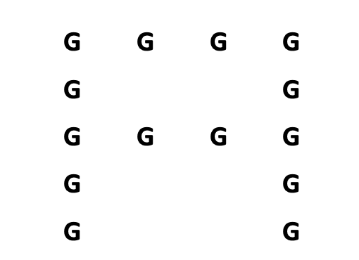
Type the BIG LETTER on your keyboard
CORRECT ANSWER: A
Type the SMALL LETTER on your keyboard
CORRECT ANSWER: G

