Slide 1
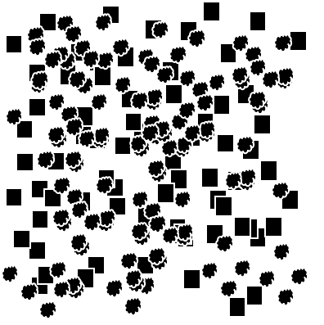

Phase 1
You will first see a fixation cross
+
Phase 2
A stimulus will appear too fast to be seen
Phase 3
A meaningless image will appear
Phase 4
A sequence of letters will appear
hutrt
truth

Slide 2
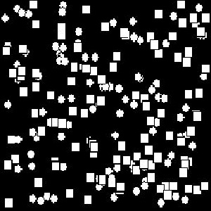

Slide 3
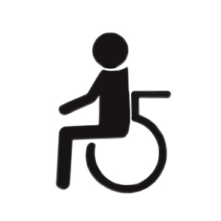



Slide 4


