Slide 1
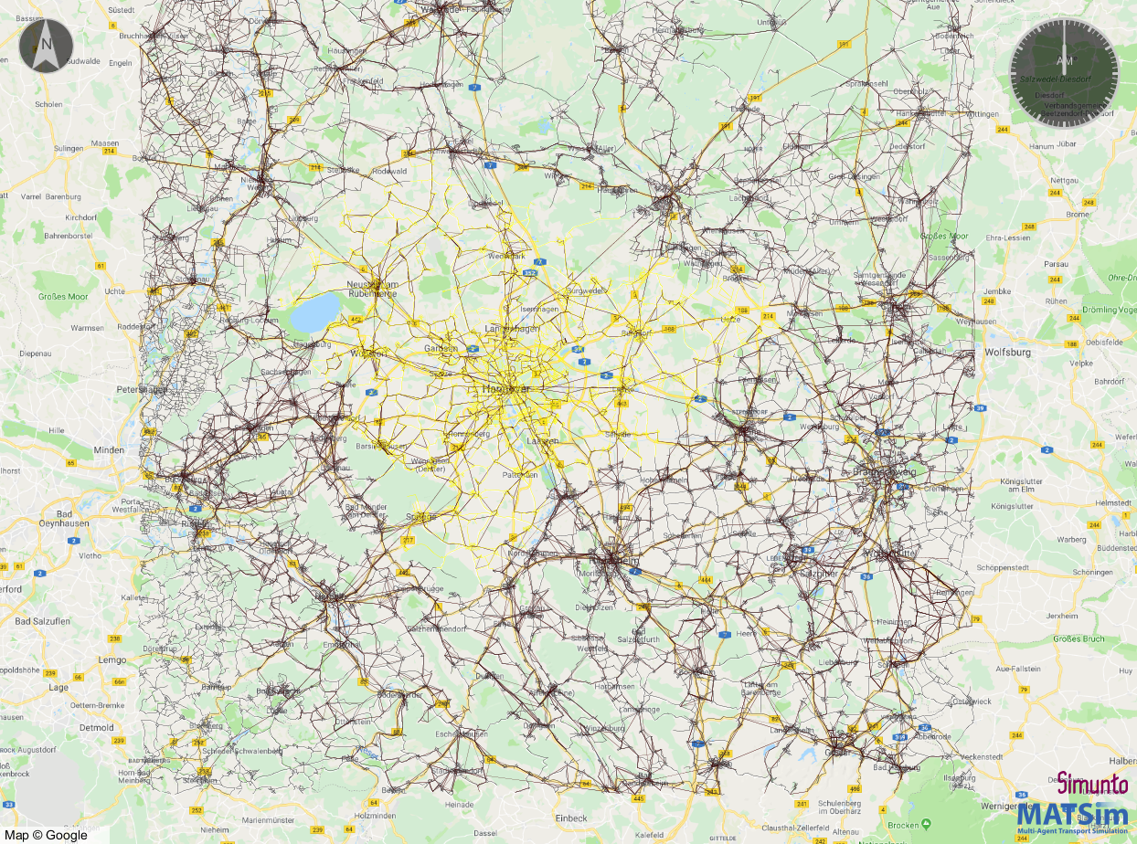
HUB_CE
HUB_H_1-5
HUB_BS
HUB_HI

