Slide 1
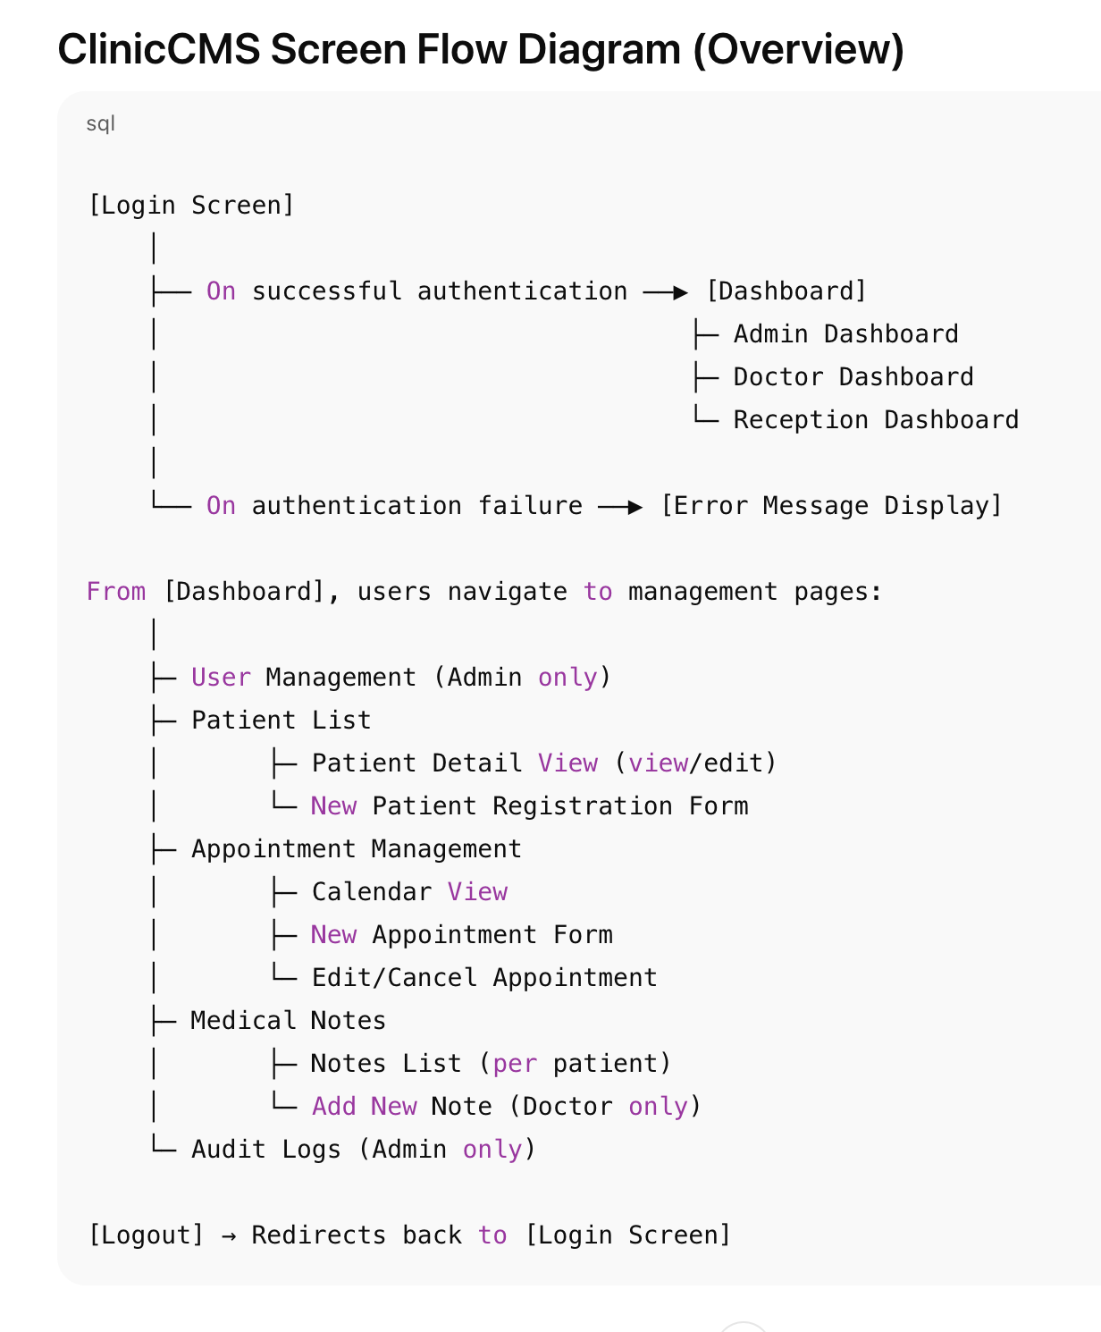
Key Button Actions Description
Screen | Button | Description
Login | Login | Verifies username and password; on success, navigates to Dashboard. On failure, shows error message.
Admin Dashboard | User Management | Navigates to the user list page where new users can be added or existing users edited.
Dashboard | Patient List | Navigates to the patient list page for viewing, editing, or registering patients.
Patient List | Add New Patient | Opens a form for entering new patient information.
Patient Detail | Edit | Opens patient information editing form.
Appointment Mgmt | Add New Appointment | Opens calendar or form to schedule new appointment (date/time, patient, doctor).
Appointment List | Edit | Allows editing existing appointment details (date, status, etc.).
Appointment List | Cancel | Changes appointment status to “canceled.”
Medical Notes List | Add New Note | Allows doctors to add new medical notes.
Dashboard | Logout | Ends user session and redirects to the login screen.
Additional Notes
After each operation, users are typically redirected to the relevant list or dashboard page to confirm action status.
Errors are displayed at the top of the page in red.
Forms validate required fields and display error messages next to fields if validation fails.
Buttons and page access are dynamically controlled based on user roles for security.

Slide 2
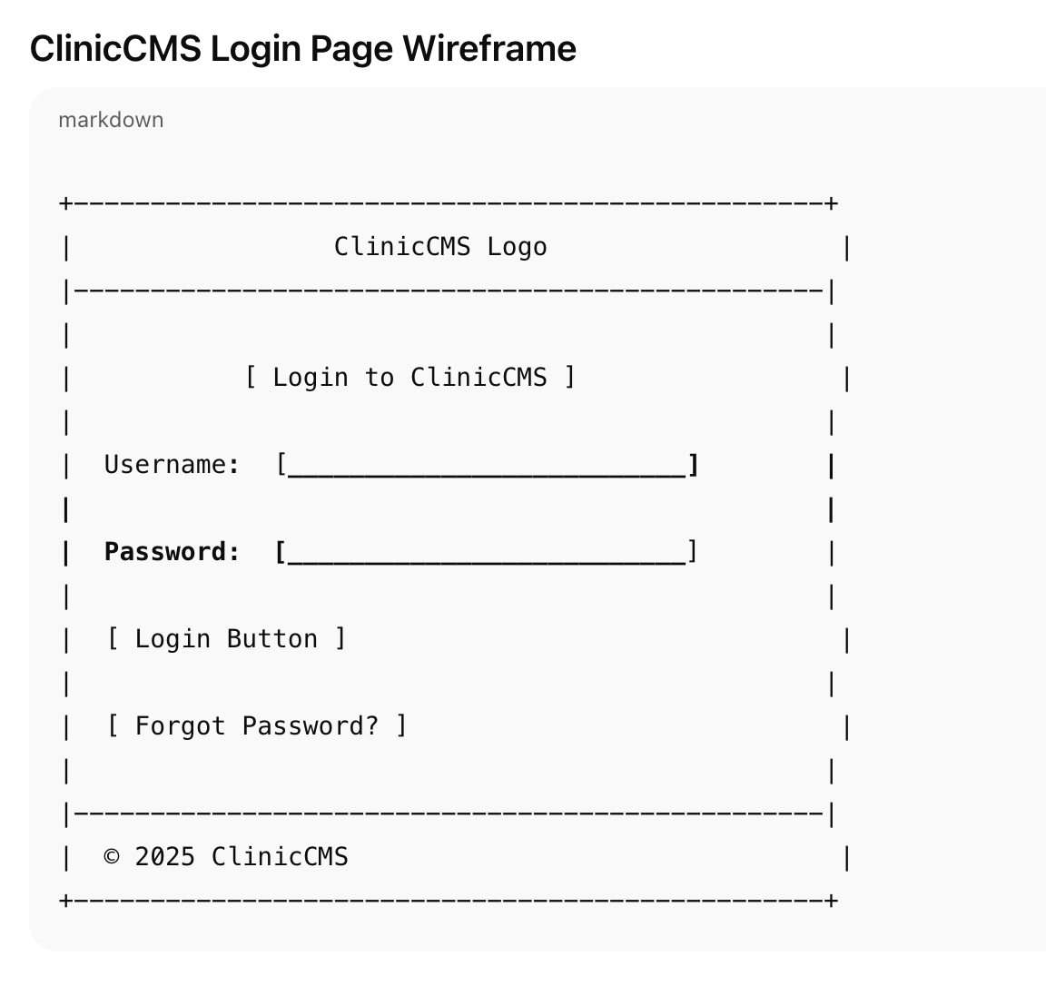

Slide 3
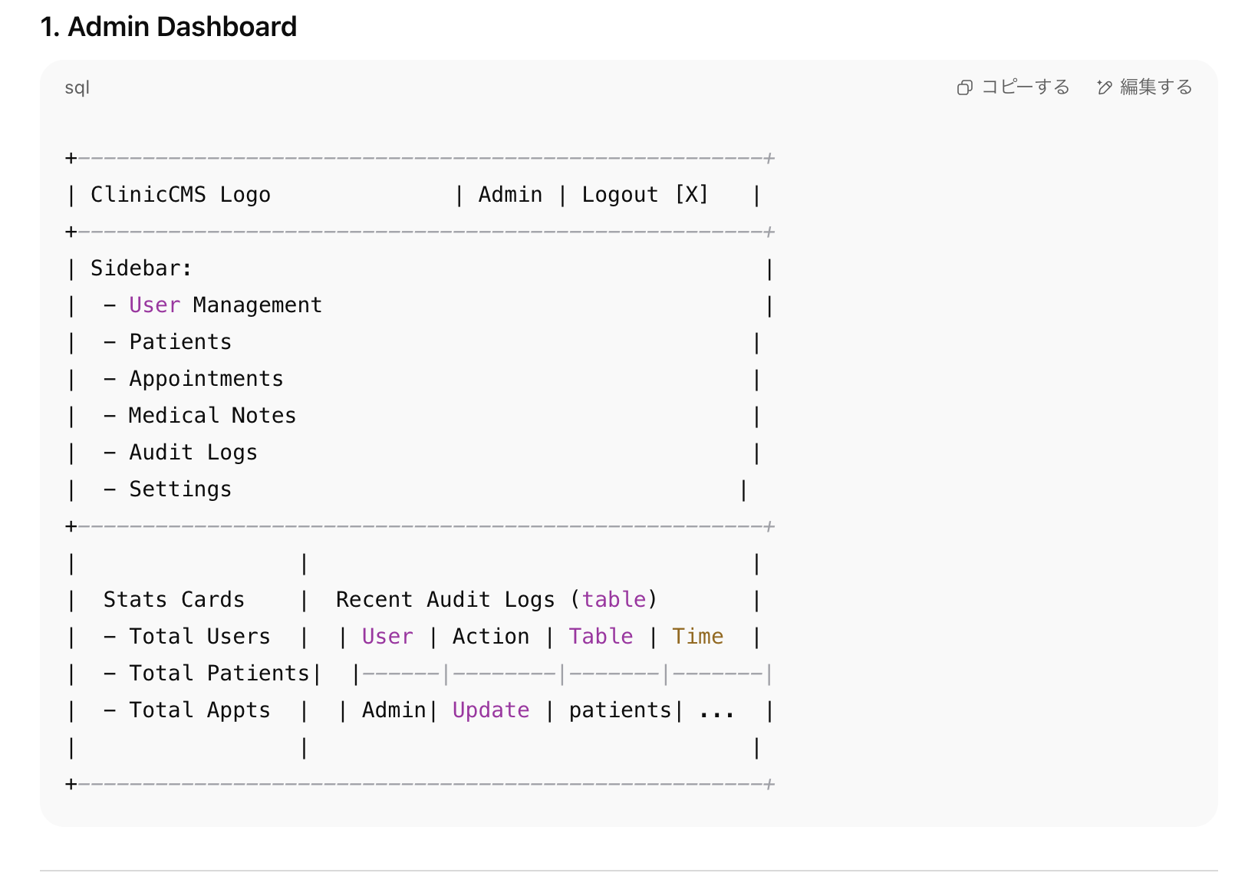

Slide 4
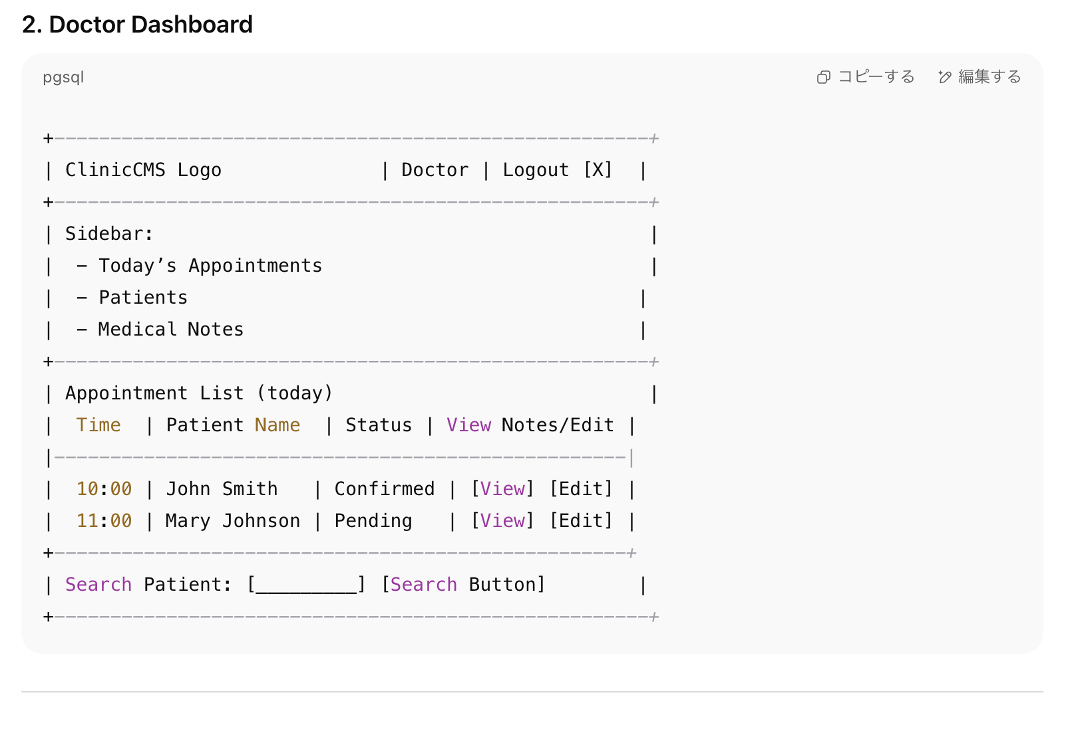

Slide 5
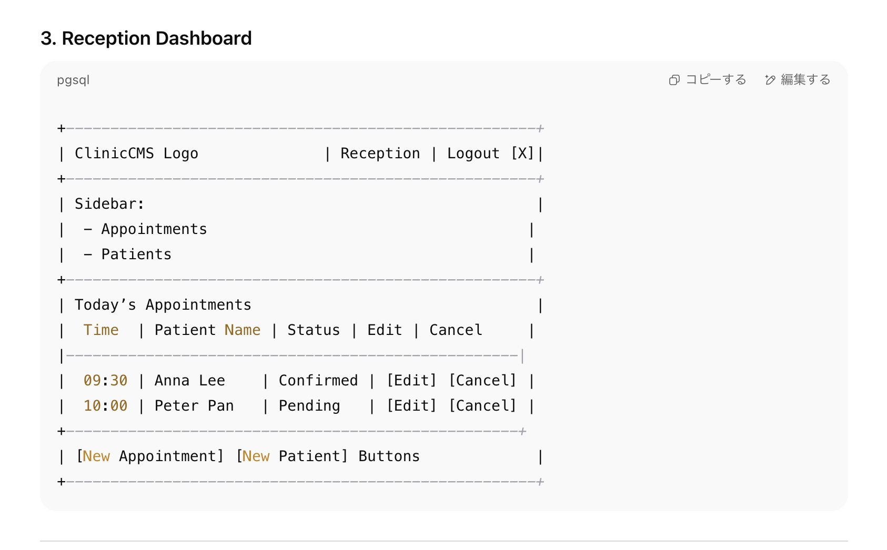

Slide 6
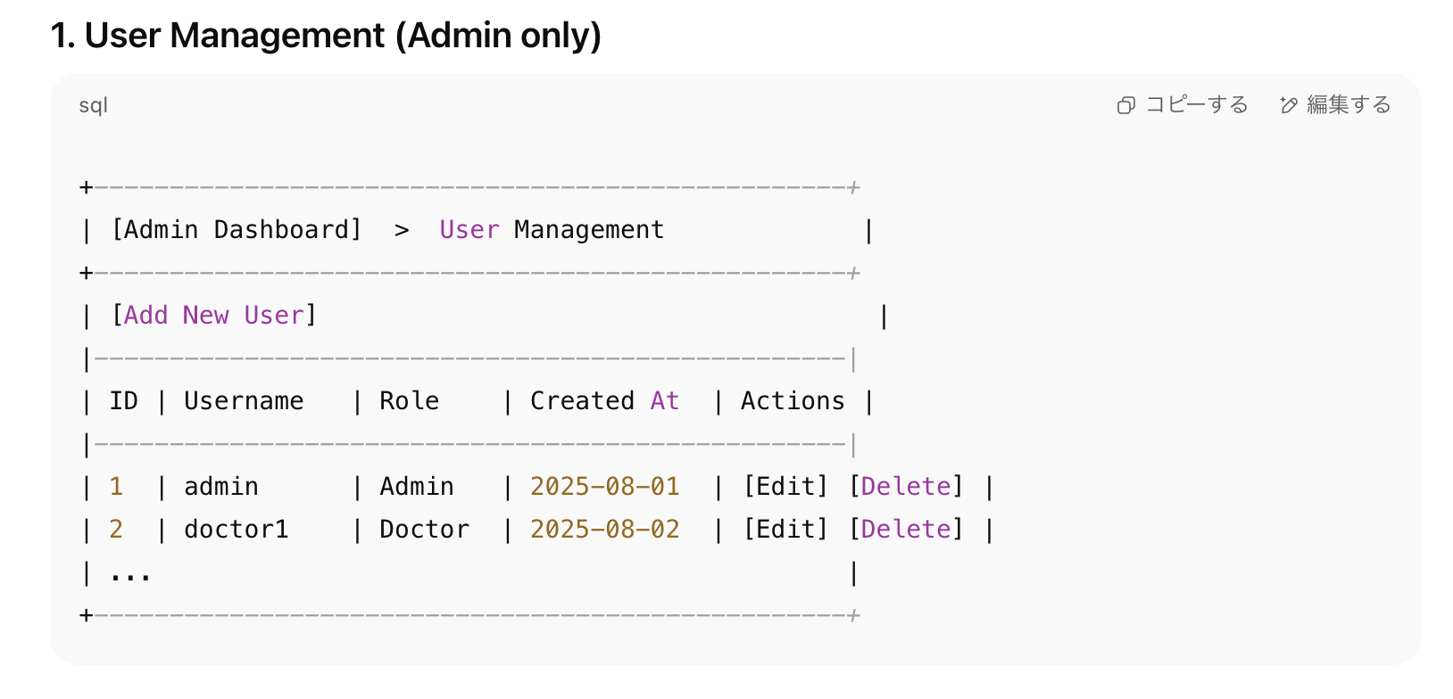

Slide 7
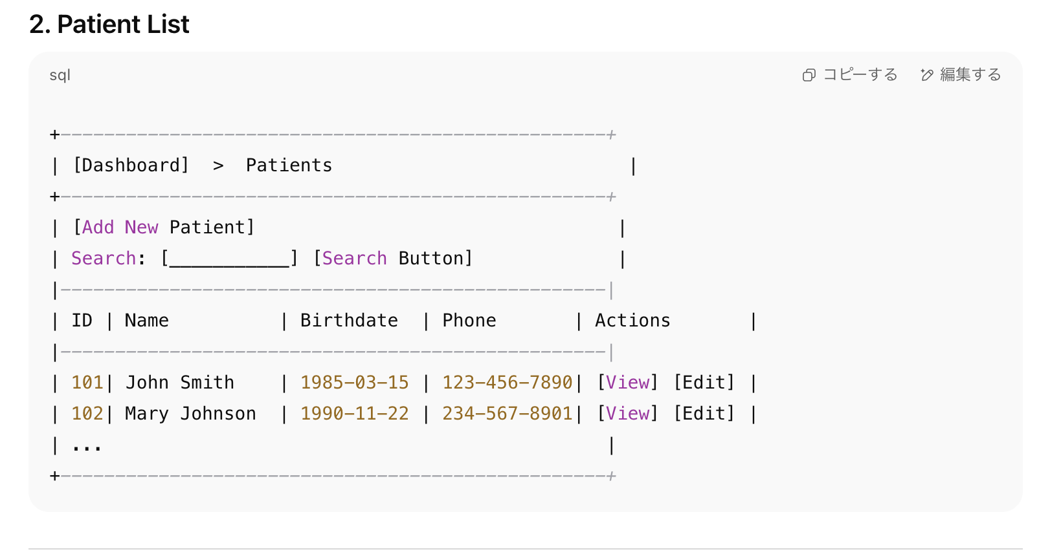

Slide 8
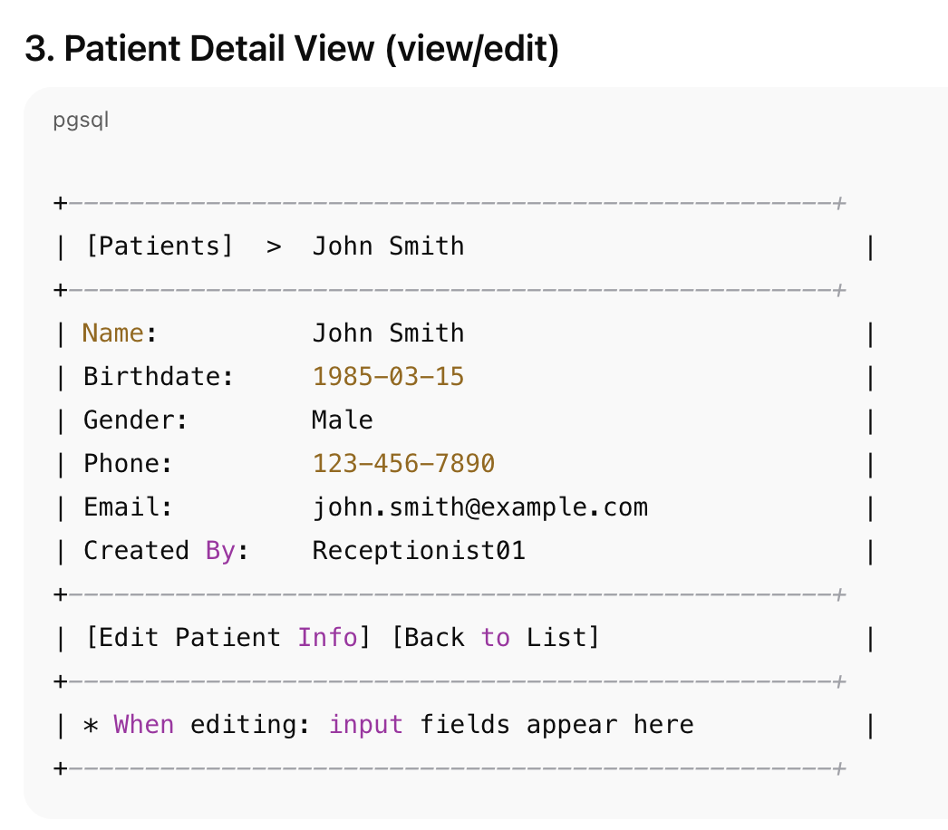

Slide 9
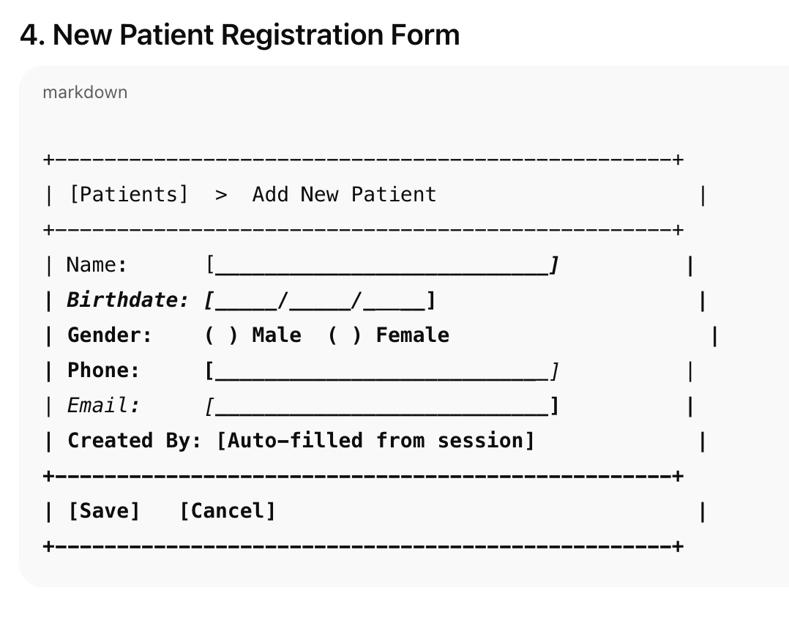

Slide 10
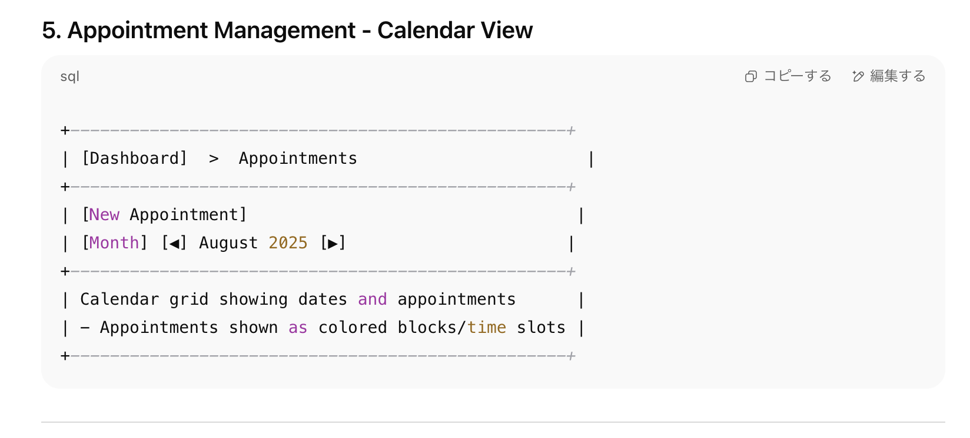

Slide 11
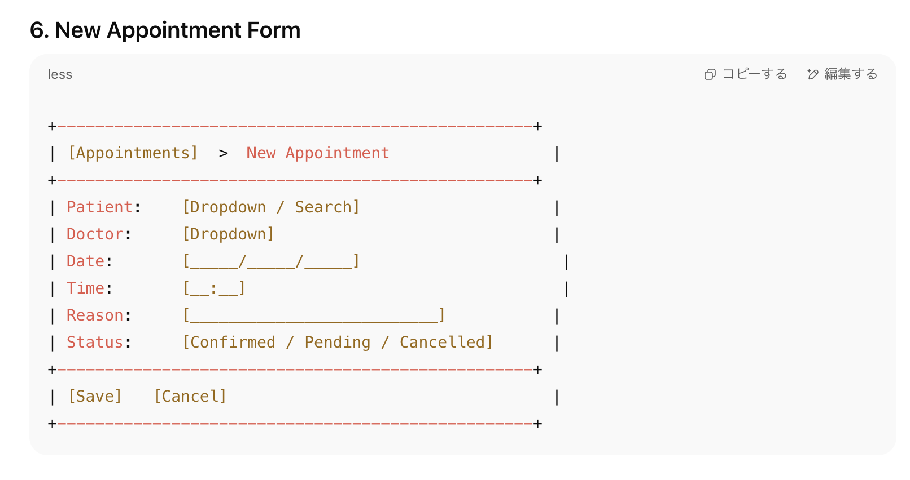

Slide 12
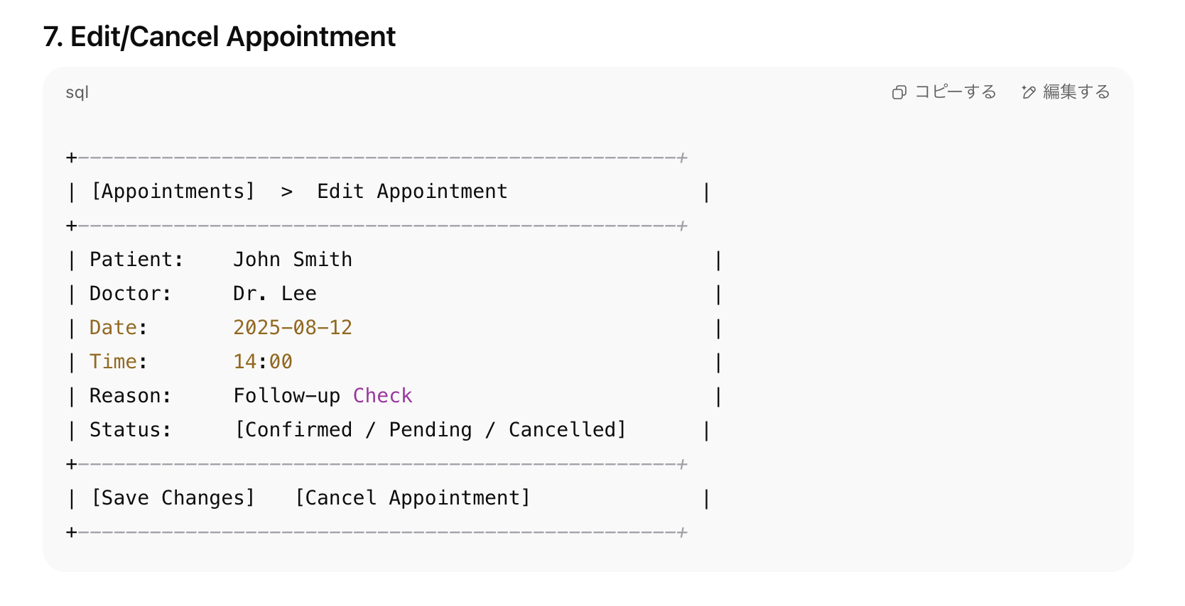

Slide 13
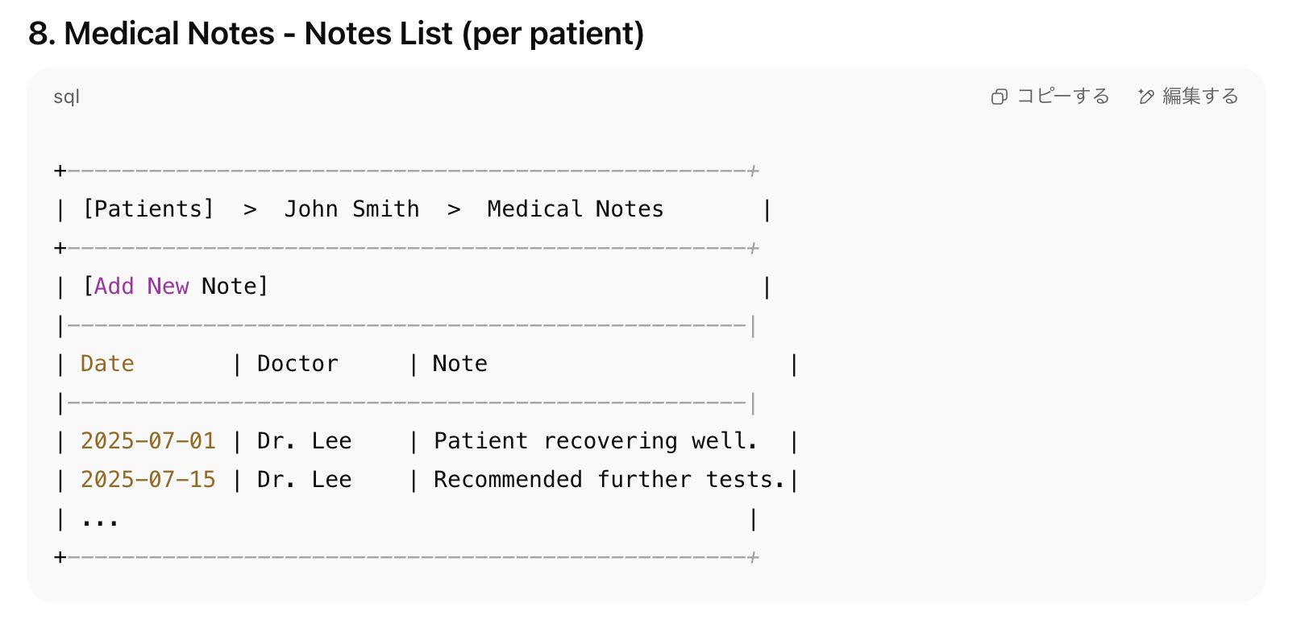

Slide 14
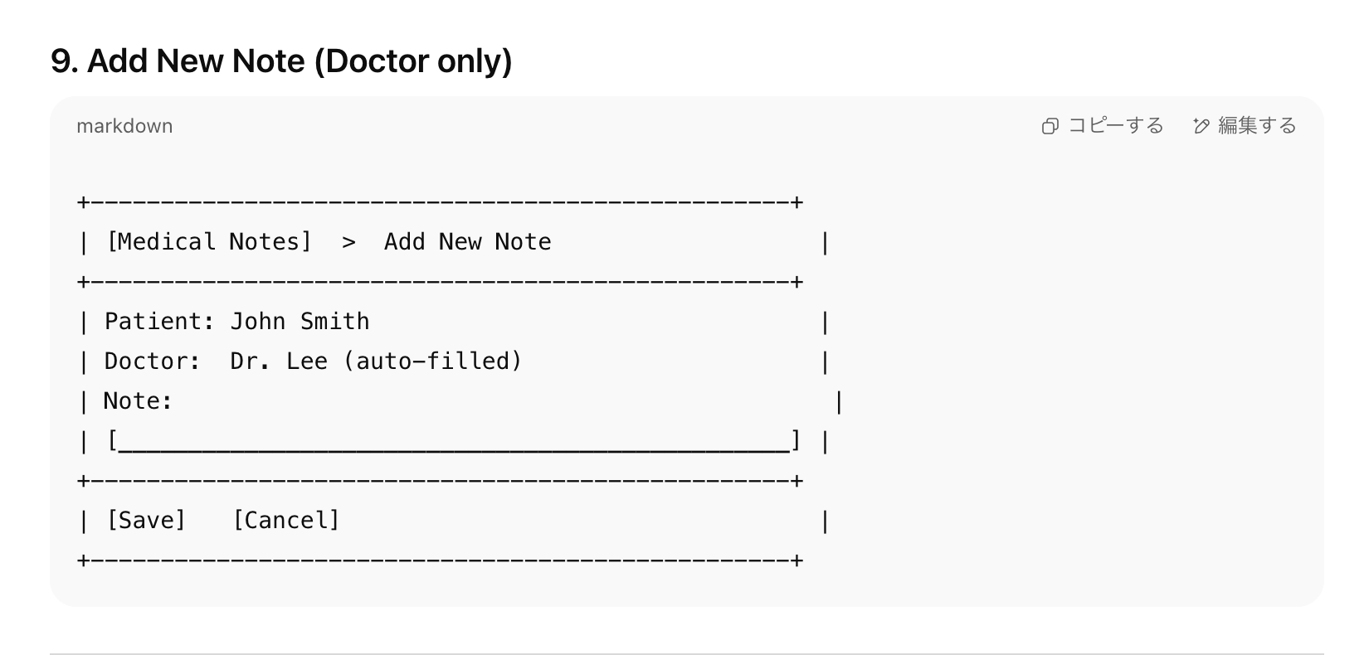

Slide 15
