Slide 1
Umeboshi Internet
It’s a easy interface of the internet.

Slide 2
What for the investors
Need money to establish
  I would like to be invest 2’000’000 yen to each investor.
  2% ownership stock in the operating corporation.
  Each investor can have 1.5% of the company’s profits.
Need resources.
  Computers (even if slow)

Slide 3
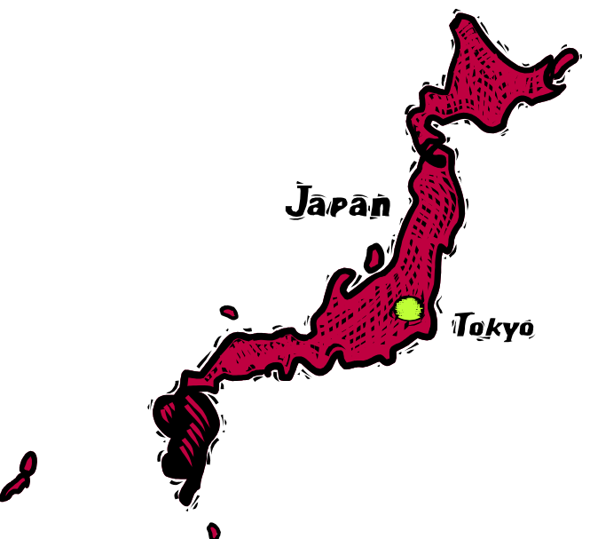


Overview
Target Area
  All over the Japan.
Target Generation
  Elderly people

Slide 4
Backgrounds
Aging of society
  Elder people community is getting growth.
  Want to use internet.
Diffusing internet infrastructure
  Fast line speed
    ADSL, optic fiber

Slide 5
Needs
Elderly people
  Want to know internet and want to use internet.
Young people
  Want to earn money.

Slide 6
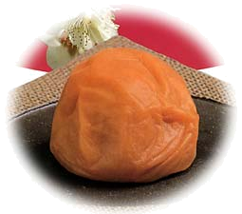
Abstract
Integrated environment
  Easy user interface
Help system
  Help them young people who is good at computer
This application’s name is
“Umeboshi Interface”

Slide 7
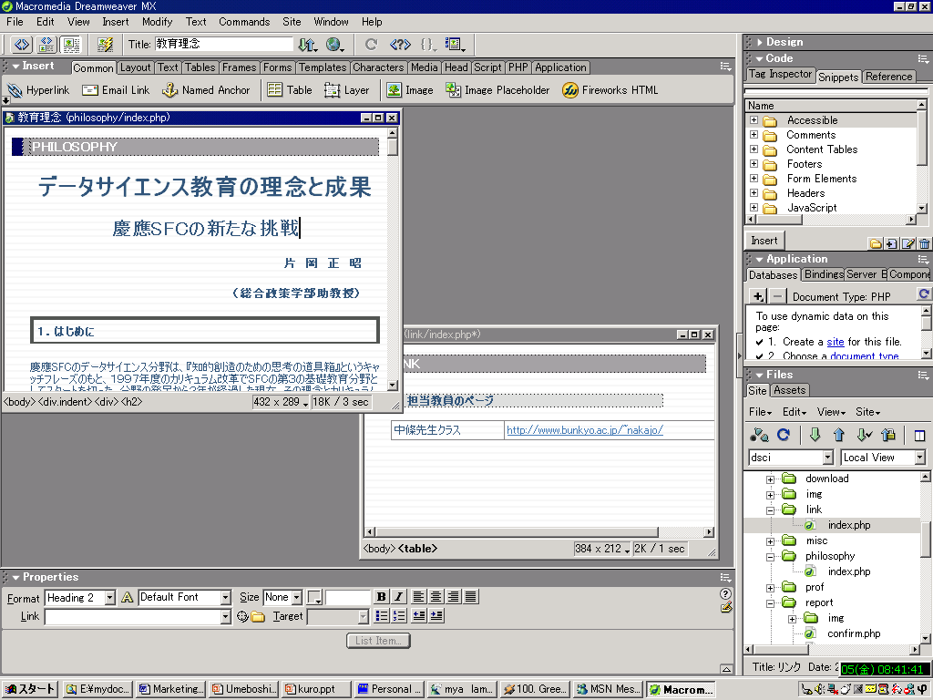
Help panel
Vide chat window
Current status
Today’s weather
Inbox
Messenger Window

Slide 8

Structure
Equipped with Umeboshi interface
Community
Space?
Equipped with Umeboshi interface

Slide 9
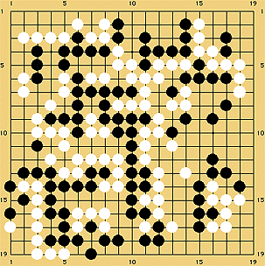
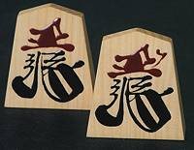
Community space
E-Mail
Bulletin Boards System
Video Chat
Games
  Igo
  Sho-gi
Editing and Publication Homepage

Slide 10
“Umeboshi Internet” derive from?
Umeboshi
  Japanese traditional
  Analog
Internet
  Futuristic
  Digital
Bridge
Software

Slide 11

About trouble
Trouble resolution system.
  Call someone who can help.
  If can, respond that calling.
  Start video chat and remote desktop assistant.
Help call !
Reply!

Slide 12
By this system
Elderly people can use internet easily.
No worry about trouble.
New business market
  Advertisement
  Products for elderly people

Slide 13
END

