Slide 1
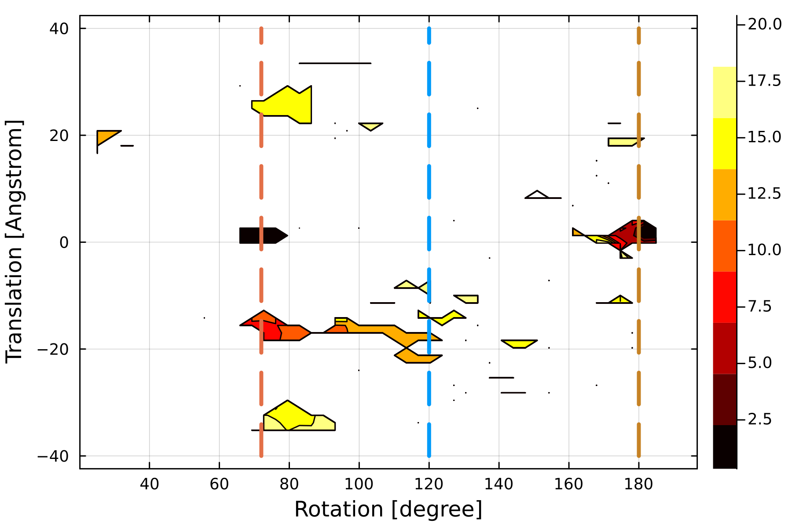
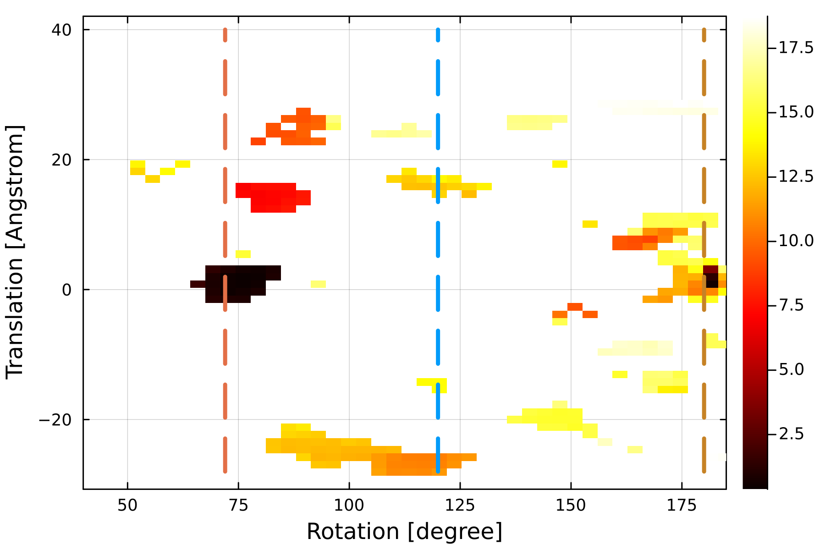
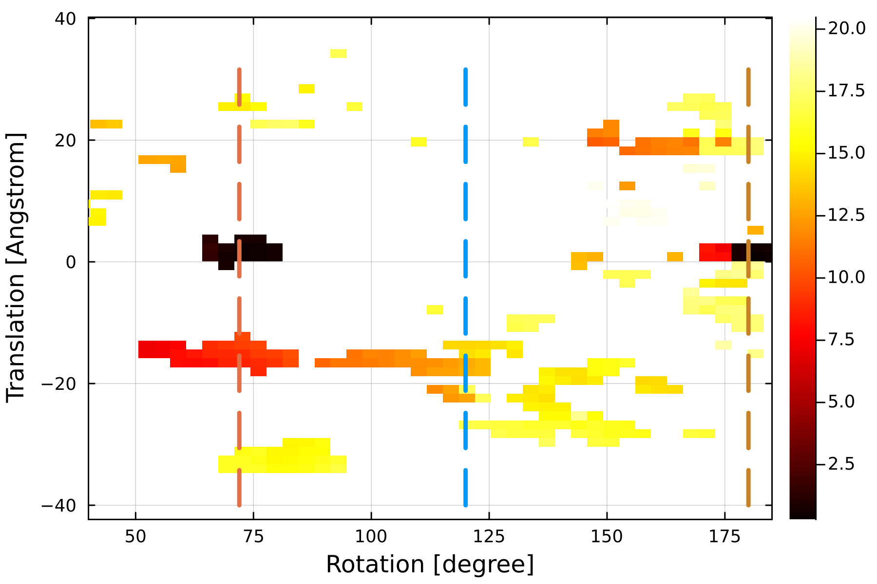
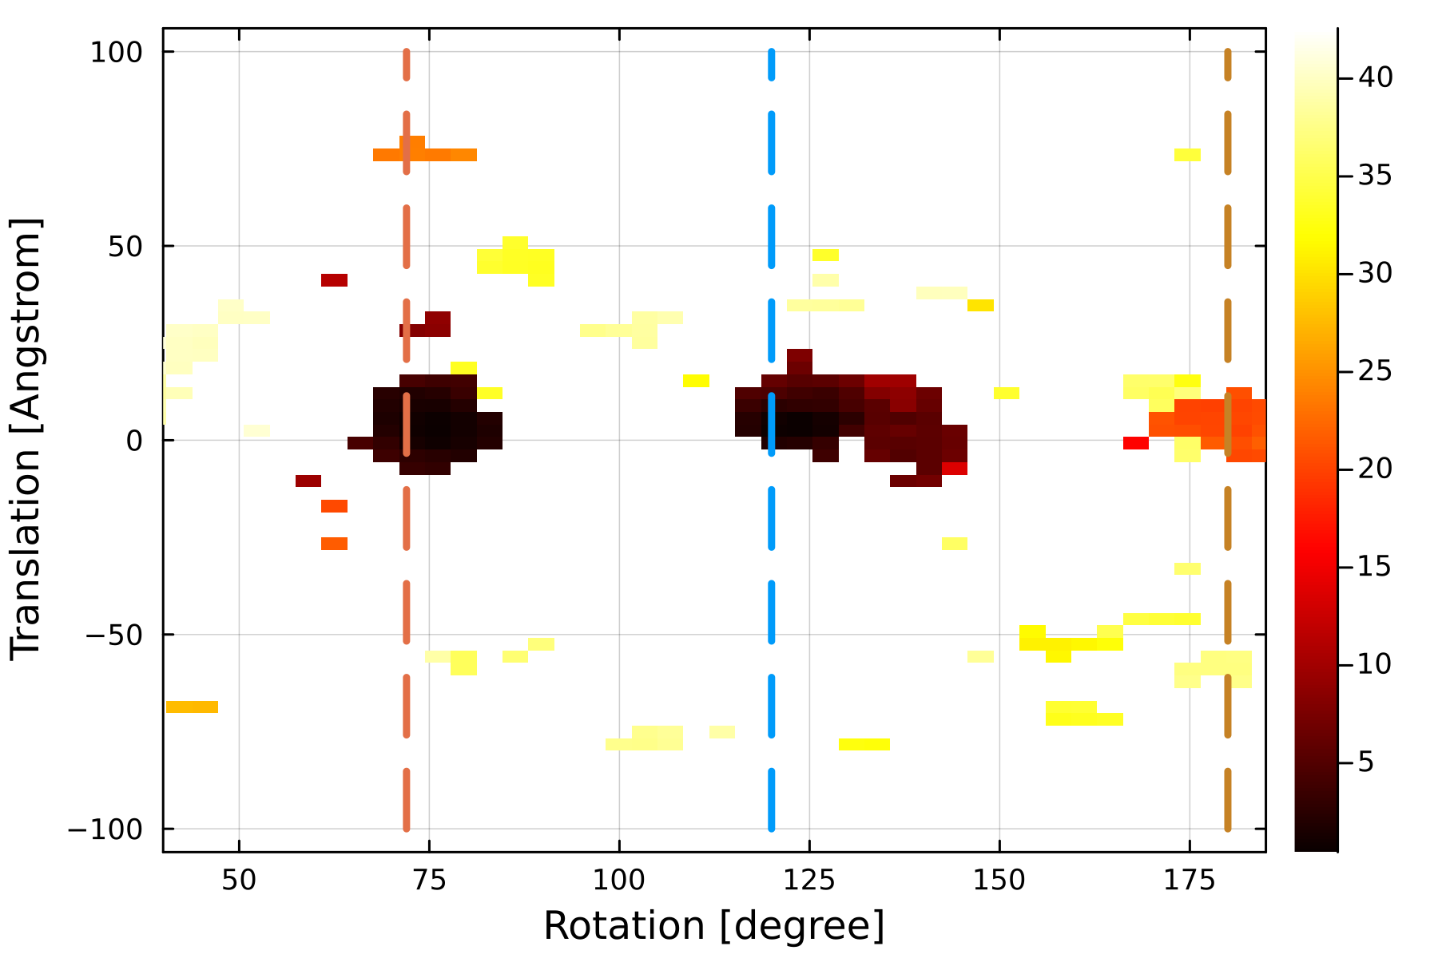
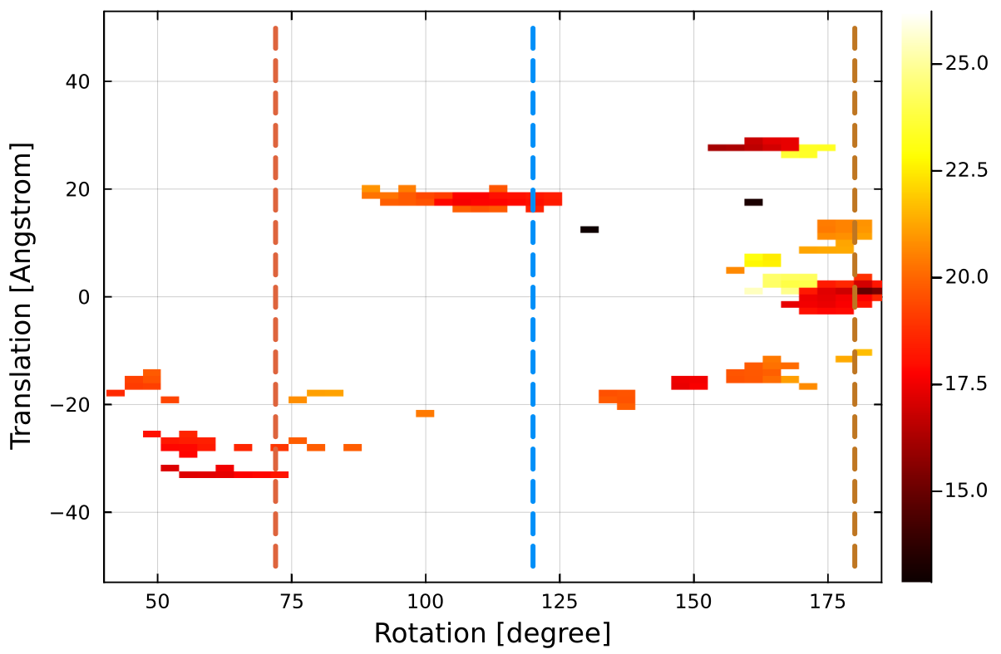
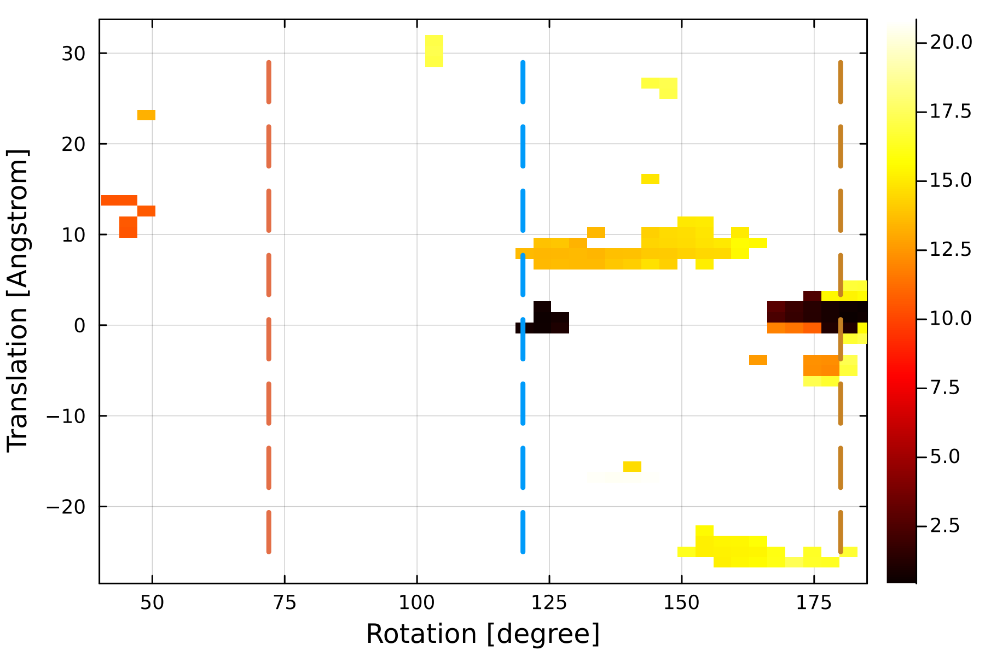
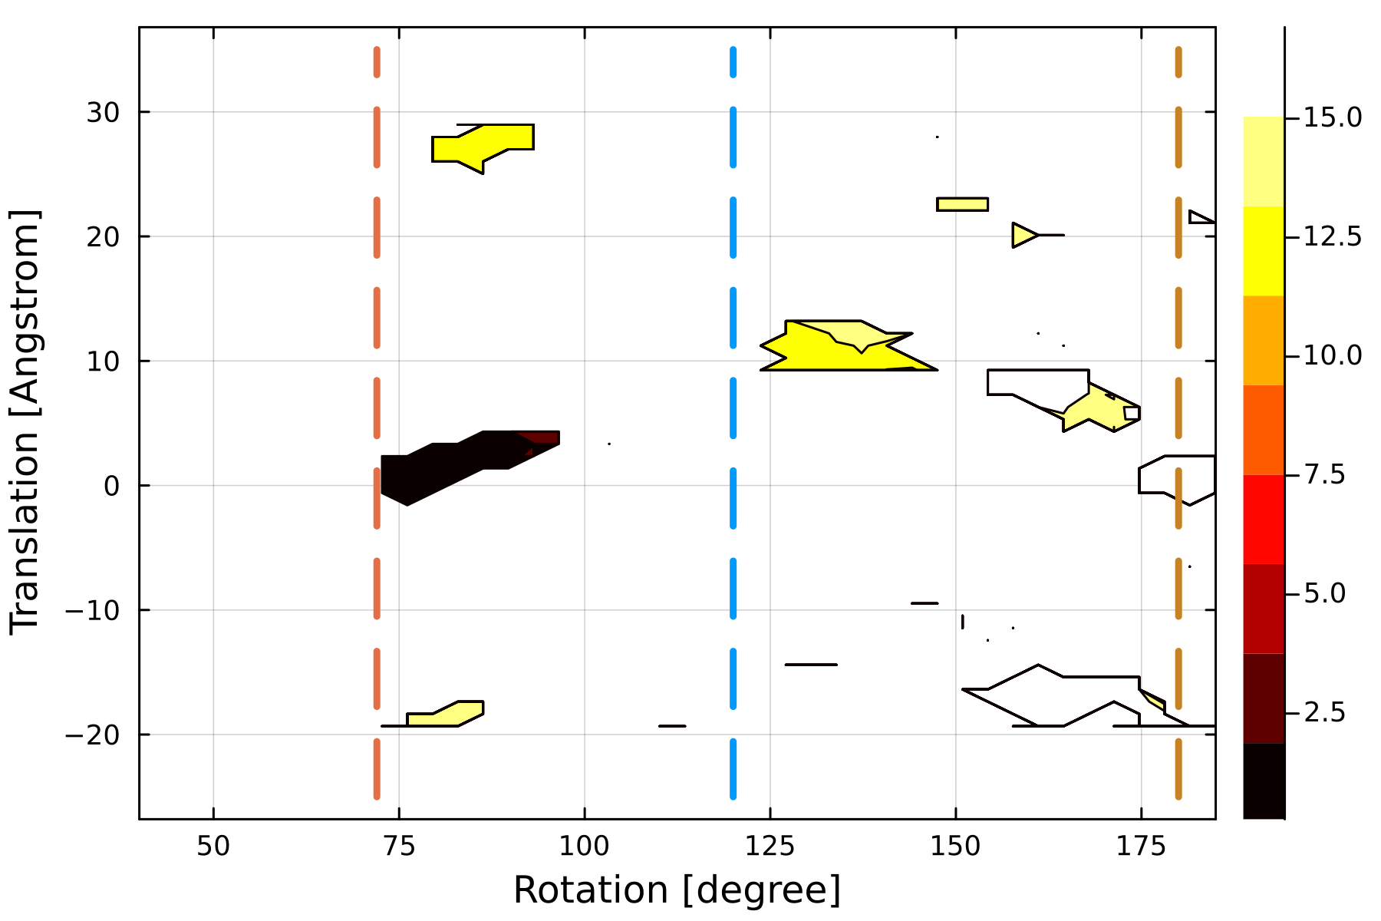
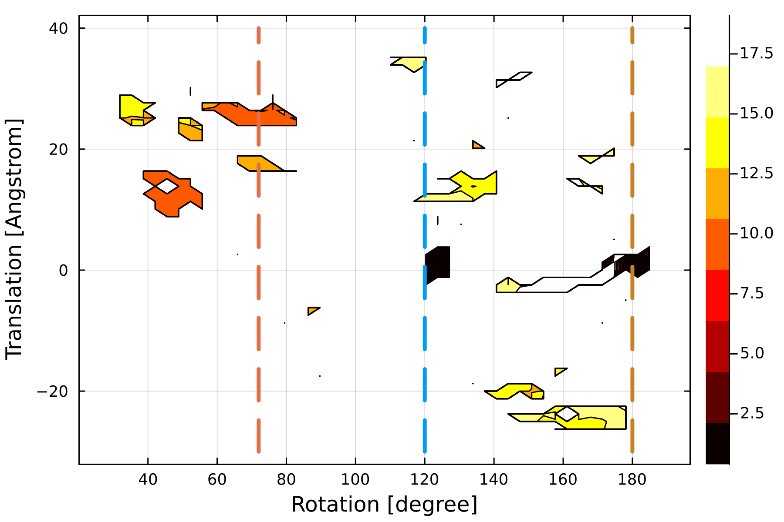
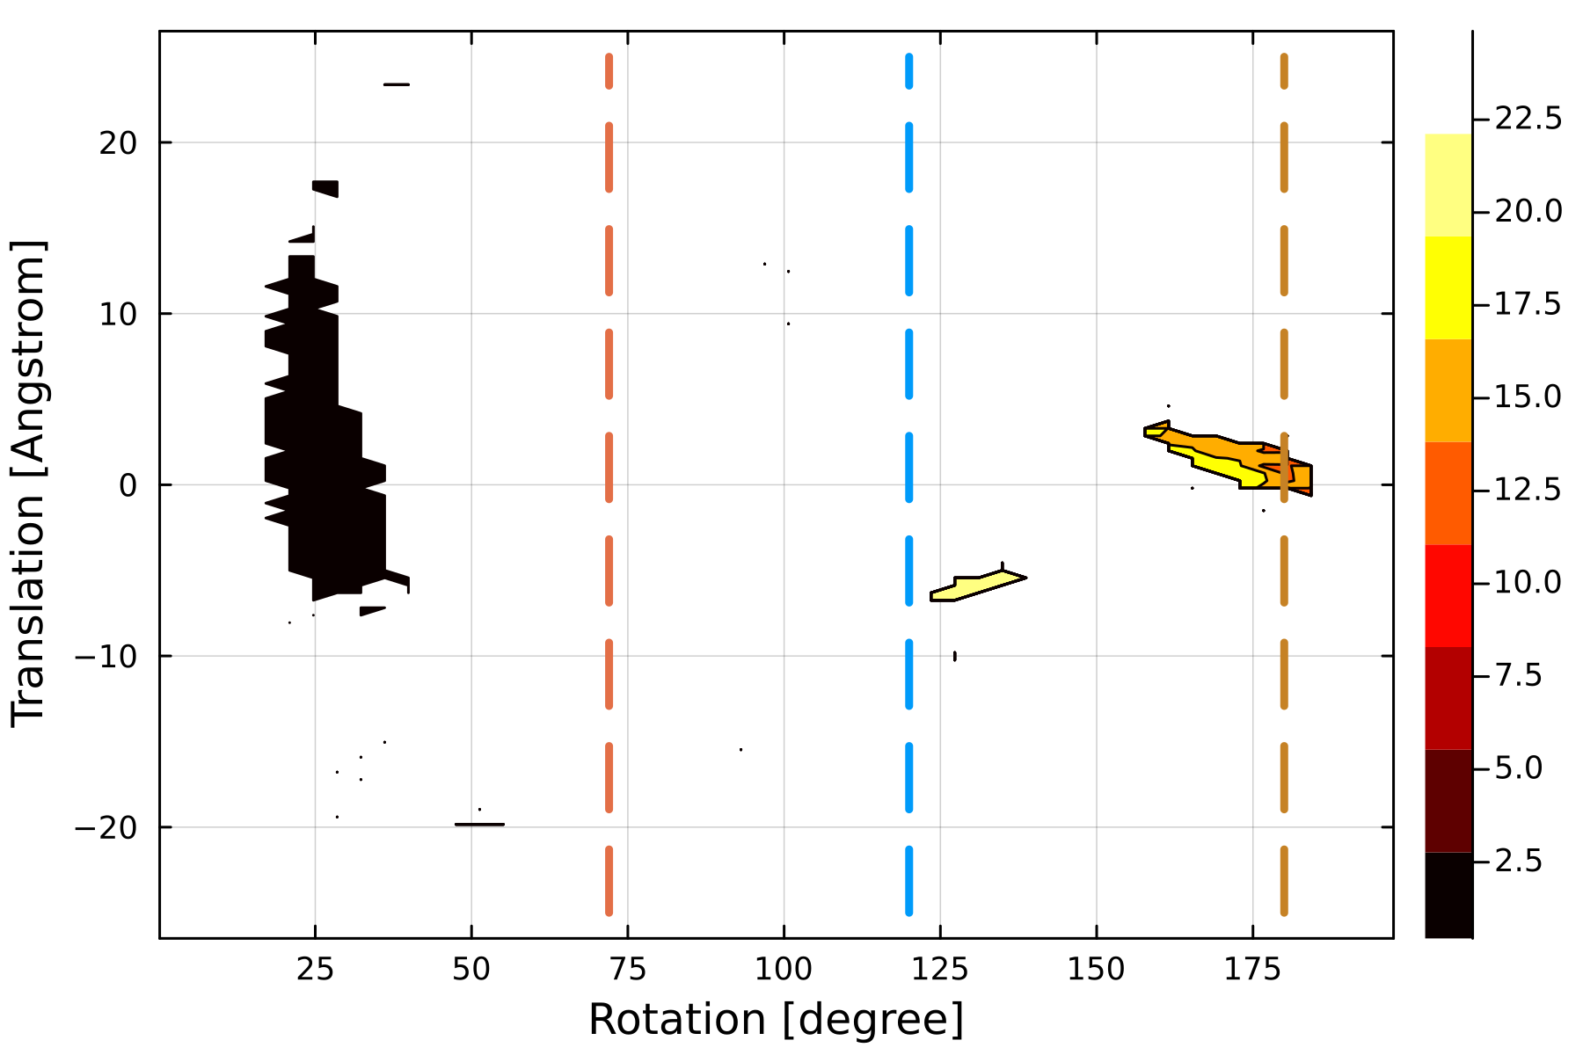
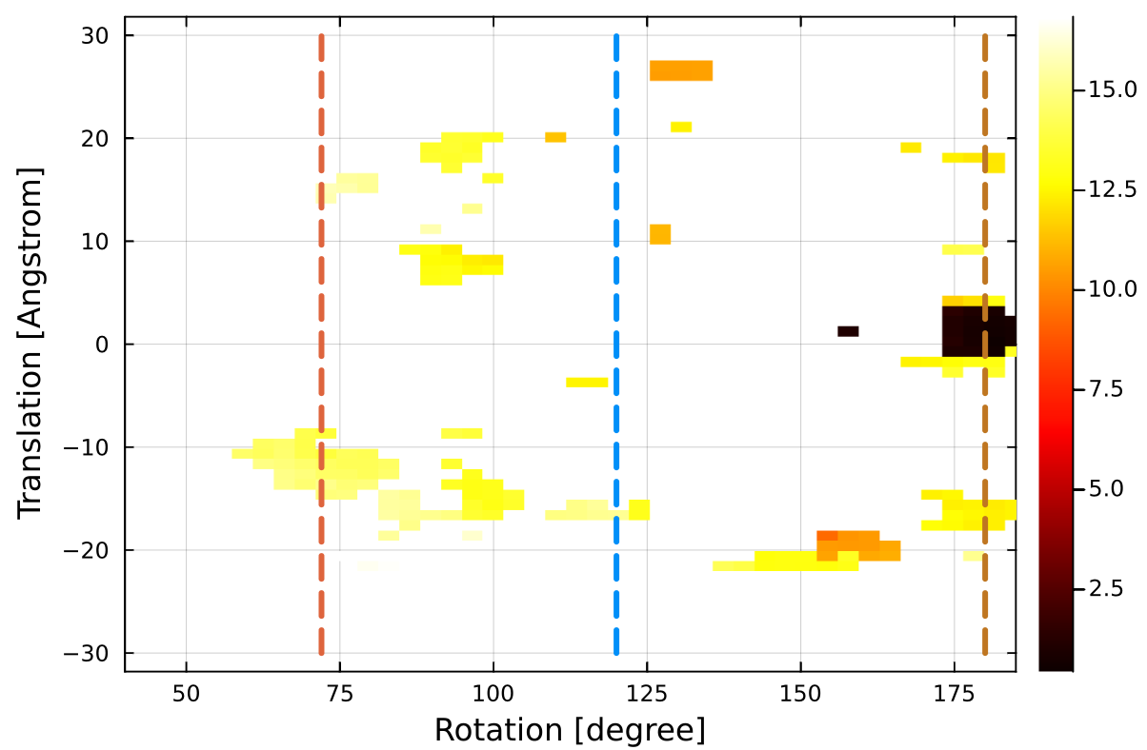
Left hand
Right hand
2BUK
RMSD [Å]
1VB4
RMSD [Å]
4V4M
RMSD [Å]
1M1C
RMSD [Å]
7ODW
RMSD [Å]
3R0R
RMSD [Å]
6S44
RMSD [Å]
5ZJU
RMSD [Å]
6R7M
RMSD [Å]
1STM
RMSD [Å]

