Slide 1
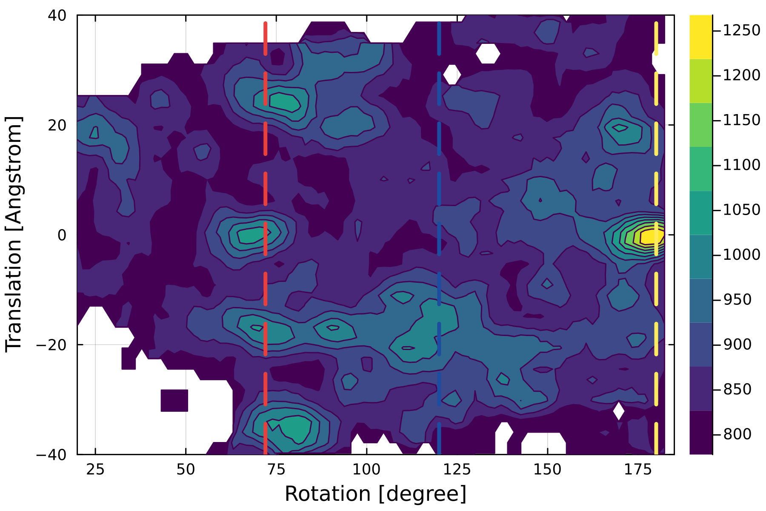
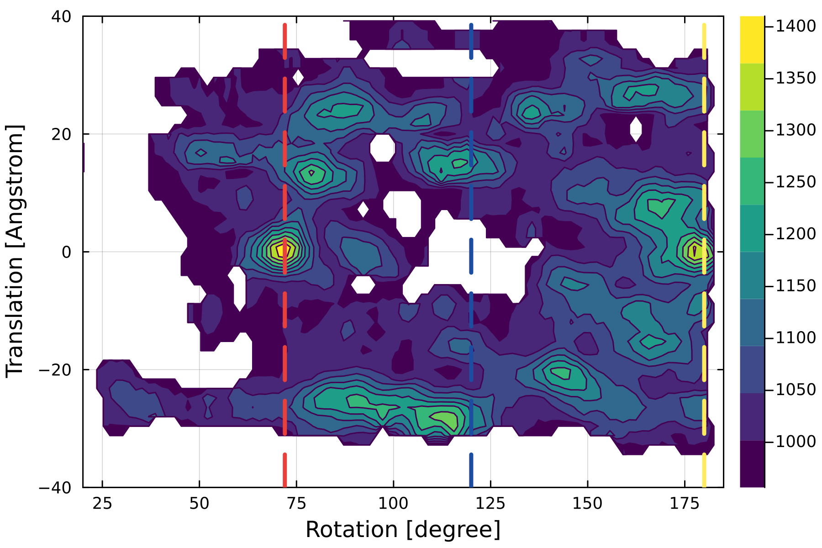
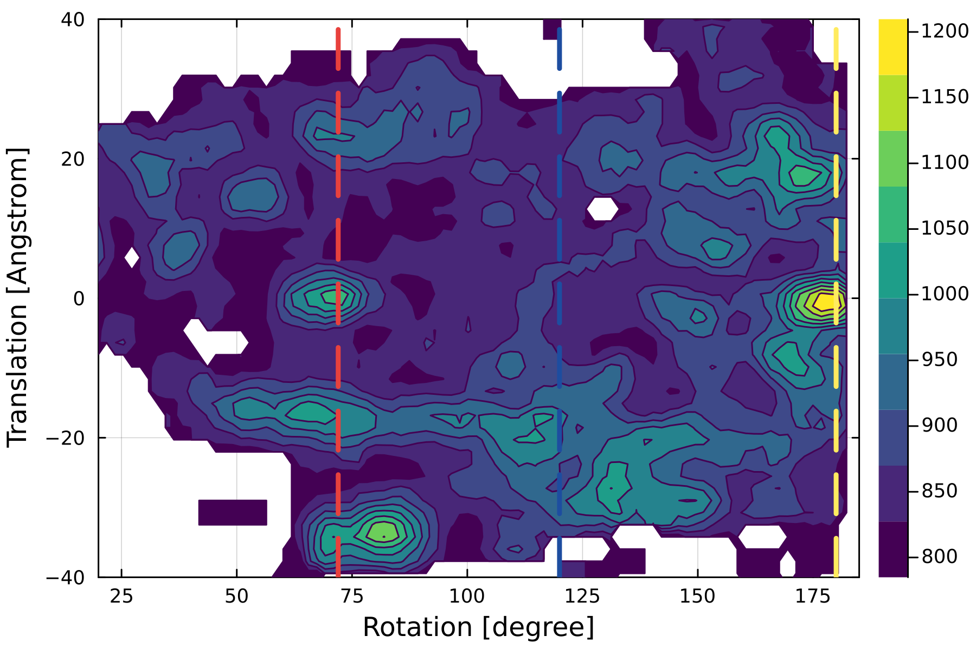
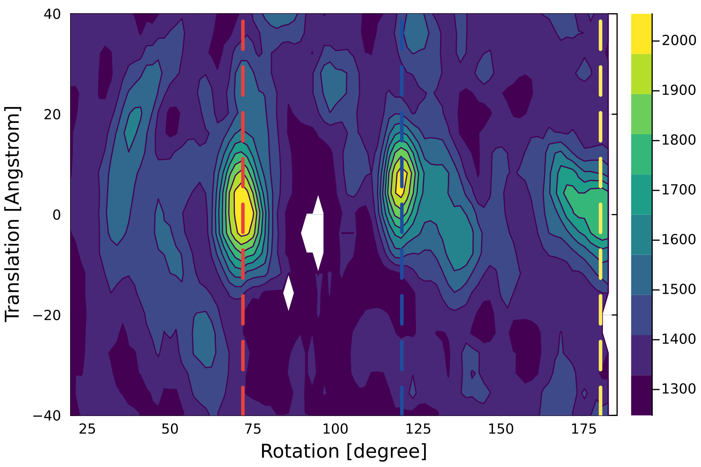
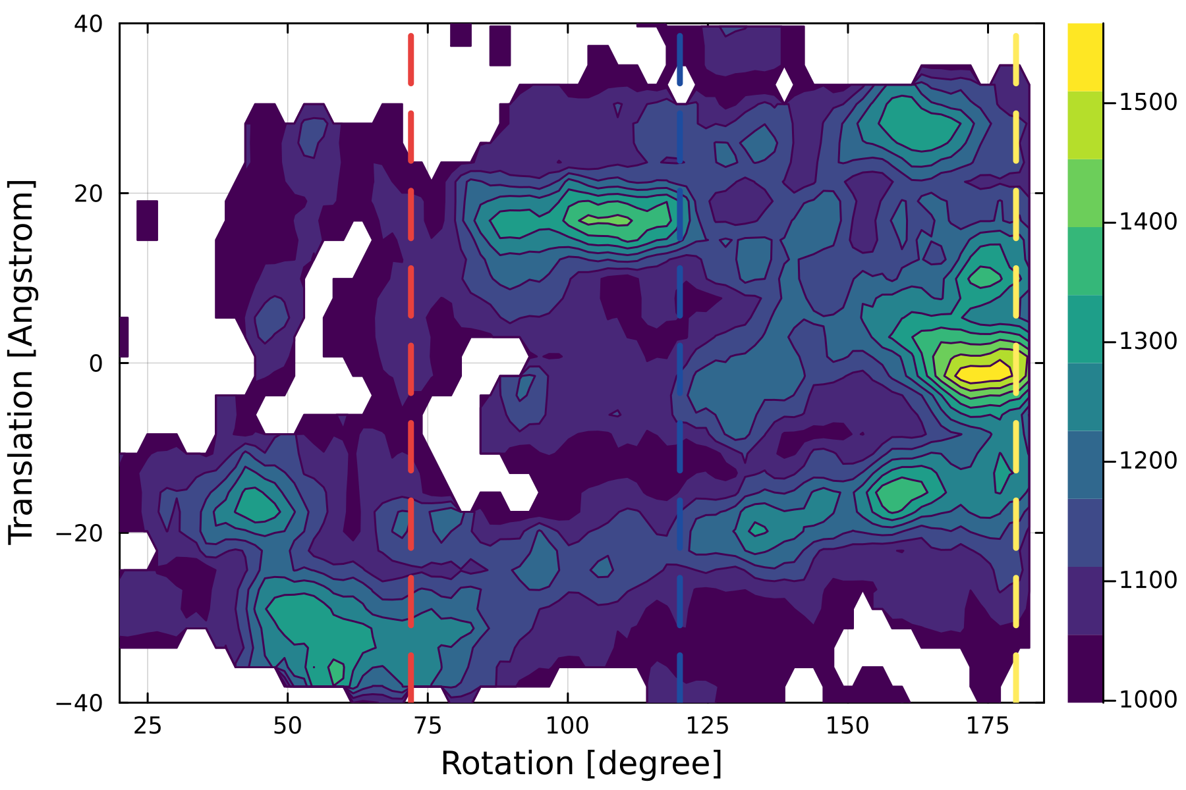
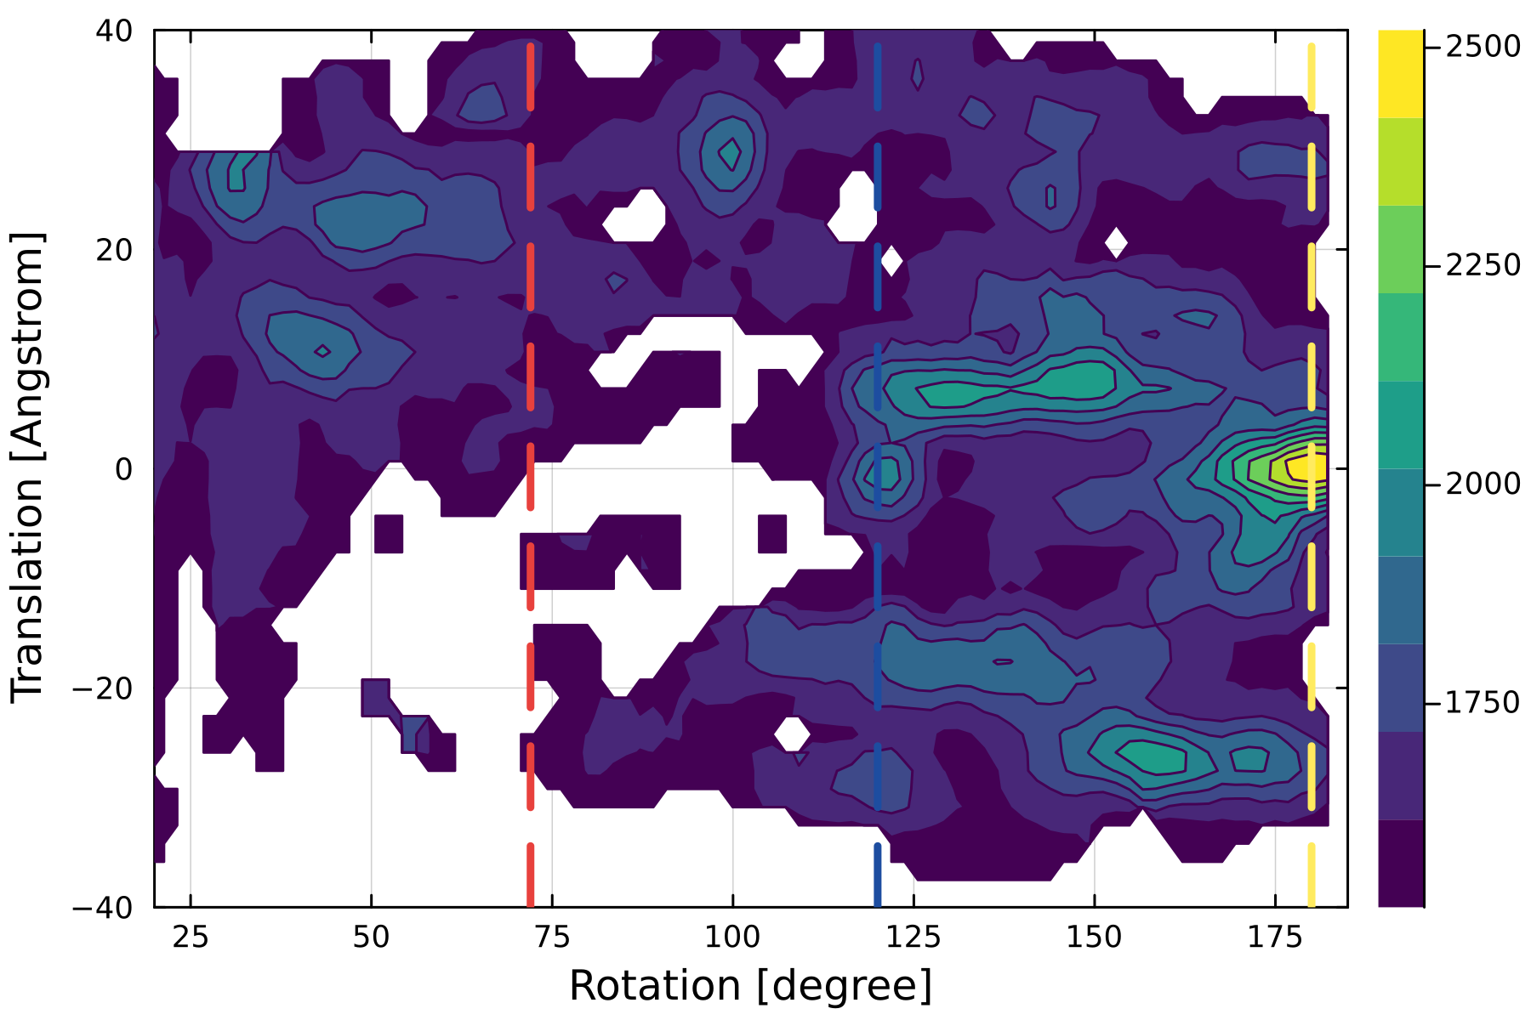
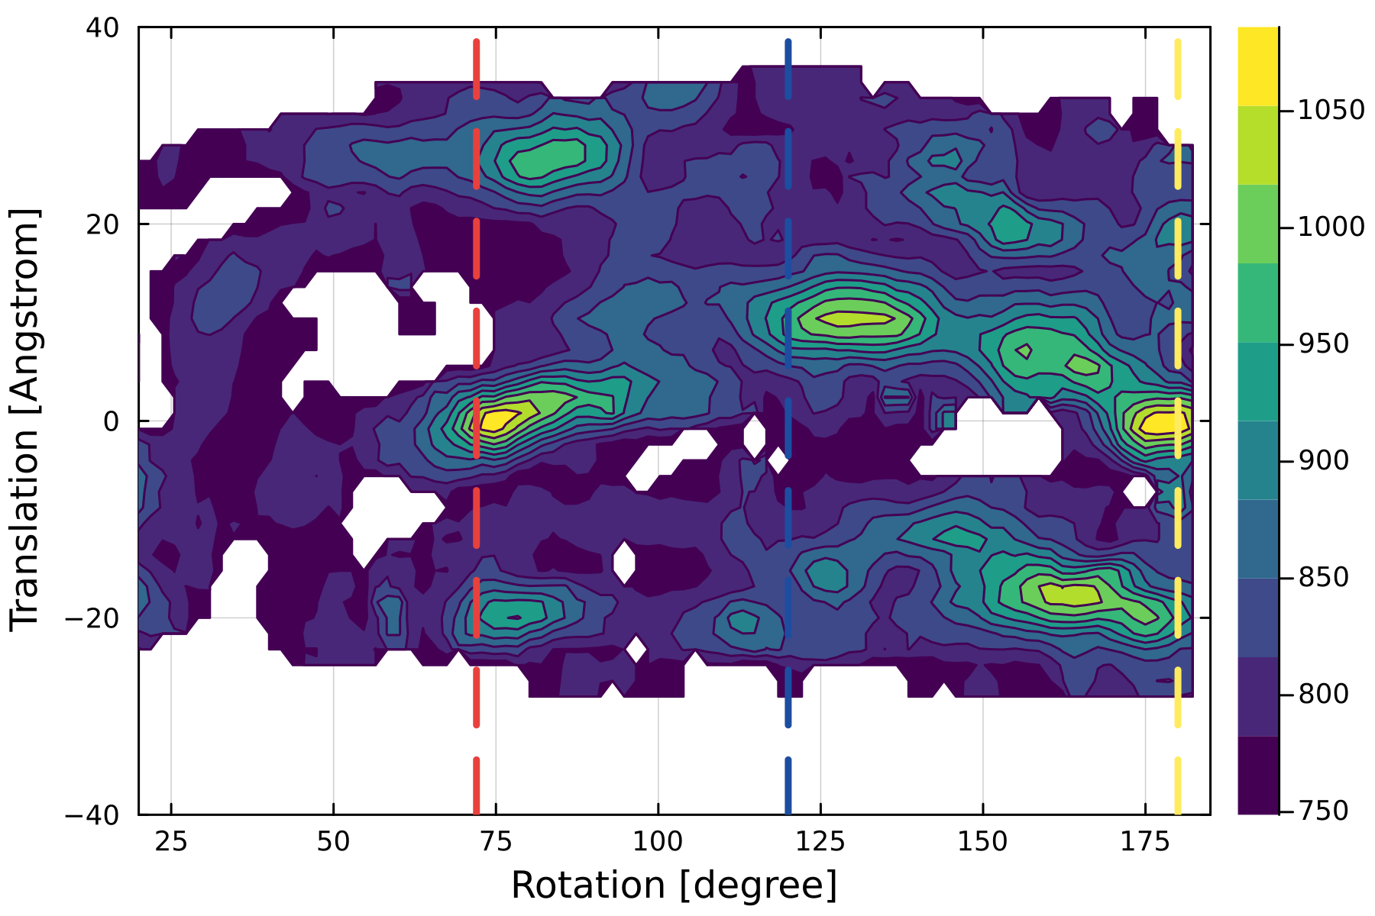
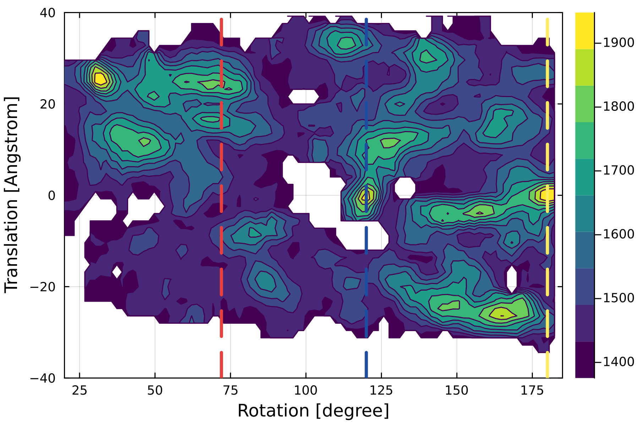
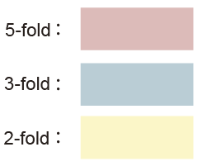
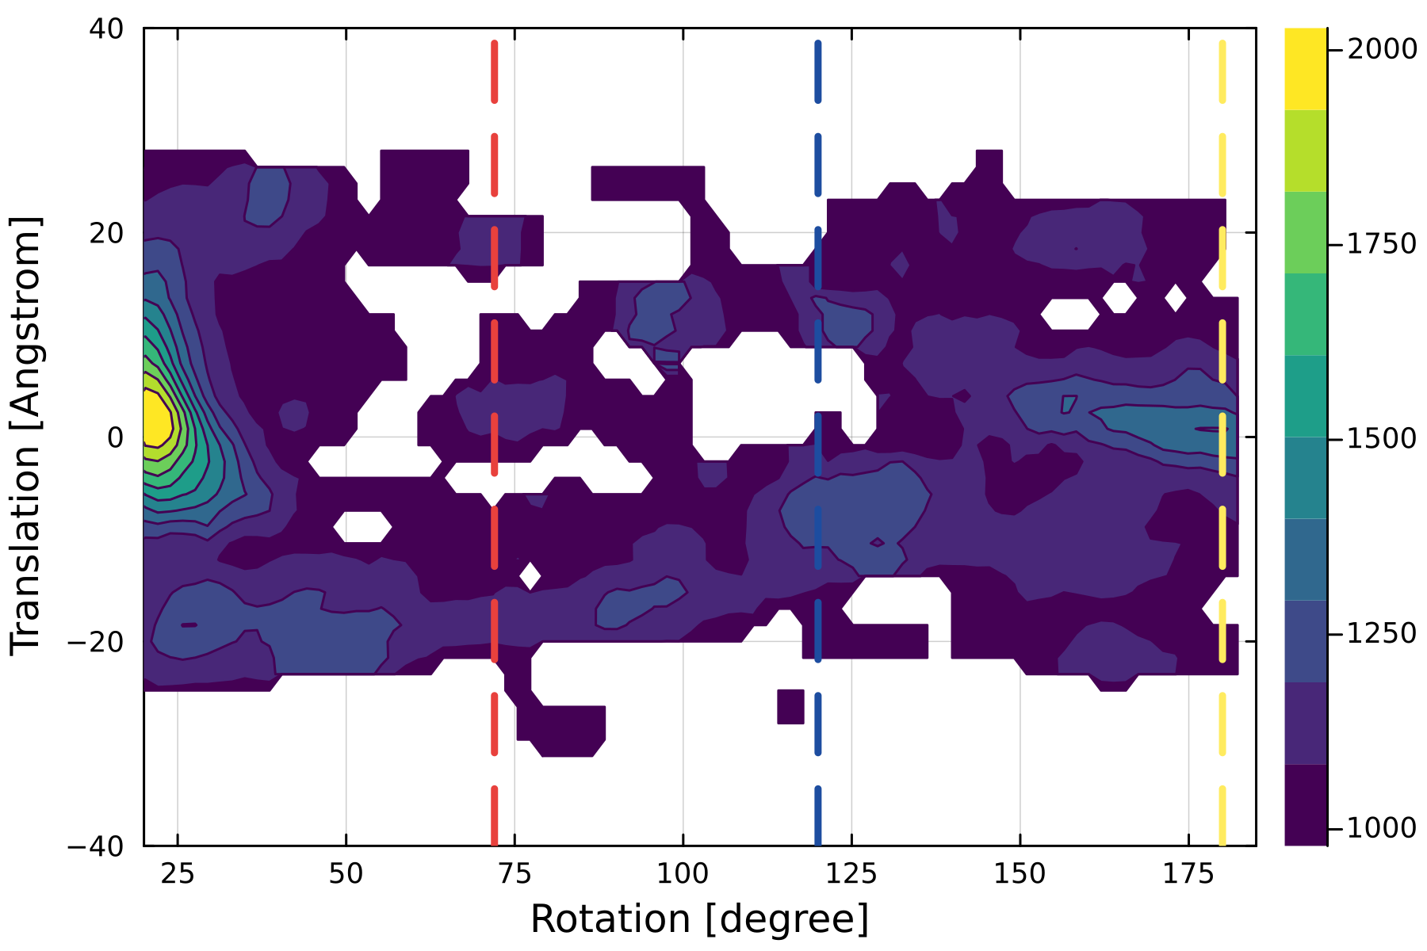
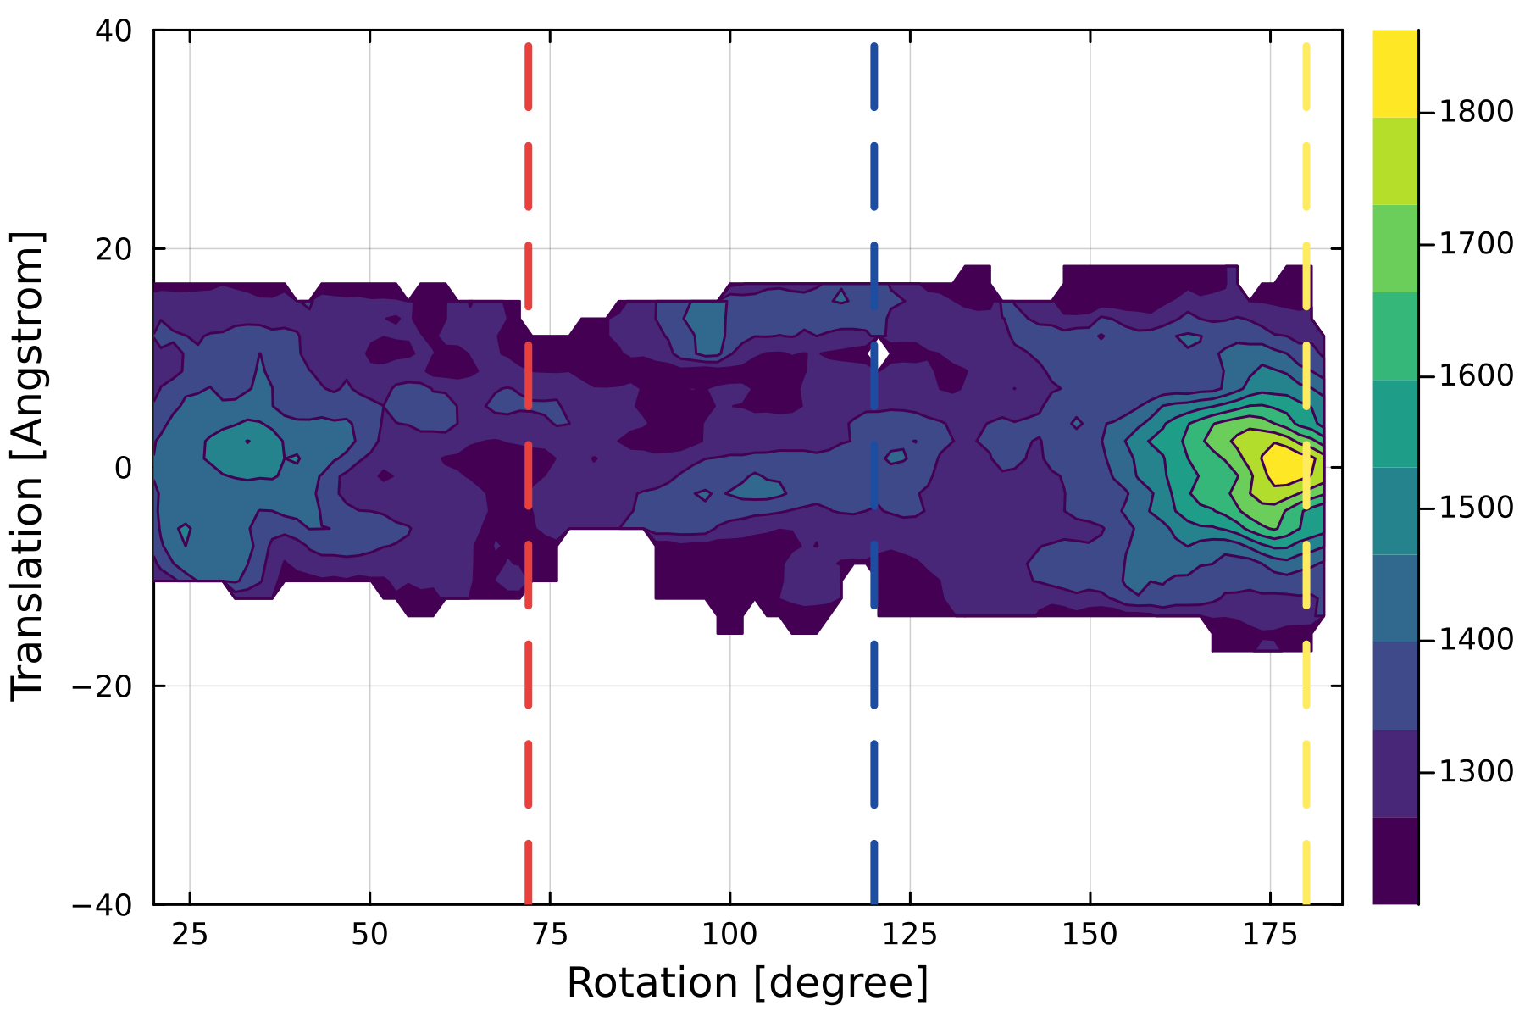
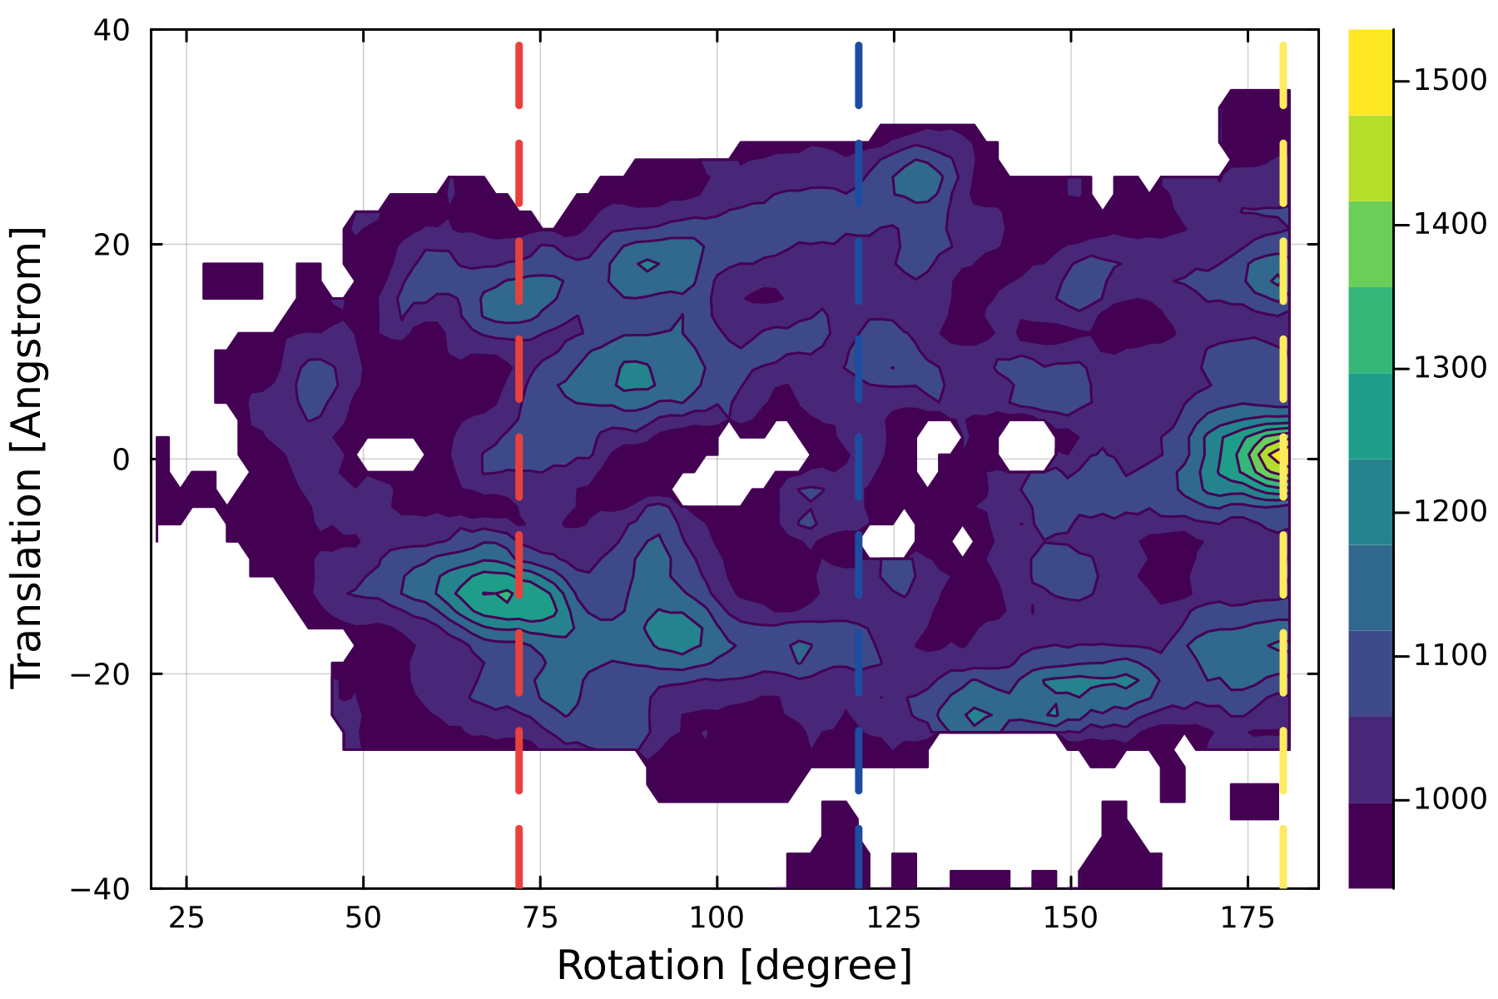
Left-handed
Right-handed
Satellite tobacco necrosis virus (PDB ID 2BUK)
Sesbanian mosaic virus capsid (1VB4)
docking score
L-A virus (PDB ID 1M1C)
STNV coat protein (PDB ID 4V4M)
Porcine circovirus 2 (PDB ID 3R0R)
docking score
Model of Haliangium ochraceum encapsulin (PDB ID 7ODW)
PCV2 virus-like particle (PDB ID 5ZJU)
docking score
Faba bean necrotic stunt virus (PDB ID 6S44)
Satellite panicum mosaic virus (PDB ID 1STM)
docking score
Tobacco mosaic virus (PDB ID 6R7M)
Chymotrypsin inhibitor (PDB ID 2M99)
Satellite panicum mosaic virus (PDB ID 1STM)

