Slide 1
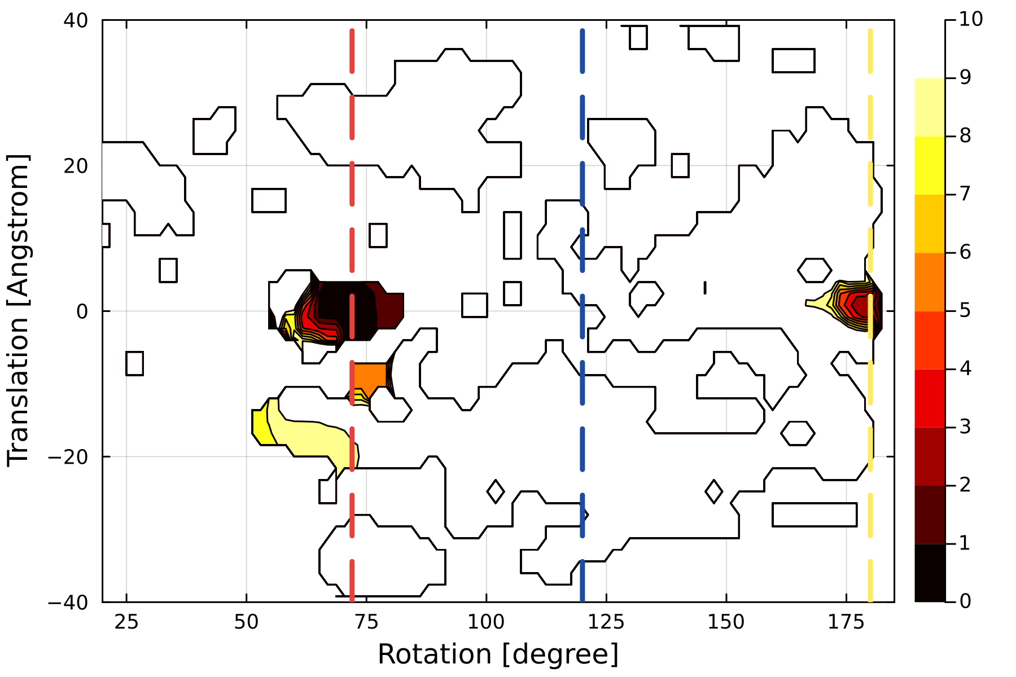
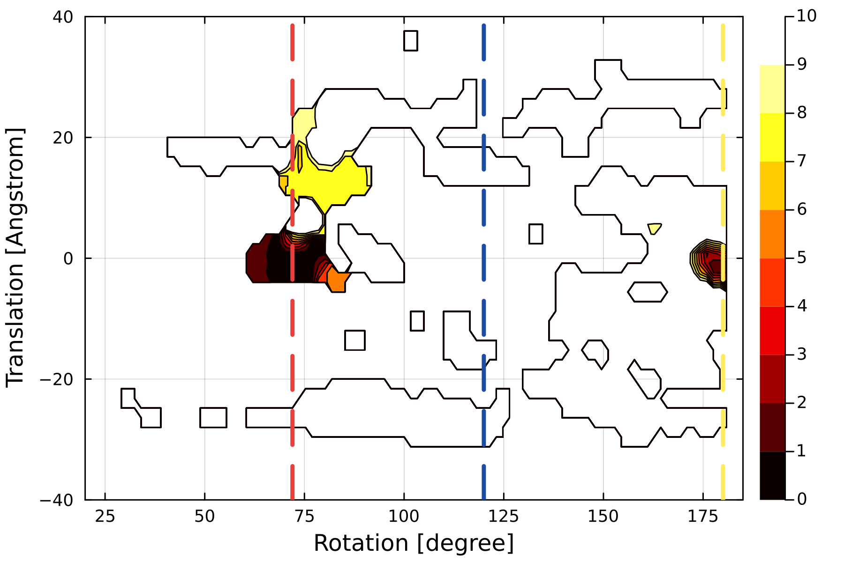
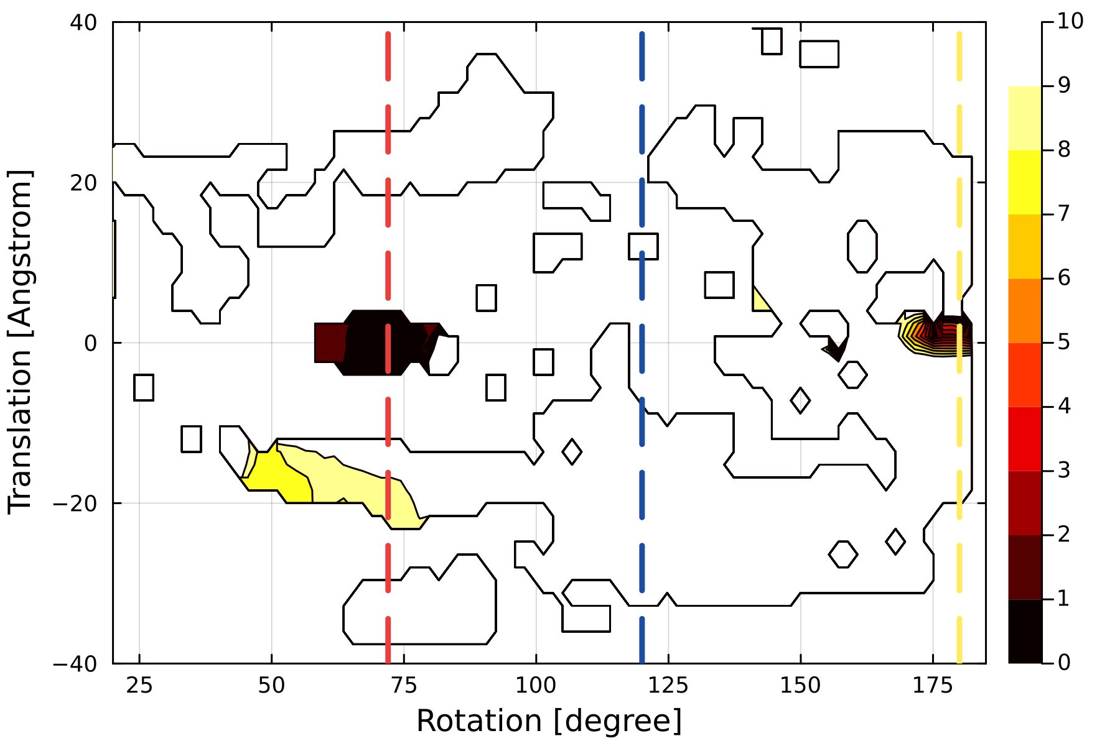
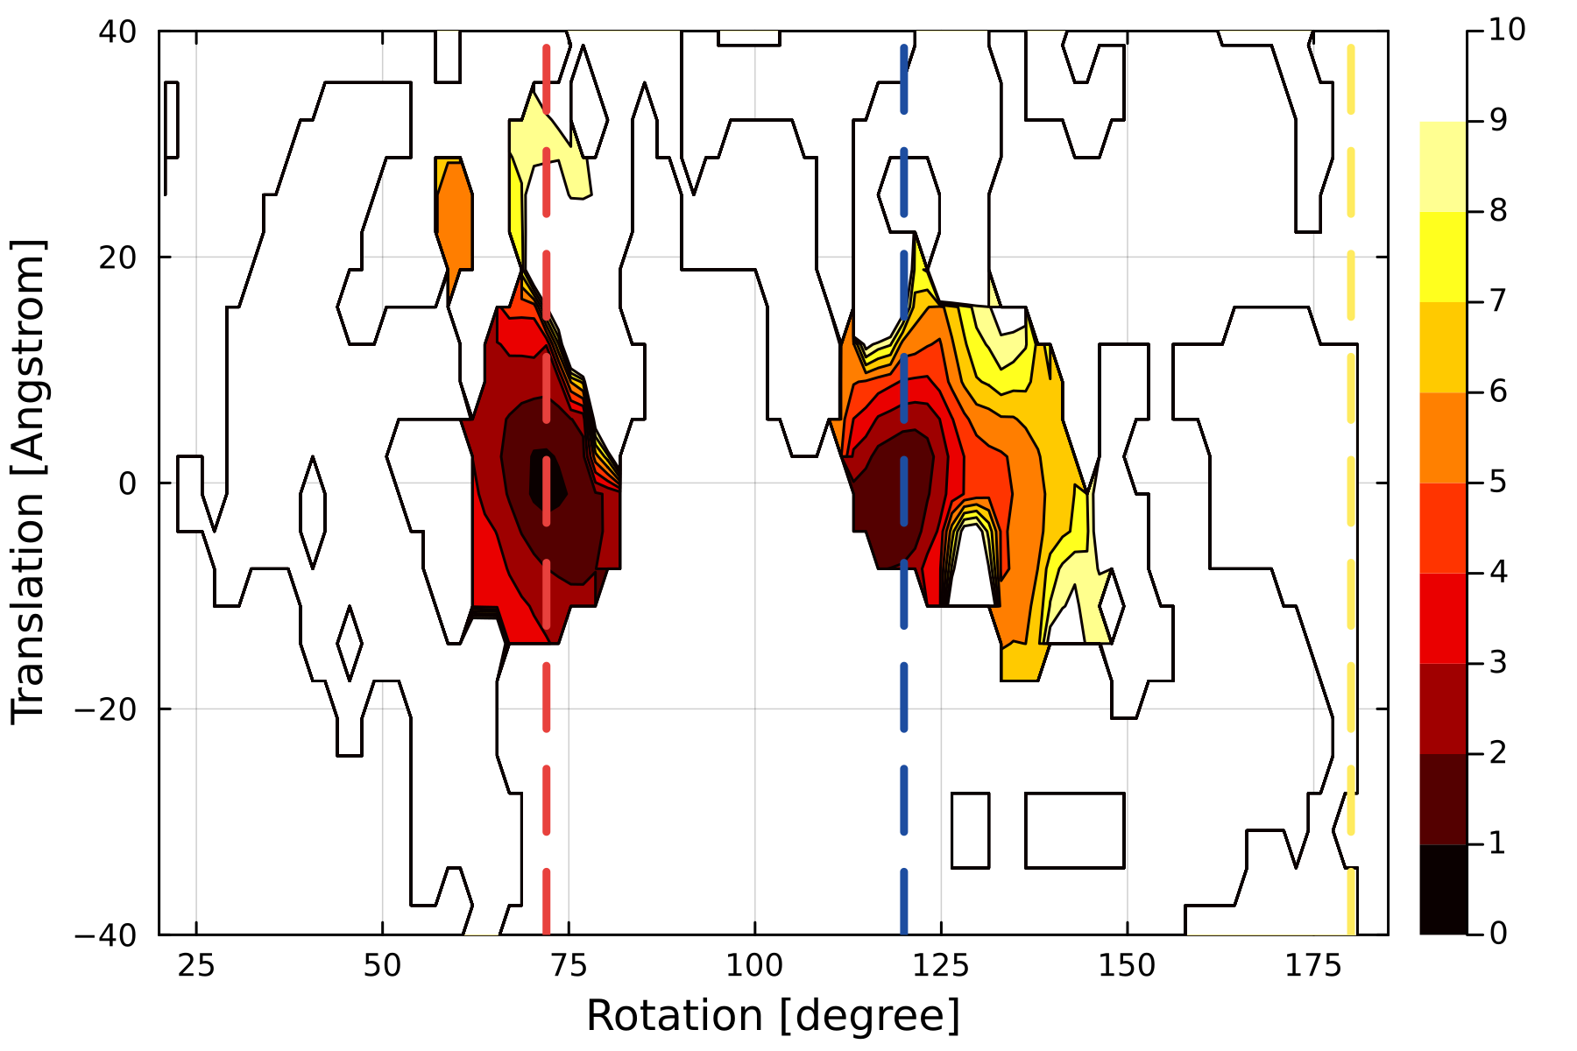
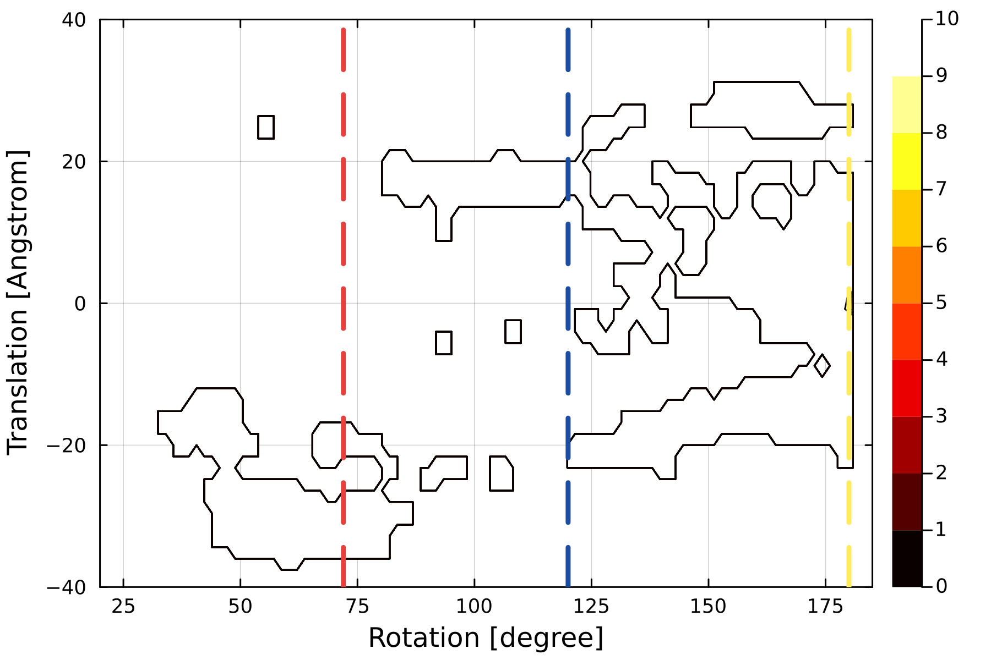
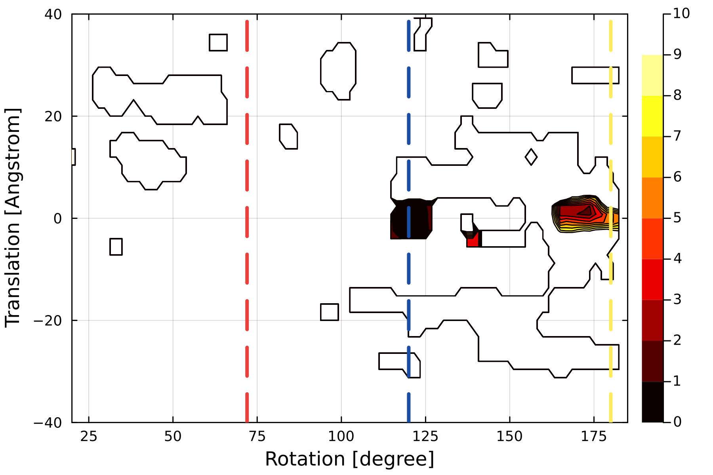
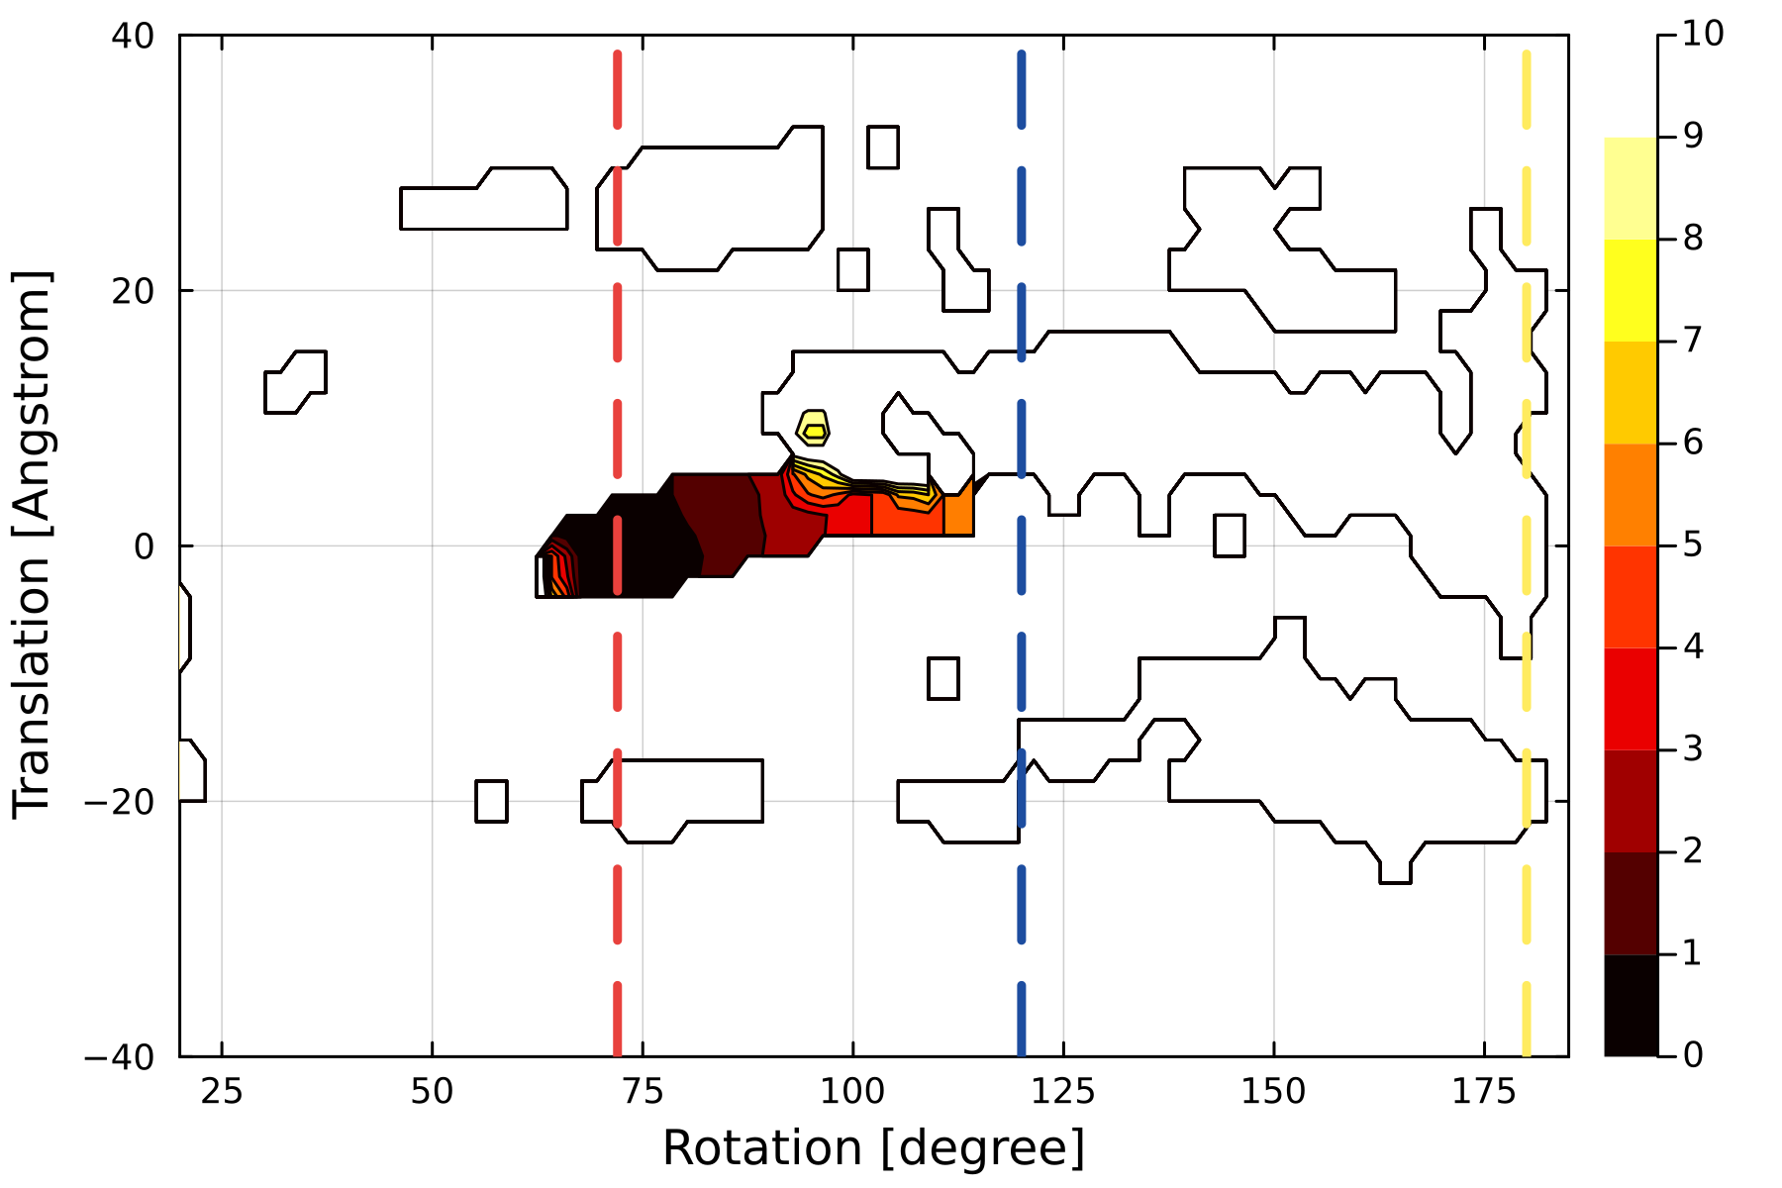
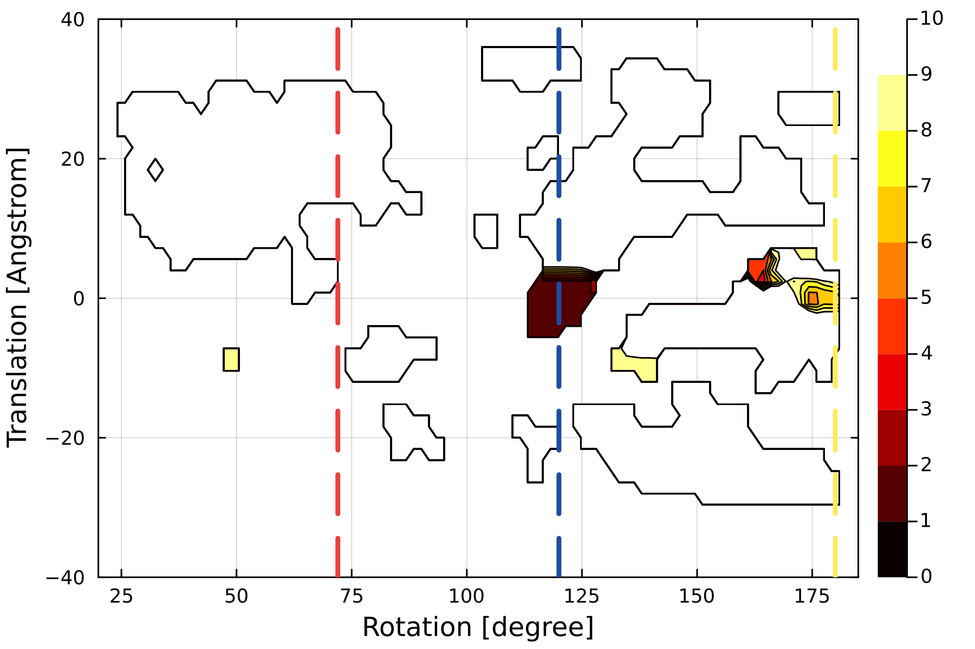
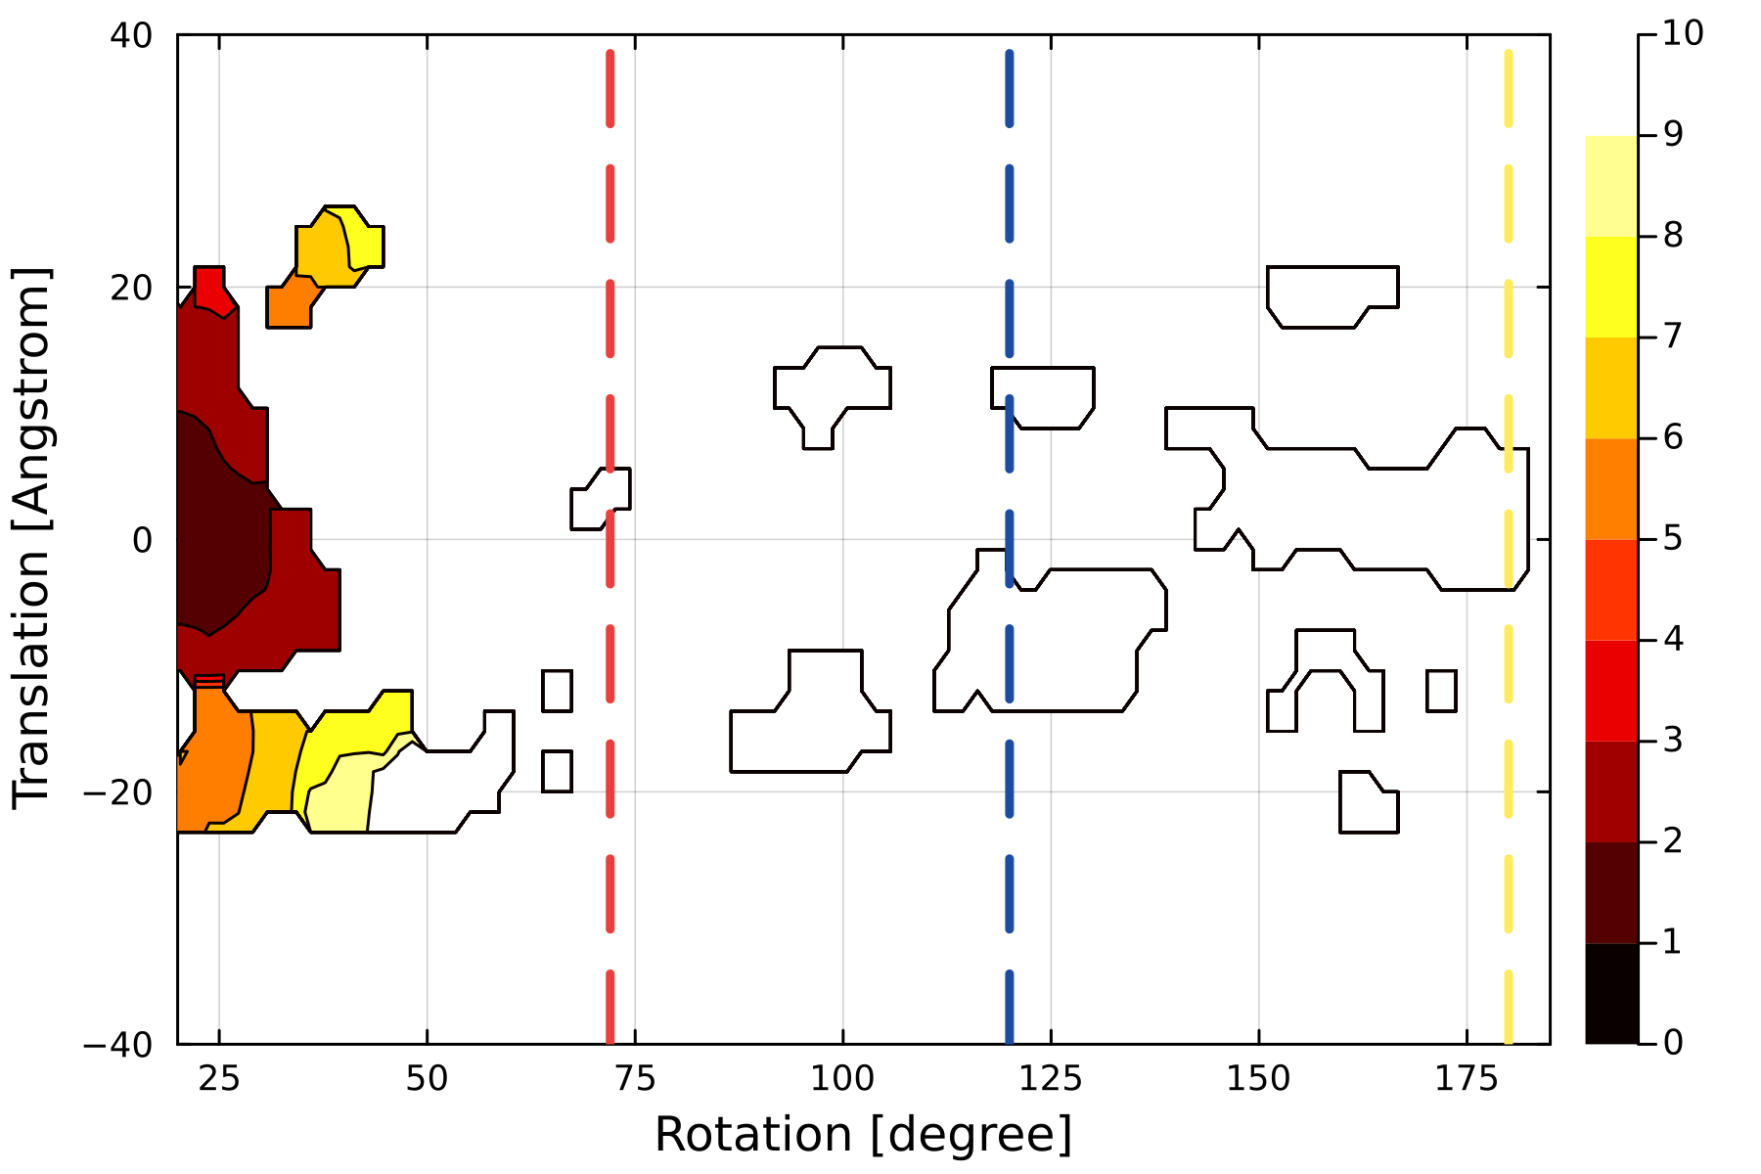
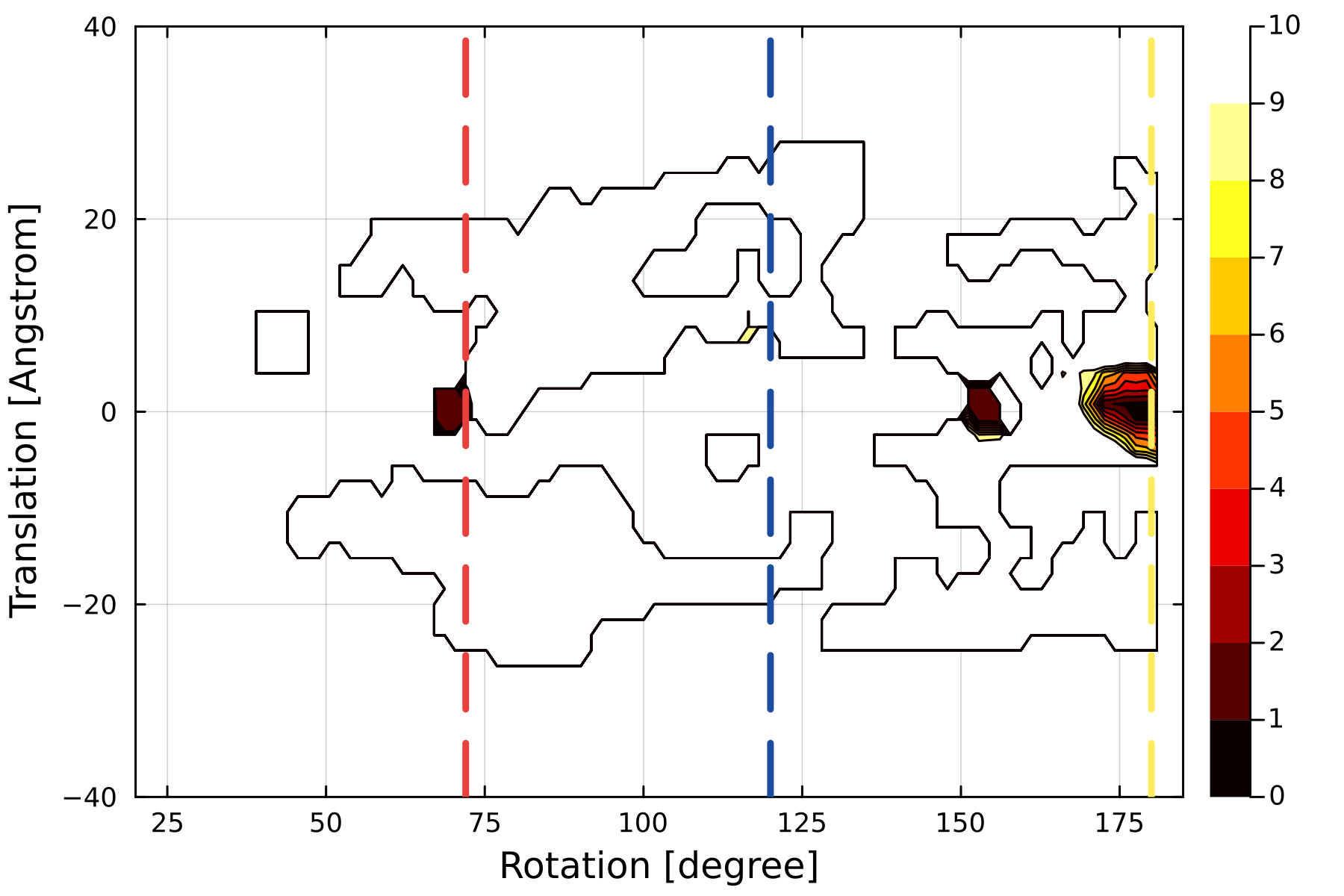
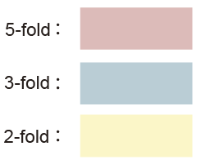
Left-handed
Right-handed
Satellite tobacco necrosis virus (PDB ID 2BUK)
Sesbanian mosaic virus capsid (1VB4)
RMSD [Å]
STNV coat protein (PDB ID 4V4M)
Porcine circovirus 2 (PDB ID 3R0R)
RMSD [Å]
Model of Haliangium ochraceum encapsulin (PDB ID 7ODW)
PCV2 virus-like particle (PDB ID 5ZJU)
RMSD [Å]
Faba bean necrotic stunt virus (PDB ID 6S44)
Satellite panicum mosaic virus (PDB ID 1STM)
RMSD [Å]
Tobacco mosaic virus (PDB ID 6R7M)
Satellite panicum mosaic virus (PDB ID 1STM)
RMSD [Å]

