Slide 1
Automatic Face Expression Recognition in Python
Mateusz Świerczyński

Slide 2
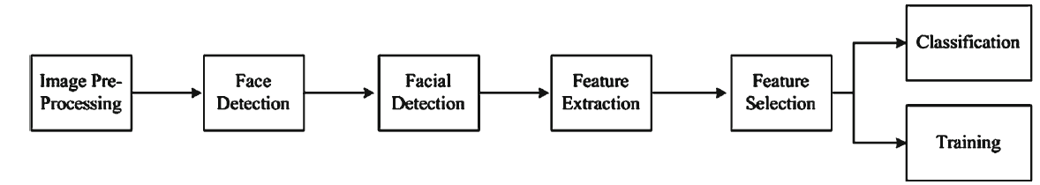
Introduction
Facial expression is a visible representation of current emotional state. It expresses not only our emotions but also provides important clues for social interactions. According to psychologists, almost 60% of the communicated message is transmitted by facial expression.
Notes:
Nowadays scientists try to improve the interaction between humans and computers and automatic face expression recognition is a key feature during communication between humans and artificial intelligence.
Emotion estimated by a computer is usually more objective than those performed by a human and can be used in clinical psychology, psychiatry and neurology. Customer’s facial expression can also be collected by service providers as an implicit user’s feedback to improve the quality of their services. A block diagram presenting steps from fetching a picture by a computer software to predicting a face expression can be seen below.

Slide 3
The Dataset
120 photo sessions of different people
327 sub sessions of 8 types of emotions
{neutral, angry, contemptuous, disgusted, fearful, happy, sad, surprised}
Additional file with sessions’ description
Source: http://www.consortium.ri.cmu.edu/data/ck/CK+/
Notes:
One of the best dataset which can be found comes from University of Pittsburgh. It is named The Extended Cohn – Kanade Dataset(CK+), after its co – founders: Jeffrey F. Cohn and Takeo Kanade. They work as University Professors at the University of Pittsburgh.
Each of the sequence contains images from ‘neutral’ frame to peak expression. These photos present facial behavior of 120 adults between 18 and 50 years of age, 69% female, 81% Euro – American, 13% Afro – American and 6% other groups. These pictures comes with high resolution so for project purposes they were resized to 640x480.

Slide 4
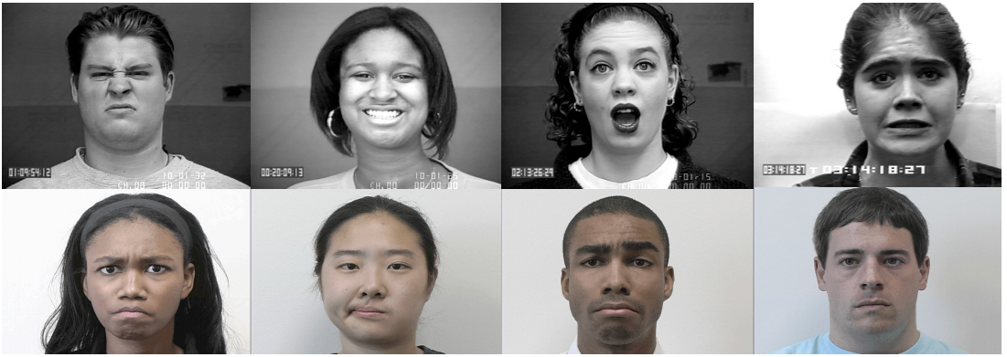
Sample photos of dataset
Examples of CK+ database. Presented emotions: a) disgust, b) happy, c) surprise, d) fear, e) angry, f) contempt, g)sadness, h) neutral. [http://www.consortium.ri.cmu.edu/data/ck/CK+/CVPR2010_CK.pdf]

Slide 5
Extracting images from dataset
From each sequence 5 last pictures have been selected
Final set consists of 1200 photos
Set is divided into 8 categories

Slide 6
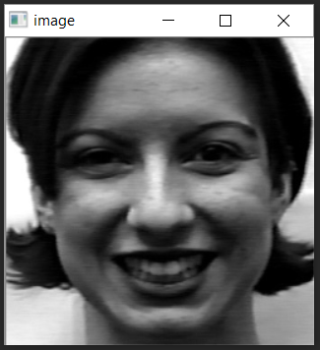
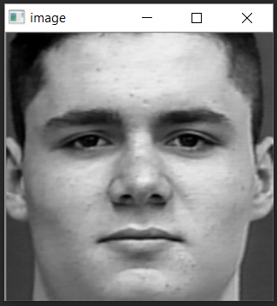
Faces extraction
Faces have been extracted by OpenCV function: CascadeClassifier(), using pre – trained classifier: haarcascade_frontalface
Extracted faces:
Sample picture after face detection and resizing
Notes:
In each photo we can see not only face, but the whole head with a small part of trunk and a background. For face expression these features are irrelevant and need to be cut off.

Slide 7
Features extraction
Pictures of dimensions 250 x 250, transformed into 1D vector
PCA to extract features for teaching the Neural Network
100 feaures for teaching Neural Network

Slide 8
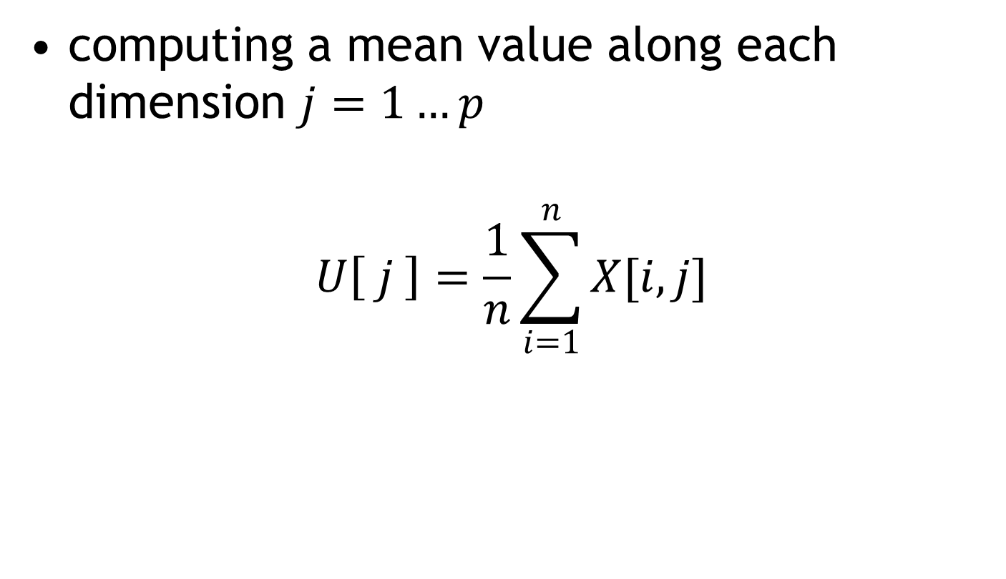
Calculating the mean value
computing a mean value along each dimension $j=1…p$
$$U\left[ j \right]=\frac{1}{n}\sum_{i=1}^{n}{X[i, j]}$$

Slide 9
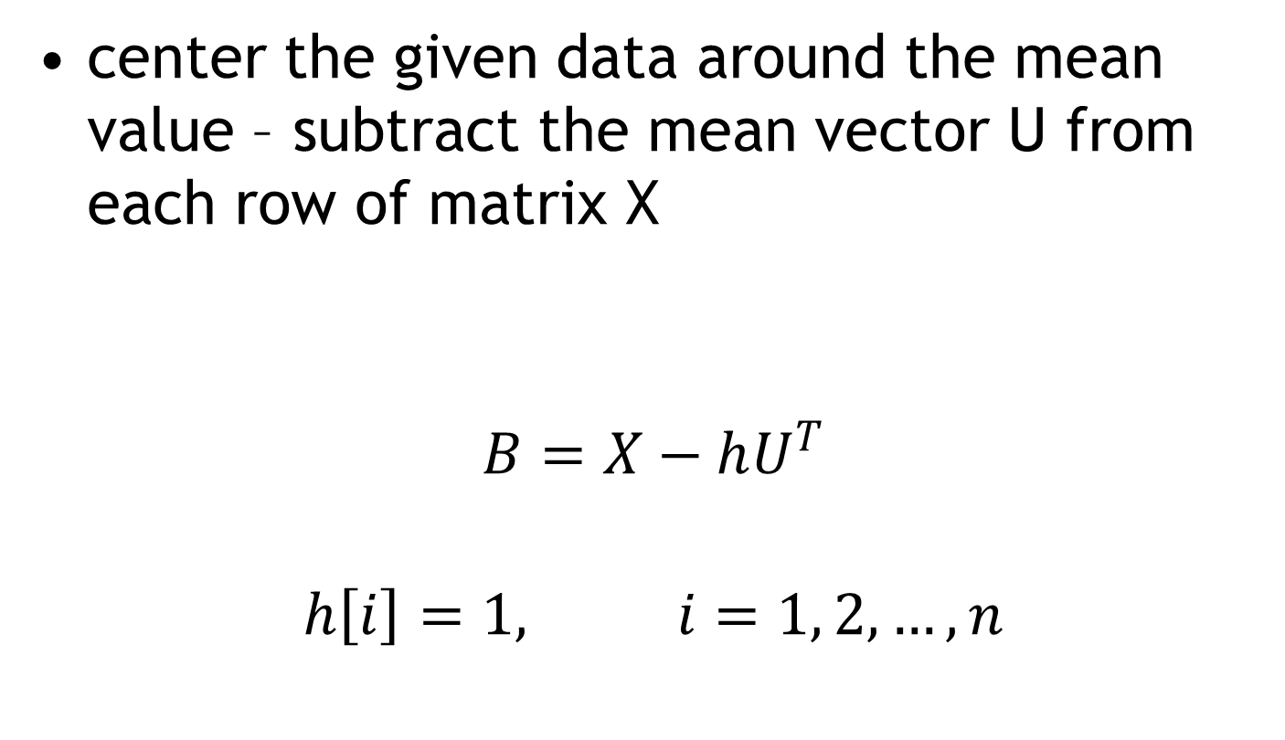
Calculating the deviation of mean value
center the given data around the mean value – subtract the mean vector U from each row of matrix X
$$B=X−hU^{T}$$
$$h\left[i\right]=1, i=1, 2, …,n$$

Slide 10

Finding a covariance matrix
$$C=\frac{1}{n−1}B^{T}∙B$$
Matrix C will look as follows:
$$\begin{matrix}{σ_{1}}^{2} & σ_{12} & … & σ_{1p} \\ σ_{21} & {σ_{2}}^{2} & … & σ_{2p} \\ ⋮ & … & ⋱ & ⋮ \\ σ_{p1} & σ_{p2} & … & {σ_{p}}^{2}\end{matrix}$$

Slide 11
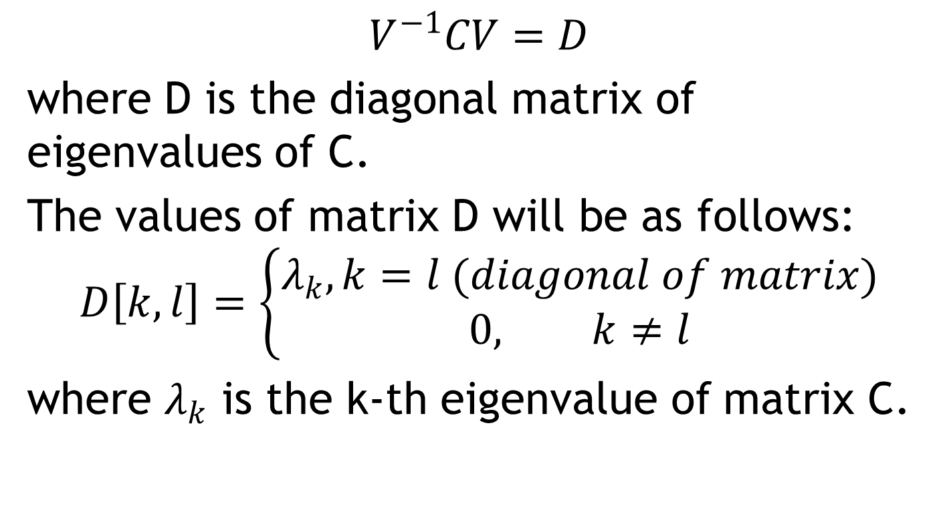
Finding eigenvectors and eigenvalues of covariance matrix
$$V^{−1}CV=D$$
where D is the diagonal matrix of eigenvalues of C.
The values of matrix D will be as follows:
$$D\left[k, l\right]=\left\{\begin{aligned}λ_{k}, k=l (diagonal of matrix) \\ 0, k≠l\end{aligned}\right.$$
where $λ_{k}$ is the k-th eigenvalue of matrix C.
Notes:
eigenvector v of a linear transformation T is a non-zero vector that, when T is applied to it, does not change direction. Applying T to the eigenvector only scales the eigenvector by the scalar value λ, called an eigenvalue.

Slide 12
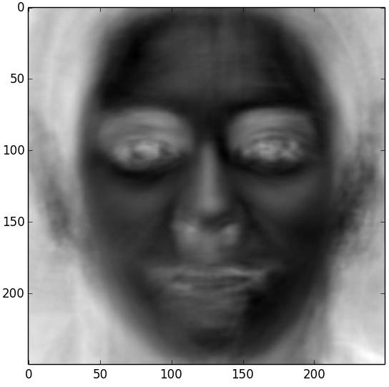
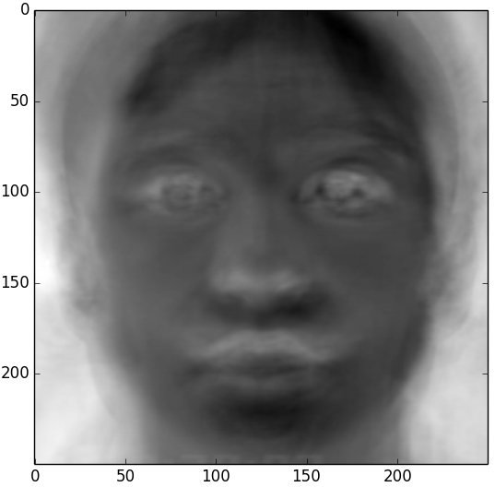
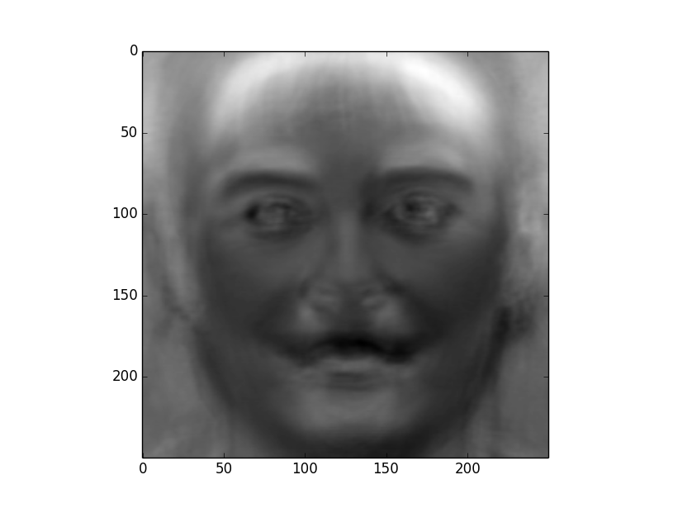
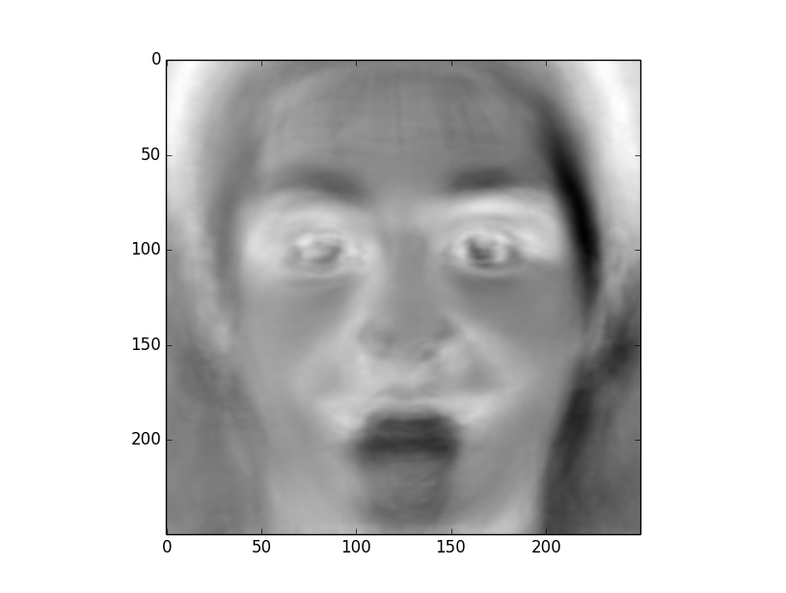
First 4 eigenvectors

Slide 13
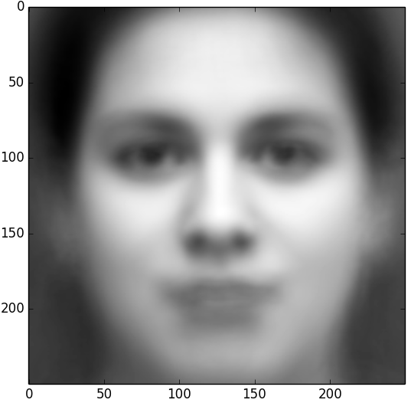
Mean value

Slide 14
Neural Network
Multi Layer Perceptron (MLP) with one hidden layer from OpenCV library
100 features = 100 neurons in input layer
Supervised learning
1200 samples, 80% - teaching, 20% - testing
8 emotions = 8 neurons in output layer
One – hot – code for transforming emotion labels into numbers

Slide 15
Hidden layer
Size defined by the best accuracy
Accuracy measured for 10 diiferent sizes, from 10 to 100 with an increase of 10
Best accuracy for 30 perceptrons in hidden layer (90%)

Slide 16
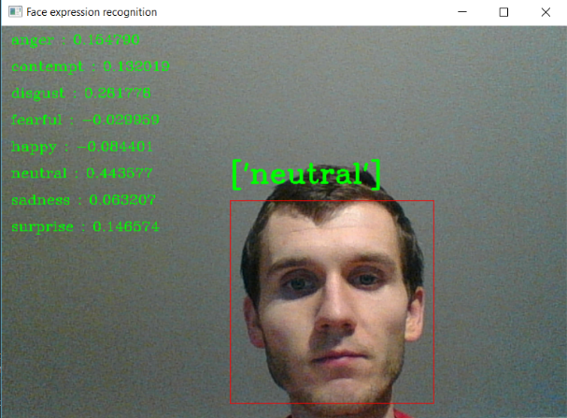
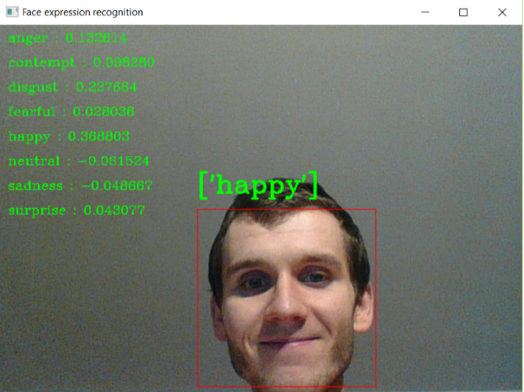
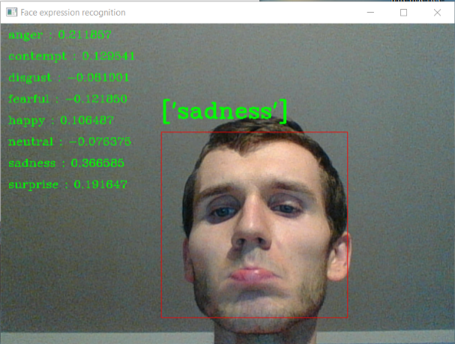
Real time face expression recognition

Slide 17
Thank You!

