Slide 1
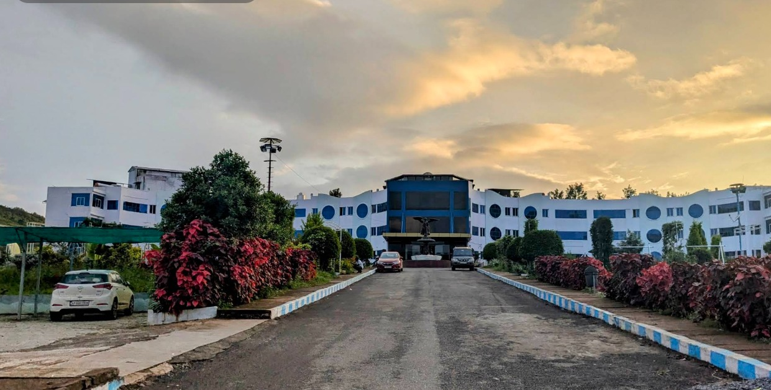
PROJECT DEMONSTRATION & ARCHITECTURE
VANA RESORT ARAKU
Full-Stack Eco-Luxury Resort Web Application & Digital Guest Experience Platform
📍 Ranajilleda Waterfalls Road, Padmapuram
FRONTEND STACK
BACKEND & DATA
RESILIENCE
GUEST SUITE
React 19 + TypeScript + Vite
PHP 8.2+ REST API + MySQL 8
100% Offline-First Fallback Engine
4 Verified Rooms • 11 Araku Spots

Slide 2
PROJECT VISION
Executive Summary & Core Objectives
Connecting Araku Valley eco-tourism with a frictionless digital guest experience.
INDUSTRY NEED
OUR APPROACH
DELIVERED IMPACT
The Challenge
The Solution
Key Results
Traditional hill resort websites suffer from outdated information, complex third-party booking commissions, lack of authentic room photos, and network downtime in remote hill terrain.
A bespoke, eco-luxury web platform for Vana Resort Araku combining verified property details, room-only galleries, an offline-resilient booking engine, and direct WhatsApp concierge.
A seamless, full-featured web app that gives travelers instant clarity, easy booking inquiries, and empowers resort management with a full operational admin dashboard.
• High OTA commissions (15–25%)
• Misleading photos & ambiguous room specs
• Lack of curated regional attraction guides
• No direct WhatsApp concierge interaction
• 100% direct bookings with zero commissions
• Strictly verified room & bathroom photos
• Comprehensive guide for 11 Araku spots
• Offline-resilient architecture with fallback
• 4 Verified Room & Suite categories
• 11 Curated Araku attractions with entry fees
• 50 High-resolution property photo snaps
• 24/7 AI virtual concierge chatbot
Vana Resort Araku • Project Demonstration & Technical Showcase

Slide 3
SYSTEM DESIGN
Technical Architecture & Engineering Stack
Engineered for extreme performance, offline fault-tolerance, and modern developer ergonomics.
Frontend Client Layer
Resilience & Local-First Layer
Backend & Data Services Layer
SPA with Hot-Module Replacement
Zero-Downtime Fallback Architecture
RESTful API & Database Integration
React 19 & TypeScript: Component-driven, strictly typed UI components
Transparent Fallback: Seamless localStorage fallback if PHP/MySQL is down
PHP 8.2+ REST API: Modular endpoints for bookings, rooms, contacts, auth
Vite 8 Bundler: Sub-second builds, lightning fast HMR dev server
Dynamic Price Engine: Calculates night totals & sample tariffs client-side
MySQL 8 Database: Normalized tables with relational constraints & indexes
Tailwind CSS: Custom resort color tokens, glassmorphism, responsive grid
Offline Inquiry Ref: Instant VR-XXXXXX booking code generation
Session Authentication: Secure session cookies for admin role privileges
Lucide React: Consistent lightweight SVG iconography across all pages
WhatsApp Deep-Link: Pre-formatted booking payload hand-off to concierge
Google Hotels Integration: XML feeds for Google Hotel Prices syndication
Vana Resort Araku • Project Demonstration & Technical Showcase

Slide 4
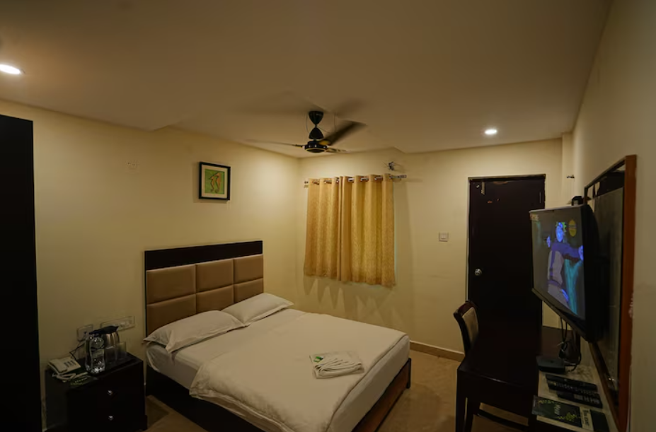
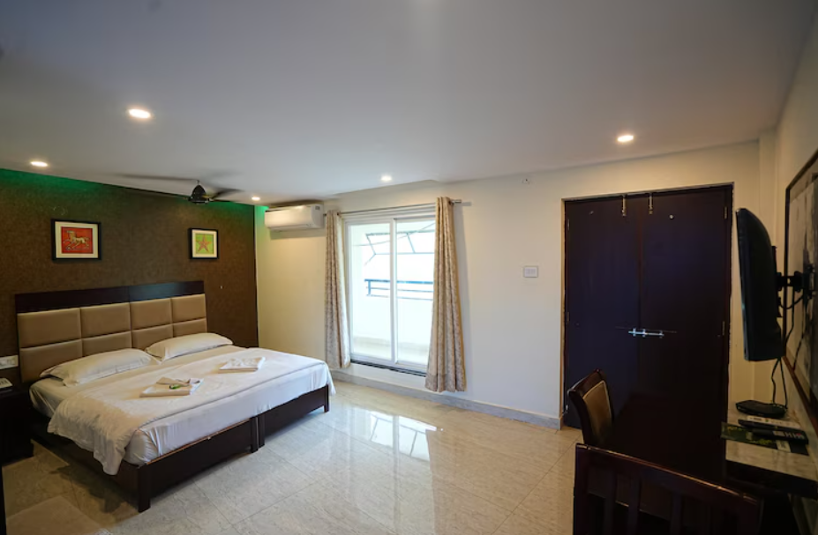
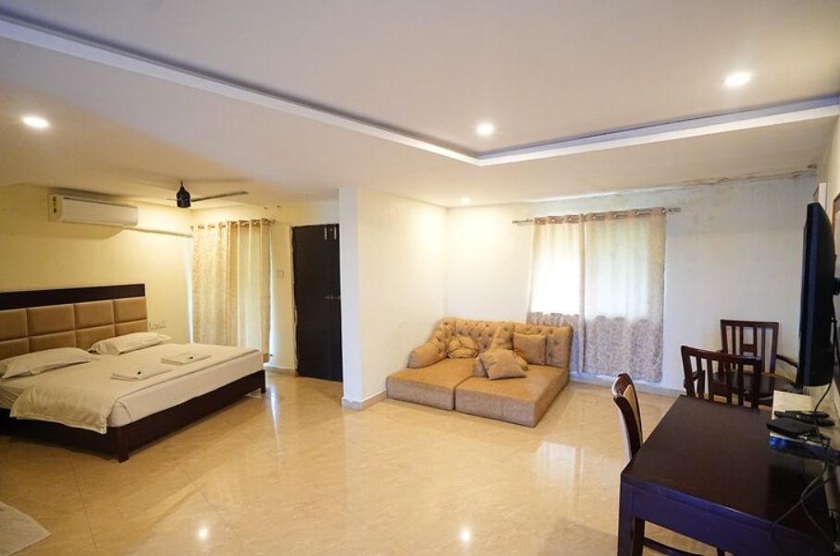
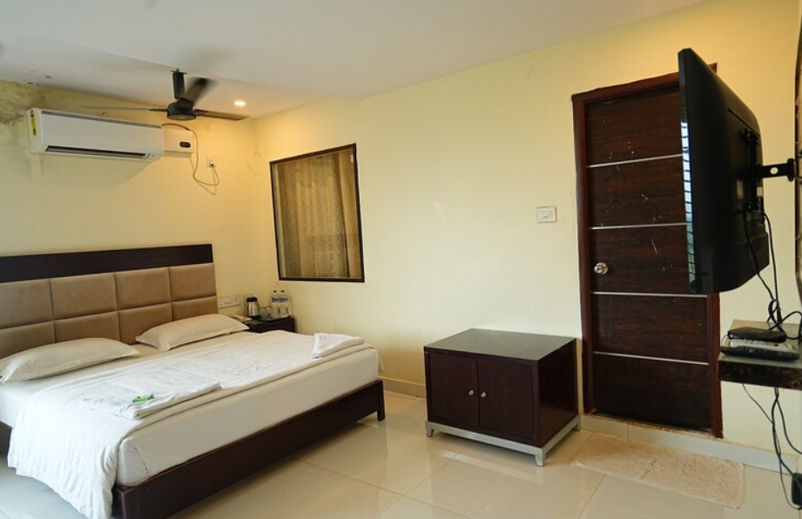
ACCOMMODATIONS
The 4 Verified Room Categories
Strictly verified room interiors and bathroom photos in View Details — zero generic distractions.
NON AC COMFORT
CLIMATE CONTROL
LUXURY SUITE
PREMIER RETREAT
Standard Non AC
AC Deluxe Room
Junior Suite
Executive Suite
₹1,500 – ₹2,199 / night
₹2,500 – ₹3,299 / night
₹4,000 – ₹4,499 / night
₹6,000 – ₹5,799 / night
272 sq.ft • Queen Bed • Max 3
370 sq.ft • Queen Bed • Max 3
462 sq.ft • King Bed • Max 3
600 sq.ft • Master Bedroom + Lounge
Natural valley breeze, mineral water, Wi-Fi, daily housekeeping, sanitized ensuite bathroom.
Efficient AC, closet space, plush queen bed, high-speed Wi-Fi, private sitting chair, floral bathroom.
In-suite room heater for chilly evenings, king bed, sofa lounge, iron & board, enclosed balcony.
Pinnacle of comfort, 600 sq.ft separate living room, leather sofa, in-room heating, private glass balcony.
Vana Resort Araku • Project Demonstration & Technical Showcase

Slide 5
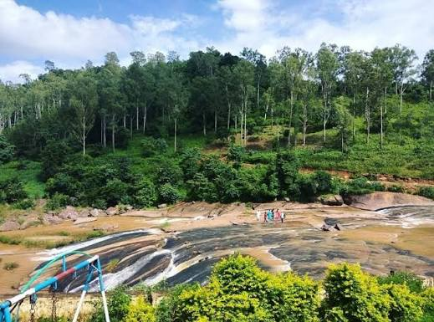
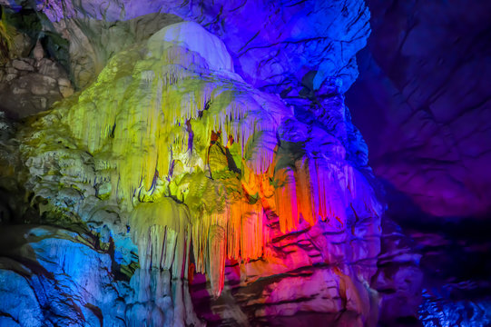
EXPLORE ARAKU
11 Curated Araku Valley Attractions
Comprehensive travel directory complete with distances, recommended hours, and entry pricing.
Attraction Name | Category | Distance | Visiting Time | Entry Fee
1. Madagada View Point | Scenic Viewpoint | 16 km | 6:00 AM – 5:30 PM | Free Entry
2. Coffee Museum | Culture & Museum | 5 km | 9:00 AM – 8:00 PM | ₹20
3. Tribal Museum | Heritage Museum | 5 km | 9:00 AM – 7:00 PM | ₹40 Adults / ₹20 Kids
4. Chaparai Waterfalls | Water Cascade | 7 km | 8:00 AM – 6:00 PM | ₹20
5. Araku Pinery | Nature & Forest | 8 km | 7:00 AM – 6:00 PM | Free Entry
6. Padmapuram Gardens | Botanical Garden | 2 km | 8:30 AM – 6:00 PM | ₹40
7. Galikonda View Point | High Altitude | 18 km | Open all day | Free Entry
8. Wooden Bridge | Scenic Spot | 3 km | Sunrise to Sunset | Free Entry
9. Sunkarimetta Church | Colonial Heritage | 12 km | 8:00 AM – 5:00 PM | Free Entry
10. Katiki Waterfalls | Jungle Waterfall | 32 km | 6:00 AM – 5:00 PM | ₹20 (Jeep extra)
11. Borra Caves | Geological Wonder | 28 km | 10:00 AM – 5:00 PM | ₹65 Adults / ₹45 Kids
💧 Chaparai Waterfalls (7 km)
🦇 Borra Caves (28 km)
Vana Resort Araku • Project Demonstration & Technical Showcase

Slide 6
RESERVATION WORKFLOW
Booking Engine & Offline Resilience
Frictionless booking experience with dynamic tariff calculation and direct WhatsApp hand-off.
01
02
03
04
Dates & Room Selection
Input Validation
Offline-First Resilience
WhatsApp Concierge Hand-off
Guest selects check-in, check-out dates, guest party size, and one of the 4 room categories.
Client-side verification ensures 10-digit phone number, valid dates (no past check-in), and party sizes.
Attempts PHP backend API. If offline (e.g. standalone Vite dev server), it seamlessly falls back to localStorage.
Success card displays full stay summary and one-tap button to notify the front desk on WhatsApp.
Dynamic night counter & instant estimated total based on verified property room tariff.
Zero page refreshes, instant feedback messages, and accessibility validation.
Generates verified tracking ref (e.g. VR-582914) with zero annoying server error banners!
Pre-formatted message contains: ID, Room, Guest Name, Phone, Dates, Nights, and Tariff.
Vana Resort Araku • Project Demonstration & Technical Showcase

Slide 7
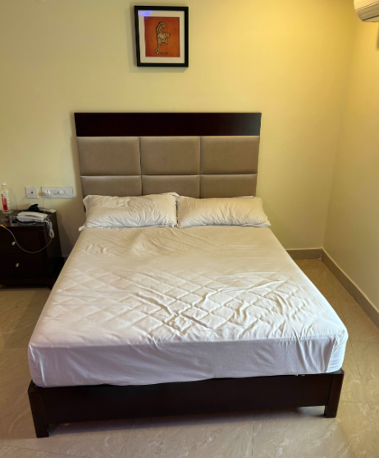
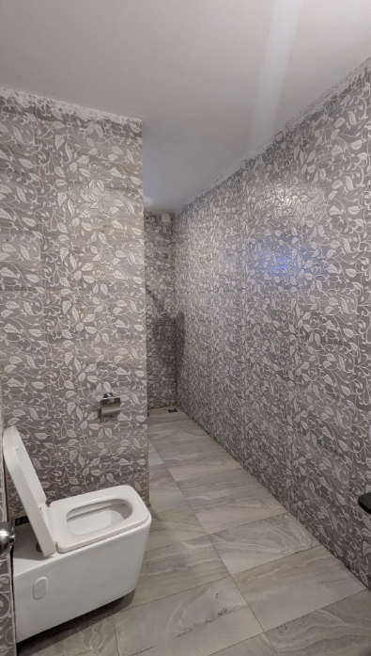
MEDIA INTEGRITY
Strictly Authentic Room & Bathroom Photos
Zero garden or resort facade distractions inside View Room Details — 100% transparency.
STRICT MEDIA POLICY
What Guests See:
✔ Genuine bedroom sleeping areas & bed setups
✔ Actual sanitized ensuite western bathrooms
✔ Modern sanitary fittings, showers, & geysers
✔ Private in-room glass balcony sitting corners
✔ Eliminated all generic garden and pool photos
✔ Prevents guest dissatisfaction upon arrival
Authentic Deluxe Bedroom & Nightstand
Designer Tiled Bathroom & Commode
Key Guest Experience Impact
By confining the "View Details" gallery strictly to verified bedroom furniture, bed angles, and real bathroom sanitary fittings, travelers get 100% confidence in the hygiene, privacy, and true layout of their room before requesting a reservation.
Vana Resort Araku • Project Demonstration & Technical Showcase

Slide 8
OPERATIONS & MANAGEMENT
Admin Operations Center & KPIs
Comprehensive resort control room for reservations, inventory, messages, and analytics.
📊 KPI Executive Stats
🛎️ Reservation Workflow
🛏️ Inventory & Rooms
Real-time overview counting total bookings, pending inquiries, confirmed stays, unread messages, and estimated revenue totals.
Review incoming customer requests, filter by pending/confirmed/cancelled, adjust final prices, and append internal admin notes.
Dynamic room pricing editor, amenity toggles, room specifications, and image gallery management for all 4 categories.
🗺️ Attractions & Gallery
✉️ Contact Desk
🔒 Security & Auth
Create, update, or remove nearby Araku destinations. Upload new property photos and categorize under dedicated tabs.
Manage customer contact messages submitted via the website with status marking (unread, read, responded).
Protected role-based management login with session cookie support and browser-based emergency recovery keys.
Vana Resort Araku • Project Demonstration & Technical Showcase

Slide 9
OTA & SYNDICATION
Google Hotel Prices & XML Syndication
Direct integration with Google Hotel Listings standards for global search discoverability.
Google Hotel Center Feed Specs
Generated Google Hotel XML Schema
<?xml version="1.0" encoding="UTF-8"?>
<listings>
<listing>
<id>vana_resort_araku</id>
<name>Vana Resort Araku Valley</name>
<address format="simple">
<component name="addr1">
Ranajilleda Waterfalls Road, Padmapuram
</component>
<component name="city">Araku Valley</component>
<component name="province">Andhra Pradesh</component>
<component name="postal_code">531149</component>
<component name="country">IN</component>
</address>
<latitude>18.3334</latitude>
<longitude>82.8821</longitude>
</listing>
</listings>
• Generates valid Google Transaction XML with real-time rate queries
• Configured Hotel ID: vana_resort_araku
• Verified property address: Ranajilleda Waterfalls Road, Padmapuram
• Coordinates: Lat 18.3334, Long 82.8821 for exact Google Maps placement
• Live Room mapping for Standard Non AC, AC Deluxe, Junior Suite, Executive Suite
Vana Resort Araku • Project Demonstration & Technical Showcase

Slide 10
DEMO GUIDE
Step-by-Step Live Demonstration Script
Follow this 5-minute structured walkthrough to deliver a flawless project presentation.
Min 0:00 – 1:00
1. Landing Page & First Impression
Open http://localhost:5173/ -> Showcase the scenic hero banner, verified property rating (3.2★ across 261 reviews), quick date booking bar, and welcome introduction.
Min 1:00 – 2:00
2. Accommodations & Authentic Photo Check
Click "Stay" -> "Rooms & Suites". Highlight the 4 categories. Click "View Details" on AC Deluxe Room to show strictly real bedroom interiors and designer tiled bathroom photos.
Min 2:00 – 3:00
3. Explore Dropdown & 11 Araku Destinations
Hover on "Explore" -> Click "Nearby Attractions". Demonstrate the 11 curated spots (Madagada View Point, Chaparai Waterfalls, Borra Caves) with distance and entry price filters.
Min 3:00 – 4:00
4. Booking Submission & WhatsApp Concierge
Click "Book Now", enter test guest name, mobile, and dates. Submit the request! Highlight instant VR-XXXXXX reference card and click the WhatsApp concierge notification button.
Min 4:00 – 5:00
5. Admin Panel & Operational Oversight
Navigate to /admin, log in as admin. Demonstrate live KPI cards, view the newly submitted booking record in the table, and update status to "Confirmed" with admin notes.
Vana Resort Araku • Project Demonstration & Technical Showcase

Slide 11
ENGINEERING HIGHLIGHTS
Core Differentiators & Best Practices
What makes this project unique, robust, and production-ready.
✓
Zero Third-Party Dependency
✓
Offline-First Resilience
✓
Strictly Authentic Media
Direct bookings handled in-house with WhatsApp concierge hand-off, saving 15–25% in OTA commissions.
Browser-level fallback guarantees reservation inquiries and admin review succeed even without active Apache/MySQL servers.
Room details showcase 100% verified room and bathroom photos — eliminating guest disappointment from generic photos.
✓
Complete Local Destination Guide
✓
Modern React 19 + TypeScript
✓
Enterprise Admin Capabilities
11 verified Araku Valley destinations with exact distances, timings, entry prices, and visiting tips right inside the resort site.
Full type safety, sub-second HMR dev turnaround, Tailwind design system, and clean reusable component hierarchy.
Complete dashboard with KPI counters, booking status workflow, contact inquiry tracker, and resort settings.
Vana Resort Araku • Project Demonstration & Technical Showcase

Slide 12
THANK YOU
Ready for Live Demonstration & Questions
PROPERTY ADDRESS
FRONT DESK DIRECT
PROJECT URL
VANA RESORT ARAKU
Ranajilleda Waterfalls Road, Padmapuram
Araku Valley, Andhra Pradesh 531149
Phone: +91 90141 15175
WhatsApp: +91 90141 15175
Email: matsyaraju909@gmail.com
Local Dev Server:
http://localhost:5173/
Admin: http://localhost:5173/admin

