Slide 1
Jet bridge airflow
reconstruction
Interpolation, support vector regression and CFD
How much can a sparse sensor array tell us?
Matthew Brasacchio 33858659
MMA3001 Numerical Methods and Machine Learning
Notes:
MAIN TALK 1/9 — target 15 seconds; total 300 seconds.
My project investigates how reliably sparse measurements reconstruct jet-bridge air speed. I compare conventional interpolation with support vector regression, and use CFD for separate numerical sampling experiments.
Previous evidence notes:
TARGET 25 seconds. MAIN TALK slide 1 of 8.
My project asks how well sparse measurements can reconstruct airflow inside a jet bridge. A few sensor readings can miss local regions of low air speed. I compared interpolation with support vector regression and used OpenFOAM to investigate spatial sampling. The main finding is that measurement coverage strongly limits what either method can establish.
SOURCES AND QUALIFICATIONS RETAINED FROM PREVIOUS NOTES:
SOURCE: PROJECT_CONTEXT.md; README.md; docs/report/MMA3001_Jet_Bridge_Submission_Draft.docx, pp.1 and 10.
Repository https://github.com/matt-b-0/jetbridge-ml-cfd, evidence revision 51a464a345291cf7634908396df5336438bc5467. Figures show existing results, not new simulations.
Sources: MMA3001 project brief pp. 8–15; current local jetbridge-ml-cfd source, tests and docs. Scientific scores remain those of evidence revision 51a464a. Presentation revision 11 November 2026. Local changes have not been published.

Slide 2
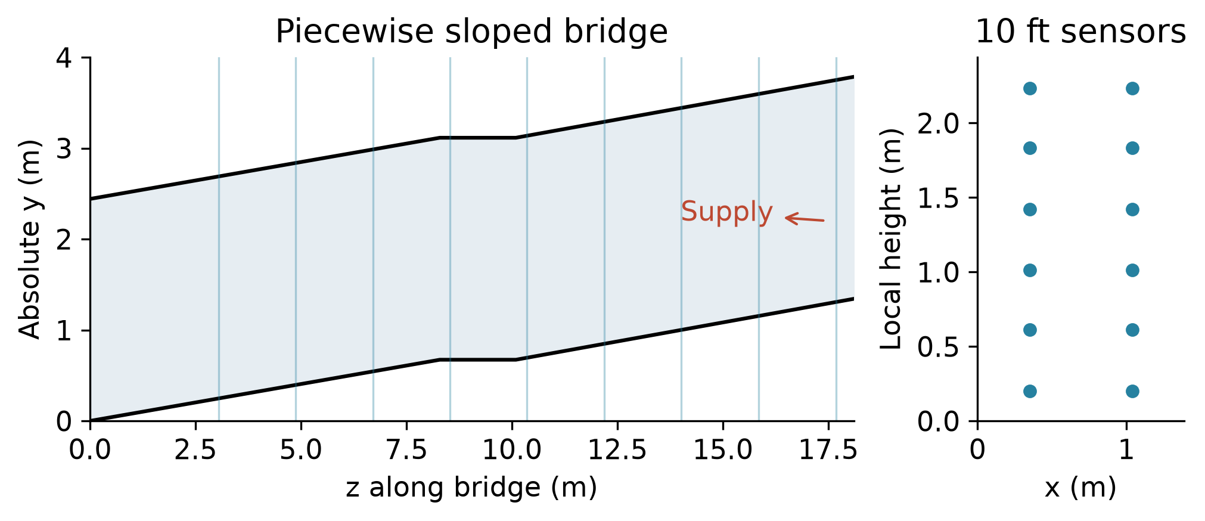
Experimental data and geometry
36 files
9 stations
504 sensor means
12 or 24 sensor positions
Metres and floor offsets
Measured scalar air speed
One apparatus. Sequential station measurements. Full 12-point hull covers 41.3% of section area.
2
Notes:
MAIN TALK 2/9 — target 25 seconds; total 300 seconds.
The inputs are sensor positions in metres and scalar speeds in metres per second. Thirty-six files at nine stations supply five hundred and four sensor means. Outputs are reconstructed maps, held-out errors, support masks and timings. Measurements are sequential and come from one apparatus.
Previous evidence notes:
TARGET 35 seconds. MAIN TALK slide 2 of 8.
The FAA and NRC dataset comes from one experimental bridge. I used thirty-six replicate-average files at nine stations, with five hundred and four sensor means. Most files contain twelve positions, while the fifty-eight-foot files contain twenty-four sequential positions. Geometry checks put the data into metres and accounted for the sloped floor. A local sensor height needs the floor elevation added. These probes measure scalar speed, which cannot directly establish signed airflow through a section.
SOURCES AND QUALIFICATIONS RETAINED FROM PREVIOUS NOTES:
SOURCE: docs/report/build_evidence_report.py section 2; docs/report/assets/geometry_compact.png; cfd/cases/empty_bridge_s01_a_10_hn_1/README.md; FAA/NRC DOI https://doi.org/10.21949/qqdx-gh59
Repository https://github.com/matt-b-0/jetbridge-ml-cfd, evidence revision 51a464a345291cf7634908396df5336438bc5467. Figures show existing results, not new simulations.
Sources: MMA3001 project brief pp. 8–15; current local jetbridge-ml-cfd source, tests and docs. Scientific scores remain those of evidence revision 51a464a. Presentation revision 11 November 2026. Local changes have not been published.

Slide 3
Interpolation and regression
Thin-plate RBF
Support vector regression
Smooth surface through retained sensors
Zero smoothing fits measurements exactly
SciPy RBFInterpolator
RBF kernel captures nonlinear patterns
Regularisation allows small fitting errors
scikit-learn StandardScaler + SVR
Baselines: retained-sensor mean, nearest neighbour and linear interpolation
3
Notes:
MAIN TALK 3/9 — target 30 seconds; total 300 seconds.
Mean, nearest and linear methods provide simple baselines. Thin-plate RBF fits a smooth interpolating surface. SVR uses regularisation and an RBF kernel. I compare them on the same withheld locations rather than assuming that machine learning will be better.
Previous evidence notes:
TARGET 45 seconds. MAIN TALK slide 3 of 8.
I compared mean, nearest-neighbour and linear baselines with two nonlinear methods. Thin-plate RBF interpolation fits a smooth surface exactly through retained measurements, but exact fitting can follow noise. SVR uses an RBF kernel with regularisation to allow small fitting errors and control complexity. SciPy supplies the interpolation routines, while scikit-learn supplies scaling and SVR selection. NumPy and pandas support data handling and calculation. The question is whether this extra fitting flexibility improves prediction.
SOURCES AND QUALIFICATIONS RETAINED FROM PREVIOUS NOTES:
SOURCE: src/jetbridge_ml/interpolation; src/jetbridge_ml/machine_learning; pyproject.toml; report p.3.
Repository https://github.com/matt-b-0/jetbridge-ml-cfd, evidence revision 51a464a345291cf7634908396df5336438bc5467. Figures show existing results, not new simulations.
Sources: MMA3001 project brief pp. 8–15; current local jetbridge-ml-cfd source, tests and docs. Scientific scores remain those of evidence revision 51a464a. Presentation revision 11 November 2026. Local changes have not been published.

Slide 4
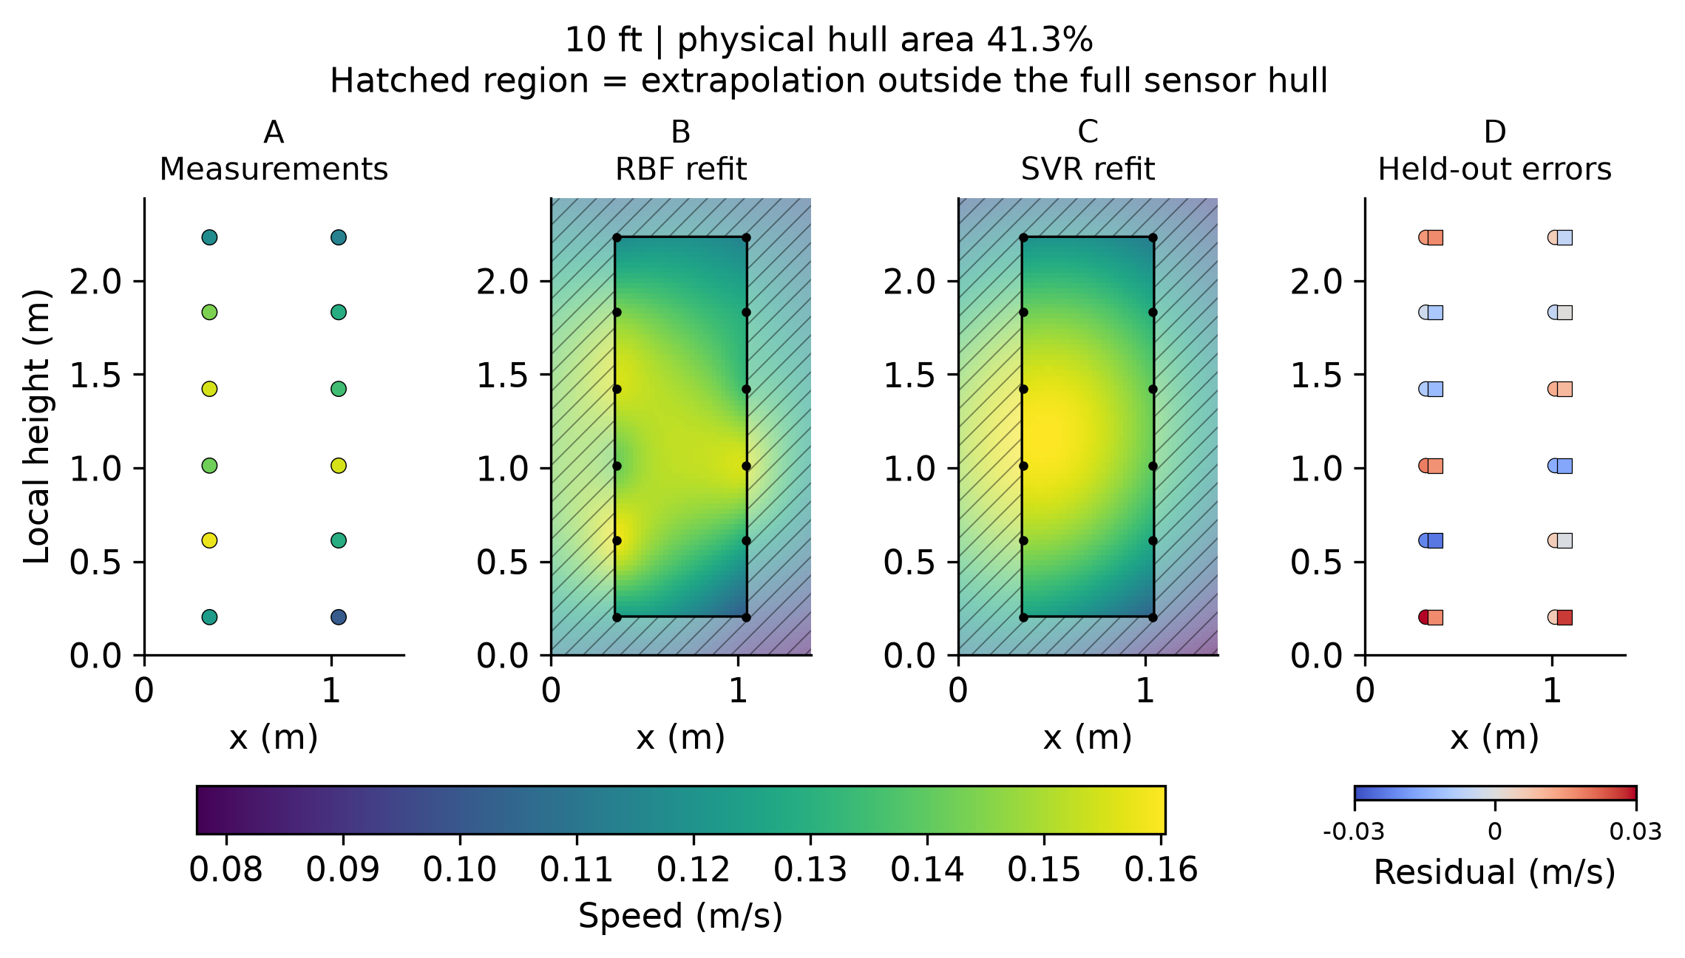
Prediction tests at withheld locations
One sensor withheld
for each outer test
SVR tuning stays inside
three inner folds
Scaling uses training data
Common support keeps
method scores comparable
10 ft example. Maps are full-array refits. Residuals come from withheld-location predictions.
4
Notes:
MAIN TALK 4/9 — target 35 seconds; total 300 seconds.
Each outer fold removes a complete location. A three-fold inner search selects SVR settings from the remaining data, with scaling fitted inside training folds. This prevents test information from entering tuning. Linear cannot extrapolate, so the main scores use common supported locations.
Previous evidence notes:
TARGET 35 seconds. MAIN TALK slide 4 of 8.
I tested prediction by removing one sensor location, fitting the remaining points and predicting the missing value. Every location takes a turn. Within each outer training set, a separate three-fold search selects SVR settings. Scaling also uses training data only. This prevents the target from influencing its own prediction. The main comparison uses common supported targets because linear interpolation cannot extrapolate. The hatching marks regions outside the full measured sensor hull.
SOURCES AND QUALIFICATIONS RETAINED FROM PREVIOUS NOTES:
SOURCE: docs/report/final_checks/experimental_10ft_coverage.png; report pp.3–4; training-only outer/inner split audit retained in repository.
Repository https://github.com/matt-b-0/jetbridge-ml-cfd, evidence revision 51a464a345291cf7634908396df5336438bc5467. Figures show existing results, not new simulations.
Sources: MMA3001 project brief pp. 8–15; current local jetbridge-ml-cfd source, tests and docs. Scientific scores remain those of evidence revision 51a464a. Presentation revision 11 November 2026. Local changes have not been published.

Slide 5
RBF has the lowest aggregate error
Mean per-file RMSE on common supported targets (m/s)
26.7% lower
RBF error versus the
mean baseline
Advantage over SVR
concentrates at 58 ft
12-point files slightly
favour SVR on average
360 common targets from 504 observations. Station and sensor count are confounded.
5
Notes:
MAIN TALK 5/9 — target 35 seconds; total 300 seconds.
RBF has the lowest aggregate RMSE, about zero point zero five metres per second, compared with zero point zero five eight for SVR. Its advantage is concentrated at the fifty-eight-foot layout. The twelve-point group slightly favours SVR. Station and count are confounded, so I cannot claim a density-only effect.
Previous evidence notes:
TARGET 45 seconds. MAIN TALK slide 5 of 8.
RBF gave the lowest mean per-file RMSE, about zero point zero five metres per second. That is about twenty-seven percent below the mean baseline. SVR scored about zero point zero five eight. However, most of RBF’s advantage over SVR comes from the fifty-eight-foot station. The common twelve-sensor files slightly favour SVR on average. Station and sensor count change together, so these results do not isolate an effect of sensor density.
SOURCES AND QUALIFICATIONS RETAINED FROM PREVIOUS NOTES:
SOURCE: README.md results table; report pp.4–5; docs/report/inputs/primary_prediction_evidence.csv. Mean of per-file RMSEs on common hull-supported targets, equal file weights. 360 common targets from 504 total sensor means.
Repository https://github.com/matt-b-0/jetbridge-ml-cfd, evidence revision 51a464a345291cf7634908396df5336438bc5467. Figures show existing results, not new simulations.
Sources: MMA3001 project brief pp. 8–15; current local jetbridge-ml-cfd source, tests and docs. Scientific scores remain those of evidence revision 51a464a. Presentation revision 11 November 2026. Local changes have not been published.

Slide 6
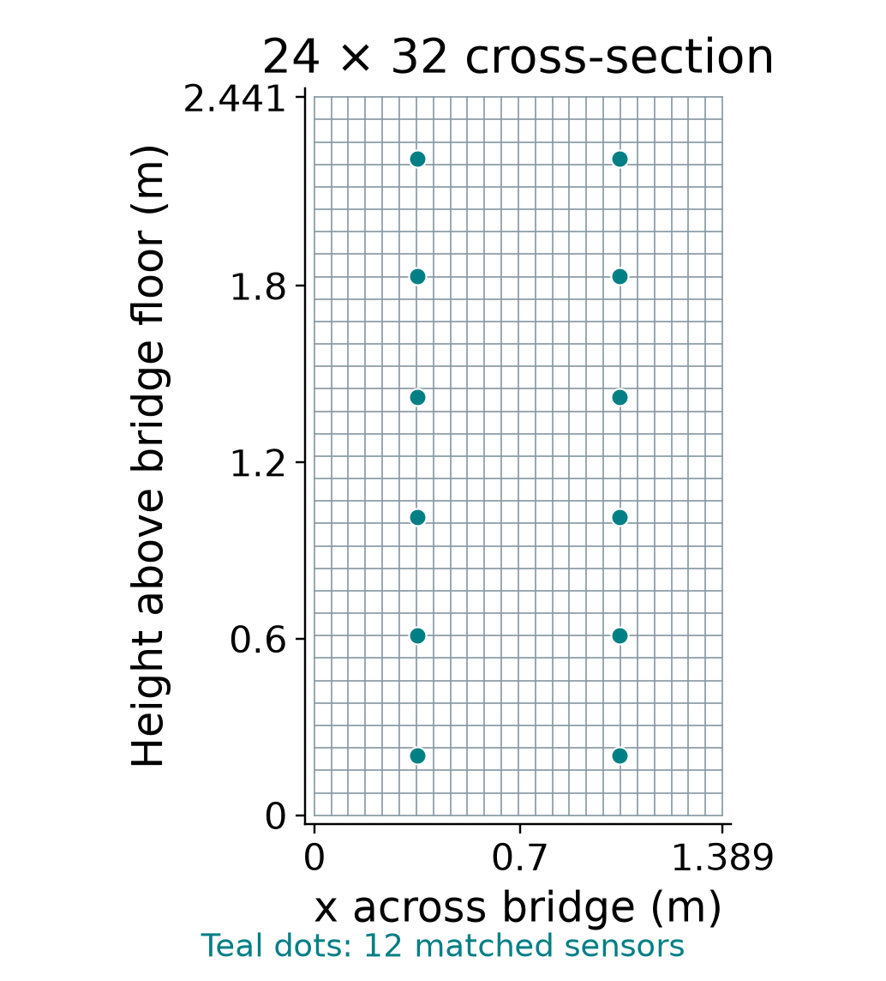
CFD setup and initial conditions
simpleFoam with k–ε turbulence
Boundary conditions
Inlet Q = 0.533866 m³/s towards −z
Outlet p = 0 m²/s²
Full-face inlet and sealed no-slip walls
Initial field guesses
U = (0, 0, −0.15747) m/s
p = 0 m²/s²
Initial turbulence assumptions
k = 9.30 × 10⁻⁵ m²/s²
ε = 1.19 × 10⁻⁶ m²/s³
24 × 32 × 184 = 141,312 cells
Three blocks along an 18.105 m bridge
Isothermal steady RANS. Uniform grading without wall inflation. ν = 1.5 × 10⁻⁵ m²/s.
6
Notes:
MAIN TALK 6/9 — target 25 seconds; total 300 seconds.
The isothermal CFD baseline uses steady k-epsilon RANS, a measured supplied flow and sealed no-slip walls. The standard mesh has one hundred and forty-one thousand three hundred and twelve cells. Full-face inlet and wall assumptions limit its physical realism.
Previous evidence notes:
TARGET 40 seconds. MAIN TALK slide 6 of 8.
The CFD baseline uses steady, incompressible isothermal flow with a k-epsilon turbulence model. The cross-section has twenty-four by thirty-two cells, giving about one hundred and forty-one thousand cells along the bridge. The inlet prescribes the measured supply flow towards negative z. The outlet fixes kinematic pressure, and the walls are sealed and no-slip. The initial velocity and pressure shown here are starting guesses. Turbulence values assume five percent inlet intensity. The full-face inlet and lack of wall inflation are modelling limitations.
Source: cfd/cases/empty_bridge_s01_a_10_hn_1/system/blockMeshDict; 0/U, 0/p, 0/k, 0/epsilon, 0/nut; constant/transportProperties and turbulenceProperties; case README. The plotted cross-section reconstructs the uniform dictionary grid at z=3.05 m; it is not a new blockMesh/checkMesh or solver run. Teal dots are matched experimental probe coordinates. Geometry width 1.388618 m, clear height 2.441448 m. Three blocks have 84,18,82 axial cells, giving 141312 total. p is kinematic gauge pressure, not Pa. Turbulence initialisation assumes I=5% and length scale 7% of hydraulic diameter. Initial nut=0 m²/s. The isothermal baseline has no temperature equation or imposed temperature initial condition. Initial guesses differ from inlet/outlet boundary constraints and from the converged field. No scientific settings changed.
Sources: MMA3001 project brief pp. 8–15; current local jetbridge-ml-cfd source, tests and docs. Scientific scores remain those of evidence revision 51a464a. Presentation revision 11 November 2026. Local changes have not been published.

Slide 7
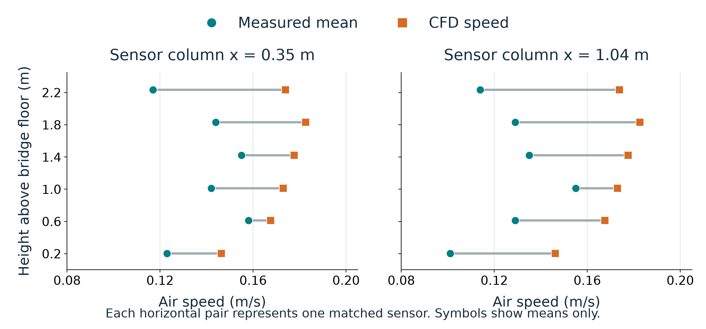
CFD overpredicts speed at all 12 sensors
10 ft matched run. Mean bias +0.0367 m/s. RMSE 0.03977 m/s.
7
Notes:
MAIN TALK 7/9 — target 30 seconds; total 300 seconds.
At twelve matched sensors CFD overpredicts every measured mean, with bias around zero point zero three seven metres per second. Numerical convergence and flux balance do not resolve that experimental disagreement. Unconverged thermal fields remain excluded from trusted references.
Previous evidence notes:
TARGET 45 seconds. MAIN TALK slide 7 of 8.
This compares CFD with the measured mean at twelve matched sensors. Teal circles show measurements and orange squares show CFD. Each grey segment connects values at the same location. Every CFD marker lies to the right, showing overprediction throughout this matched array. Mean bias is about zero point zero three seven metres per second. Although the isothermal case met its numerical stopping criteria, physical accuracy remains unresolved. Inlet and wall assumptions or omitted leakage may contribute. The unconverged thermal case stays excluded from trusted reference and training data.
SOURCES AND QUALIFICATIONS RETAINED FROM PREVIOUS NOTES:
Source: matched_sensor_audit.csv, S01-A-10-HN-1, 12 published mean speeds and CFD cellPoint samples at saved iteration 237. Same input as the original slide 8. Source revision 51a464a. Coordinates: published x/y/z, local height y minus floor elevation. Temporal SD is fluctuation of raw observations, not uncertainty of the mean. The figure is descriptive for one matched run, not an inferential significance test. No CFD rerun or recalibration.
DELIVERY: Grey segments represent a difference between two speeds, not uncertainty bars. Temporal SD profiles are now on slide 14. End the main talk at slide 8.
Sources: MMA3001 project brief pp. 8–15; current local jetbridge-ml-cfd source, tests and docs. Scientific scores remain those of evidence revision 51a464a. Presentation revision 11 November 2026. Local changes have not been published.

Slide 8
Repository, documentation and tests
One workflow, inspectable evidence
README → data, environment and reproduction commands
HTML API → parameters, returns, exceptions and source
Tests → numerical checks and held-out-target isolation
Live example: opposite errors give zero bias, but RMSE = 0.2 m/s
Open docs/presentation/index.html before the talk. Detailed tests are available for questions.
8
Notes:
MAIN TALK 8/9 — target 65 seconds; total 300 seconds.
I will briefly show the repository and documentation. [Switch to the pre-opened local presentation page.] The README gives the setup and reproducible workflows. The API link opens the actual function documentation with parameters, returns and source. [Open metrics API, then return.] This small test uses errors of plus and minus zero point two metres per second. Bias cancels to zero, but MAE and RMSE both remain zero point two. That is why I report several metrics. The fresh test report is linked here; the leakage test and affine-field checks are available for questions. [Return to PowerPoint.]
DEMO FALLBACK: if switching takes over 10 seconds, use the on-slide example and the backup test slide. Do not wait for CFD or the full suite during the talk.
Sources: MMA3001 project brief pp. 8–15; current local jetbridge-ml-cfd source, tests and docs. Scientific scores remain those of evidence revision 51a464a. Presentation revision 11 November 2026. Local changes have not been published.

Slide 9
Limitations and AI reflection
Coverage limits reconstruction
RBF leads overall; its advantage concentrates at 58 ft
CFD convergence does not establish physical accuracy
Thermal fields remain unconverged and excluded
AI supported implementation, debugging and reporting
Engineering objectives, interpretation and conclusions remained the author’s responsibility.
Next: better boundary measurements and an independent sensor-layout test
9
Notes:
MAIN TALK 9/9 — target 40 seconds; total 300 seconds.
The principal lesson is that spatial coverage and validation design matter more than model complexity. AI assisted code, debugging and reporting, as disclosed in my author statement and log. My engineering objectives, interpretation and conclusions remained central. I would next improve boundary measurements and test an independently specified sensor layout.
Previous evidence notes:
TARGET 30 seconds. MAIN TALK slide 8 of 8.
The practical outcome is an exploratory reconstruction workflow that reports prediction errors and marks unsupported regions. The project connected interpolation and regression with numerical error and verification. The next priorities are improved boundary measurements, matched CFD conditions and an independent sensor-layout test. The repository includes attributed inputs and a reproducible run-all script. AI supported implementation and reporting, while interpretation remains my responsibility. Thank you.
SOURCES AND QUALIFICATIONS RETAINED FROM PREVIOUS NOTES:
SOURCE: README.md; docs/LIVE_DEMO.md; docs/report/ai_statement.txt; report p.10.
Repository https://github.com/matt-b-0/jetbridge-ml-cfd, evidence revision 51a464a345291cf7634908396df5336438bc5467. Figures show existing results, not new simulations.
Sources: MMA3001 project brief pp. 8–15; current local jetbridge-ml-cfd source, tests and docs. Scientific scores remain those of evidence revision 51a464a. Presentation revision 11 November 2026. Local changes have not been published.

Slide 10
Backup Libraries and their roles
Tool | Role in this project
NumPy and pandas | Arrays, source tables, unit conversion and metrics
SciPy | Linear / nearest interpolation, thin-plate RBF and hulls
scikit-learn | Scaling, SVR and training-only parameter selection
Matplotlib | Spatial fields, residuals and comparison figures
OpenFOAM v2412 | Steady RANS and CFD virtual-sensor studies
pytest, Ruff and Git | Regression checks, static checks and reproducibility
SVR has no neural-network epochs. Use learning curves or solver diagnostics when discussing training.
10
Notes:
QUESTION ONLY. Explain the library by the numerical responsibility it serves. Data processing, interpolation, ML and CFD remain separate modules. Source: pyproject.toml, README.md and src/jetbridge_ml in the project repository. An epoch-loss plot is not a standard SVR training measure.

Slide 11
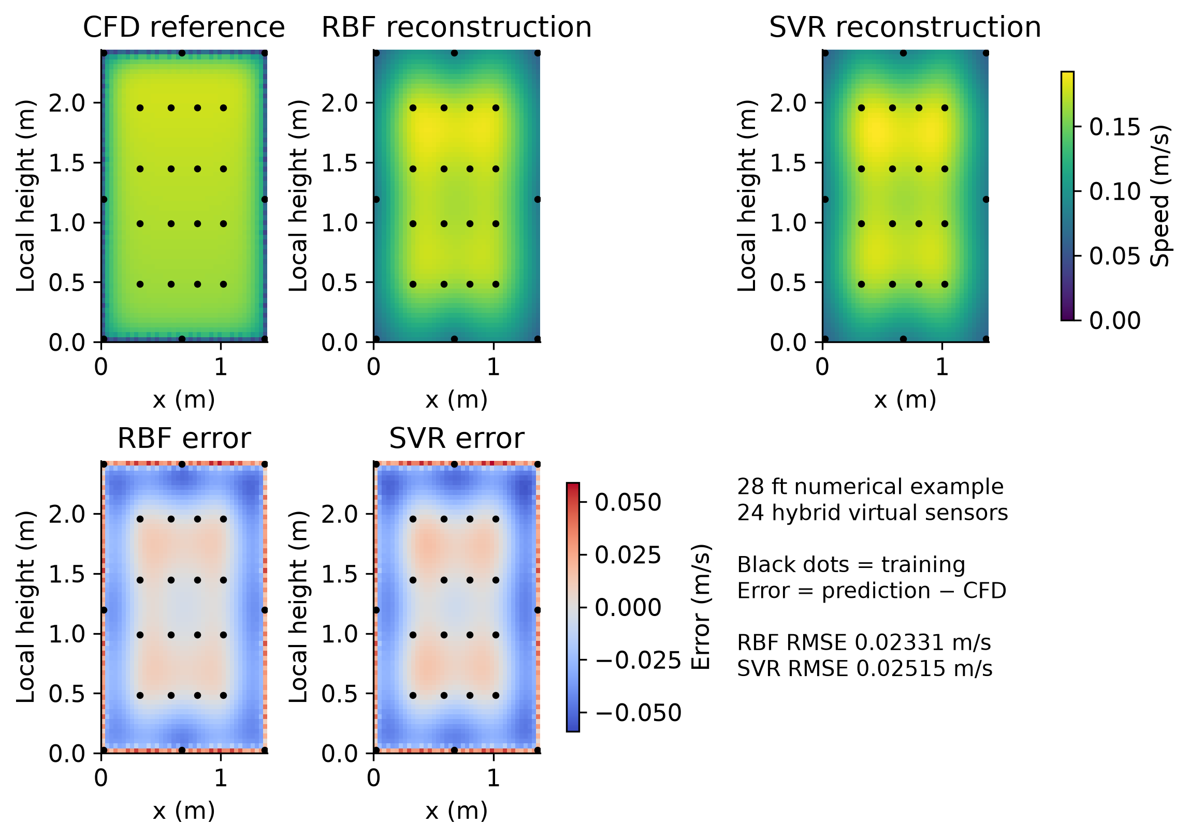
Backup Reconstructing a CFD field
28 ft CFD plane
24 hybrid sensors
RMSE (m/s)
RBF 0.02331
SVR 0.02515
This evaluates a saved
CFD field, with its own
modelling limitations.
11
Notes:
QUESTION ONLY. Virtual sensors sample the numerical field and predictions are compared with disjoint CFD reference points. These RMSEs must not be mixed with experimental held-location RMSEs. Source: docs/report/final_checks/cfd_reconstruction_large.png and docs/report/evidence/cfd_example_predictions.csv.

Slide 12
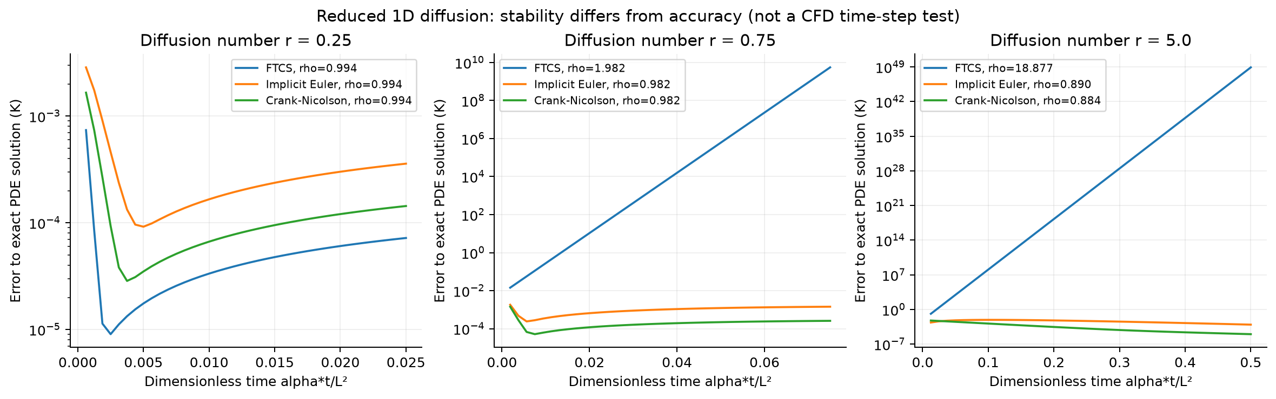
Backup Numerical stability and accuracy
Reduced 1D diffusion problem with a known analytical reference
FTCS: diffusion number r = αΔt / Δx² ≤ 1/2
Implicit stability still requires an accuracy and refinement check
12
Notes:
QUESTION ONLY. This separate taught-method exercise compares FTCS, backward Euler and Crank–Nicolson. The FTCS condition applies to the specified linear one-dimensional diffusion problem, not to the steady SIMPLE iteration in the nonlinear CFD case. Stability and accuracy differ. Source: docs/report/assets/diffusion_stability.png and docs/numerical_stability_study.md.

Slide 13
Backup Sources and scope
FAA / NRC experimental dataset
Lebbin and Laengert (2026)
Communicable Disease Transmission in Air Travel: Jet Bridge Ventilation Dataset
https://doi.org/10.21949/qqdx-gh59
Project evidence and reproducibility
github.com/matt-b-0/jetbridge-ml-cfd
Evidence revision 51a464a Published report dated 27 October 2026
Code: MIT External dataset: CC BY 4.0
AI assistance supported implementation and reporting. No new CFD run is claimed here.
13
Notes:
QUESTION ONLY. Detailed source paths accompany the relevant slide notes. Dataset DOI and attribution: data/demo/ATTRIBUTION.md. Author reflection: docs/report/ai_statement.txt. Scientific data and figures are retained from the published report. Presentation drafted 3 November 2026.

Slide 14
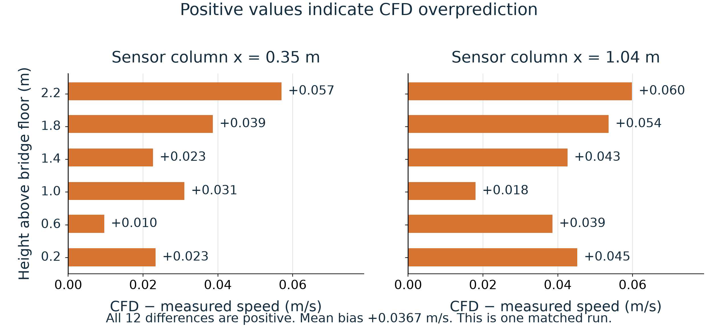
Alternative B Size of the CFD overprediction
Positive differences mean CFD predicts a higher speed at that sensor.
14
Notes:
OPTIONAL FIGURE WORKSHOP. Alternative to the main comparison on slide 7. End the main talk at slide 9.
Source: matched_sensor_audit.csv, S01-A-10-HN-1, 12 published mean speeds and CFD cellPoint samples at saved iteration 237. Same input as the original slide 8. Source revision 51a464a. Coordinates: published x/y/z, local height y minus floor elevation. Temporal SD is fluctuation of raw observations, not uncertainty of the mean. The figure is descriptive for one matched run, not an inferential significance test. No CFD rerun or recalibration.

Slide 15
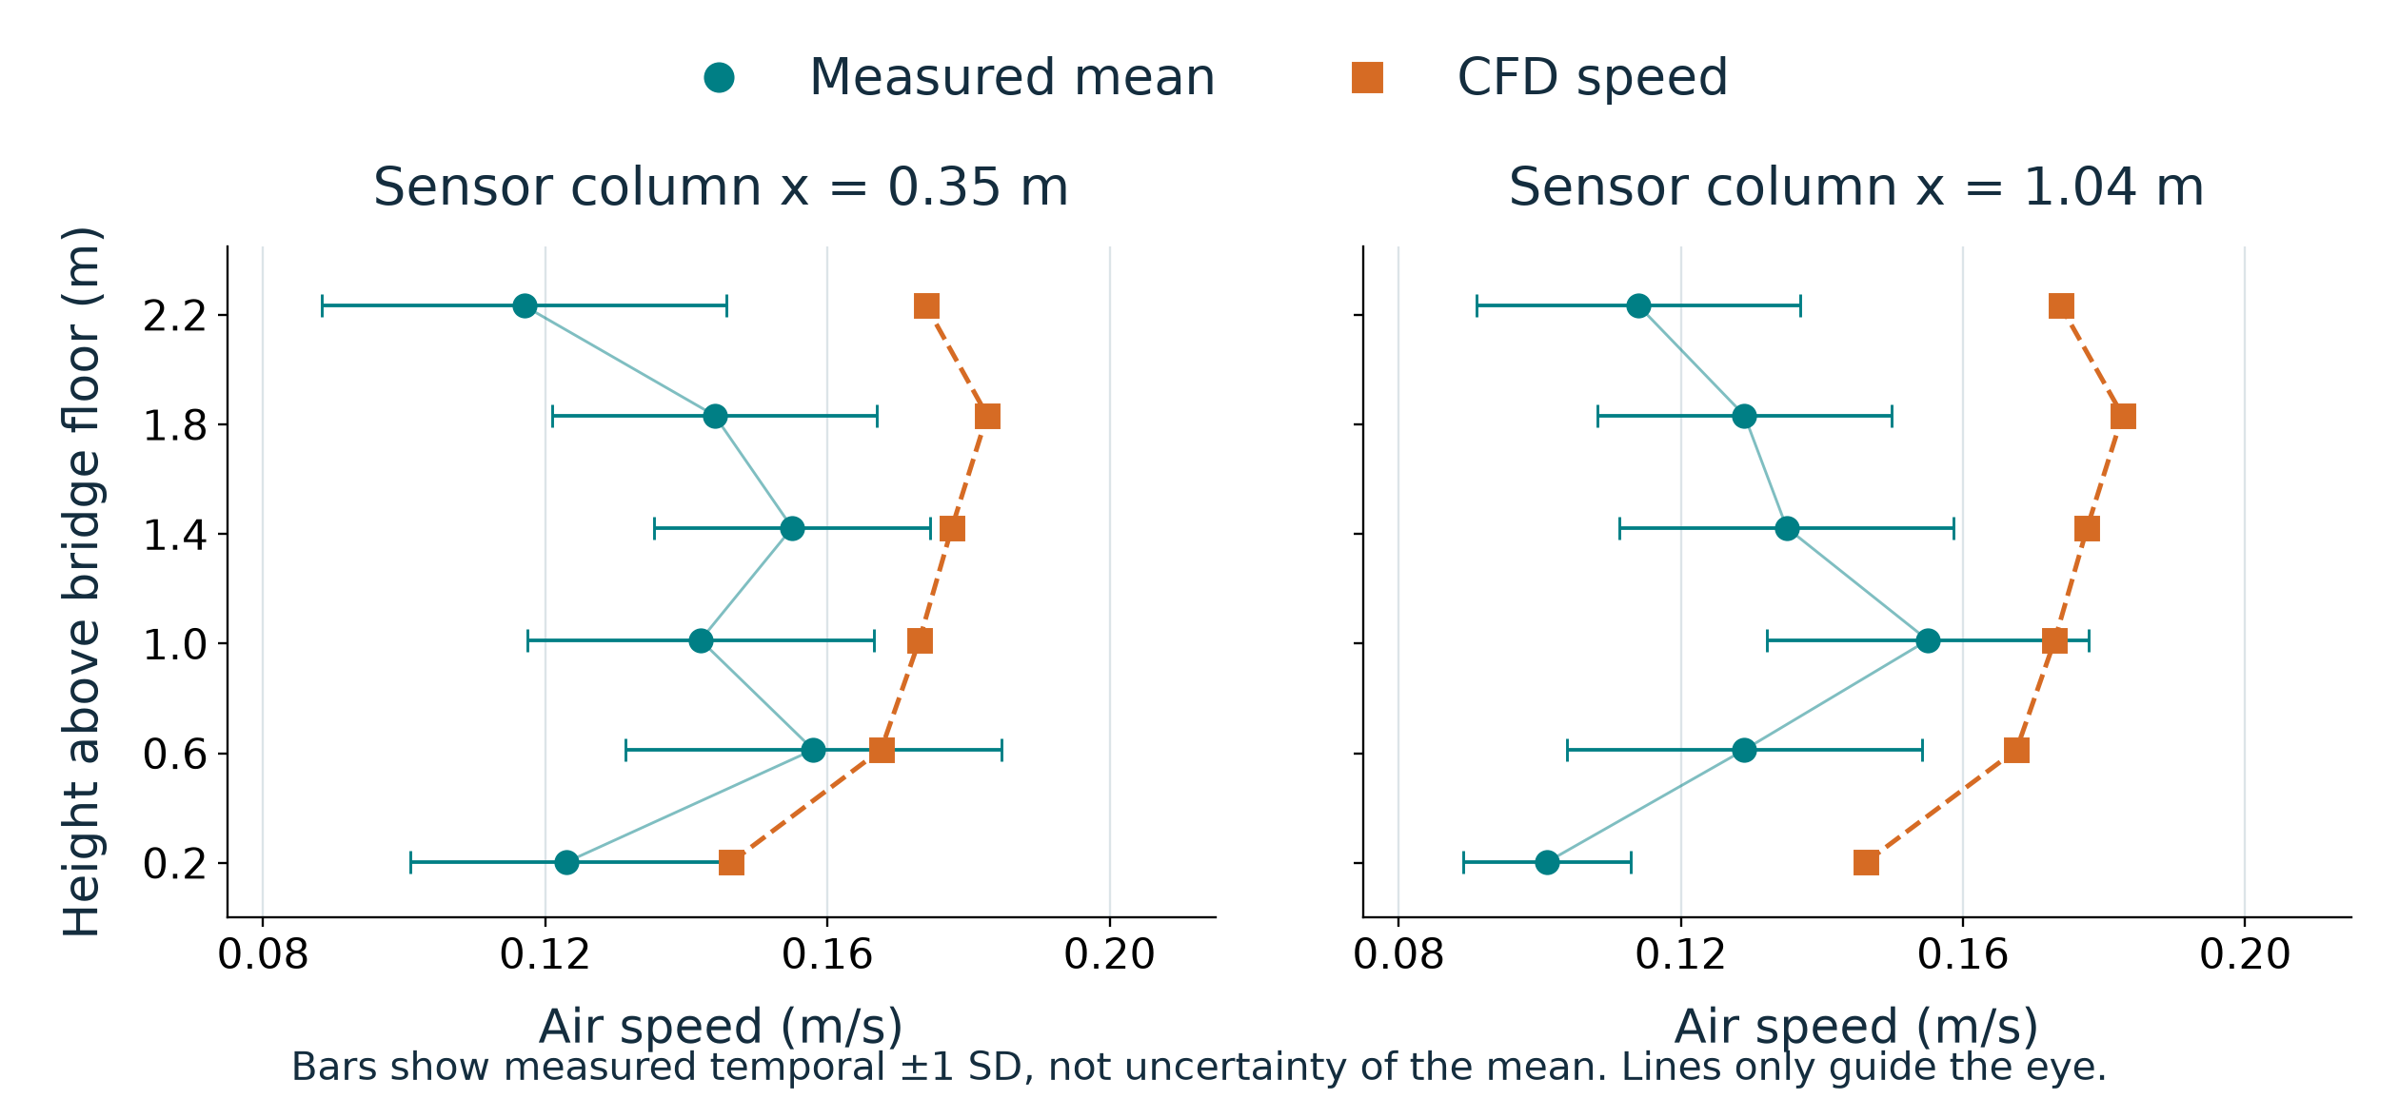
Alternative C Height profiles and temporal variation
SD describes temporal fluctuation. It does not provide a confidence interval.
15
Notes:
OPTIONAL FIGURE WORKSHOP. Alternative to the main comparison on slide 7. End the main talk at slide 9.
Source: matched_sensor_audit.csv, S01-A-10-HN-1, 12 published mean speeds and CFD cellPoint samples at saved iteration 237. Same input as the original slide 8. Source revision 51a464a. Coordinates: published x/y/z, local height y minus floor elevation. Temporal SD is fluctuation of raw observations, not uncertainty of the mean. The figure is descriptive for one matched run, not an inferential significance test. No CFD rerun or recalibration.

Slide 16
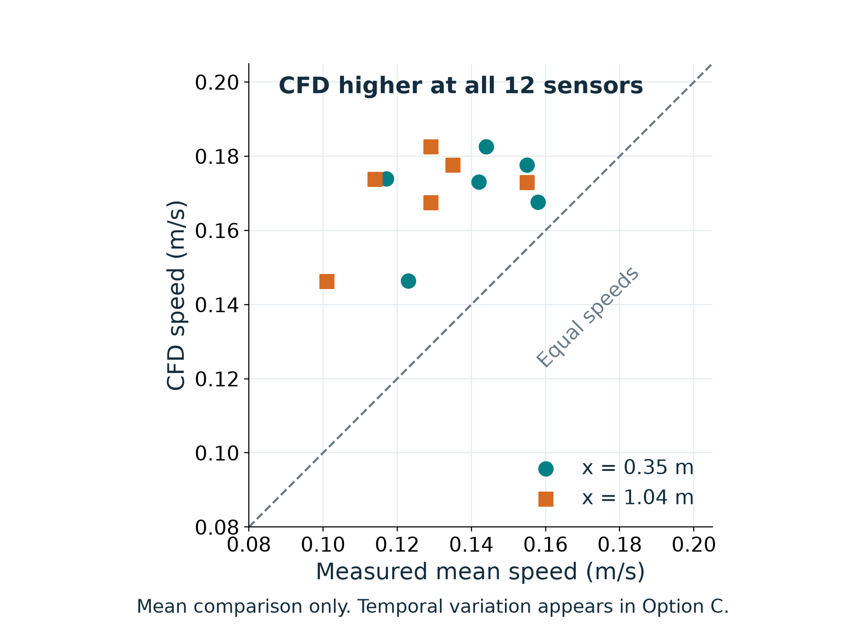
Alternative D A simpler parity comparison
Points above the diagonal indicate higher CFD speed than the measured mean.
16
Notes:
OPTIONAL FIGURE WORKSHOP. Alternative to the main comparison on slide 7. End the main talk at slide 9.
Source: matched_sensor_audit.csv, S01-A-10-HN-1, 12 published mean speeds and CFD cellPoint samples at saved iteration 237. Same input as the original slide 8. Source revision 51a464a. Coordinates: published x/y/z, local height y minus floor elevation. Temporal SD is fluctuation of raw observations, not uncertainty of the mean. The figure is descriptive for one matched run, not an inferential significance test. No CFD rerun or recalibration.

Slide 17
Backup Rubric evidence
Engineering problem
Coordinates + scalar speed → maps, errors and support
Repository and documentation
README, meaningful commits, API pages, licence and tests
Validation and computational approach
Withheld locations, leakage checks, baselines, cost and sensitivity
AI use and reflection
Disclose assistance; explain actual checks, errors and decisions
17
Notes:
QUESTION ONLY. Exact rubric headings are on pp. 10–15. Page 8 defines the report and repository deliverables; page 9 requires a 5-minute talk plus 3 minutes of questions. Do not claim a guaranteed grade. Explain concrete evidence for each row.
Sources: MMA3001 project brief pp. 8–15; current local jetbridge-ml-cfd source, tests and docs. Scientific scores remain those of evidence revision 51a464a. Presentation revision 11 November 2026. Local changes have not been published.

Slide 18
Backup A test with a known answer
Why zero bias is insufficient
actual = [0.1, 0.3]
predicted = [0.3, 0.1]
errors = [+0.2, −0.2] m/s
Bias = 0.0 m/s
MAE = 0.2 m/s
RMSE = 0.2 m/s
pytest.approx allows floating-point rounding
assert checks the result against an independently calculated answer
tests/test_presentation_examples.py • test_zero_bias_can_hide_large_local_errors
18
Notes:
QUESTION ONLY. Explain imports first, then actual and predicted arrays. regression_metrics computes the three metrics. Each assertion compares to a hand-derived value. Errors cancel only in signed bias. pytest.approx tolerates floating-point representation; it does not allow arbitrary error. This checks metric implementation, not physical CFD validity. Full line-by-line explanations appear in docs/presentation/index.html.
Sources: MMA3001 project brief pp. 8–15; current local jetbridge-ml-cfd source, tests and docs. Scientific scores remain those of evidence revision 51a464a. Presentation revision 11 November 2026. Local changes have not been published.

Slide 19
Backup Preventing test-data leakage
Change the hidden answer; keep the fitted prediction
1. Withhold sensor 0 and fit using the remaining sensors
2. Change only sensor 0’s target to an extreme value
3. Repeat training and parameter selection
4. Assert that sensor 0’s prediction stays unchanged
Also check: inner train/validation indices do not overlap
Scaling statistics use only inner training coordinates
19
Notes:
QUESTION ONLY. Open tests/test_four_workstreams.py at test_nested_test_target_does_not_change_its_model, then test_inner_scaling_and_location_groups_exclude_validation. The first exercises real SVR with a reduced test grid. The second verifies scaler means and coordinate grouping. Do not confuse these checks with the monkeypatched noise-fit test, which tests orchestration rather than real model fitting.
Sources: MMA3001 project brief pp. 8–15; current local jetbridge-ml-cfd source, tests and docs. Scientific scores remain those of evidence revision 51a464a. Presentation revision 11 November 2026. Local changes have not been published.

Slide 20
Backup Accuracy, robustness and computational cost
Accuracy
Common-support RMSE, MAE and bias; paired run comparisons
Robustness
Sensor placement, input perturbations and separate mesh checks
Cost
Repeated fit/predict timings; SVR search measured separately
Traced Python allocations are not total memory. Small arrays do not establish large-scale scalability.
20
Notes:
QUESTION ONLY. Source: controlled_performance.py, sensor_design_study.py, numerical_stability_study.md and current summary. Controlled timing uses warm-up, interleaved repeats and single-thread limits. Reconstruction Lab timings use a different protocol and must not be substituted silently. Sensor layouts are exploratory; synthetic noise is not measured instrument uncertainty.
Sources: MMA3001 project brief pp. 8–15; current local jetbridge-ml-cfd source, tests and docs. Scientific scores remain those of evidence revision 51a464a. Presentation revision 11 November 2026. Local changes have not been published.

