Slide 1
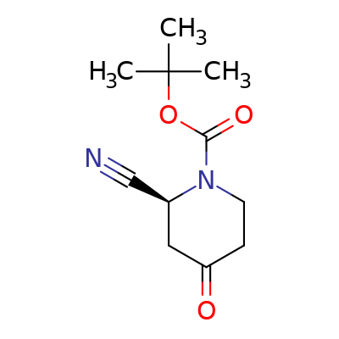
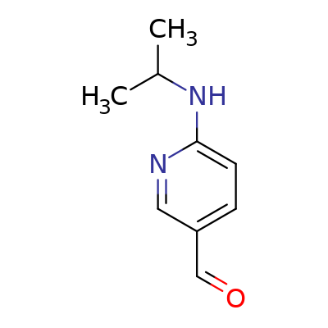
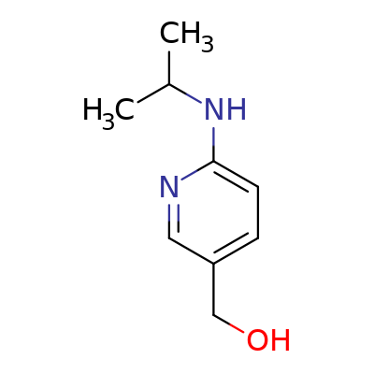
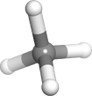
Result | CRA-035000 | CRA-035001 | CRA-035002
Compound Structure | CC(C)(C)OC(=O)N1CCC(=O)C[C@H]1C#N | CC(C)NC1=CC=C(C=O)C=N1 | CC(C)NC1=CC=C(CO)C=N1
ID | CRA-035000 | CRA-035001 | CRA-035002
Rationale | demo: A small Live Report for testing the poses feature. | demo: A small Live Report for testing the poses feature. | demo: A small Live Report for testing the poses feature.
Lot Scientist | LiveDesign LiveDesign demo demo demo demo demo demo | LiveDesign LiveDesign demo demo demo demo demo | LiveDesign LiveDesign demo demo demo demo demo demo
Fake 3D model with 2 Poses (3D)

Slide 2
Result | CRA-035000 | CRA-035001 | CRA-035002
Fake 3D model with 2 Poses (Docking Score) | -9 | -9 | -6
Model async (3D)

