Slide 1
Detecting Conversations Going Viral
Applying Change detection algorithms to Data from social media

Slide 2
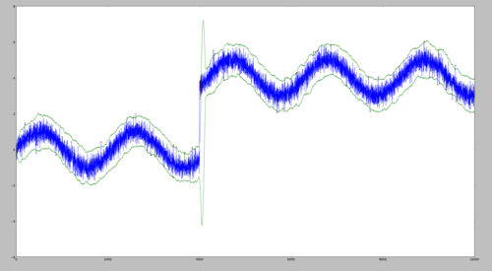
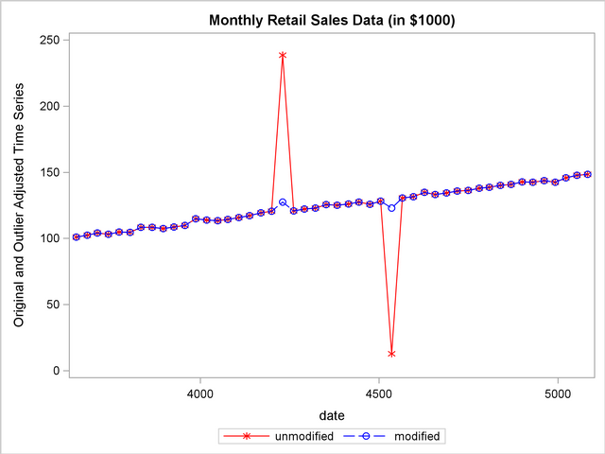
What is a change point?
Change Point
Outliers
From: Chris Natoli, Cody Buntain, and Miroslav Živković
OSDC PIRE Fellowship 2014

Slide 3
Existing Research
Lots of existing approaches & algorithms. For example:
CUSUM – Cumulative Sum tests
LRT – Likelihood Ratio Tests
KCD – Kernel-Based Change Detection
Two main categories:
Offline – batch operations on existing data
Online – Re-evaluate as each new data point arrives

Slide 4

But why social media?
“We offer a complete all-in-one tool with all national and international media, social media, internal social media, print and RTV integrated, that supports Marketing, Corporate Communications, PR…”

Slide 5
Enter: BrandMonitor
“…Displays sentiments, trends, volume, influentials, opportunities and dangers that are important for your online and offline reputation” http://www.buzzcapture.com/en/what-we-do/products/#brand-monitor
Notification function for changes in conversation volume:
%n increase within x minutes / absolute n increase -> client gets a message.
We can do better.

Slide 6
Conversation Volume from Social Media
Unpredictable. Kind of.
Multi-variate – several underlying factors that influence: information source reach, population distribution, time of day, etc.
Parametric – we rely on samples of a given population, and assume it’s nature.
“Banana” gains a sudden spike in popularity – 15th January 2017, 12:00pm

Slide 7
What’s the plan?
Select some relevant change detection algorithms;
Implement them;
Obtain a set of relevant test data;
Run them;
Evaluate them:
Mean delay for detection;
Probability of non-detection;
Algorithm performance
Michéle Basseville, Igor V Nikiforov, et al. Detection of abrupt changes: theory and application. Vol. 104. Prentice Hall Englewood Cliffs, 1993.

Slide 8
The Hypothesis:
“…a fact that is well known in the statistics community: there is no test that is “best” in all situations…”
Daniel Kifer, Shai Ben-David, and Johannes Gehrke. “Detecting change in data streams”. In: Proceedings of the Thirtieth international conference on Very large data bases-Volume 30. VLDB Endowment. 2004, pp. 180–191.
So:
No single method will prove more effective than the others tested, given the test harness that I detailed in my research method.

Slide 9
Project Timeline
Week 1: Initial settle-in at Buzzcapture
Week 2: Collation of data for testing & transformations
Week 3-7: First implementation of algorithm implementations
Week 8: Development and testing of test harness, generation of test results
Week 10-13: Write-up of results and implementation of algorithm in production

Slide 10
Questions?

